Slide 1
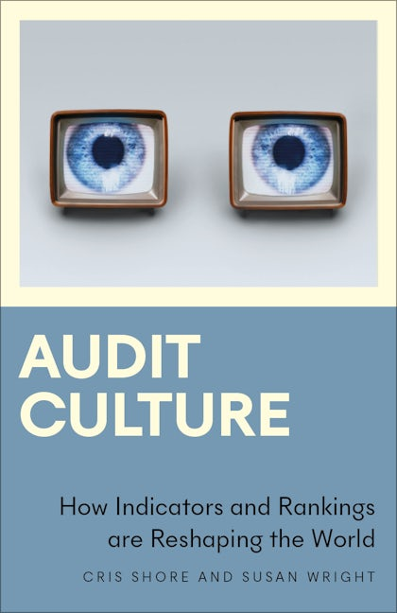
Audit Culture: How Indicators and Rankings are Reshaping the World
Cris Shore and Susan Wright
Education Department, University of Oxford
7 June 2024

Slide 2
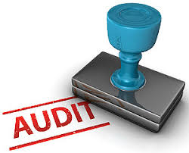

What is ‘audit culture’?
The (mis)uses of accountancy and metrics-based governance
“… audit culture refers to contexts where auditing has become a central organizing principle of society, and where life and work are increasingly structured through the techniques, rationalities and language of accountancy” (p. 4)
Confusing accountability with accountancy

Slide 3
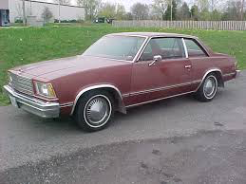

2: Why does audit culture matter?
‘Costs’ of governing by numbers: GM’s use of Cost-benefit analysis
General Motors 1979 Chevrolet Malibu. Cost benefit applied to problem. GM calculates net savings of $6 per car by not fixing fuel tank problem
$4.9 Billion Jury Verdict, 10 July 1999
‘banality of evil’ or standard business model? e.g. Toyota 2014; VW ‘Dieselgate’ scandal 2015)
Notes:
Another e.g. of calculative technologies and “governing by numbers” from the automobile industry also highlights the ‘banality of evil’ that results from the marriage of cost accountancy with the single-minded pursuit of profit:
Joel Bakan [The Corporation] tells the chilling story of a woman who was driving her children in the back of a 1979 Chevrolet Malibu when another car slammed into her as she waited at a red light. The impact caused the fuel tank to explode and cause a fire that burnt her children. She sued General Motors for the negligent design of the fuel tank. She alleged that it was too close to the rear bumper and that it had no proper metal brace to separate the tank from the rear. During the trial a memo written in 1973 by a General Motors engineer concluded that maintaining the current fuel tank was cheaper than designing a tank that did not explode in a crash.
The analysis was done assuming that there would be 500 fatalities and that each fatality would cost $200,000. He then estimated that since there were 41 million General Motors automobiles on the road, the cost per car to GM would be $2.40. On the other hand, the cost of designing a non- exploding fuel tank was $8.59 per car, and hence GM would save over $6 per car by maintaining the status quo. It is this process of cost-benefit analysis that has Bakan exercised, and in his concluding chapter he calls for legislation that prohibits corporations from “acting in ways that are reasonably likely to cause harm, even if definitive proof that such harms will occur does not exist.”15
NB. In 2014 Japanese car manufacturer Toyota fined 1.2 billion for concealing safety flaws in its Lexus models

Slide 4
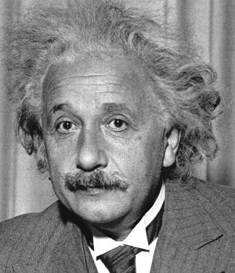

Other reasons why we should be concerned about the spread of audit culture
Replacing professional judgment with numerical / economic calculus
Substituting trust for surveillance, inspection & control (panopticism)
Rise of managerialism and at-a-distance control -- erosion of democracy
Perverse effects of auditing and rankings (gaming, culture of compliance, increased stress and anxiety)
Rise of global audit/accountancy firms (and spread of “audit capitalism”)

Slide 5
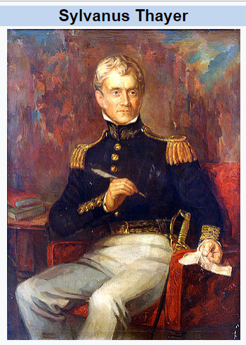

3: How did we get here?
Performance Audit: From Education & the Military to the Corporation & Back
In 1815, studied for two years at the French Ecole Polytechnique.
1817 Superintendent of the West Point Military Academy
1817, West Point institutes educational system from France’s Ecole Polytechnique ‘total accountability system, where all aspects of performance are constantly measured, evaluated & recorded (Hoskin & Macve 1988: 49)
Weekly/daily tests:
standardised, 7-point
numerical scale
Graduates became managers of new US corporations – instituted the system of daily, weekly, monthly grading of output from each individual and unit.

Slide 6

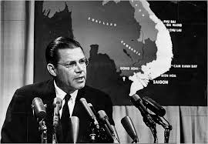

From Ford Motor Company to the Vietnam War
IBM computers spreadsheets; performance targets – bureaucratic, task-driven, fiercely competitive culture
“Start with Taylorism, add...a dose of McNamaraism, and by the late 1970’s you had the great American corporation that was being run by bean counters” (Peters 2001: 88).
As US Secretary of Defence under President Kennedy McNamara transfers system to running of Vietnam war (counting kills & body bags)
Notes:
Image Source: http://www.barebonesbiz.com/2011/02/01/accounting-for-beginners/

Slide 7

Audit as Tool of New Public Management
Regardless of failure, numerical measures were transferred to public sector during 1980s as key element of New Public Management reforms
Performance of schools, hospitals and most public services reduced to a number and ranked in league tables
Why? Powerful tool for government & management:
When a ranking or performance indicator is used to allocate funding, this one mechanism has effects across three scales:
  whole sector is reorganised in pursuit of competitive advantage
  each organisation is re-purposed around targets and incentives
  Every individual is impelled to concentrate on what counts
OK, Queen Bee has set some new KPI’s
Pollen collection (gm/day)
Number of bee stings (5 per hive/week)
Sleep (minutes/day) Max 0.

Slide 8

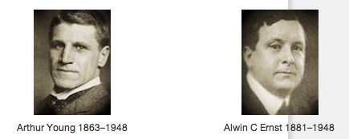

4. Who Benefits from spread of audit culture?
Big 4 Accountancy Firms: Deloitte, PricewaterhouseCoopers (PwC), Ernst and Young (EY) and KPMG.
One of fastest-growing industries: Big 4 operate in over 150 countries, employ over 1.5 million professional staff.
Combined revenues of over $200 billion in 2023
  ‘”Deloitte’ is the brand under which nearly 200,000 professionals in independent firms throughout the world collaborate to provide audit, consulting, financial advisory, risk management, and tax services to selected clients.”
Notes:
Among the key drivers of audit culture are the international accountancy firms: Deloitte, PwC, Ernst & Young and KPMG.
The Big 4 today operate in 150 countries. Between them they employ over 944,900 staff and, in 2017 generated combined revenues of over $134.28 billion US (Statista 2018).
POINT? - Accountancy has become one of the world’s fastest growing industries – thanks to the guaranteed market that government legislation has provided for them: [i.e. every company, business, hospital, local authority, charity in the UK is legally required to have its finances professionally audited].
Few professions enjoy such protection, privilege or lucrative opportunities. Even during the GFC, when other professions were declining, Big 4 continued to grow, e.g. in 2011/2012 they grew by an astonishing 6% netting over US $110 billion.

Slide 9
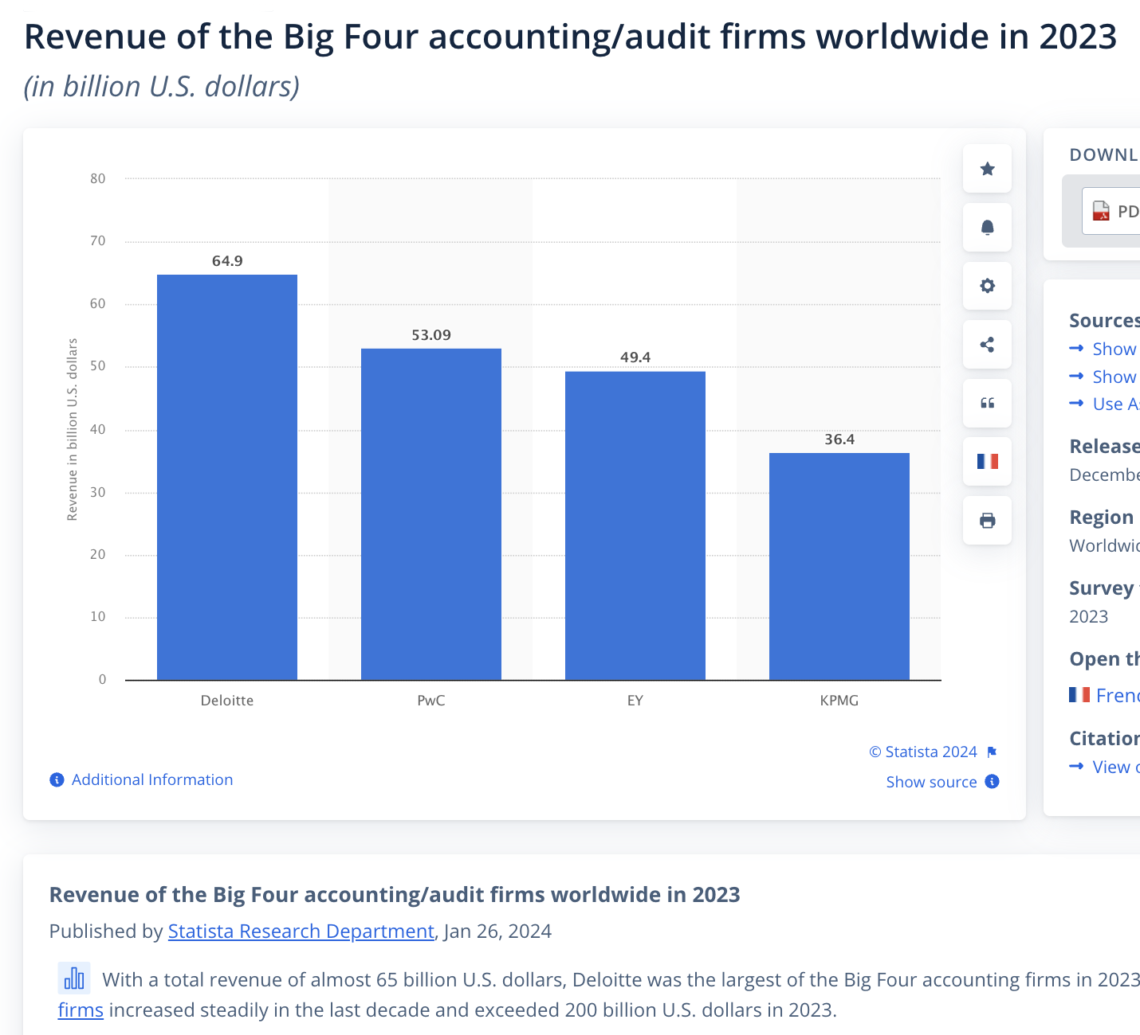
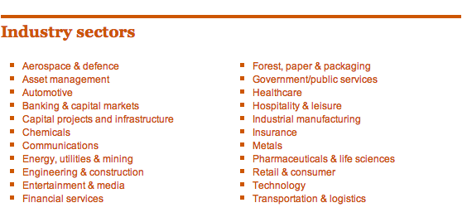
PWC’s expansion into 22 other Industry sectors
Notes:
Just as Big 4 have helped government expand the notion of audit, so their own portfolio of activities and diversified income streams have grown. Today, auditing is no longer the main business of these audit firms – it’s probably more a ‘loss leader’
This slide illustrates how the Big Four have expanded their services beyond financial accounting:
PWC offers their services and expertise in 22 industry sectors. Financial services is hidden at the bottom of the first column.
Ernst and Young offers sustainability assessment: “EY’s clean technology and Climate Change and Sustainability Services (CCaSS) focused services incorporate sustainable actions into your business. Our clean technology service identifies how your business can align with climate change and sustainability opportunities. We look across your business to understand what will work for you from carbon credits, green IT, to green real estate transactions”
Just to illustrate the scale and size of the accounting industry:
the UK has about 34,435 GPs to take care of family health, but it has more than 360,000 professionally qualified accountants – & another 165,000 accountancy students are registered with UK professional bodies. According to Prem Sikka (2018) that is the highest number per capita in the world.
Not clear what benefit UK economy derives from this disproportionate no. of accountants. ‘Certainly not freedom from frauds & fiddles, the production of meaningful company accounts, safe pension schemes, the absence of tax dodging or an abundance of good corporate governance.’ (Sikka 2018)

Slide 10
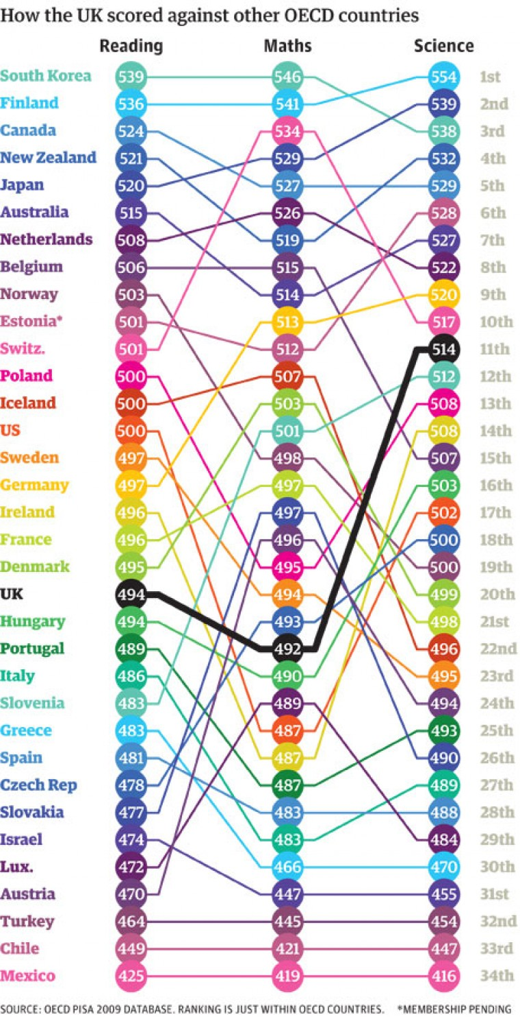
Other Ranking Organisations (& Agents of Global Governance): Credit Rating Agencies & OECD
Credit Rating Agencies - Moody, Standard and Poor, Fitch…
THE/QS - university ranking agencies (Innovation; Entrepreneurial; Sustainability; Impact etc)
OECD = subscription club for world’s richest countries.
Constructs statistics on members’ progress in becoming ‘knowledge economies’
Programme for International Student Assessment (PISA) – assesses countries’ education systems by testing 15 year olds
OECD league tables plot how countries are going up or down
Notes:
Other International Ranking Agencies – OECD and PISA
The OECD is notable as an international agency that produces Education at a Glance and PISA ranking which governments take extremely seriously and use to shape their policies

Slide 11
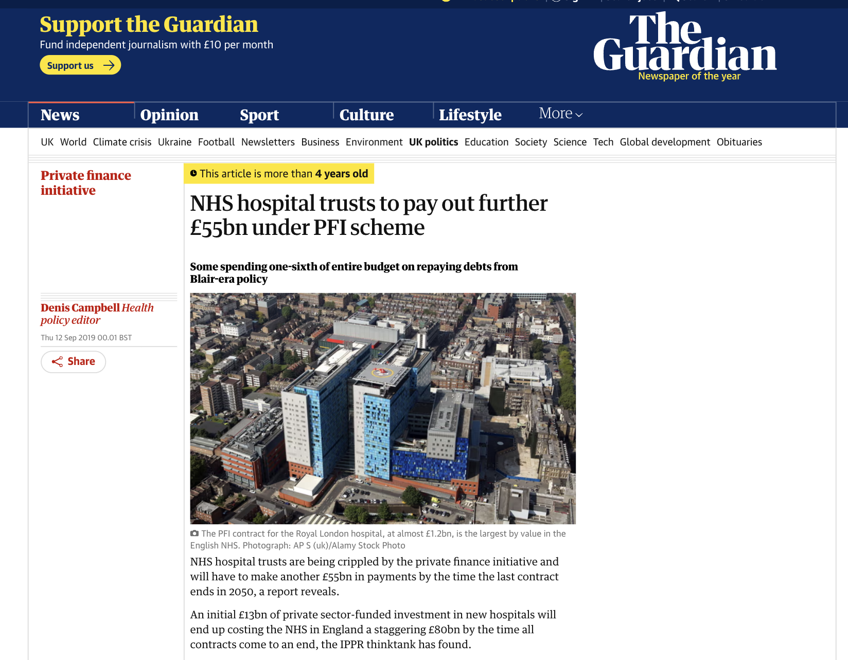
Other Beneficiaries: Management consultants, PPP brokers, venture capitalists, private finance

Slide 12

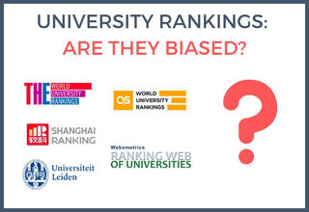

5: Who Loses?
1: Professionals:
HE Case Study - story of Marina Warner
2: Public sector organizations & the public
Academy schools case study

Slide 13


6: The Way Forward: changes needed on four scales
Other ways to assure quality, probity and accountability
Scale 1: Mobilising the agency of individuals:
Using spaces within our own purview: Anke Schwittay
Scale 2: Whole system changes:
E.g. reform of child protection in UK. From Eileen Munroe (2011) report to integrated & supportive system that empowers social worker teams

Slide 14

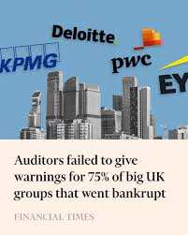

Scale 3: Reform the audit industry
String of audit failures & scandals: BHS, Patisserie Valerie, Ted Baker, Wirecard, Carillion …..
Kingman Report (2018): Brydon Report; 2019 Improving Audit Quality and Effectiveness; report for Labour Party, Reforming the Audit Industry; House of Commons (2019) Future of Audit.
Scale 4: Replace audit with democratic accountability
Critical, dialogic accounting: Social & Environmental Accounting costs (Judy Brown); use alternative concepts and measures: greater public ‘accountability’

Slide 15
Finally
Narratives not just numbers
Encouragement, not punishment
Stop thinking of people/organisations as economic units of resource
Rebuild public trust
Audibility, not hyper-visibility

