Slide 1
‘Standing on the shoulders of students ’? How international doctoral knowledge contributes to the Social Sciences
Prof Catherine Montgomery
Visiting Fellow Department of Education, Oxford University 2024
Dr Jenny Basford, British Library
Heather Rosie, British Library
Dr Francesca Poli, UCSC Milan

Slide 2

What is a library?

Slide 3

Collections as data?

Slide 4

Building of huge and diverse digital collections: offers endless opportunities for secondary data analysis

Slide 5


These collections open new opportunities for historians, journalists and researchers
Text mining techniques such as information extraction, categorisation, clustering, natural language processing (NLP), and topic modelling have become very popular in the research community to search for relationships among text documents (Candela and Carrasco, 2021, p.820)

Slide 6
Opportunities of Generative Artificial Intelligence?
Exponential development of Artificial Intelligence has presented endless opportunities to mine the digital repositories and augment transnational knowledge mobility by synthesising the research and generating summaries and outcomes
‘Electronically mediated communication has made possible the birth and rapid expansion of a global science system, not driven by technology as such but by human agents’ (Marginson, 2022, p.1567).

Slide 7


Slide 8
International doctoral student mobility as knowledge generation
Internationally mobile doctoral students play a crucial role in enabling globalised universities to generate new knowledge and innovations (Chellaraj et al. 2008)
Flows of doctoral students, as highly skilled migrants, constitute ways to create knowledge across and within certain boundaries (Bilecen and Faist, 2015)
But doctoral knowledge is rarely surfaced as a coherent body of knowledge from which the international HE community can learn (Montgomery, 2019)

Slide 9
Challenges of diverse knowledge?
Some thesis titles:
'I drum therefore I am' : a study of kit drummers' identities, practices and learning
From punk to the hijab : British women's embodied dress as performative resistance, 1970s to the present
Feet and footwear : friends or foes?
Car stickers and coffee mugs : a study of football and everyday life
Highlighting hair : what can be revealed about reading hair in medieval Welsh literature

Slide 10
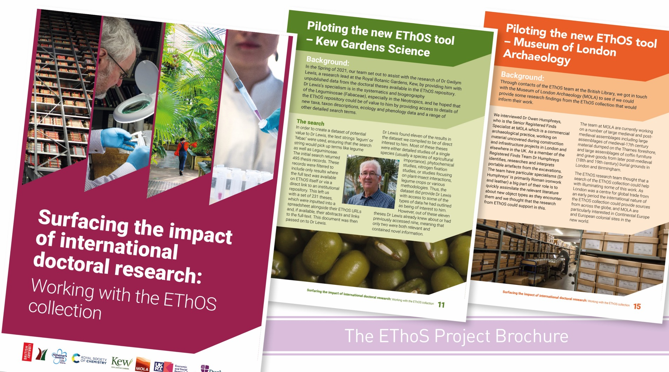

Slide 11
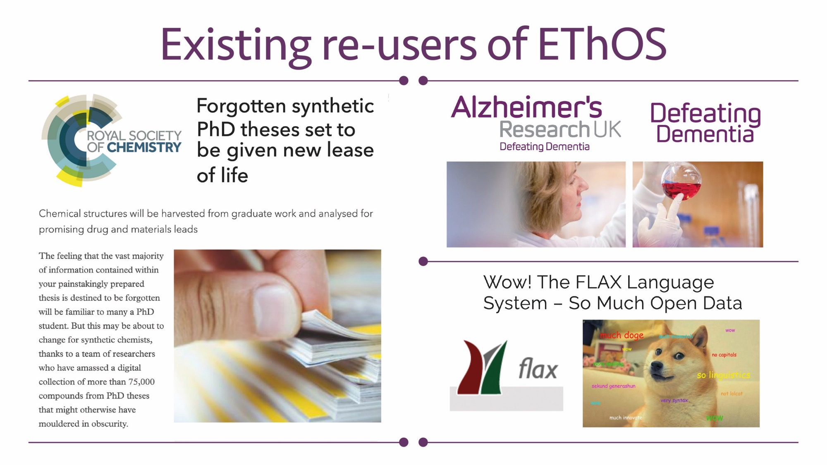

Slide 12

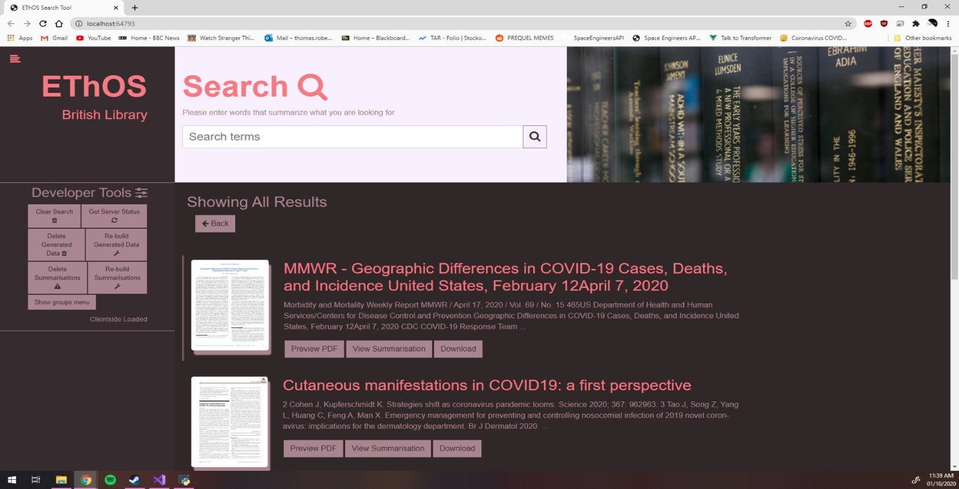
First prototype of new interface

Slide 13
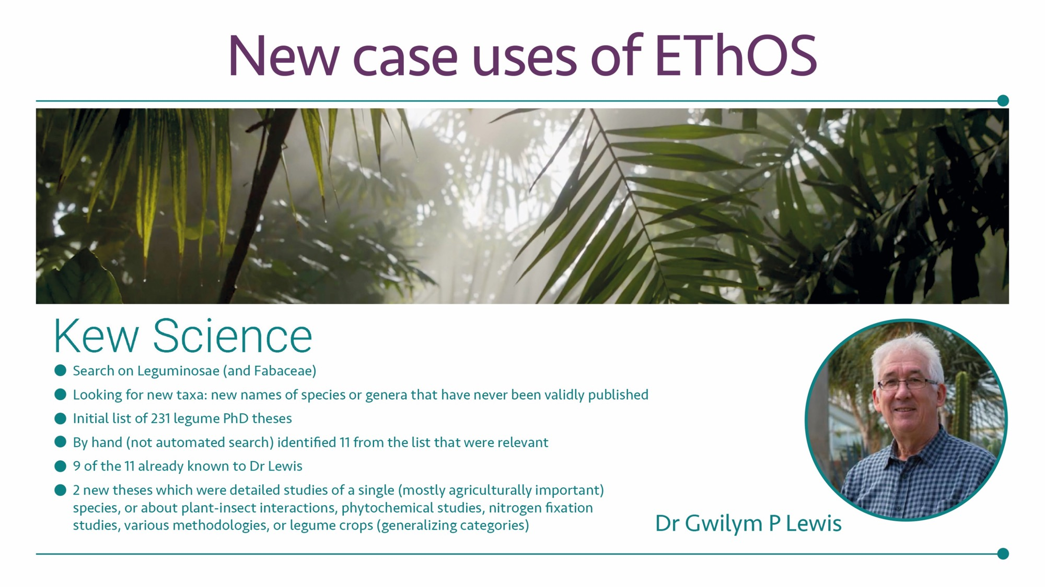

Slide 14
What is in the EThOS collection?
HOW TO GET TO GRIPS WITH SUCH A HUGE REPOSITORY OF KNOWLEDGE?
Today’s presentation will consider:
Overall picture of EThOS – numbers of theses, dates and institutions
19 subject categories indexed to the Dewey Decimal system (1876)
Social Sciences: selected 7 social sciences categories and added in Medicine and Health as a benchmark as the biggest category
Focus on Education: numbers, dates and institutions
Theses about or relating to India– how the doctorate entwines with states such as India? (Simpson, 1983; 2009)

Slide 15
All UK Doctoral theses by date

Slide 16
UK Doctoral theses in the Social Sciences

Slide 17
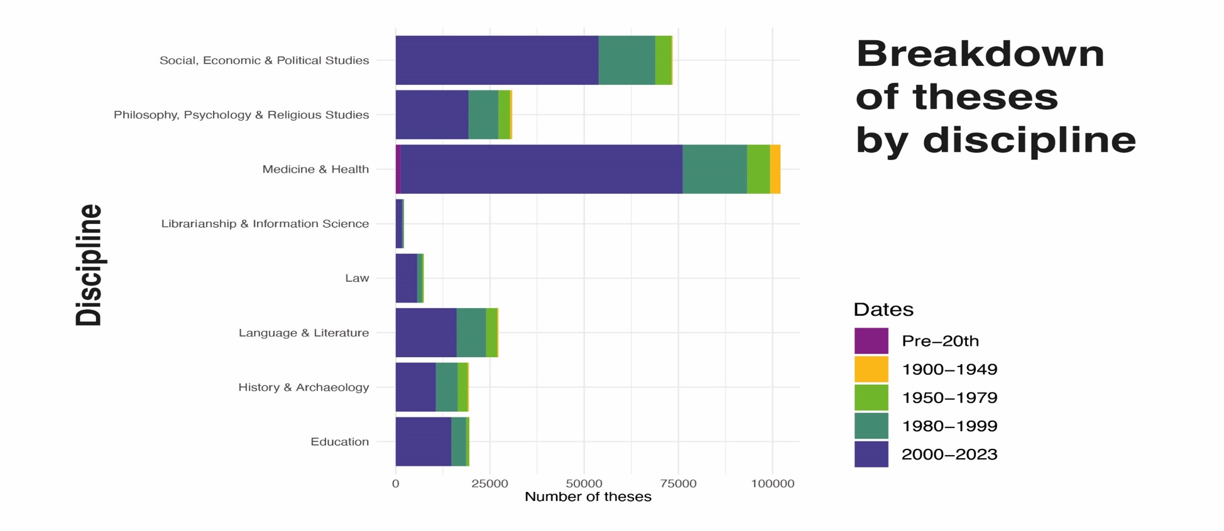
Disciplines in the Social Sciences and dates

Slide 18
Early decades of Education theses
University | Number
University of Edinburgh | 17
University College London | 4
University of Oxford | 3
Royal Holloway | 2
University of Aberdeen | 2
University of Birmingham | 2
University of Cambridge | 2
University of Glasgow | 2
University of London | 2
University of St Andrews | 2
Royal Holloway | 1
Aberystwyth University | 1
Durham University | 1
King's College London | 1
SOAS | 1
University of Leeds | 1

Slide 19
Exponential development of numbers of institutions

Slide 20
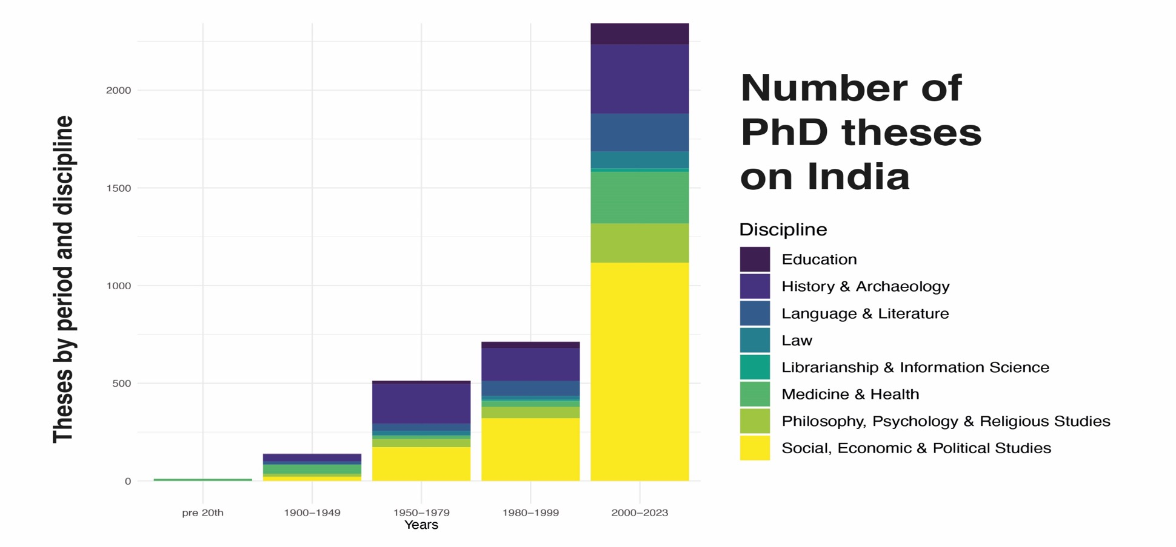
India and the doctorate

Slide 21
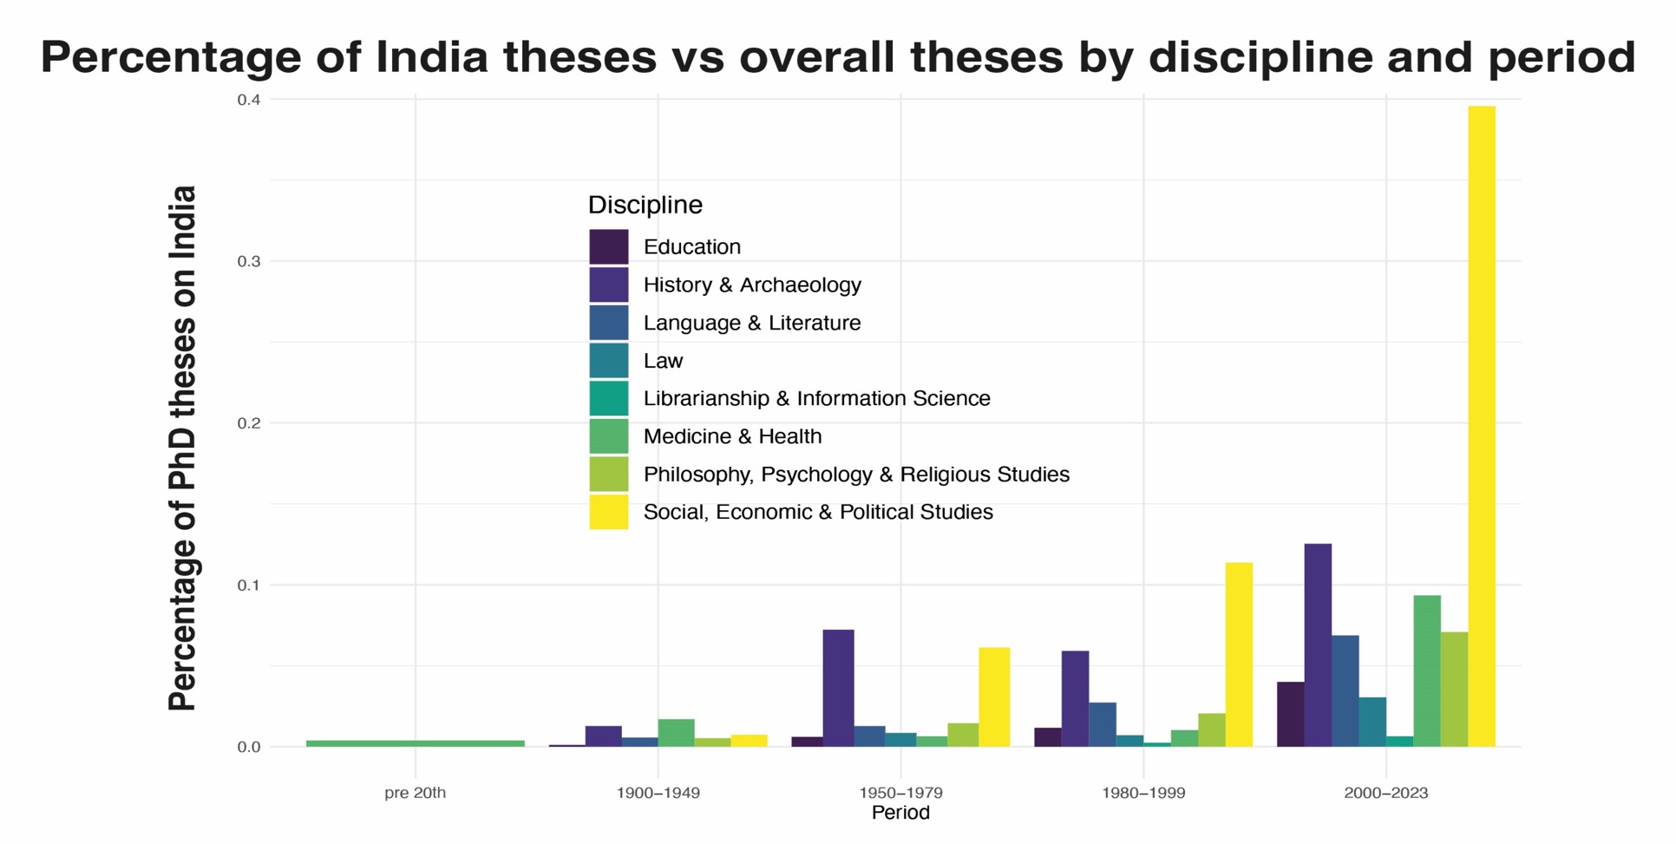

Slide 22
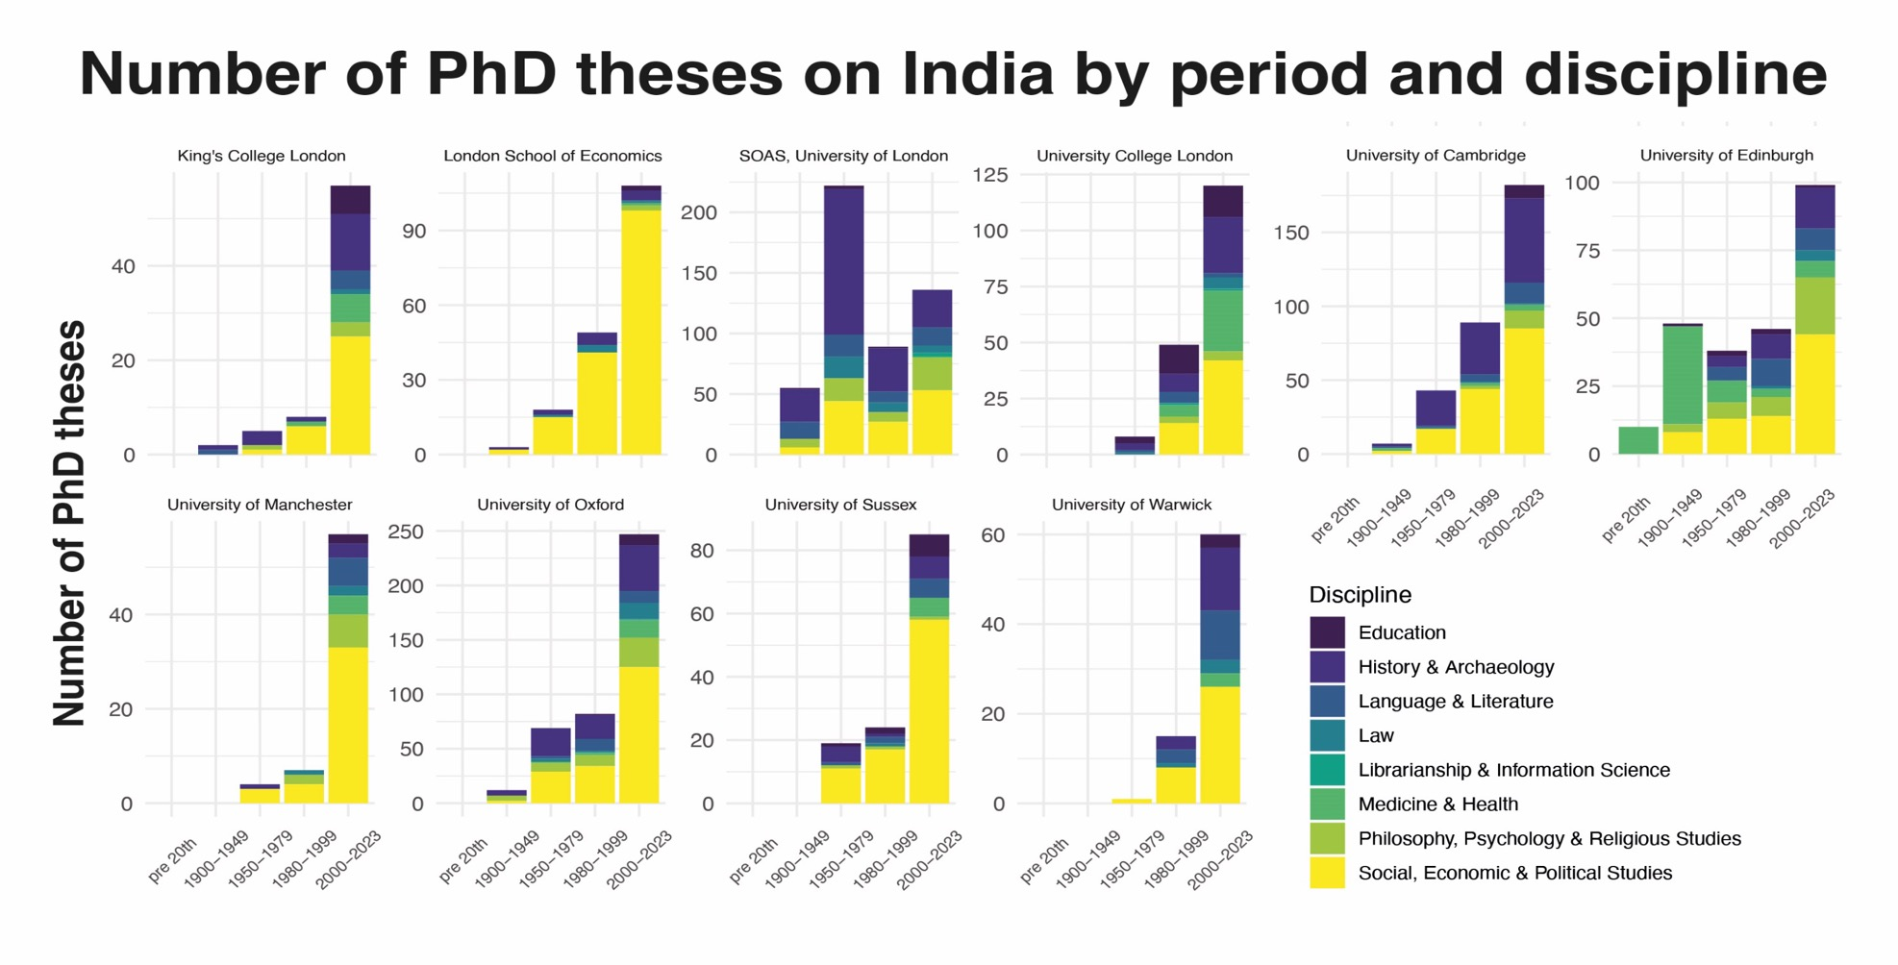

Slide 23
What can EThOS tell us?
Histories of higher education? (Mills, 2024; Simpson, 1983; 2009)
Development of disciplines and contributions of student research (Larivière, 2012)
Contribution to ‘global science’ (Marginson, 2022) and ‘transnational knowledge mobility’ (Shen, Xu and Wang, 2022)
Understanding cross-border research trajectories and networks?
What constitutes research capacity? What is research? (Oancea, 2023)
Part of the ‘global knowledge system’? (Shen, Xu and Wang, 2022)

Slide 24
Doctoral theses as part of the global science system
…’the global science system is not normatively integrated from a single centre, the nation-state. It is grounded in the autonomous self-managed association of scientists themselves (Royal Society 2011, 6), regulated by autonomous professional conventions and standards (King 2011) and by global publishing. […] Science is not either global or national/local. It is both at the same time.’ (Marginson, 2022, p.1567)

Slide 25
Publications so far
Montgomery, C., Stewart, C., Aduragba, C. and Poli, F. (2024). Unveiling Crisis in Globalised Higher Education: Artificial Intelligence Insights from the Doctoral Research of EThOS. Higher Education Quarterly. https://doi.org/10.1111/hequ.12537
Montgomery, C. and Poli, F. (2024). International doctoral research and contributions to knowledge: exploring the impact for the academic community. In Jones, E., Norlin, B., Rönnqvist, C. and Sullivan, K. (Eds). Internationalization of the Doctoral Experience: Models, Opportunities and Outcomes. Routledge.
Montgomery, C. (2019). Surfacing ‘Southern’ perspectives on student engagement with internationalisation: doctoral theses as alternative forms of knowledge. Journal of Studies in International Education. 23(1) 123 –138. https://doi.org/10.1177/1028315318803743
Montgomery C. (2020). Exploring rurality and ethnicity in globalised higher education: ideologies, intersections and narratives in doctoral research theses. Compare: A Journal of Comparative and International Education. 50, 7, 978-994. https://doi.org/10.1080/03057925.2020.1756744

Slide 26
References and influential texts
Bilecen, B., & Faist, T. (2015). International doctoral students as knowledge brokers: Reciprocity, trust and solidarity in transnational networks. Global Networks, 15(2), 217–235. https://doi.org/10.1111/glob.12069
Candela, G. and Carrasco, R. (2021) Discovering emerging topics in textual corpora of galleries, libraries, archives, and museums institutions. Journal of Association of Information Science and Technology (JASSIST). 2022;73:820–833.
Chellaraj, G., K. Maskus and A. Mattoo (2008) ‘The contribution of international graduate students to US innovation’, Review of International Economics, 16 (3), 444–62, doi: 10.1111/j.1467-9396.2007.00714.x
Connell, R. (2007). Southern theory: The global dynamics of knowledge in social science. Sydney, Australia: Allen & Unwin
De Sousa Santos, B. (2014). Epistemologies of the South: Justice against Epistemicide. USA: Paradigm Publishers.
Houtondji, P. J. 1996. African Philosophy: Myth and Reality. 2nd ed. Bloomington, IN: Indiana University Press
Larivière, V. (2012) On the shoulders of students? The contribution of PhD students to the advancement of knowledge. Scientometrics 90, 463–481 (2012). https://doi.org/10.1007/s11192-011-0495-6
Marginson, S. (2022) What drives global science? The four competing narratives, Studies in Higher Education, 47:8, 1566-1584, DOI:10.1080/03075079.2021.1942822

Slide 27
Manathunga, C., Singh, M., Qi, J. & Bunda, T. (2023) Using Chinese and First Nations philosophies about time and history to reimagine transcultural doctoral education, Discourse: Studies in the Cultural Politics of Education, 44:1, 121-132, DOI:10.1080/01596306.2021.1972531
Oancea, A. (2023). Beyond the frame: hard-to-assess research–impact nexuses in the social sciences and the humanities. In M. Ochsner & Z. Bulaitis (Eds.), Accountability in Academic Life: European Perspectives on Societal Impact Evaluation (pp. 51-59). Edward Elgar https://doi.org/10.4337/9781800885738.00011
Simpson, R. (1983) How the PhD came to Britain: A century of struggle for postgraduate education. Society for Research into Higher Education, Guildford.
Simpson R. (2009) The Development of the PhD degree in Britain, 1917-1959 and since. An evolutionary and Statistical History in Higher Education. Edward Mellon Press, New York.

Slide 28
References 2
Montgomery, C. (2019). Surfacing ‘Southern’ perspectives on student engagement with internationalisation: doctoral theses as alternative forms of knowledge. Journal of Studies in International Education. 23(1) 123 –138. https://doi.org/10.1177/1028315318803743
Montgomery C. (2020). Exploring rurality and ethnicity in globalised higher education: ideologies, intersections and narratives in doctoral research theses. Compare: A Journal of Comparative and International Education. 50, 7, 978-994. https://doi.org/10.1080/03057925.2020.1756744
Montgomery, C. and Trahar, S. (2023) Learning to unlearn: exploring the relationship between internationalisation and decolonial agendas in higher education. Higher Education Research and Development Journal. Forthcoming May 2023.
Olenina, A., Bamberger, A. & O. Mun (2022). Classed and gendered internationalisation of research and knowledge production: a critical analysis of international doctoral students in the UK (1998-2016), International Studies in Sociology of Education, DOI: 10.1080/09620214.2021.2008266
Tuhiwai Smith, L. (2012). Decolonizing Methodologies, 2nd Edition. New Zealand: Otago Press.
Whitsed, C., Burgess, M. & Ledger, S. (2021). Editorial advisory board members on reimagining higher education internationalization and internationalization of the curriculum. Journal of Studies in Higher Education doi: 10.1177/1028315320984840
Xu, C.L. and Montgomery, C. (2019). Educating China on the Move: A Typology of Contemporary Chinese Higher Education Mobilities. Review of Education. 7(3), 598-627 https://rdcu.be/80tW
Young, M. (1971) Knowledge and Control: New Directions in the Sociology of Education. British Sociological Association.

