Slide 1


Education and Exclusion ? Muslim Minority Educational Institutions in India
Dr. Hem Borker
Jamia Millia Islamia

Slide 2
Constitutional Mandate
Minority Educational Institutions (MEIs) are established and managed by the members of a religious/linguistic minority community and meant to serve educational interests of the community of belonging
This vision of inclusion was highlighted by Dr. B.R. Ambedkar in Constituent Assembly debates, 1948:
Non-discriminatory clauses:
  No discrimination by state against educational establishments founded and run by religious and linguistic minorities
  No discrimination in granting recognition or assistance to such institutions solely based on their minority status.
Inclusion
Keeping the MEI’s open to students from all communities to ensure inclusivity while safeguarding their rights - cannot be compelled against their will to join classes on religion.
Article 29
Protection of Interests of the Minorities
Article 30
Right of minorities to establish and administer educational institutions

Slide 3

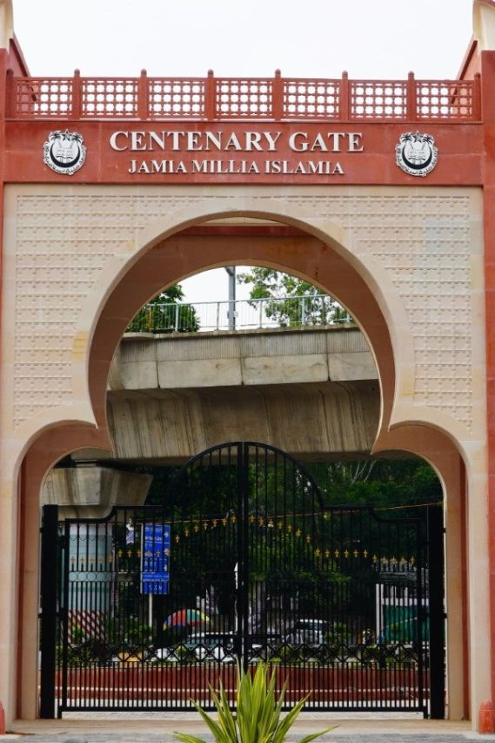

Muslim Minority Educational Institutions
Primary Schooling to Higher Education levels
  Schools
  Institutions of Higher Education
  Universities
  Professional Colleges
  ITIs/Polytechnics
  Madrasas

Slide 4
Muslim Educational Exclusion
Literacy : The literacy rate among Muslims is the lowest as compared to other communities (GoI, 2007).
High percentage of children (15%) who have never attended school (GoI, 2014) and the lowest mean years of schooling (GoI, 2006).
Drop Outs : High dropouts beginning at a young age of 10 years, as compared to other socio-religious communities (GoI, 2014, NSSO 75th Round , 2017-18 )
The rate of dropouts increases with the increase in the level of education resulting in the low presence of Muslims at higher levels of education as compared to other socio-religious communities (GoI, 2014).
Notes:
A time trend of literacy levels amongst different communities clearly indicates that the educational gap between Muslims and other communities has sharply increased, especially after the 1980s (GoI, 2006).
Muslim community also has the largest number of nowhere children, i.e. children neither attending an educational institution nor part of labour force.

Slide 5

Decline in Muslim Enrolment
Muslims declined from 5.4% in 2019-20 to 4.6%
(Aishe, GoI)
Central Universities
8.41 to 8.24%
Institutions of national importance
1.92 to 1.87%
Public-funded state universities
5.29 to 4.30%
Self-financed private universities 4.25 to 3.87%
Government deemed universities
1.10 to 1.03%
Government-aided deemed universities 14.55 to 11.84%
Self-financed private deemed universities
3.47 to 3.04%
Colleges of central universities
4.68 to 3.58%
Colleges of state universities from 6.05 to 5.09%
Notes:
This decline in enrolment of Muslim students by 8 per cent from 2019-20 (1,79,147 students) stands in stark contrast to other groups whose enrolment in higher education has increased such as Dalits (4.2%), Adivasis (11.9%)and OBCs (4%) as compared to 2019-20.
The 20-21 All India Survey of Higher Education (AISHE) highlighted that in all these 149 Institutions of National Importance (such as IIT, IIM, AIIMS, NIIT ) the share of Muslims is at the bottom with 1.9% ( viasvais SC and ST students was 13.1% and 6.1%).

Slide 6
VIEWS OF Muslim students : Muslim MiE are Accessible, Affordable, Accountable, Aspirational
Affordable
The institution takes staggered fees for the girls when the money from the scholarships or after the agricultural season
Degree College, Bijnor, Uttar Pradesh
Achievable’, Accessible
I am an tailor. I studied still class 7th. My two boys are getting good marks but 90 percent is less in India today, competition is a lot.. this institution is accessible.. they can get through engineering here
Parent admitting son in BA programme, Delhi, JMI
Aligarh Muslim University has an internal quota for its own students …students join secondary school to become eligible for the quota for engineering and medicine.
Student, AMU

Slide 7
Familial
I got into top universities in Delhi but opted for this as I did my schooling (11^{th/} 12th), BA, MA and now PhD … I like mahual - egalitarian culture, secular education and religious ethos …it is a place I feel at home
Phd Student, Jamia Millia Islamia (JMI).
Accountable
No studies stake place in regular government colleges, boys stand outside and loaf around (awaragardi), eve tease girls (ladkiyon ko chedte hain).. There is some accountability (jawabdari) here
Parent of College Graduate , Bijnor
Aspirational value
‘Getting in JMI, AMU for students in Rural Bihar, UP, Mewat is like getting into Oxford and Cambridge..
School Principal, Ranchi

Slide 8
Safety
My parents were fearful in sending me to pursue higher education outside Kashmir..Delhi being the closest and Jamia being a minority university located in a Muslim area with lots and lots of Kashmiris around they were ok with me coming here and living in a hostel.
Phd scholar, JMI, Delhi
Gendered Reasons
I wanted to study Sciences but I was told I could only go to a girls’ college and this is the only Muslim girls’ degree college here , it only offers Bachelors in Arts programme …
BA Student, Bulandshahar, Uttar Pradesh
I studied in a Co-ed Urdu medium Minority school 85% students were girls because these schools are considered best (most appropriate) for girls, then I joined this Technical College for Muslim Minorities as it was the closest to home.
BSc. Computers, Karad , Maharashtra

Slide 9
Reaching the Aspired Higher Education Destinations : MEI’s as A Paradoxical Resource
Raising Aspirations & Getting good Jobs
My family has a wood business in Saharanpur. I thought eventually as the only son I will manage it. Earlier I only wanted to complete a degree – I enrolled in BA programme at Aligarh Muslim University. There I lived in the hostel and joined activities like debating. That made me realise I can win debates. When the CAA came, I joined the protests. On social media I had to explain what was wrong in the Act. Now I am doing my Phd on Pasmanda Muslims..I can never go back to being that quiet, apolitical small businessman personality
Phd Scholar Jamia Millia Islamia.
My brother came to know that with his marks he could study BPharma from Muslim college Hardoi, Neither he nor my parents knew that there was a job-oriented option like Pharmacy we thought there was only BSc or Medicine.
Student , Bijnor, Uttar Pradesh

Slide 10
Education to careers : ‘Aspiration Caps’
Inability to access Dominant Social Networks
Wider Political processes marked by Rise of right-wing forces
‘Minority Tag’ : Construct of being a Minority Institution

Slide 11
Stepping Outside the ‘Bubble’
Inability to Access dominant Social Network
Unemployment is bad everywhere, that’s why it’s a national election issue but things have become really bad for Muslim institutions… placement this year it is not even 30%. This 30 number is also owing to our Alumni network.
Student Coordinator, Placement Cell, Jamia Millia Islamia
All the good jobs are taken by the students who come from better backgrounds – they are educated in private schools, speak good English, know how to present themselves and have contacts ... the rich students get placed first and the ones who really need a job, the students with good marks but ordinary background, get left behind.
Student , Jamia Millia Islamia

Slide 12
Mei graduates Entering the job market : Minority tag
I joined as a JRF after topping in my bachelors and masters. I chose to study here over other universities that offered me a doctoral place because I felt it’s this university that made me realize my academic potential .. but now I realise Jamia is a bubble.…In interviews for academic posts I was asked what are my views on Ghazwa-e-Hind which has no correlation to my doctoral work on climate change.
Phd Scholar , Jamia Millia Islamia
In the feedback session we were told the students need better orientation, Muslim students are spoilt in Muslim institutions.. They are not ‘professionals’. .making much fuss about dress and prayers …
Student, Placement Cell, Malana Azad National Urdu University , Hyderabad
The State Rural livelihood Mission which recruits from our Department , openly(khule aam) - offers Delhi University graduates a higher salary package than Jamia for the same entry level position. We cannot keep explaining to everyone that JMI is equivalent and in fact has a better national ranking than DU ..
MSW , Jamia Millia Islamia

Slide 13
Double Bind :
Concerns regarding safety , discrimination leads Muslims to only limit (self-confine) themselves to minority institutions
Processes that restrict social mobility to ‘Good Jobs’ (high status and/or salary jobs)

Slide 14
Policy view vs Field View
The policy view
The education lag of Muslims is explained by emphasising religious and cultural factors internal to the community rather than socio socio-economic marginalisation (Alam, 2013). This includes citing
  Religious conservatism and socio- cultural ethos of Muslims (Baig 1974; Borooah and Iyer 2005; Sharma 1978; Vajpeyi 1989)
  Conservative gender norms (See Hussain, 2022; Sherin, 2023)
  Muslim preference for identity-based community institutions such as madrasas and Muslim minority education institutions (Borker, 2018).
The policy discourse contains a stated commitment to educational equality. It ostensibly addresses the educational marginalization of Muslims youth by offering opportunities for inclusion in mainstream quality higher and technical educational institutions.
Commitment is not reflected in policy action. There is very low investments in creating greater access of Muslim students to quality mainstream educational avenues. A good example is the downward slide in student aid and scholarships available for Muslim youth.

Slide 15
Decline in Minority Scholarships
Withdrawal of Scholarships: Central Government cancelled two scholarships for Minority Students in November 2022
  Pre-matric scholarship (class 1 to 8)
  Maulana Azad National Fellowship (MANF) for M.Phil and PhD programmes
Decrease in Spending : Between 2019 and 2022, the govt spending on 6 educational schemes for religious minorities dropped by around 12.5% and the number of beneficiaries declined by 7%
Implementation Issues: CBGA report Analysis the Union Budget 2022-23 highlights
  poor coverage of beneficiaries.
  Utilisation of the budget under the scholarship schemes in the last quarter of financial year -beneficiary students receive their scholarships end of the academic year.
Inadequate scholarship Amount
Notes:
The Pre-matric, Post-matric and Merit-cum-Means scholarship have poor coverage

Slide 16
Vicious Cycle
Policy Emphasis on religious and cultural factors as explaining educational backwardness of Muslims
Low investment in expanding Greater Access of Muslim students to Mainstream Educational options
Reducing responsibility of education of Muslims to minority educational institutions
Exclusionary Inclusion in MEI’s
Educational Disadvantage of Muslims

