Slide 1
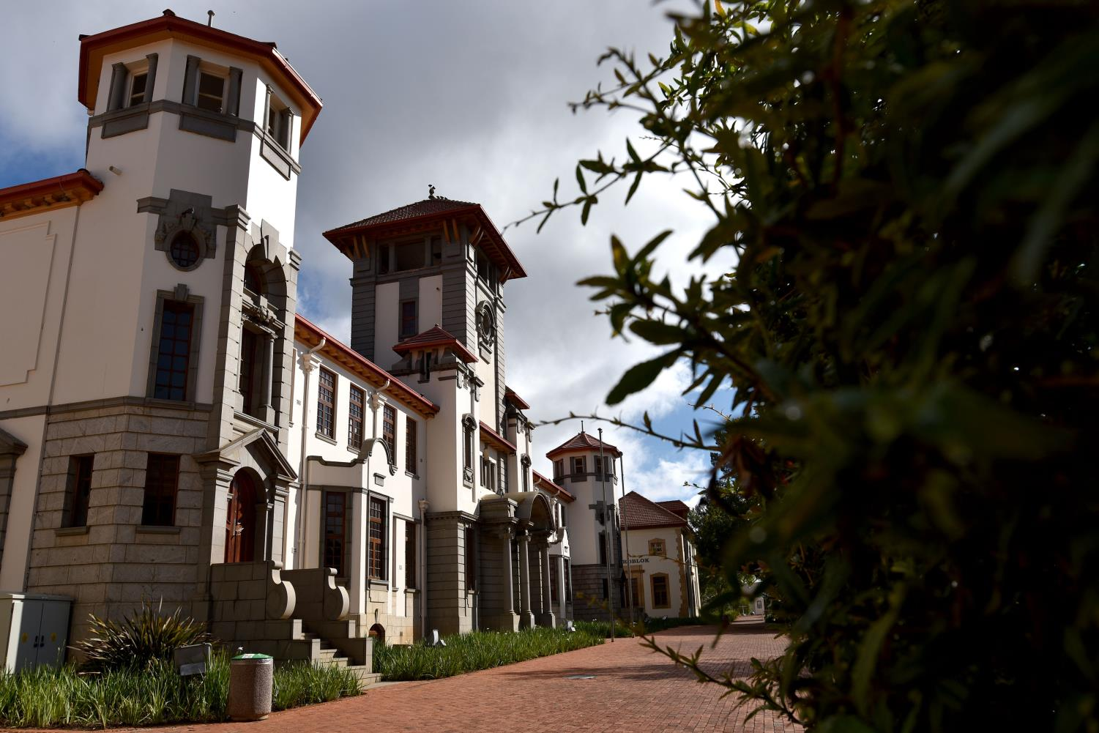


Widening University Access and Participation in the Global South: Using the Zambian Context to Inform Other Developing Nations
Edward Mboyonga
mboyonga.e@ufs.ac.za
University of the Free State, South Africa

Slide 2
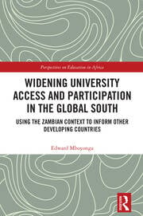
Outline of the presentation
Background
Private higher education in the Global South
Zambian perspective
Conclusion

Slide 3
Background
“Access to higher education has increased in all regions of the world over the past two decades, and more than a third of the global population now continue with some form of post-secondary study” (UNESCO, 2020:26).
While the increase in enrolment in higher education seems to indicate progress towards making education more accessible globally, there are still significant disparities in access to higher education.

Slide 4
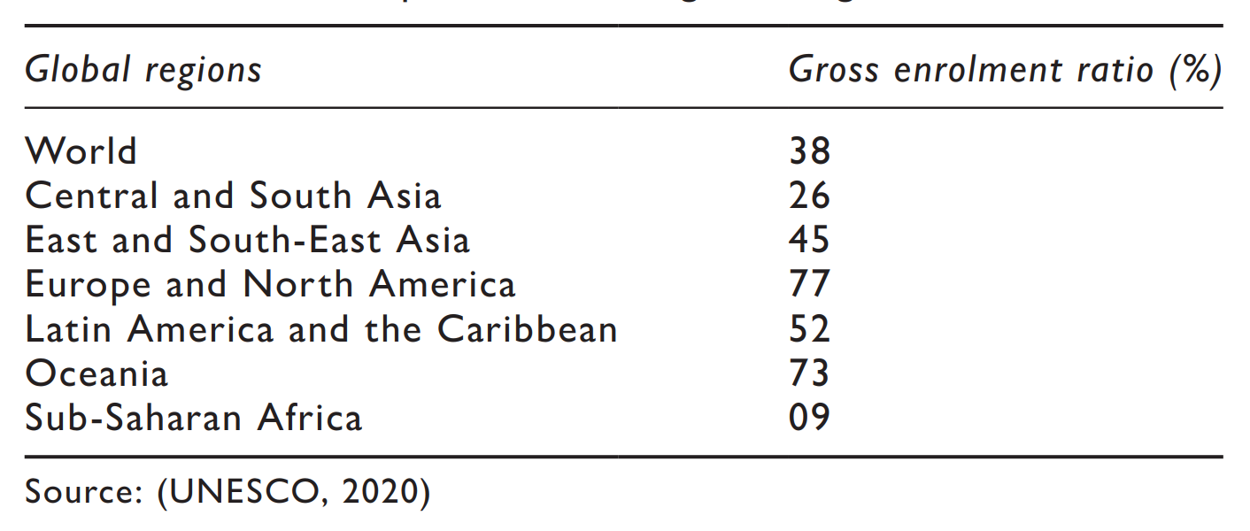
2018 Higher education participation rates for Sub-Saharan Africa compared to other global regions
The situation persists that “even when access is widespread, inequalities are perpetuated within the higher education system” (Clancy & Goastellec, 2007:139).
For most sub-Saharan African countries, enhancing access to HE remains a significant concern, especially since the current gross enrolment of 9% for higher education is below the global average of 38% (UNESCO, 2020).
Many low-income countries in Sub-Saharan Africa struggle with limited government funding and inadequate infrastructure, which prevents public universities from accommodating the growing need for university education.

Slide 5
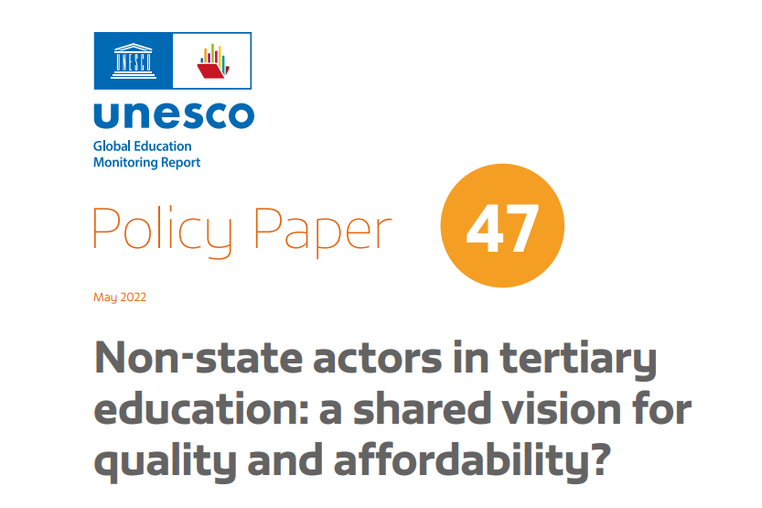
Private higher education as panacea for widening access in the Global South
“The Education 2030 Framework for Action,- the roadmap for achievement of the SDG 4 , highlights the crucial role of non-state actors in education. The ambitious education goal cannot be achieved by governments alone….”
(UNESCO,2022)
“The notion that education should be funded and managed entirely by the state is no longer feasible. In an era of growing demand for education, few states have the resources to fund education on their own or the management capacity to do so. As such, there is a need for the involvement of the private sector and indeed, the input of the private sector can greatly benefit [the] education system” - (Masaiti et al., 2018:80)

Slide 6
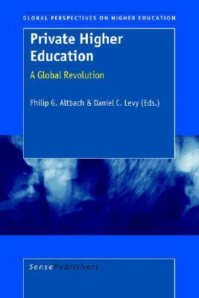
“PHE- a global revolution’ (Altbach & Levy, 2008)
Globally, the private sector now enrols one in every three tertiary education students, reflecting 32.9% of the total HE enrolment (Levy, 2018; Tamrat, 2020).
Not enough clear evidence about the effects of privatisation on improving access and the quality of education [in Africa] (Pedró et al., 2015).
Common assumptions about private HEIs focusing more on making profits rather than improving the quality of education, especially in low-income countries where they are not as prestigious as the likes of Harvard, Duke, Stanford, Yale, or Princeton in the United States.

Slide 7
Private higher education as panacea for widening access in the Global South
PHEIs are moving from the periphery to the mainstream in the higher education sector in many African countries (Tamrat,2017)
Kenya - substantial increase in demand for enrolment in private universities, which doubled for the 2024 academic year (Nganga, 2024). The PHE sector dubbed a ‘key partner’ in Kenya’s development (Muyaka, 2024).
South Africa - PHE credited for being at the ‘confluence of education, the market, and transformation’ (Somerville,2024).
Nigeria - private universities are seen as ‘bastions of stability’ amid disruptions in the public higher education system (Oseni & Tiamiyu, 2024).
In Zambia, 54.4% students are enrolled in private universities compared to 45.6% in public universities (HEA, 2023), making it one of the few countries with the highest level of student enrolments in private universities in Sub-Saharan Africa.
Hence, private higher education should not be overlooked when looking at human development issues in developing countries, especially in Africa

Slide 8
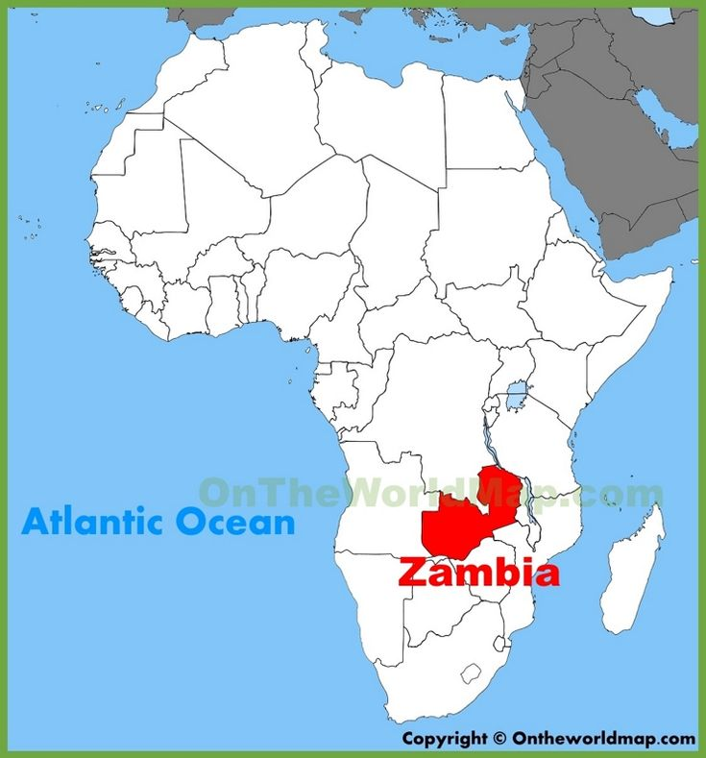
Perspectives from Zambia
Opportunity to access HE is a challenge for many young people due to insufficient government funding for students
Zambia ranks among African countries with lowest participation rates in HE, only 299 university students per 100,000 inhabitants (UNESCO,2016)
Universities absorb 12 % of 180,000 high school graduates annually (MOHE, 2019)
One of the most liberalised African countries in terms of social provision
53 private universities and 9 public universities (HEA, 2024).
Enrolments: Private universities (54.4%) vs public universities (45.6%)

Slide 9
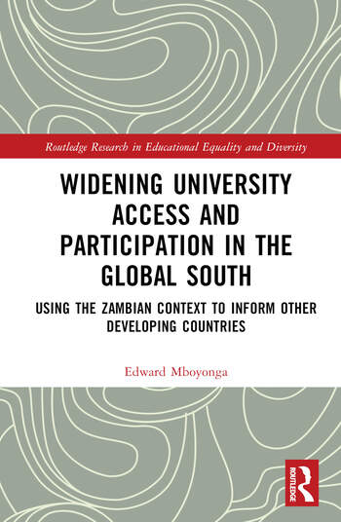
Only perfunctory scholarly attention has been paid to the potential role that private universities play in equalising students’ opportunities to gain access to higher education and fostering their contribution to the public good
Research explores the relevance of private universities as non-state actors in Zambia by interrogating how they enhance social justice through widening access and participation in higher education and what kinds of graduates are produced.
It follows Castells’ statement that “Whether a university in legal terms is public or private is not as essential as the university being geared towards the public interest. Universities can be private or public but work towards the public interest” (Castells, 2017: 64).

Slide 10
Methodological approach
Qualitative case study design focusing on two private universities (Hillside and Damview) in Zambia
48 research participants, comprising 14 university staff and 34 students
The research was conducted in two phases. PhD research between 2020 and 2022, involved interviews with 14 university staff and 28 students from two private universities. Postdoctoral research (2023–2024), during which I conducted follow-up interviews with some lecturers and students to consolidate the findings from the initial study.
Data was collected using a triangulated approach of multiple research tools, comprising semi-structured interviews, focus group discussions, document reviews, and observations.
Thematic analysis was used to develop themes and sub-themes, forming the basis for this discussion.

Slide 11
A capabilities conceptualisation of access to higher education in developing countries
Capabilities approach (Sen, 1999; Nussbaum, 2000). Suitable for an empirically driven, contextually relevant, and theoretically rich understanding of access to HE and capability formation but also of structural inequalities that negatively affect university access and participation in Global South contexts.
Challenges the dominant and limited framings of access to HE by offering an expansive view of access beyond mere entry into universities or numerical expansion of student enrolments.
Broaden our understanding of access to HE by focusing not only on physical access but also on epistemological access (Morrow, 1994, 2009), as the acquisition of transformative knowledge that can enhance students’ real opportunities and freedoms to transform their lives and communities.
Offer alternative approaches for reflecting on HE’s purpose and value beyond economic outcomes by suggesting an expansive view through an ethically oriented and socially just lens of the capability approach.

Slide 12

Achieving formal access
Driving factors behind students’ decisions to enroll in private universities universities.
Having flexible admissions,
Availability of financial support,
Meeting differentiated demands,
Establishing satellite campuses in rural provinces

Slide 13
Flexible admissions
“I applied to various public universities, such as the University of Zambia and the Copperbelt University, to study medicine but was not selected. Even though I scored 8 points, an excellent result in Grade 12, I failed to meet the cut-off points to be admitted under government sponsorship, which was 7 points for females. So, as time went on, I decided to enroll at this [private] university and am now studying clinical medicine” _ (Kate, Clinical Medicine, Hillside University).
“We promote access by offering alternative learning programmes through different study modes, including regular sessions, evening contact, and distance learning, according to the student’s needs” - (Head of Department, Business Studies, Damview University)
Availability of financial support
“The university offers scholarships to school leavers, which was a major factor for me when applying. Applying for the scholarship is simple compared to UNZA or CBU, where you must first apply to the university, wait for their response and then apply for government bursaries through the Bursaries Committee. But here, you apply for the scholarship while applying for enrollment”- (Siphiwe,Nursing, Hillside University)
“Scholarships have made us grow. As I said, we target the vulnerable in terms of scholarships. We start at 25% and go up to 100%, which can be adjusted upwards depending on the vulnerability (Lecturer, Faculty of Medicine” Damview University)
Affordable tuition fees- E.g UNZA BSc Nursing 2024 (K31,878) & Eden University (K 17,000).

Slide 14
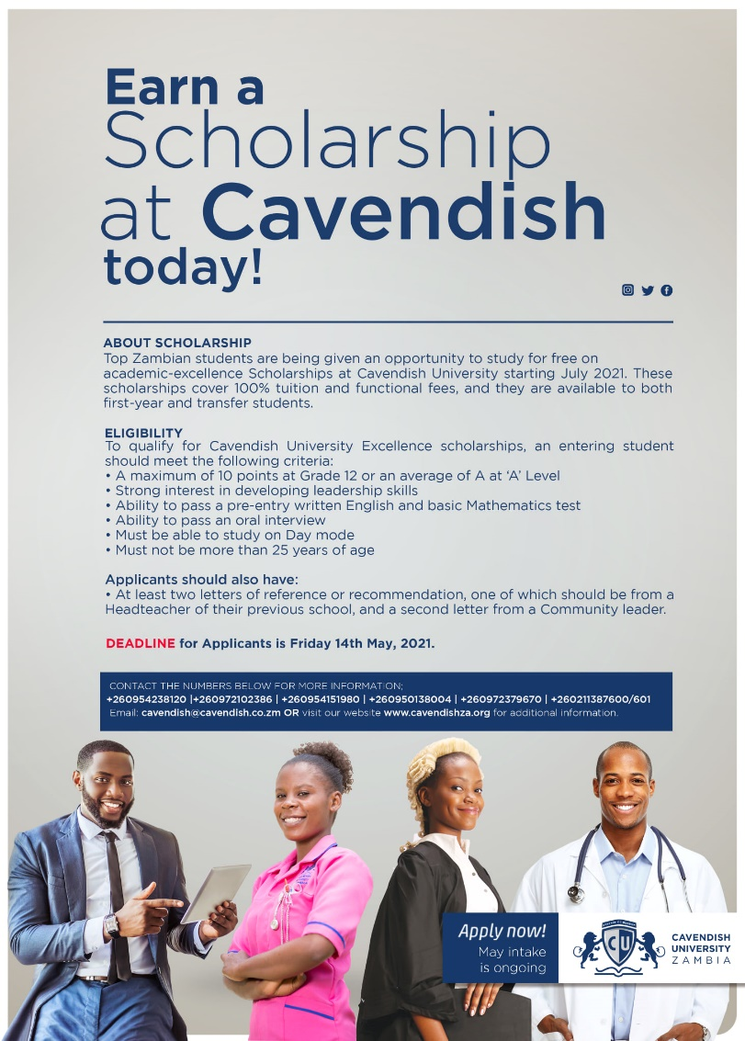

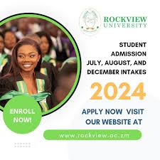

Slide 15
Meeting differentiated demands
“I enrolled at this university because it offers a degree programme in business studies specialising in logistics, transport, and fleet management. When I was applying, no government university was offering the same programme. But now I am told that Chalimbana University (public) has also introduced it”. - (Bright, Logistics, Damview University).
“It is easier to get a degree in time [at a private university], unlike in public universities, because we do not have unnecessary closures, mainly caused by lecturers’ strikes or violent student riots. Here, there is no political interference like in government institutions, where they close every time during elections”.
(Grace, Law, Hillside University)
Establishing satellite campuses in rural provinces
“Our mission is to supplement government efforts to enhance development through trained human resources. For this reason, we have established a branch campus in Eastern Province. Most universities are along the rail line, but people who need university education are in rural areas. So, we are taking education right in their backyards”. (Registrar, Corporate and Governance Affairs, Damview University)
“I enrolled at this university because I did not have to leave Eastern Province. A university nearby has made it less costly for my family and me. At least we do not worry about the costs of boarding houses or the expensive life of Lusaka, where most universities are located”. - (Mubanga, Damview University)

Slide 16
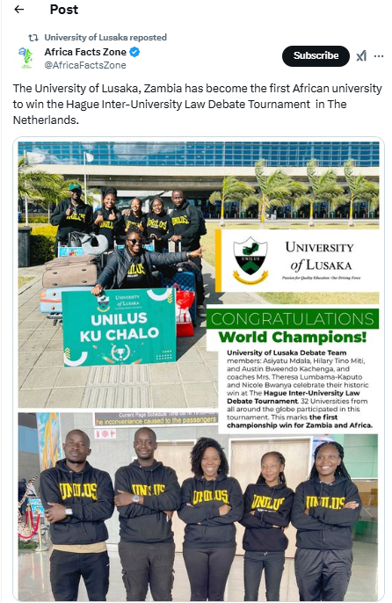


Slide 17
Valued capabilities and functionings
Access enabled through private universities has to some extent, enhanced valued capabilities and functionings among students:
The capability of epistemological access: Accessing and gaining knowledge through private universities; participating and achieving in and through higher education, enabled by private universities.
The capability for epistemic contribution: Having knowledge and being able to share knowledge.
The capability for aspiration: Making plans for one’s future career or setting personal goals; mobilising plans to improve the lives of others now and in future.
The capability for recognition, respect, and belonging: Using one’s voice, being respected, recognised and treated with dignity; having a sense of belonging to the university.
The capability for Ubuntu: Displaying and exercising humane values such as empathy, care, tolerance or respect for others.
The capability for employability: Gaining various skills that would help students earn employment and having entrepreneurial skills for self-employment.

Slide 18
Capability domains
Knowledge domain - epistemological access and epistemic contribution
Self-development - aspiration on the part of the students.
Relational - Capabilities for recognition, respect and belonging, and Ubuntu.
Economical domain - Capability for employability
Summation of various capabilities into these four domains illustrates that efforts to widen access to HE in Global South should provide opportunities for students to access knowledge that fosters self-development, relational attributes and economic opportunities.

Slide 19
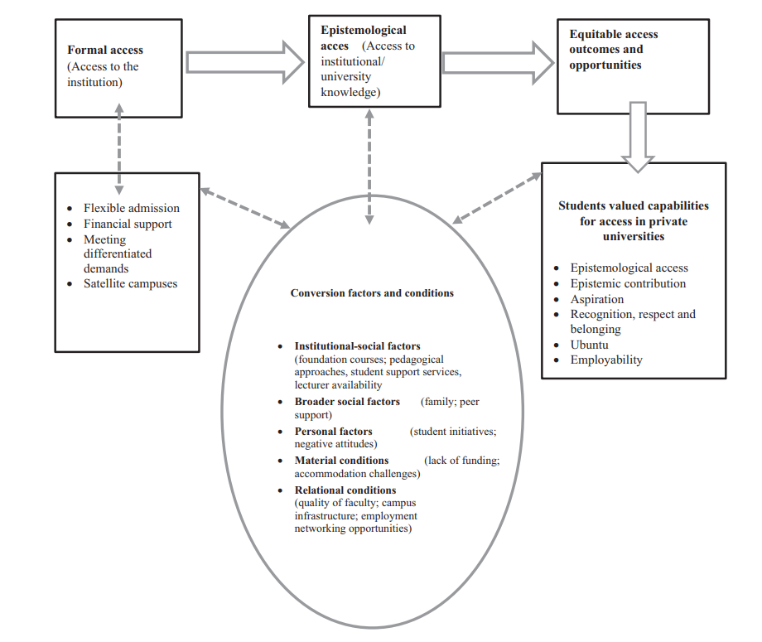
Re-thinking university access towards human development in developing countries

Slide 20
Conclusion and the way forward
Although (higher) education is considered a public good and largely a state responsibility, there is need for the involvement of non-state actors in its provision.
Rather than a fixation on the politics of ownership, the focus here should be on the broader role of higher education and how different actors can co-exist to deliver this public good to drive sustainable human development.
For human development to be met, access to HE needs to ensure not only physical access as enrolment but also epistemological access, as the development of knowledge that can transform students’ lives and society.

Slide 21
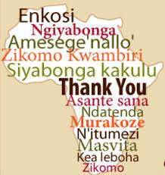
Questions and comments are welcome!!!!

