Slide 1

The national/international interface in the context of “polycrisis” and the prospect of post-neoliberal higher education
Convenors:
Vincent Carpentier, Professor of Higher Education and Society at IOE, University College London.
Yann Lebeau, Professor of Higher Education Research, University of East Anglia.
Panel members:
Mário Azevedo, Professor at the State University of Maringá (Paraná, Brazil).
Kirsten Jæger, Associate Professor in Intercultural Studies at Aalborg University, Denmark.
Abass B. Isiaka, Senior Research Associate in Widening Participation at the University of East Anglia.
Hanne Tange, Associate Professor in English and Global Studies at Aalborg University.
Panel 2G

Slide 2
The Panel perspectives
Our focus
Polycrises and the national/international interface.
Emerging and re-emerging trends in de-internationalisation, forced internationalisation, welfare nationalism, sustainable and inclusive internationalisation.
Towards a post-neoliberal global HE landscape?
Our approaches
A historical perspective on the tensions between massification and internationalisation in HE
A multiscalar approach of internationalisation and its regulation (institutions, states, regional actors and global agencies).
A pluriversal perspective on the global HE field and related discourses and initiatives.

Slide 3
Historical trajectories of Massification and internationalisation and the possibility of a cosmopolitan and inclusive system: French and British perspectives
Vincent Carpentier IOE, University College London, UK
Internationalisation doubly affected by a crisis of globalisation and a crisis of the funding of HE systems both revealed by the 2008 crisis, unresolved since then and exacerbated by Covid-19. Internationalisation is challenged from different directions:
  As contributor and receiver of growing inequalities within and between countries. (Unterhalter and Carpentier 2010)
  by growing focus on immigration and neonationalism within and between countries (Brogger 2021; Douglas, 2021)
  Environmental issues
This questions whether internationalisation can be corrected, transformed, reimagined, reversed (Shahjahan & Morgan 2016; Stein 2019) and to reflect on the ways to develop a sustainable and inclusive cosmopolitan HE system (Marginson 2020)
Internationalisation as response to globalisation or agency and responsibility of HE systems and their institutions to address global and national challenges?
Looking back at the national/global interface by comparing and contrasting historical trends, patterns and structures of funding, expansion and differentiation of HE systems to those of inward student mobility in the UK and France since the 1920s.

Slide 4
Expansion and fluctuations: historical trajectories of domestic and international students
Expansion and fluctuations
Considerable expansion of the number of internationals students in both countries.
The expansion of student mobility follows the growth of the whole system.
Not linear-fluctuations and shocks (Wars, empires, crises, migrations…).
Fluctuations much sharper for international students than domestic students (shock absorber?)
Impact from crises in 1930 in France and 1973 and 2008 in the UK (funding and immigration debates)

Slide 5
Intensity:
Intensity
Openness or dependence?
Higher intensity might result from increasing numbers of international students or shrinking numbers of domestic students or both.
Always a substantial presence of international students in both systems
Strong fluctuations- the meeting of massification and internationalisation
The UK ahead since 2000s
International students as a share of all students

Slide 6
Differentiation and internationalisation
Drivers behind internationalisation: similar or distinct?
What are the effect of internationalisation on institutional stratification?
What are the effect of HE stratification on internationalisation?
Proportions of international students in each type of institutions across the HE sector

Slide 7
Marketisation
In the UK Internationalisation became increasingly connected to a wider shift from cost-sharing to public private substitution in funding (Carpentier 2021) raising issues about sustainability, stability, equity and quality (Lomer 2018)
Trend emerging in France as fees were introduced in universities but not implemented yet (Carpentier and Courtois 2024)
Reflections
Historical contingency shows that internationalisation represents at times an experiment of broader shifts in HE and at others an intensifier of existing transformations.
This shows potential for considering internationalisation as a central rather than a peripheral driver of a massified cosmopolitan and inclusive public service of higher education.
A post neoliberal global HE? This starts with a realignment of the rationales which requires a revival of public investment to reverse public-private substitution in the UK and address underfunding in France.
Reducing inequalities within HE systems by revisiting the national/global interface not sufficient but a start to engage with polycrises

Slide 8
Internationalisation of higher education within the Global South
Mario Azevedo
State University of Maringá and CNPq, Brazil

Slide 9
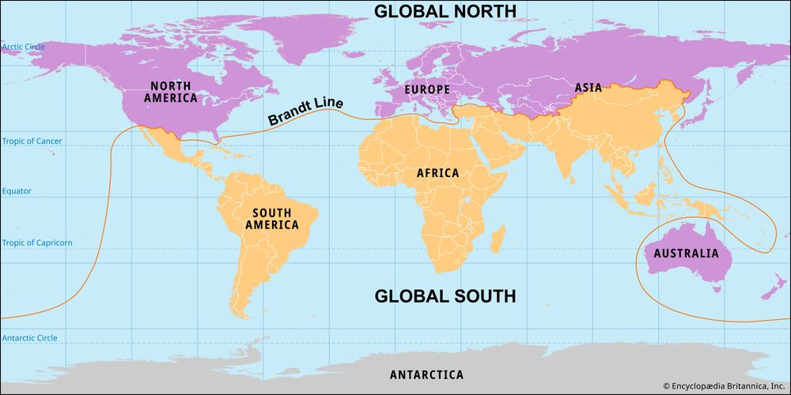
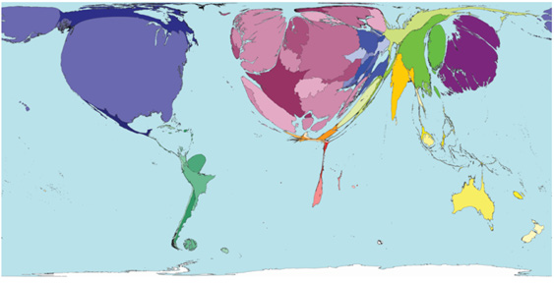
Global North and Global South
Brandt Report of 1980
Source:www.britannica.com/topic/Global-North-and-Global-South, 2025
Science production: North Unipolarity?
Source: Sasi Group, Univ. Of Sheffield, And Mark Newman, Univ. Of Michigan

Slide 10
Global South and Internationalisation of Higher Education
The Global South refers to a group of developing countries, as described in the well-known Brandt Report of 1980*. The term Global South has been used to describe a condition of inequality in relation to the Global North, characterized by higher poverty rates, lower life expectancy, higher illiteracy rates, lack of access to basic health services, among other deficiencies. The notion of the Global South implies the presence of power asymmetries at intra, inter and transnational levels, but it also suggests the possibility of solidarity through political and social movements that resist and seek to transform these disparities, such as South-South cooperation (Muhr and Azevedo, 2018).
* “The ‘North and South’ framework was first used by Carl Oglesby, who in 1969, when writing about the Vietnam War (1954–75), referred to “the North’s dominance over the global South.” However, the terms’ initial popularization is most commonly attributed to a 1980 report authored by a commission chaired by the former German chancellor Willy Brandt: North-South: A Programme for Survival, also known as the Brandt Report” (Miles Kenny)
References: Field theory (Pierre Bourdieu); Agenda (Dale); Hegemony (Gramsci)

Slide 11
Efficiency + Ideas [Gestion + Civilization]: “Heart of Darkness” (Conrad, 1899).
As a starting point for the contrast between the Global North and the Global South, it is worth mentioning the literary work of Joseph Conrad Heart of Darkness (1899)
Global North: "[Marlow] had the pose of a Buddha preaching in European clothes (…). ‘Mind (…) What saves us is efficiency” > Assuming the Roman conquerors of Britain did not dominate with "efficiency"
“The conquest of the earth (…) is not a pretty thing when you look into it too much” (Charles Marlow)
“I was also one of the Workers (…). Something like an emissary of light (…) [= ideas, civilization]”
“She [a dignitary's wife] talked about 'weaning those ignorant millions from their horrid ways’”
Kurtz [in Congo] = Europe: “This was because it could speak English to me. The original Kurtz had been educated partly in England (…). His mother was half-English, his father was half-French. All Europe contributed to the making of Kurtz; (…) the International Society for the Suppression of Savage Customs had intrusted him with the making of a report, for its future guidance (…)”.
Kurtz is also admired by a Russian character: “For him evidently Mr. Kurtz was not in his grave; I suspect that for him Mr. Kurtz was one of the immortals”.

Slide 12
Internationalisation of HE within the Global South
Traditional definitions of internationalisation are often rooted in Global North perspectives.
Challenges for Global South Internationalisation: Inequality, underfunding, consumerism, pollution, historical disadvantages, commodification, financialization, assetization, monetization, rentism, authoritarian populism (new nationalisms, new imperialisms), geopolitics (including knowledge politics), knowledge-based enclosure economy as opposed to "common good“ and “public good” etc.
Perspectives: Mutual Respect, Cooperation, decolonial futures and Sustainable, Solidary and equitable internationalisation.
Utopias for/from Global South: “concrete utopia”/“con crescere”/ “​​growth together” (Ernst Bloch, 2000); “inédito viável”/“untried possible”/ “untested feasibility” (Freire, 1976); “Tianxia” (Yang, Marginson and Xu, 2022), “Ubuntu” (Mukwamboa, Mkwananzib and Seshoka, 2024), “Bem Viver”/“Buen Vivir” (Acosta, 2016).

Slide 13
Some Brazilian Internationalisation (HE) experiences within Global South
Mercosul Educacional (Argentina, Brasil, Paraguai, Uruguai e Venezuela);
BRICS Network University (BRICS NU) and the BRICS League of Universities (BRICS UL), which seek partnerships between HEIs of the member countries of The BRICS group (Brazil, Russia, India, China, South Africa and new partners).
Zicosur Universitário - South American Central-West Integration (Argentina, Bolivia, Brazil, Chile, Paraguay, Peru and Uruguay
AUGM - The Montevideo Group of Universities Association (universities from Argentina, Bolivia, Brazil, Chile, Paraguay and Uruguay).
The Latin American Doctorate in Education (Doutorado Latino-Americano em Educação) - Federal University of Minas Gerais (UFMG)/IESALC-UNESCO
Student-Agreement Program (PEC-G) of the Brazilian Ministry of Foreign Affairs (MRE)
The Postgraduate Student-Agreement Program (PEC-PG)
UNILA - Federal University for Latin American Integration (2010);
UNILAB - University for International Integration of the Afro-Brazilian Lusophony;
PALOP (Portuguese-Speaking African Countries) and CPLP (Community of Portuguese-Speaking Countries);
PESA - Emergency Academic Solidarity Program (A Program for Welcoming Refugees from Crisis-Affected Countries).

Slide 14



UNESCO’s Global Convention: A Regulatory Regime for post-market Internationalisation?
Yann Lebeau and Abass Isiaka

Slide 15
CONTEXT
Global knowledge society in need of corrective institutional frame after years of aggressive (neo)liberalisation and commodification, competition and excellence (Zapp & Ramirez 2019)
Rising national protectionism and de- internationalisation (Tange & Jaeger 2021)
Pressing demands and Increased agency of global south countries to decolonise internationalisation and bring more equity in global regulations (Kapfudzaruwa 2024)
Forced mobility and forced internationalisation on the rise (Ergin et al. 2019).
UNESCO Global Convention Concerning the Recognition of Higher Education Qualifications (hereafter GC) adopted in 2019 as the first legally binding instrument deployed to regulate global HE) (UNESCO 2019)
  Builds on and expands the remit of existing UNESCO-supported regional recognition conventions (e.g Lisbon, Addis, Tokyo) to establish a framework for the fair, transparent, and non-discriminatory recognition of higher education credentials.
  Has the potential to challenge State and institutional prerogatives over study mobility while resolutely aligning UNESCO’s HE agenda with growing demands for sustainable approaches, including renewed attention to forced internationalisation (Article VII).

Slide 16
QUESTIONS
  Who needs further regulation of Global HE?
  Who owns the UNESCO’s GC agenda?
Through Network Ethnography and conceptualisation of the GC as discursive space, our project analyses the conditions of emergence and implementation of the Global Convention and its place within current discourses and initiatives for the regulation of international study mobility.
It also considers the significance of Article VII of the Convention (related to undocumented refugees) and of the concomitant piloting of the UNESCO Qualification Passport (UQP) for refugees and vulnerable migrants.

Slide 17
GLOBAL CONVENTION AS DISCURSIVE SPACE
A loose and decentralised structure open to influence
UNESCO as “norm entrepreneur” in the soft governance of global higher education
The GC process as a unique, inclusive and highly codified discursive space for policy recommendation and adoption
“If you look at the list of countries, that have so far ratified the global Convention, of course, those 21 states parties are clearly from the Global North. Anybody can be part of this, and hopefully, the good practices will be shared under the auspices of the Global Convention. Not least on recognition, but on quality assurance and on recognition of prior learning,…” (Chief of HE Section, UNESCO)
“There is an actual way of influencing also... especially from the UNHCR, [they] attended these meetings and were actively promoting this inclusion of Article 7. Obviously, it is the same with the Council of Europe, our partner with the Lisbon convention, and we also have the European qualification passport. So yeah, there were voices from these groups.” (Programme Officer UNESCO HQ)
“So there was a generally very positive reception of this idea. Then, of course, there were…two to three years of consultations and negotiations over the text…and then this text was circulated. We got quite a lot of feedback, I think around 100 Member States responded. And yeah, there were literally thousands of comments to the draft.” (UNESCO HQ Programme Officer)
“When it comes to Higher Education cooperation between Member States, it's been stronger in Europe, and it kind of started in Europe on the scale that we see now with both the Lisbon Recognition Convention and the Bologna Process, which almost started at the same time. And then, of course, it has inspired the other regional conventions” (President, GC Bureau).
A consolidation of Europe’s normative powers

Slide 18
DISCUSSION/PROVOCATIONS
Lisbon goes global
An idea of and for Europe. The GC promotes European recognition and QA regulations globally
“new” global standards and regulations prepare the ground for unequal insertion of the Global South into the post-market international HE
National HE interests are driving engagement or non-engagement with the Convention.
Forced Internationalisation challenges Western dominated conceptualisations Inclusive Global Higher Education?

Slide 19
Nation states and trends towards de-internationalisation
Hanne Tange and Kirsten Jaeger, at Aalborg University, Denmark

Slide 20
The utopian moment(s) of international student mobility
“The curiously utopian moment bracketed by the end of World War II and the onset of the Cold War” (Sluga 2010) fostered the establishment of international organizations promoting international student mobility for the sake of tolerance and peace, based on notions of
Cosmopolitan internationalism (UNESCO: World citizenship)
Scientific progress through sharing:
  “The Intellectual resources of members” should be “freely available to European youth” (CoE 1953, preamble to European Convention on the equivalence of diplomas leading to admissions to universities”
Academic mobility can contribute to intercultural understanding across profound political differences:
  “the close relationship that exists between their cultures despite their diversity of languages and the differences in economic and social systems …desiring to strengthen their cooperation in the field of education” (UNESCO Convention on Recognition of Studies…”, 1975, promoting mobility during the Cold War

Slide 21
Cosmopolitan internationalist utopianism meets national economic and political rationales…
“Undesirable mobility effects”
  Too many students of ”undesired” nationalities
  Too many students studying ”undesired” academic fields (SSH/STEM)
  Too many students return too soon after graduation
De-internationalization policies and internationalization guided by national interests:
  States are still obliged by Recognition Conventions to open their HE programs to international students
  New governmental(ity) strategies in managing international student mobility

Slide 22
Return to the nation 1 (culture)
Not nationalism, but nationalisms
One ‘cluster’ of ideas deriving from the idea of the university as a nation-building institution (19th C Europe, postcolonial concern with ‘indigenous’ languages + heritage)
Cultural nationalism: international HE as ‘threat’ to ‘our’ culture and language (debates on ‘Englishisation’, curricular concerns)
Nation-building: university’s responsibility to the nation(preventing domain loss, producing national history, professions such as Law)
National protectionism: introducing policies to ‘protect’ the national domain (language laws, policies favouring native students)

Slide 23
Return to the nation 2 (welfare/realism)
A second ‘cluster’ of ideas relates to the welfare state, labour market needs, attracting the ‘right’ talent + nation branding; often overlooked in debates on new nationalism
Economic nationalism: HE must deliver value for money; internationalisation fine when contributing to national wealth
Welfare nationalism (EU): int. students – value for taxpayers’ money or a drain on national resources? (eg. EU free movers , claiming free HE + students grants/loans, with no guaranteed pay-back for nation)
Cosmopolitan nationalism: using international HE in the national interest (eg Chinese interest in PISA, South Korean ‘international’ campuses)

Slide 24
Debate/questions
For All
How do we reconcile the rationales behind the internationalisation of HE? How can we avoid thinking in term of trade off between cosmopolitan and inclusive HE?
What internationalisation? What paths and/or utopias for the Global South?
"concrete utopia"/“con crescere”/“growth together”; "inédito viável“/“untried possible”, “untested feasibility”; "Tianxia", "Ubuntu", "Bem Viver"/"Buen Vivir" etc.
Is the transition towards sustainable internationalisation in need of global regulation?
How can universities balance the conflicting demands of nation-building and global knowledge exchange in an age of rising nationalism?

