Slide 1

The Global Evolution of Higher Education Accountability : A Social Network Analysis of the Scholarly Literature
Joshua Brown, Johns Hopkins University
anthony lising antonio, Stanford University
Thomas Cowhitt, University of Glasgow
Shinui Kim, Johns Hopkins University
9 September 2025
Notes:
Good afternoon.
On behalf of Josh, Tom, and Shini, I want to thank the Centre for Global Higher Education for hosting this talk today.
Today we would like to share some research in progress. The origin story to this work revolves around Josh Brown, our leader on this project. Josh was the editor of the journal, Research & Practice in Assessment and he reached out to me to serve on the editorial board. I was beginning to dabble in social network analysis and he was finishing a defining article on accountability in higher education. A few conversations over the years and this project was born.
Together with Thomas Cowhitt from the University of Glasgow and Shinui Kim from Johns Hopkins, we are sharing a social network approach to examining the accountability literature in higher education.

Slide 2
Traditional Renderings of Accountability in Higher Education
“Traditional” Literature Review
Manual search, reading, and analysis
Identify substantive areas, "gaps" in the literature
Conclusions: opportunities and challenges in the literature
Example: "Definitions of quality in higher education: A synthesis of the literature." (Schindler et al., 2015)
Focused Analytic Review
Search focused on a specific question
Focus on substantive sub-area, directed analysis
Conclusions: how literature informs the research question
Example: "Tracing accountability in higher education." (Macheridis & Paulsson, 2021)
Focus on single community or professional association
Example: "Fifteen years of Quality in Higher Education.“ (Harvey & Williams, 2010)
Notes:
We position our work alongside “traditional” literature reviews, which are valuable readings and renderings of a corpus of knowledge for researchers. Some of those approaches found in the accountability literature include the following:
A most traditional approach identifies a knowledge domain and the analyst conducts the search, typically with the goal of identifying substantive topic areas based upon their prevalence in the literature. A primary objective is identifying what is not covered, and what novel knowledge problems are ripe for study. The Schindler piece, Definitions of Quality in Higher Education, orients and analyzes the literature in this way, offering conclusions about the different ways quality has been defined.
Some reviews undertake a specific question in their analysis of the literature, such as Tracing Accountability in Higher Education, which focuses on the relationship between understandings of Accountability and changes in the HE landscape
Or, a review might focus on a single community or association of scholars, such as Harvey and Williams’ review of articles published in the journal “Quality in Higher Education.”

Slide 3
Traditional Renderings of Accountability in Higher Education
Limitations
Can ignore temporal aspects of knowledge development
Focus on "gaps" in the literature may obscure influential actors and relationships
Directed/focused analyses may artifactually put authors in conversation
Notes:
There are some limitations to these traditional approaches.
The first is that this is typically done by hand. Or should I say by the straining eyes of the researcher across hundreds and hundreds of articles.
One consequence of that is that many reviews largely ignore the temporal aspects of knowledge development, instead treating knowledge as static and lumped into discrete topical areas first and foremost. There are exceptions as we’ve seen, but a more typical handling of time is using it to limit the literature to a particular publication window. Otherwise there are just too many articles to consider.
A second limitation is that traditionally literature reviews are conducted to identify “gaps” in the literature, those unanswered questions that reside in the literature. This objective can obscure influential actors and ideas in an area simply because they are associated with a well-populated topic. We will see an example of this later in our presentation. (This is the Banta reference)
Lastly, analyses of focused sub-areas, often grouped by keywords in abstracts or titles, may appear to put authors in the same “discussion room” so to speak, which may or may not actually reflect their knowledge and use of each others’ work.

Slide 4
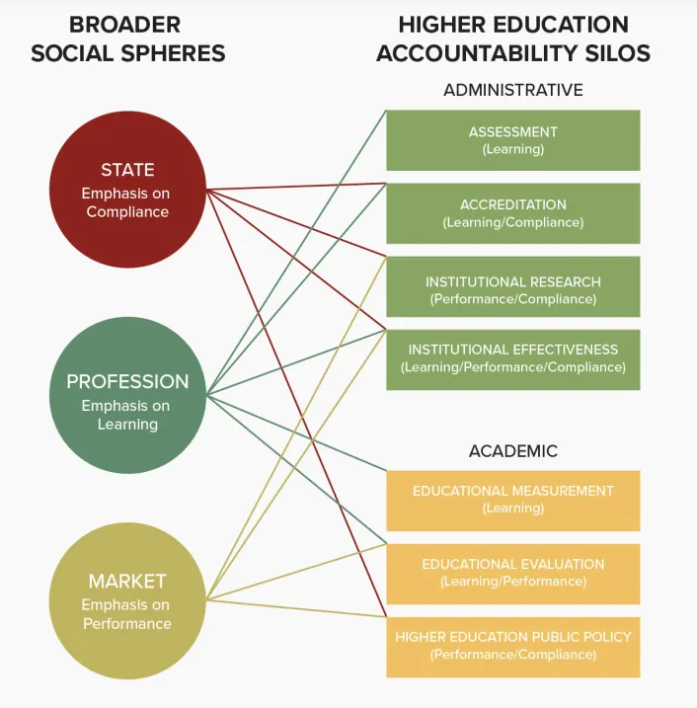
Another Rendering: Seven Silos
Institutional logics approach
Identifies “institutional” knowledge communities
Seven Silos
Assessment, Accreditation, Institutional Research, Institutional Effectiveness, Educational Evaluation, Educational Measurement, and Higher Education Public Policy
Brown, J. T. (2017). The Seven Silos of Accountability in Higher Education: Systematizing Multiple Logics and Fields. Research & Practice in Assessment 11(1), 41-58
Notes:
My colleague Josh offered another approach, reflective of his expertise in organizational sociology. He reasoned that discourse and understanding of accountability was an organizational phenomenon and employed institutional logics to systematize the literature into what he calls, seven silos of accountability. the novelty here is that he assumes that there are knowledge communities that take up common understandings and practices of accountability that may differ from others.

Slide 5
Another Rendering: Seven Silos
Pluses
Identifies the role of government and policy actors in the development of knowledge
Highlights the contingency of meaning on community and conversation
Obscurities
Geographically limited
Remains a temporally static approach
Culturally biased interpretation
Brown, J. T. (2017). The Seven Silos of Accountability in Higher Education: Systematizing Multiple Logics and Fields. Research & Practice in Assessment 11(1), 41-58.
Notes:
My colleague Josh offered another approach, reflective of his expertise in organizational sociology. He reasoned that discourse and understanding of accountability was an organizational phenomenon and employed institutional logics to systematize the literature into what he calls, seven silos of accountability. the novelty here is that he assumes that there are knowledge communities that take up common understandings and practices of accountability that may differ from others.

Slide 6
Mixed Methods Social Network Analysis: A Global, Longitudinal View of Knowledge
Notes:
Observing this, we have been exploring MMSNA – a mixed method, social network analysis approach to analyzing literature.
MMSNA typically involves the use of descriptive network statistics or modelling to identify non-random or network structures of interest. Researchers use this quantitative data of whole networks to identify select nodes and edges for further exploration, which in the case of co-citation network analysis, directs the exploration of qualitative data within a corpus of literature.
We used a triad census to identify a particular type of triad (O21U) that signals a shared reference between articles in a co-citation network. We then engaged with the underlying reference use within each article to understand the co-citation incident.
References for MMSNA:
Crossley, N., & Edwards, G. (2016). Cases, mechanisms and the real: The theory and methodology of mixed-method social network analysis. Sociological Research Online, 21(2), 217-285.
Froehlich, D. E., Van Waes, S., & Schäfer, H. (2020). Linking quantitative and qualitative network approaches: A review of mixed methods social network analysis in education research. Review of research in education, 44(1), 244-268.
Froehlich, D. E., Rehm, M., & Rienties, B. C. (2020). Mixed methods social network analysis. Mixed methods social network analysis: Theories and methodologies in learning and education, 1-10.

Slide 7
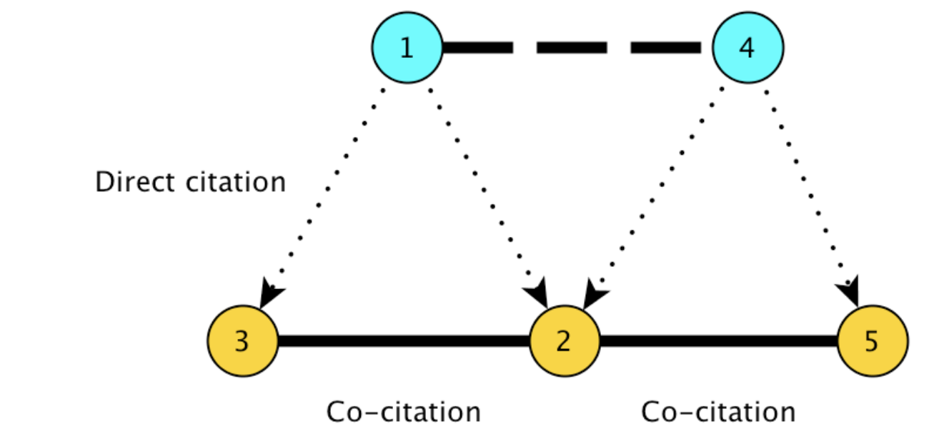
Co-citation Network
Articles
012U triads indicate “conversation” or moving from isolate to “community”
References

Slide 8
Mixed Methods Social Network Analysis: A Global, Longitudinal View of Knowledge
Domains of Knowledge
Knowledge Communities
Static Ideas
Evolution of Ideas
Autonomous Actors
Relational actors

Slide 9
Mixed Methods Social Network Analysis (MMSNA)
Scholarly article co-citation networks
Authorial relations through references-in-common
Scholarly knowledge communities
Empirically derived communities relationally linked in a knowledge space
Contextual relations
Linked connections are observed in (con)text
Temporal development
Growth of knowledge communities are observed over time

Slide 10
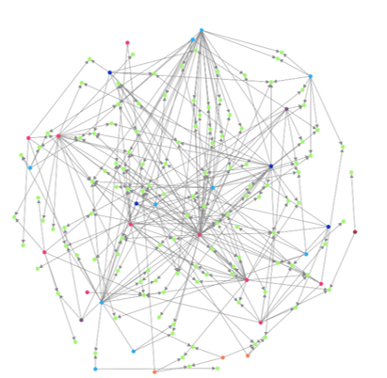
Research Question
What can we learn about the scope and evolution of higher education accountability through the analytical lens of knowledge communities?

Slide 11
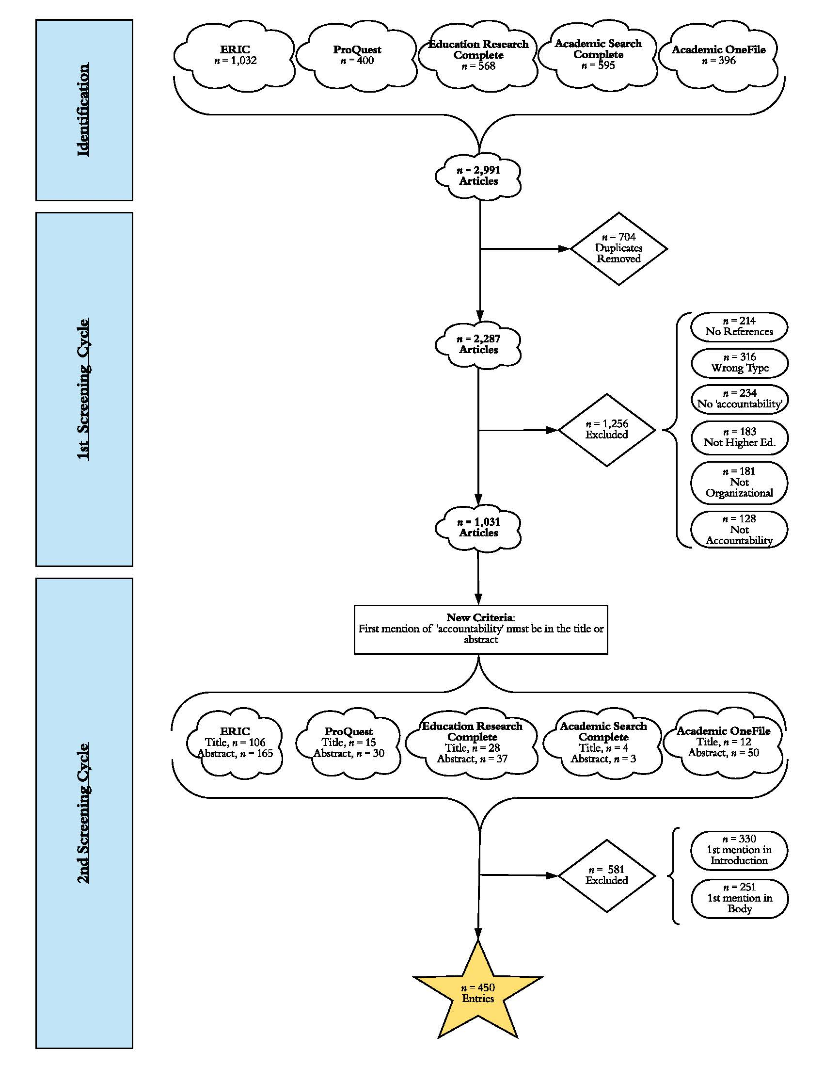
Data Corpus
HE accountability search 1974-2017 → n = 2,991 articles
Inclusion criteria: accountability in title or abstract
n = 450 articles

Slide 12
Data Corpus
HE accountability search 1974-2017 → n = 2,991 articles
Inclusion criteria: accountability in title or abstract
n = 450 articles → 12,270 references

Slide 13
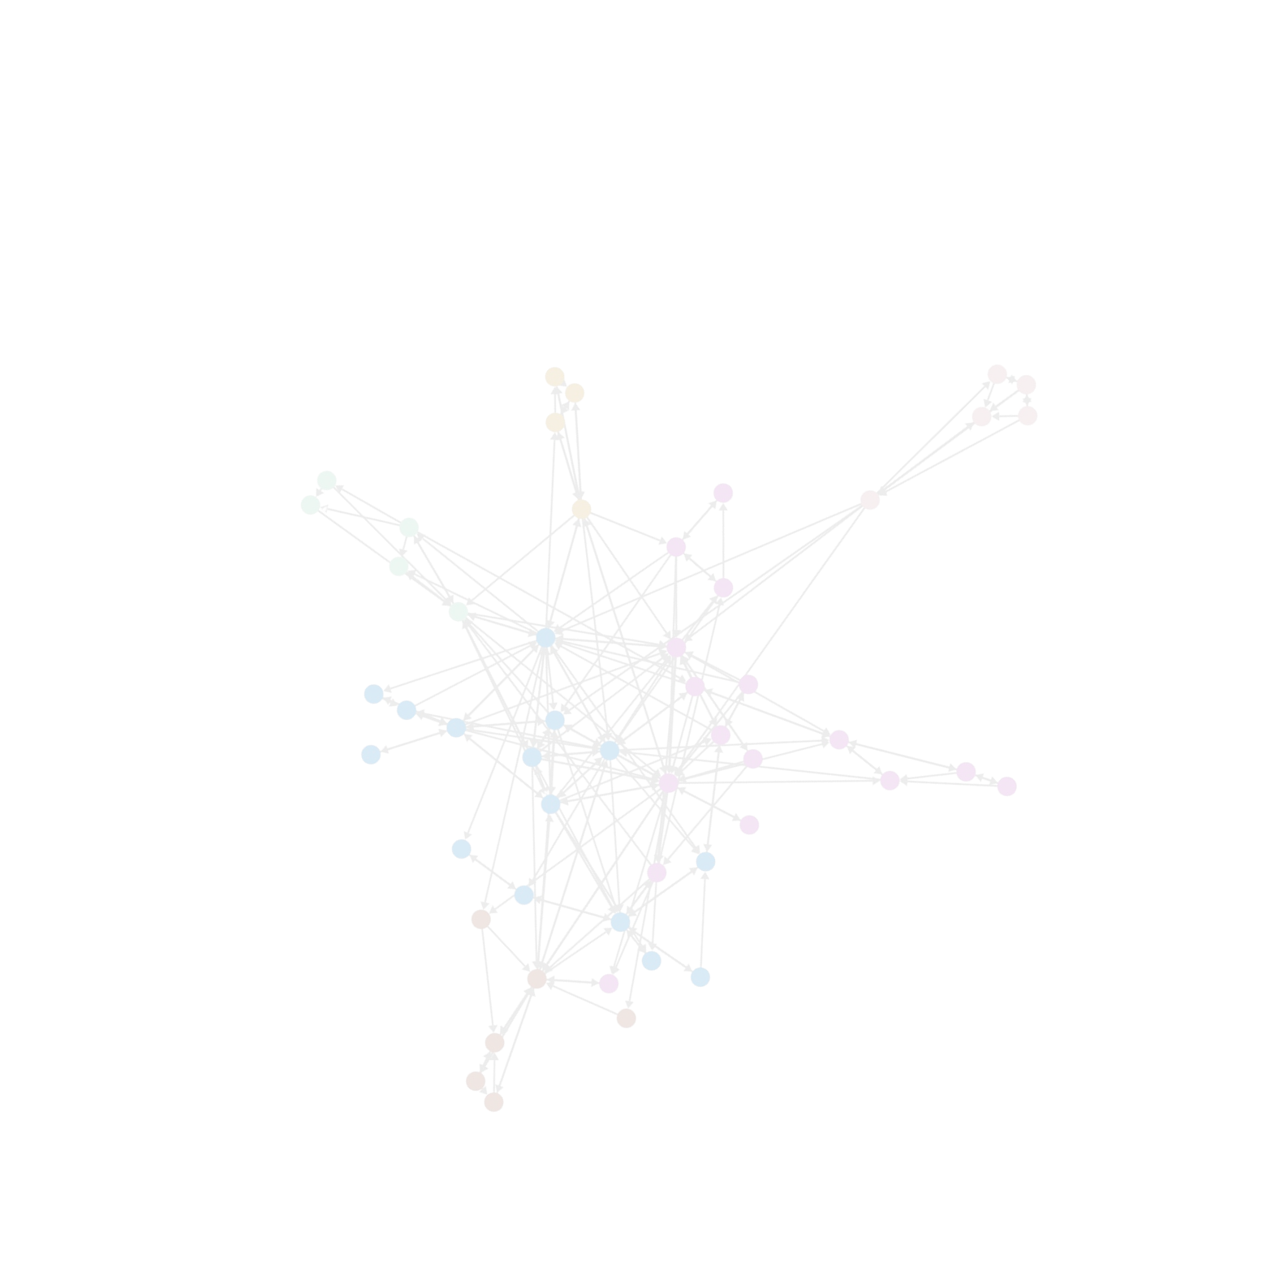
MMSNA Methodology
Phase 1
Generating the co-citation network (450 articles, 12,270 references)
Phase 2
Partitioning
Phase 3
Accounting for time- policy-informed 5-year panels
Phase 4
Embedding qualitative content into Narrated Network Diagrams
Phase 5
Sequencing interactive displays into network schemas
Notes:
Phase 2: empirically identifying knowledge communities

Slide 14
MMSNA Methodology: A brief glimpse
Notes:
Phase 2: empirically identifying knowledge communities

Slide 15
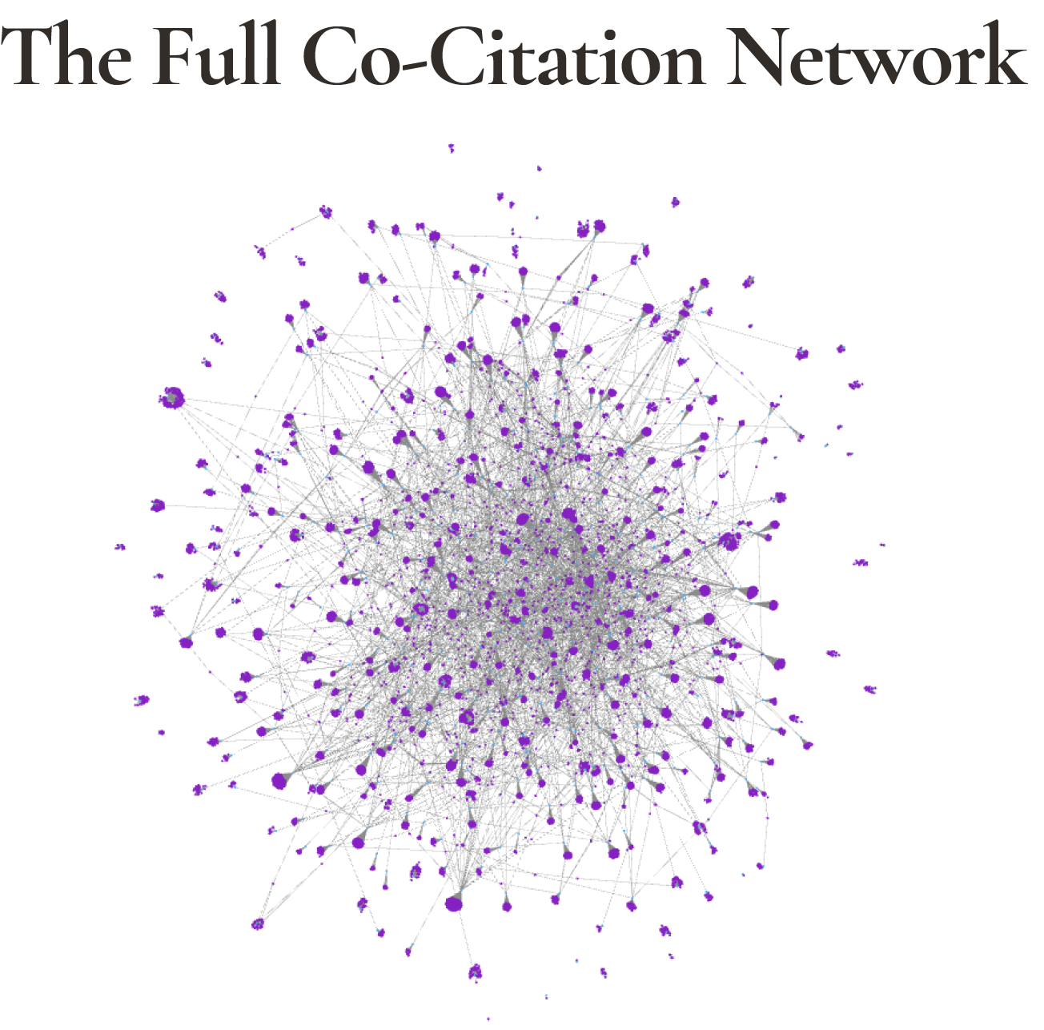
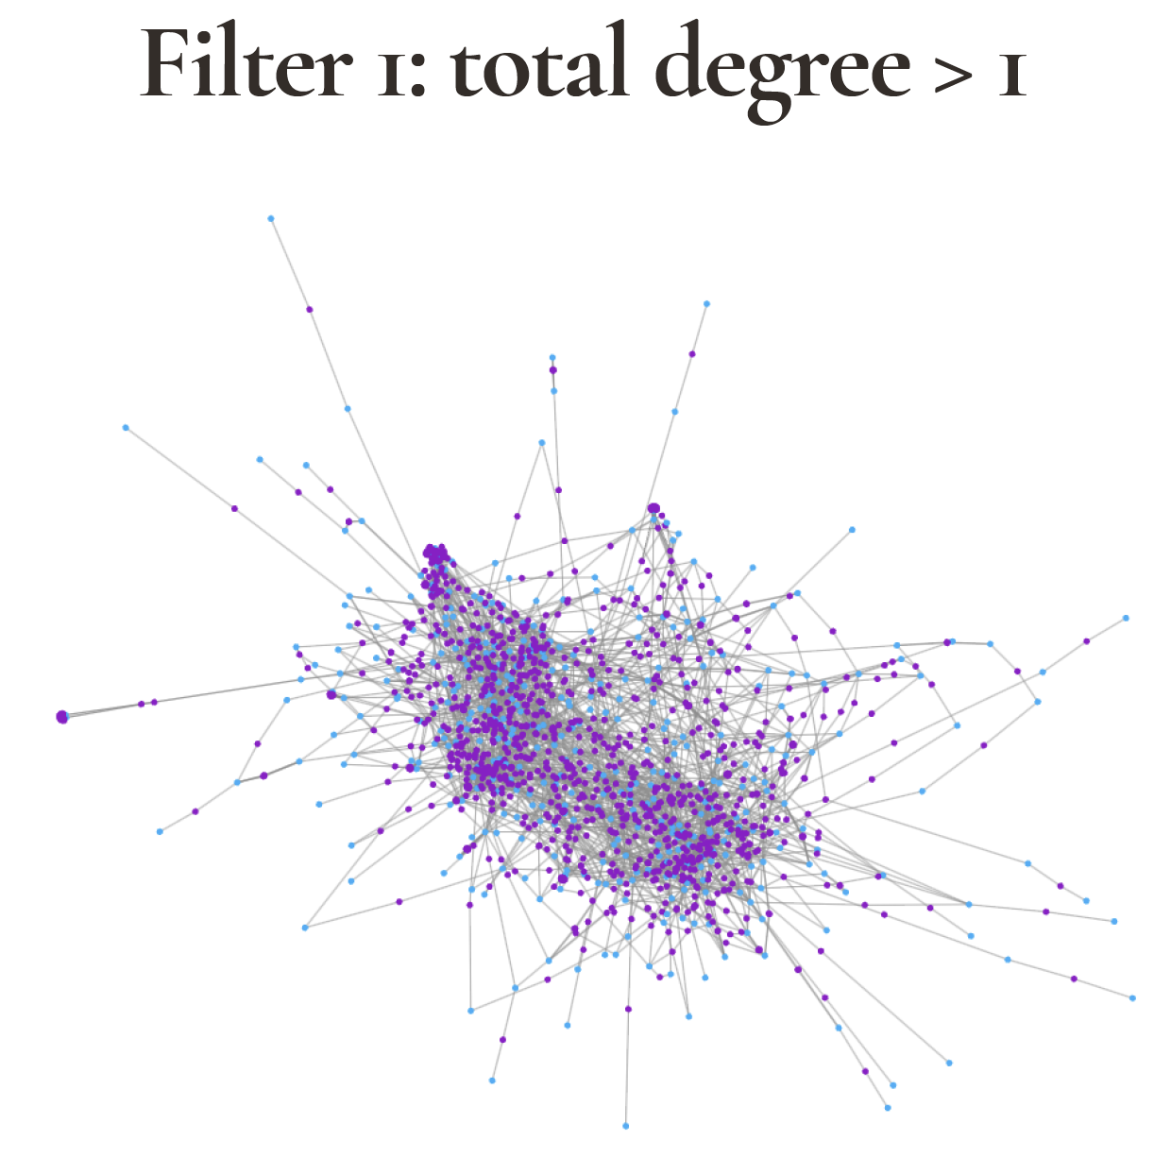
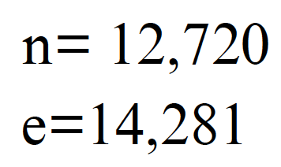
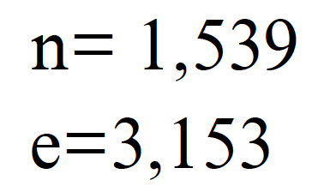
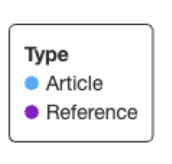
Notes:
many more references, lots of purple
filter out references that are not shared, or graphically, those that have at least two connections or edges
much smaller network. BUT still difficult to visualize

Slide 16
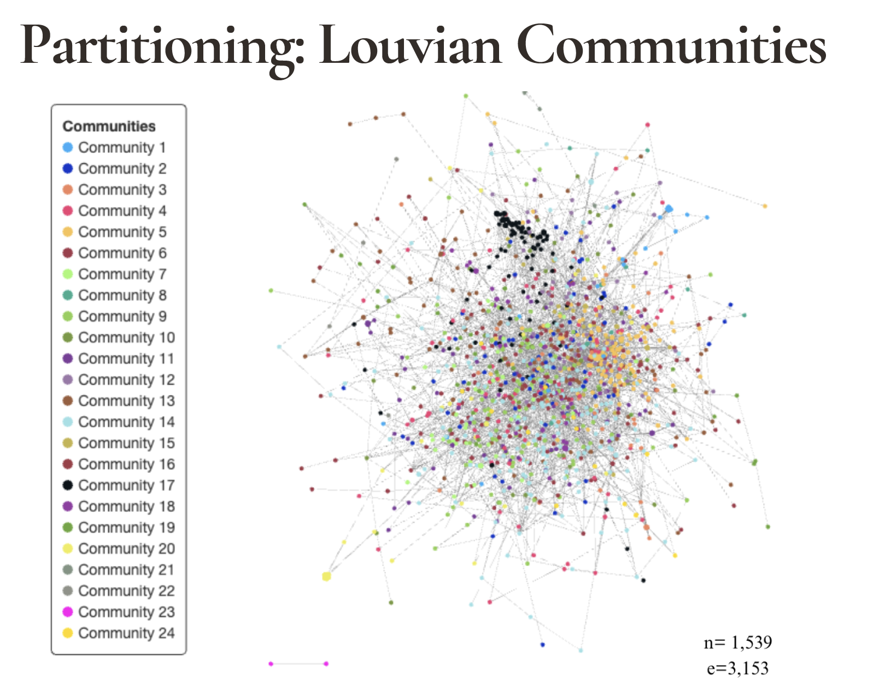
Accountability Knowledge Communities, pre-1992 to 2016
Notes:
Our next step is to empirically derive knowledge commiunities.
We do so by using community detection techniques that essentially identify groups of nodes (articles and references) that are mathematically more connected to each other than to any other community. We ran different models and found this one to provide the most distinctive communities.
In this case, 24 communities

Slide 17
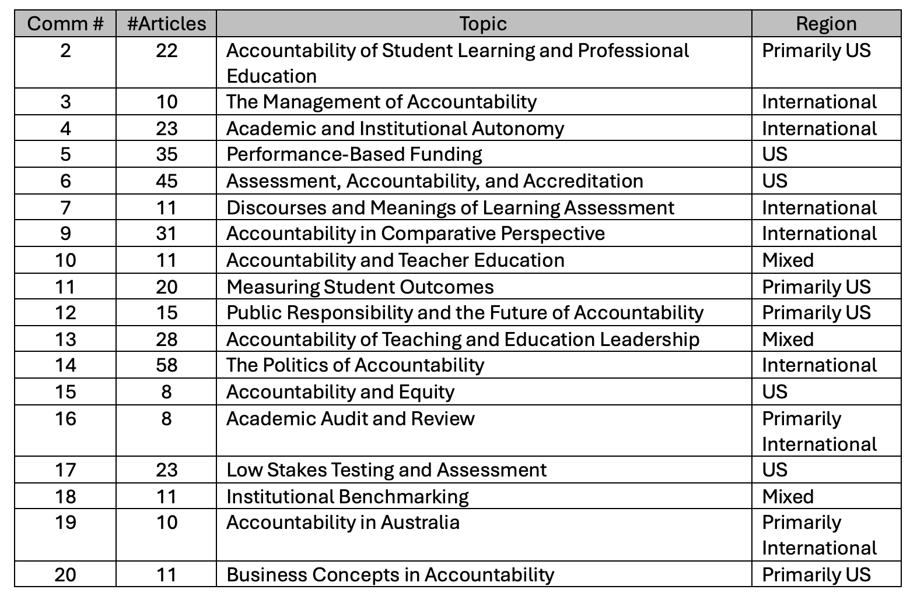
Accountability Knowledge Communities, pre-1992 to 2016
Notes:
Here is an abbreviated list of those communities, now with names based upon our reading of the articles in each community. We dropped some communities because they were too small, typically 3 or under 3 articles.

Slide 18
Accountability Knowledge Communities, pre-1992 to 2016

Slide 19
Accountability Knowledge Communities, pre-1992 to 2016
Notes:
Finally, we noticed that communities were also defined by the origin of the journals, as either American or international.
Today we’ll share our analysis of four of these communities.

Slide 20
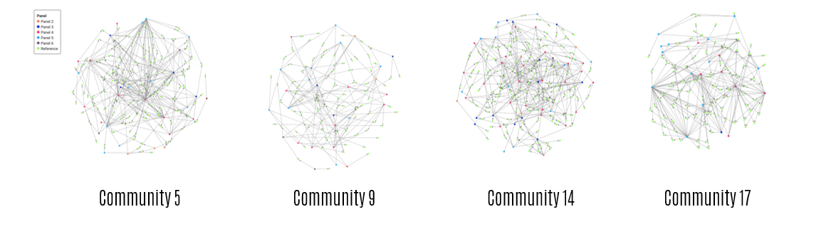
Deep Dive into Four Communities
Result

Slide 21
Result
Deep Dive into Four Communities
U.S.
International
International
U.S.

Slide 22
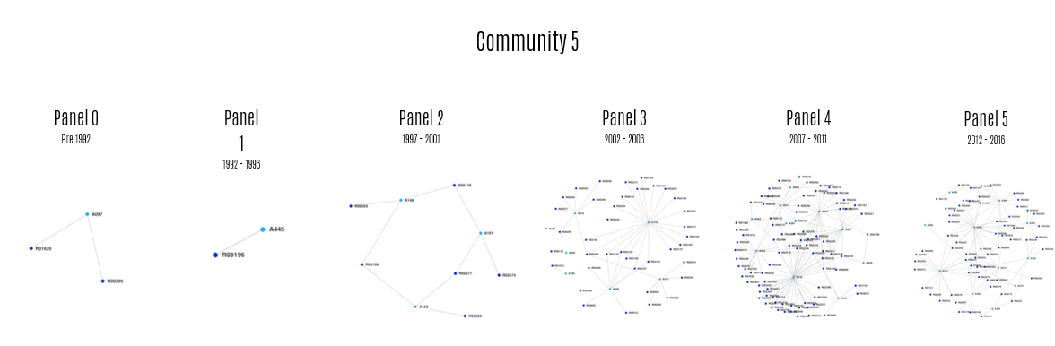
Result
Community 5 – Performance Based Funding

Slide 23
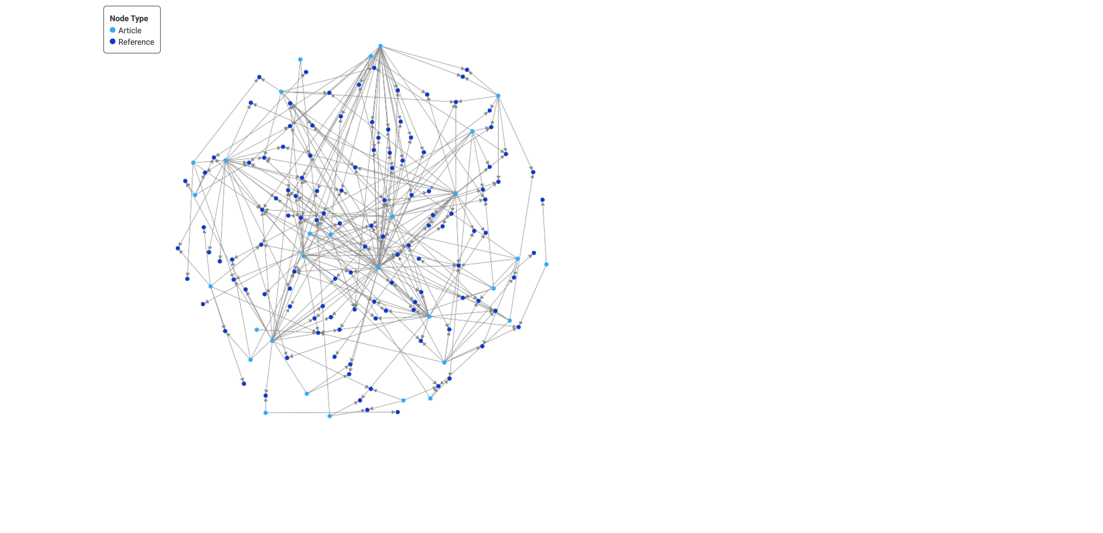
Result
Community 5 – Performance Based Funding
This is a U.S. centric community that examines public policies at the state level that connecting student level outcomes with institutional funding.
Builds momentum over time, publication focus is on articles and reports.
The articles focus on state accountability in higher education generally (e.g., A101, A153) or
on the data system infrastructure demanded by a new state accountability regime (A148).
Increase coincides with “PBF 2.0” which arises following the Great Recession.
Incremental Evolution

Slide 24
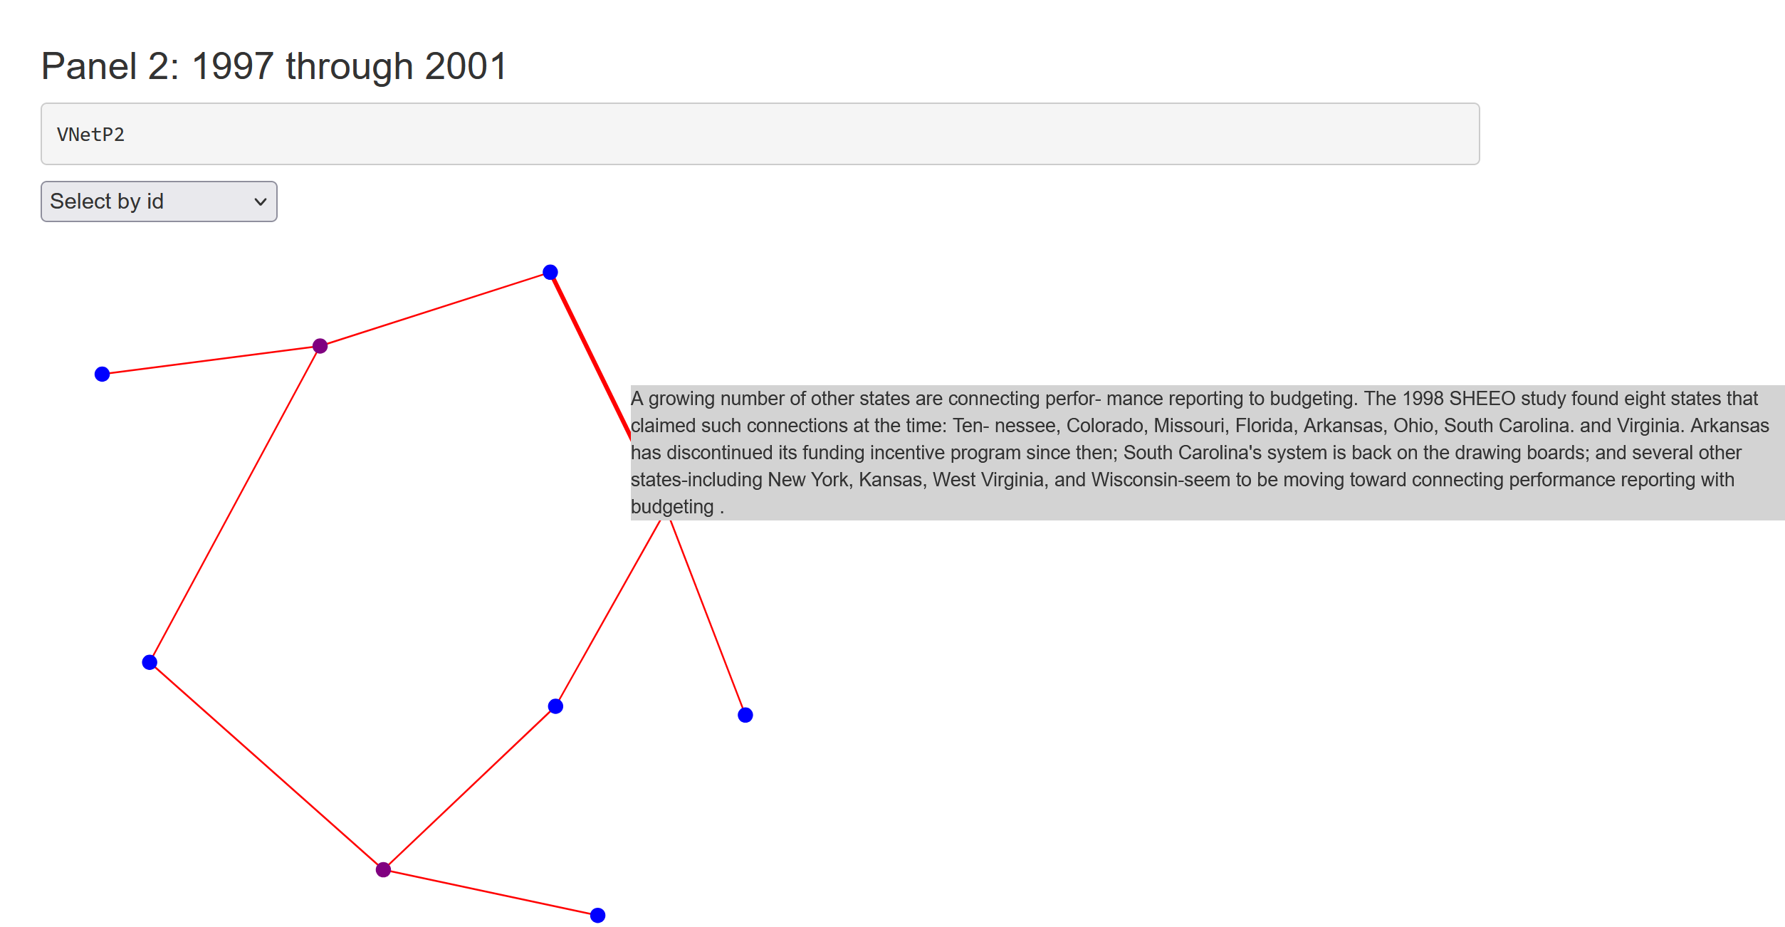
Result
Community 5 – Performance Based Funding
The early “ring” highlights the interconnectivity of the community and its emphasis on accountability in different U.S. states.

Slide 25
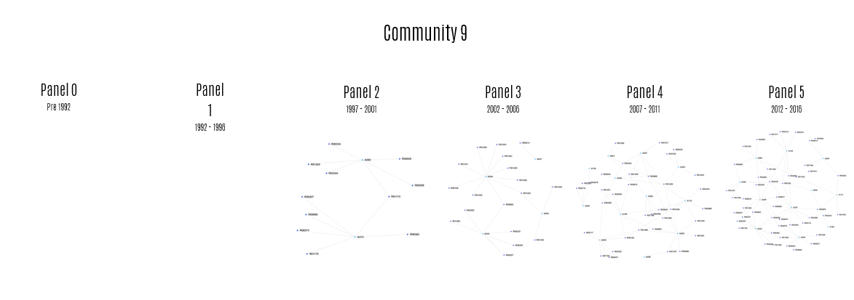
Result
Community 9 – Comparative Perspective of Accountability

Slide 26
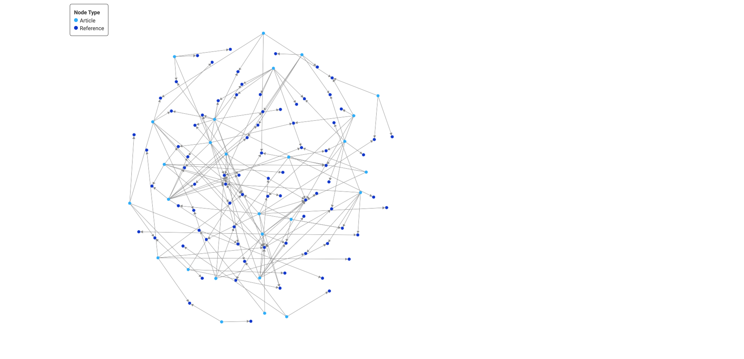
Result
Community 9 – Comparative Perspective of Accountability
This is an international community that uses comparative frameworks to examine accountability trends at macro levels, usually nations or systems.
Rooted in academic discourse, it lacks reports by governments and organizations.
Early panels are concentrated on European countries but shifts to developing countries in later panels as those nations attempt to adopt accountability system including South Africa, China, Kazakhstan, Nigeria, and Pakistan.
Not every idea migrates from the U.S.
Persistent Diffusion

Slide 27
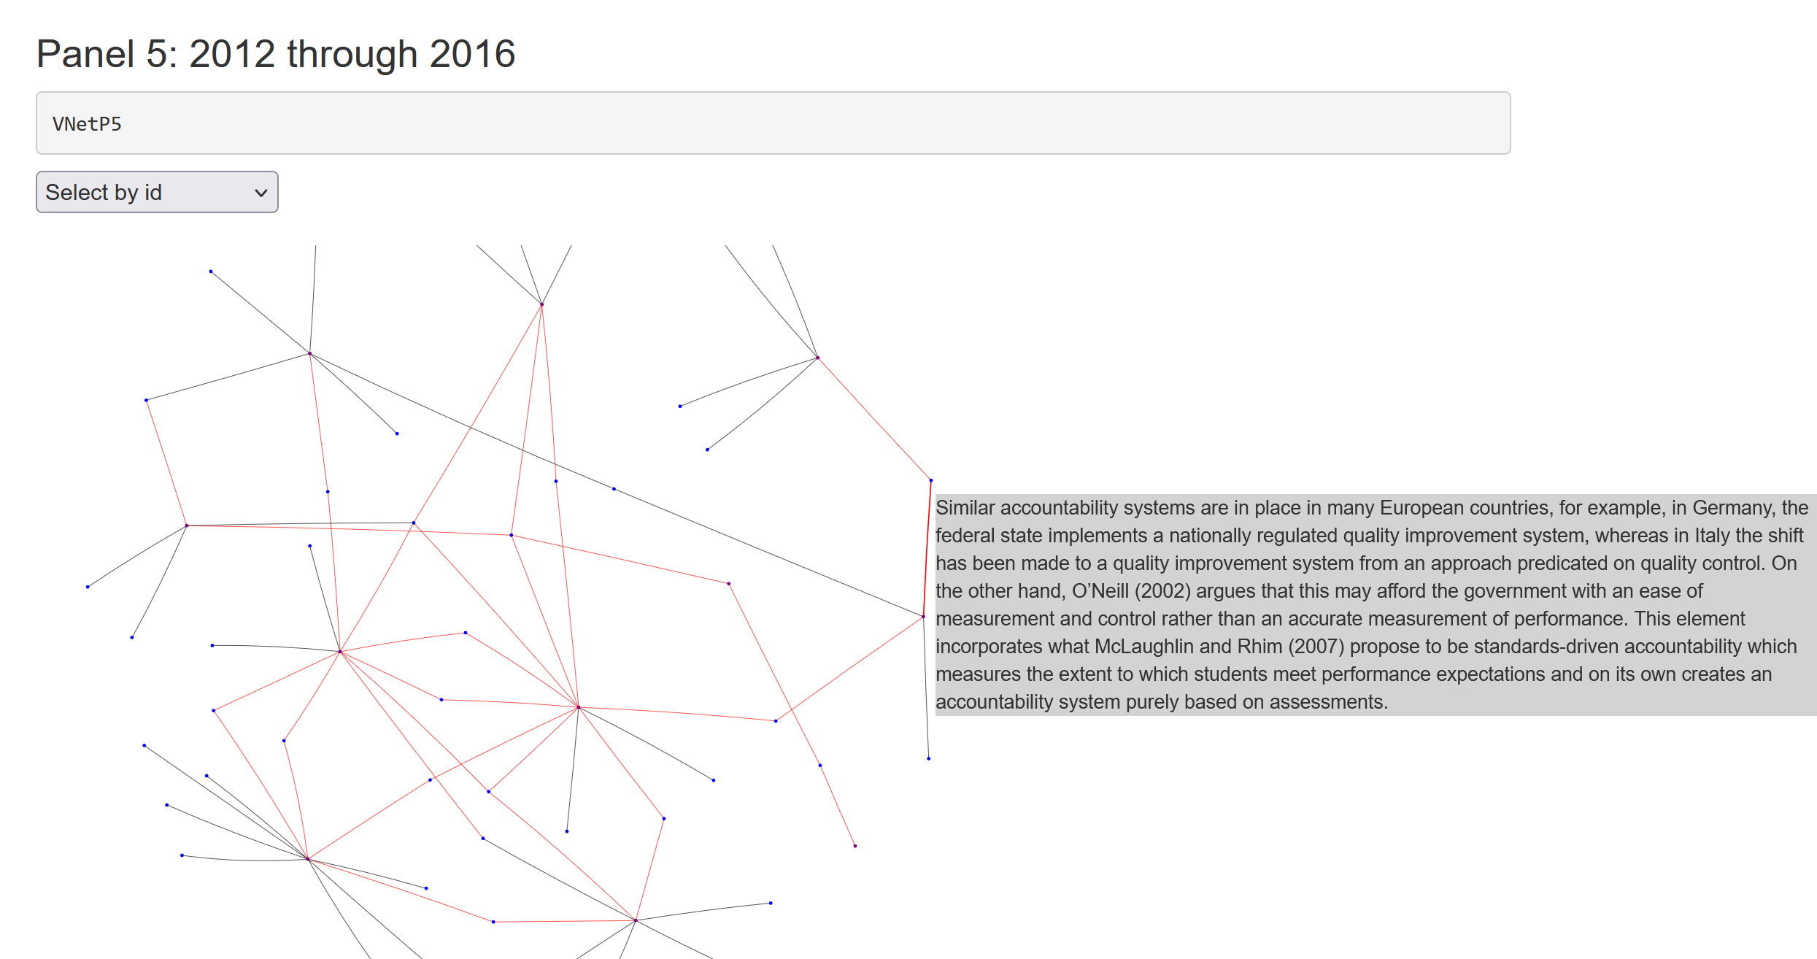
Result
Community 9 – Comparative Perspective of Accountability
Articles view accountability in a macroscopic perspective, instead of individual student assessment and evaluation. National and transnational analysis are conducted and transmission of trends in accountability of higher education is highlighted, especially from developed to developing countries.

Slide 28
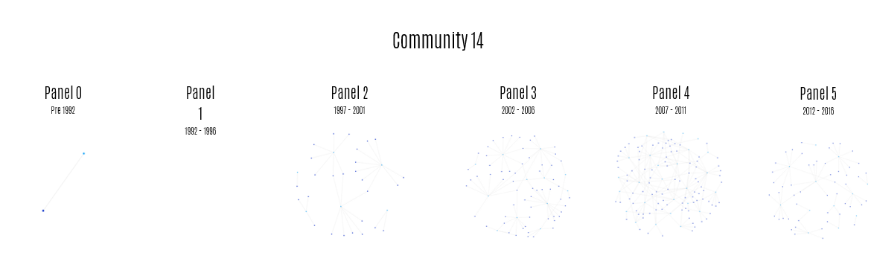
Result
Community 14 – The Politics of Accountability

Slide 29
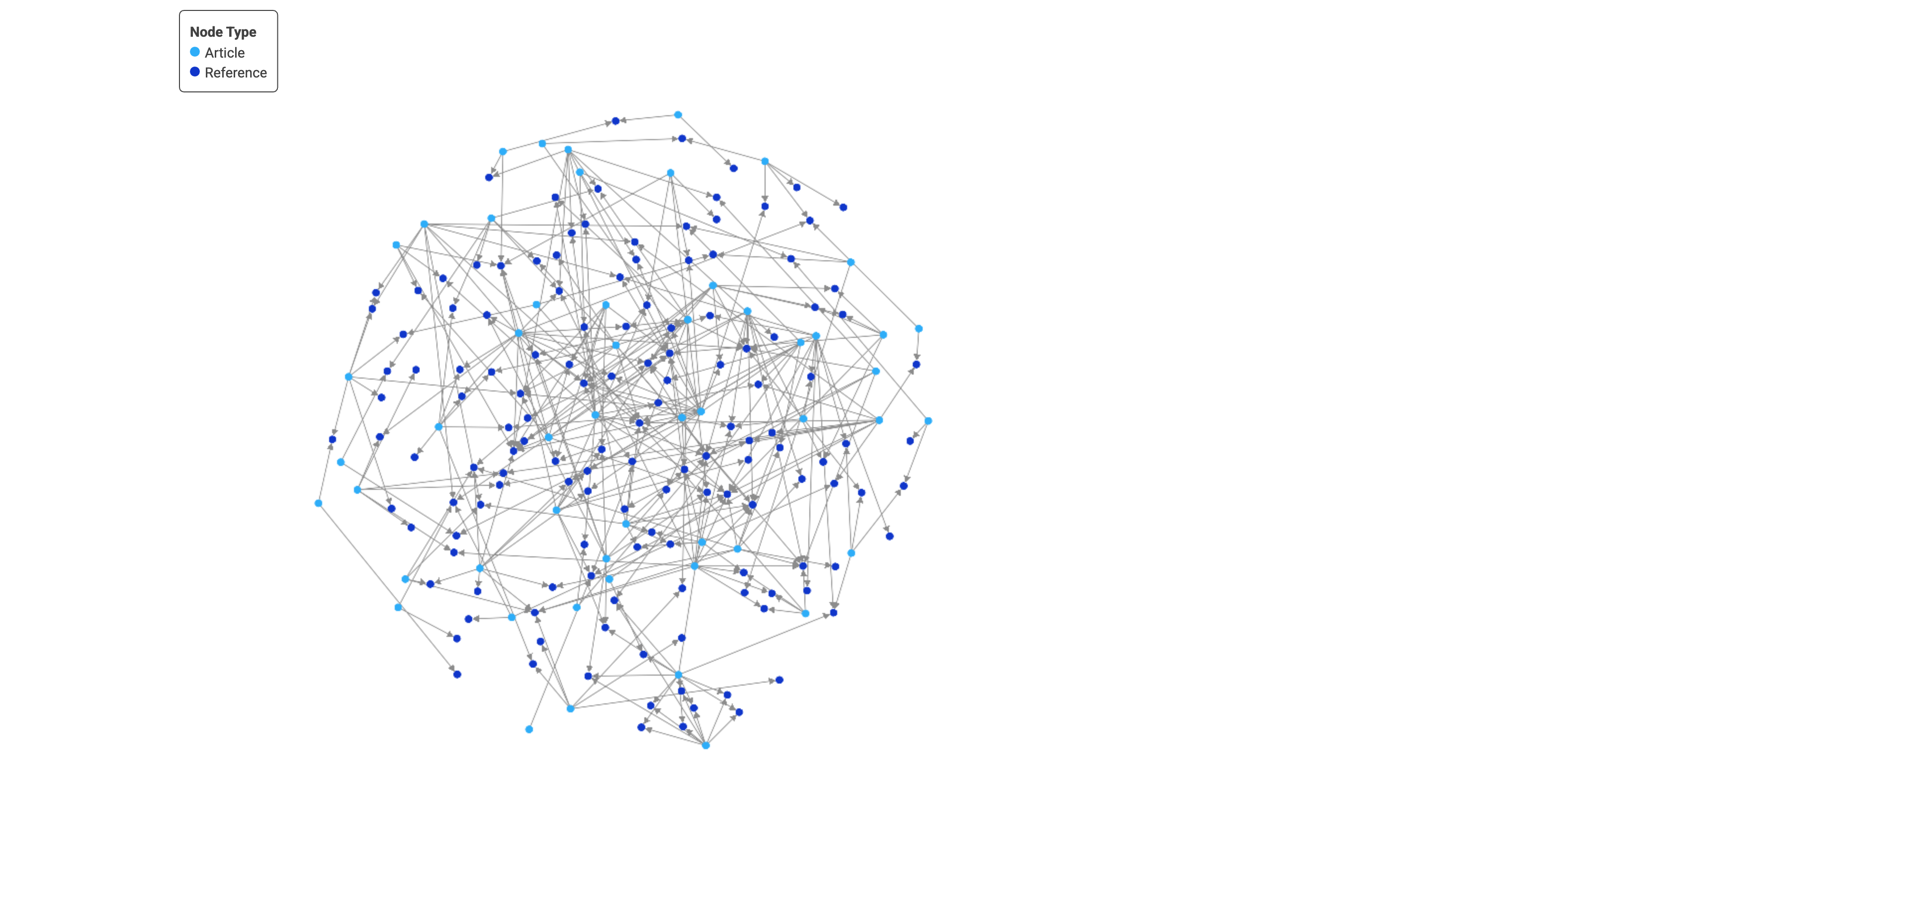
Result
Community 14 – The Politics of Accountability
An international community that begins in early 2000s with the emergence of a new audit logic that emphasizes quality assurance.
Books and government reports are common “bridges” or ties between articles.
Two references serve as a “thread” throughout the community – The Audit Explosion (1994); The Audit Society (1997).
Later panels see the conversation shift from audit to globalization and neoliberalism. And from Western to developed or developing countries (Jamaica, Mexico, South Africa, Hong Kong, Singapore, and China)
Peak to Pullback

Slide 30
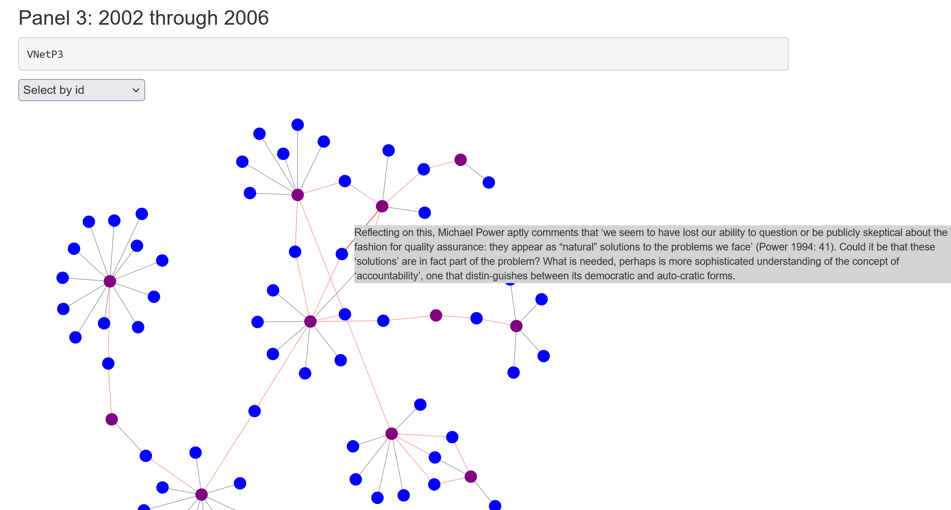
Result
Community 14 – The Politics of Accountability
In later panels, three new books enter as conceptual anchors – Universities in the Marketplace (Bok, 2009); Academic Capitalism (Slaughter & Rhoades, 1997); and The Enterprise University (Marginson & Considine, 2000)
There is also a shift from earlier logics (macro) to later strategies (micro).

Slide 31
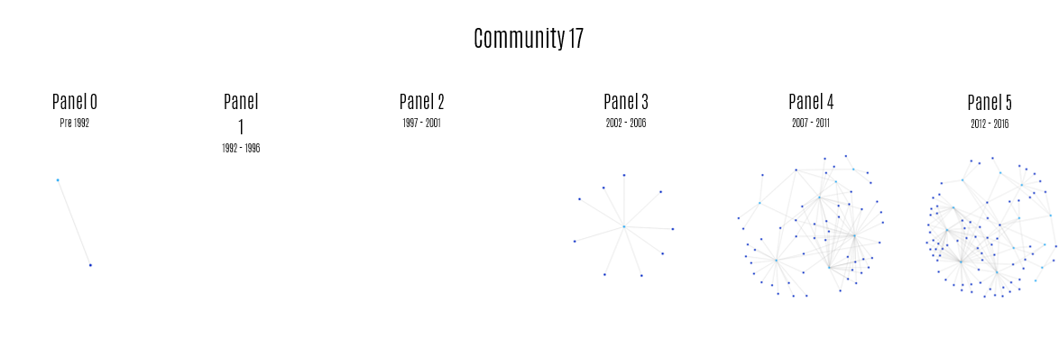
Result
Community 17 – Low Stakes Testing & Assessment

Slide 32
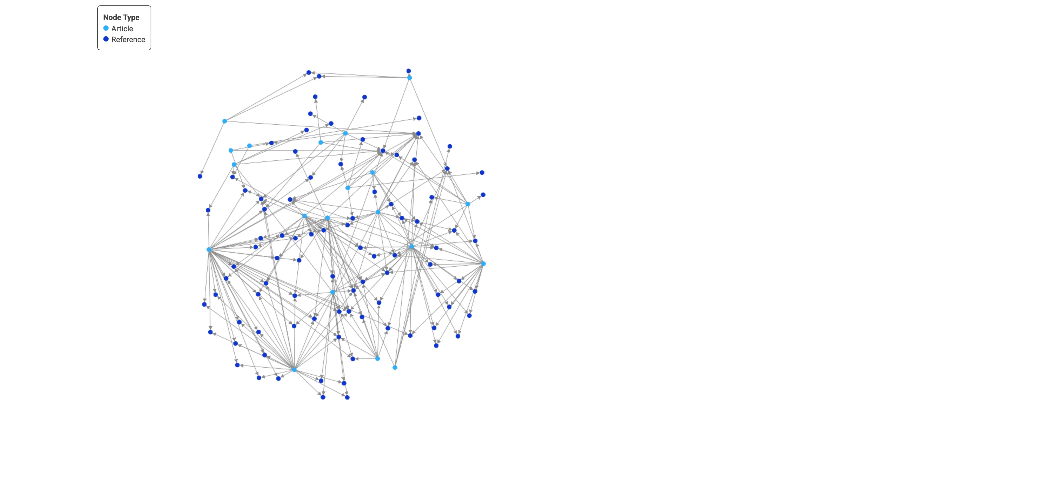
Result
Community 17 – Low Stakes Testing & Assessment
This is a U.S. centric community that emphasizes the application of psychometric methods to create tests and educational assessments within individual institutions to measure change in students.
High stakes admissions tests are SAT, ACT, GRE, LSAT
Explodes in final panels (4 & 5)
The two emphases are captured in the Banta article that asks: “Can assessment for accountability complement assessment for improvement?”
Most cited “A Test of Leadership” by US Dept of Educ
Explosive Expansion

Slide 33
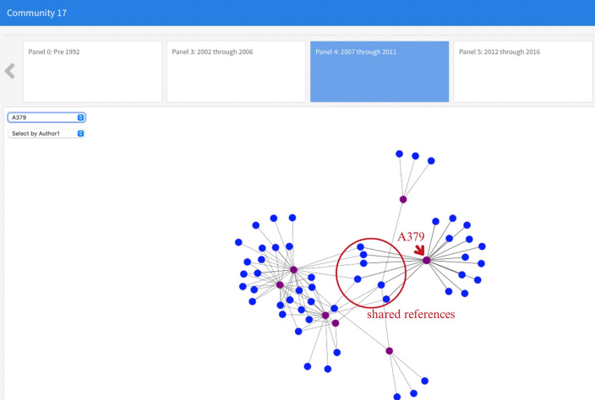
Result
Community 17 – Low Stakes Testing & Assessment
in Panel 4, two perspectives on assessment are noticeable in the configuration of the panel into two halves, one focusing on value-added and quality assurance (A060, A255, A256, A257, A122), while the other half focuses on the assessment of student learning and improvement (A156, A379).
The two halves of the network in Panel 4 are held together by 6 references that form 021U triads which bridge these two discussions

Slide 34
Implications for research on HE accountability
Highlights the role of government in catalyzing both national and international knowledge communities
Method for tracing the development of an idea for any field of research
First-of-its-kind to map higher education accountability globally
Strategize future scholarly/sector impact based on historical patterns
Highlights blind spots. (e.g. U.S. did not have a comparative, Politics of Acct vein)

Slide 35
Discussion & Q/A
Please reach out to any of us with additional questions or to connect on social media
Joshua Brown
Email: Joshua.brown@jhu.edu
anthony lising antonio
Email: aantonio@stanford.edu
Thomas Cowhitt
Email: Thomas.cowhitt@glasgow.ac.uk
Shinui Kim
Email: skim555@jh.edu

