Slide 1

“It’s not just opening the doors”: Challenges and possibilities for refugees’ access to higher education
October 2025, CGHE
Mir Abdullah Miri (University of Bath), Holly Rooke (University of Sheffield), and Corinne Squire (University of Bristol)
Contributing authors: Ruqaiyah Kaderbhai; Rose Kane-Smith; Evie Vaid; Elisha Verebes
Notes:
Deleted the next UoB slide

Slide 2
Research context
“I couldn’t think of any other way of making the life that I have now in the UK than going to university”
Globally, c. 9% of people from refugee backgrounds attend university, two-thirds are men. UNHCR’s target: 15% by 2030. Catalysing this move: UNHCR’s Each One Take One
51.1 million refugees needing international protection; 26% in high-income countries; <1% in UK
Incomplete data and relatively little research on refugees’ HE access
Universities celebrate enrolled refugees, may neglect those who don’t come through the door
HE access difficulties across majority and minority worlds: citizenship status; fee and other resource costs; qualifications transfer; language skills; economic, social, personal issues
HE access difficulties are also historical. High-income countries often host refugees from previous colonies. Refugees say: ‘We are here because you were there’ (Africa et al., 2017).
Existing research rarely includes all relevant sectors
Notes:
Updated figure for UNHCR target
Because CGHE is interested in the global and mainly the majority world picture I’ve included that background
Have also tried to make a case for the relevance of UK work
Cut? Of 123.2 million forcibly displaced people, nearly half are internally displaced; I did include this at first
Have not included the 40% figure re, people attending university globally because it deosn’t seem fasible – do you know how it’s validated? Of course the number is over 9%
Add EOTO weblink?
Under ‘other resource costs’ could mention digital requirements,
Have used the ‘getting through the door’ argument from Mir’s latest presentation
Have removed the references from the second bullet point as the slide is a bit wordy.
Original refs are: 51.1 million refugees, asylum-seekers needing international protection (UNHCR, 2025), 26% in high-income countries (European Civil Protection and Humanitarian Aid Operations, 2025), <1% in UK (Migration Observatory, 2025)

Slide 3

Questions and methods
What are the benefits of HE for refugees?
What are barriers to and supports for HE access?
What factors impact HE progression?
How can we remove constraints and improve possibilities for refugees’ HE access?
2022-4 research, post-Covid-19, in cost of living crisis, with intensifying legal and political ‘hostile environment’ for all migrants and refugees in many high-income countries.
38 semi-structured interviews with people from refugee- backgrounds, HE, NGOs, FE, and local authorities in the south-west of the UK.
Thematic analysis.
Notes:
Mention that SW is low in terms of refugee numbers, high in terms of services, so should be doing the best within the UK.
Mention that LAs were accessible to research but especially at the time, government was not and was going to keep its discussions and decisions out of public view.
Changed the ‘broader possibilities’ question 4 because I don’t think this was exactly the question we were asking – it was more of a policy question

Slide 4
Findings 1: Benefits of
higher education
“People from refugee backgrounds can benefit from higher education like anybody else... everyone benefits from higher education in terms of social development and career-wise”
1) Career and economic benefits
Access to a greater range and higher standard of career options
Increased choice over future career pathways and long-term employability
2) Skill development and networking benefits
Development of both practical and life skills
Creation of professional and personal networks
3) Social and well-being benefits
Supporting integration
Increased feelings of belonging, pride,
achievement and confidence
4) University and community benefits
Increased skills, knowledge and diversity within universities
Increased levels of high-skilled, high-paid labour within communities
Notes:
Have reduced font sizes throughout so the presentation slides match each other

Slide 5
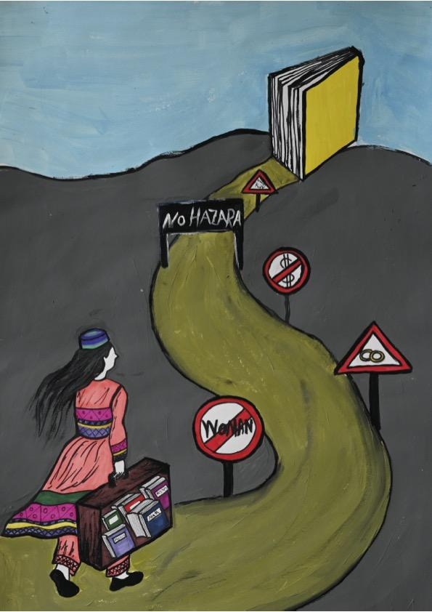
Findings 2: Barriers to access
Academic, linguistic, legal, economic, psychosocial, and institutional barriers, including…
Immigration-related precarity
Difficult-to-meet English language requirements
Qualification transfer and recognition of existing experience
Unfamiliar education system
Lack of digital resources and/or familiarity
Economic constraints

Slide 6

Findings 3: Enhancing access
Both existing and possible strategies to support better HE access…
Extended teaching support
Friend and family support
High individual engagement
Language skills
Foundation and access courses
NGO support
Academic support initiatives

Slide 7
Findings 4: Institutional support and constraints
Institutional difficulties
Incoherence
Lack of refugee-specific institutional practice
Resource shortages
Exclusion and institutional racism
Institutional possibilities
Coherence
Refugee-centredness
Increased resources
Openness
“Refugee students don't fit a UK traditional definition of widening access, they don't really meet an international definition as well, that's why I think it's definitely a bit of a gap”

Slide 8
Findings 5: Progress in HE
“When you undertake study in higher education, a support network can be a very, very important factor in your success”
It’s not just about gaining HE access, but having
a positive experience once in HE and being supported to progress…
University-specific factors
Specific, on-going support, especially dedicated staff tutors
Community among other refugee-background students
Academic issues: different teaching styles, online learning, new types of assignments
Holistic attention to refugees’ needs
Non university factors
Support from family, community and employers
Notes:
Small edits here

Slide 9

Key recommendations

Slide 10
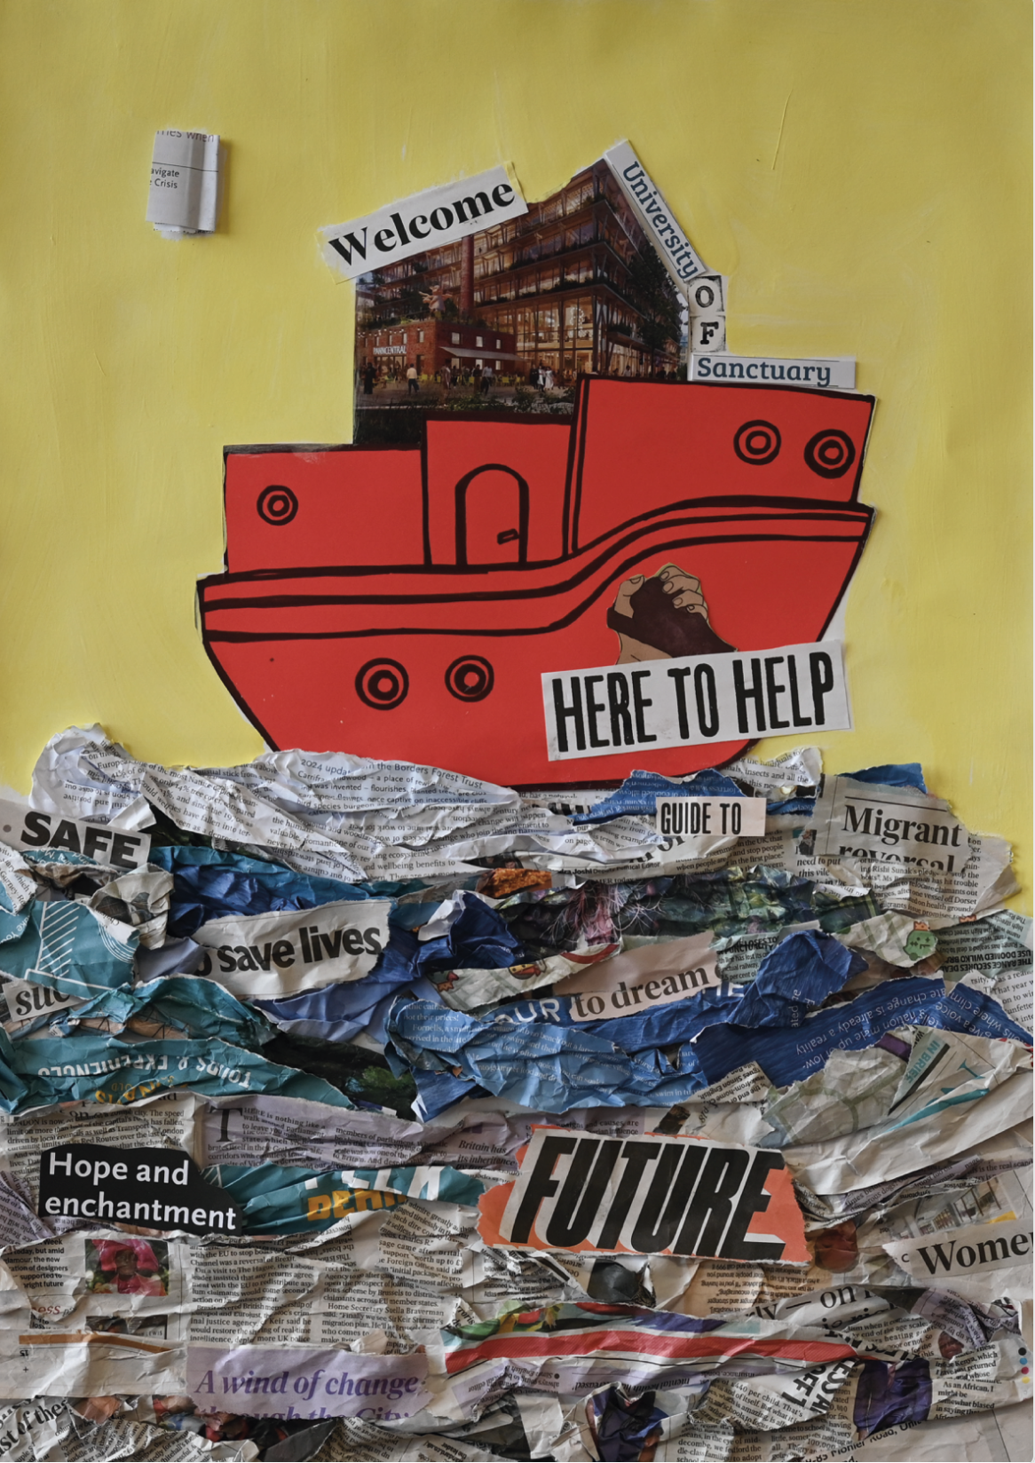
General recommendations
for all sectors
Adopt a refugee-centred approach
  Refugee involvement in shaping HE support (“Nothing about us, without us”)
Recognise refugees’ own resources
  Support aspirations, skills, and community networks
Ensure in- and cross-sector collaboration
Address hostile environments for migrants and refugees
  Counteract restrictive immigration policies, processes and discrimination

Slide 11
Practical actions for all sectors
Improve access to HE information
  Make HE pathways clear and widely available
Support language and qualification recognition
  Offer alternative English language tests and fairer evaluation of non-UK qualifications
Improved financial support
  More scholarships, expanded fee waivers, and maintenance grants
Enhance digital and academic preparation
  Provide free digital skills training and preparatory academic courses
Develop within and cross-sector partnerships
  Clear shared aims that are assessed regularly
Notes:
Some repetition across the slide set – not sure I can resolve that now but I think some later slide sets may have tried!
Added in a partnership practical action – remove if not necessary

Slide 12

What universities and colleges can do
Refugee-inclusive admissions & support
  Designate key contacts for refugee admissions
Create welcoming environments
  Social support, childcare, transport, and mental health services
Improve progression support
  Expand mentorship, career counseling, and alumni networks
Publish transparent data
  Track and report refugee admissions, retention, and graduate outcomes

Slide 13
Role of NGOs, local authorities and refugees
NGOs:
  Work closely with HE and FE institutions to support HE preparation
  Include HE access in advocacy and funding applications
Local government:
  Train staff on supporting refugees into HE
  Ensure HE access is part of wider refugee integration policies
Refugees and communities:
  Build peer networks and support systems
  Engage in HE advocacy and raise awareness of available resources
Notes:
Again, tried to make this more relevant across countries.

Slide 14
Policy changes needed
HE policymakers:
Provide more maintenance loans and grants (including Shariah-compliant loans)
Develop flexibility about how refugees meet academic and language requirements
Adopt inclusive approaches to refugees from all backgrounds, ages, sexualities and genders
Integrate expanded provision for refugees and that for historically low HE-access citizens
Provide holistic university access and progression, recognising refugees’ different educational backgrounds, childcare and other responsibilities, and mental health issues
Immigration policymakers:
Remove work and study restrictions for asylum-seekers
Where asylum-seekers are state-supported, allow them to relocate for university
Where asylum accommodation is state-provided, provide free transport to HE
Recognise the HE needs and possibilities of refugees
Notes:
Tried to generalise this a bit to non-UK contexts
Also, after the detailed results, these were quite few so, explanded to address results more.
We need to say that these are quite UK-specific, in places!

Slide 15
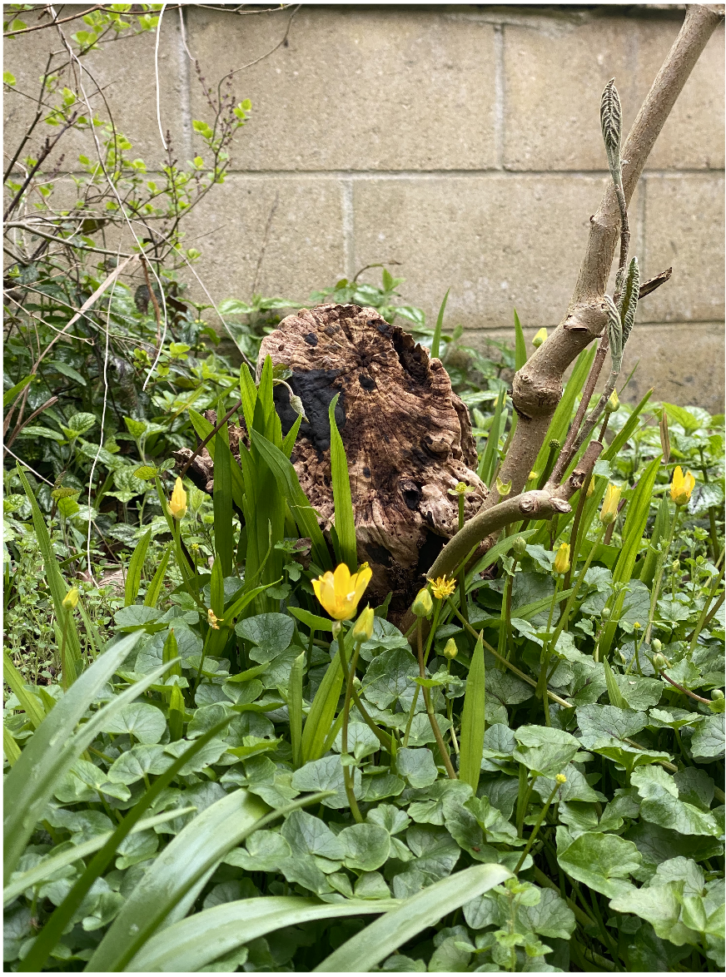
Call to action and next steps
Collaboration is key
No single sector - or country - can solve this alone
Immediate actions
Simplify admissions, increase funding, and provide clearer guidance
Adopt refugee-led and holistic approaches in all refugee HE access initiatives
Link refugees’ HE access, HE progression, and post-HE
Long-term change
Policy shifts to remove systemic barriers
Cross-national work to expand refugees’ HE experiences
Notes:
Added points re. immediate and long-term shifts, and also tried to be a bit more gloval
MIR I think you should be presenting these last slides!
I realise the last bullet point slightly repeats the first. Maybe change?
Not sure exacttly how this slide is different from the previous onw, bur I don’t think repeating does any harm?

Slide 16
Thank you!
With thanks to our participants for their insights; all the individuals and organisations who supported this project in various ways; and Bristol University’s Temple Quarter Engagement Fund for funding this work.
Contacts:
Mir Abdullah Miri: mam306@bath.ac.uk
Holly Rooke: hkrooke1@sheffield.ac.uk
Corinne Squire: corinne.squire@bristol.ac.uk
Full report and recommendations: migration.bristol.ac.uk/refugees-access-to-higher-education/
Policy briefing: bristol.ac.uk/policybristol/policy-briefings/refugee-education-he/
All the images in this presentation and in the reports are from the March 2024 workshop ‘Finding Home’ in Education at the University of East Anglia and Kings College London. Many thanks to the artists who kindly shared their work with us.
Notes:
Do we want one or both links or neither?

Slide 17
Final thoughts
What individual action could you take to improve access to HE for people from a refugee background?
What collective action could you take to improve access to HE for people from a refugee background?
How might you contribute to Each One Take One? www.unhcr.org/what-we-do/build-better-futures/education/higher-education-and-skills/each-one-take-one
Notes:
Can we cut this slide? OR Should we, here, just delete the padlet and barcode, and ask people to think about this?
Have also suggested we get people to engage with Each One Take One – this will be an international group, and my impression of EOTO is that it’s not really as internationally networked as it could or should be

