Slide 1
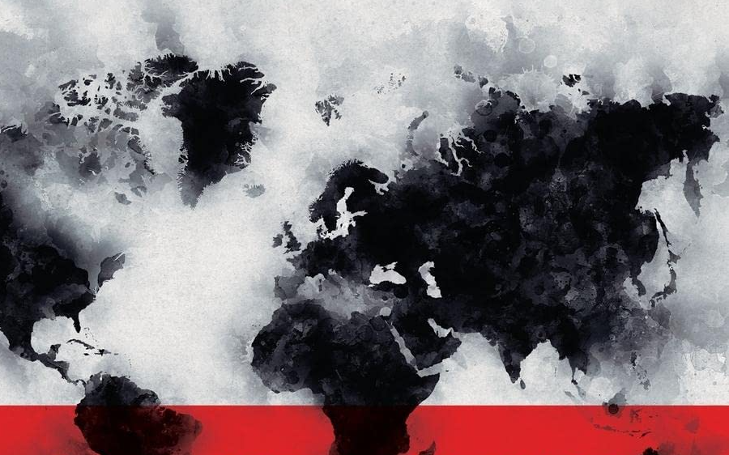
Trump’s America, Higher Education and the Emergence of a Neo-Academic Cold War
Centre for Global Higher Education
September 16, 2025
John Aubrey Douglass
Center for Studies in Higher Education
Goldman School of Public Policy - UC Berkeley

Slide 2

An Apology – Trump’s America going rogue
A Slow-Moving Coup?
Unprecedented claim of executive authority
Civil service purge/appointment of apparatchiks
Attack/pack courts
Using Fed powers to attack political enemies
Media controls/social media/censorship
Militarization of police
Voting/election manipulation
Acquiescence of economic elites
Orwellian messaging/reinterpretation of history
Expansion of the Security State – AI
Universities as the enemy

Slide 3
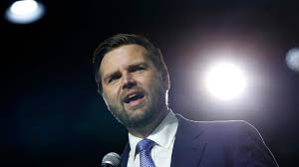
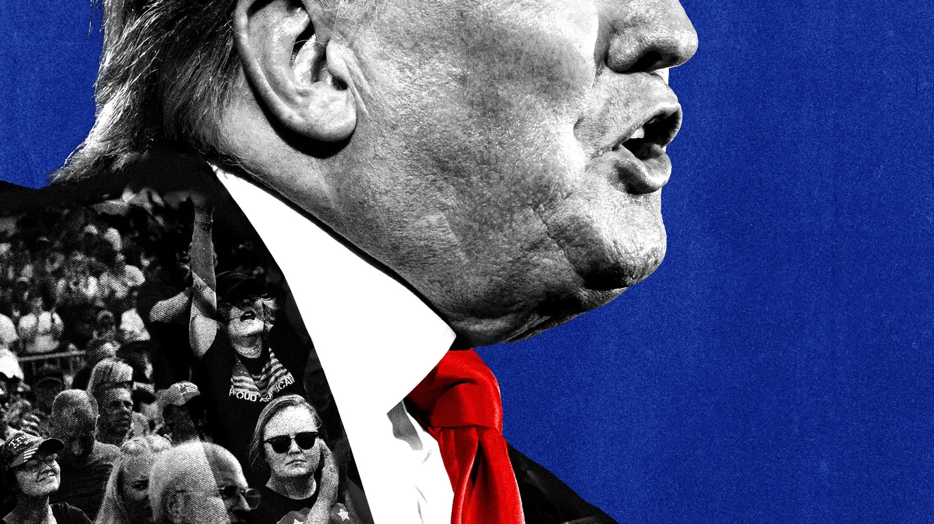
“If any of us want to do the things that we want to do for our country, and for the people who live in it, we have to honestly and aggressively attack the universities in this country . . . The Universities are the Enemy.” - JD Vance
Universities and colleges are “dominated by Marxist Maniacs and lunatics.” - Trump

Slide 4
And what is wrong with America’s universities?
Decline in trust/value for money – some blame in HE sector!
Part of Deep State
Focus on the Elites - Too Woke – brainwashing our youth
Politically biased research – scientist are political operatives not to be trusted – climate change, vaccines . . .
Governance/management by liberal elites
Source of Trump/MAGA political opposition
Knowing/Unknowing facilitators of science and tech espionage
A popular target for Trumps political base
An opportunity to leverage and showcase federal powers of investigating, funding, regulating, and intervene in governance and management of selected universities – Harvard, Columbia, UCLA . . .

Slide 7
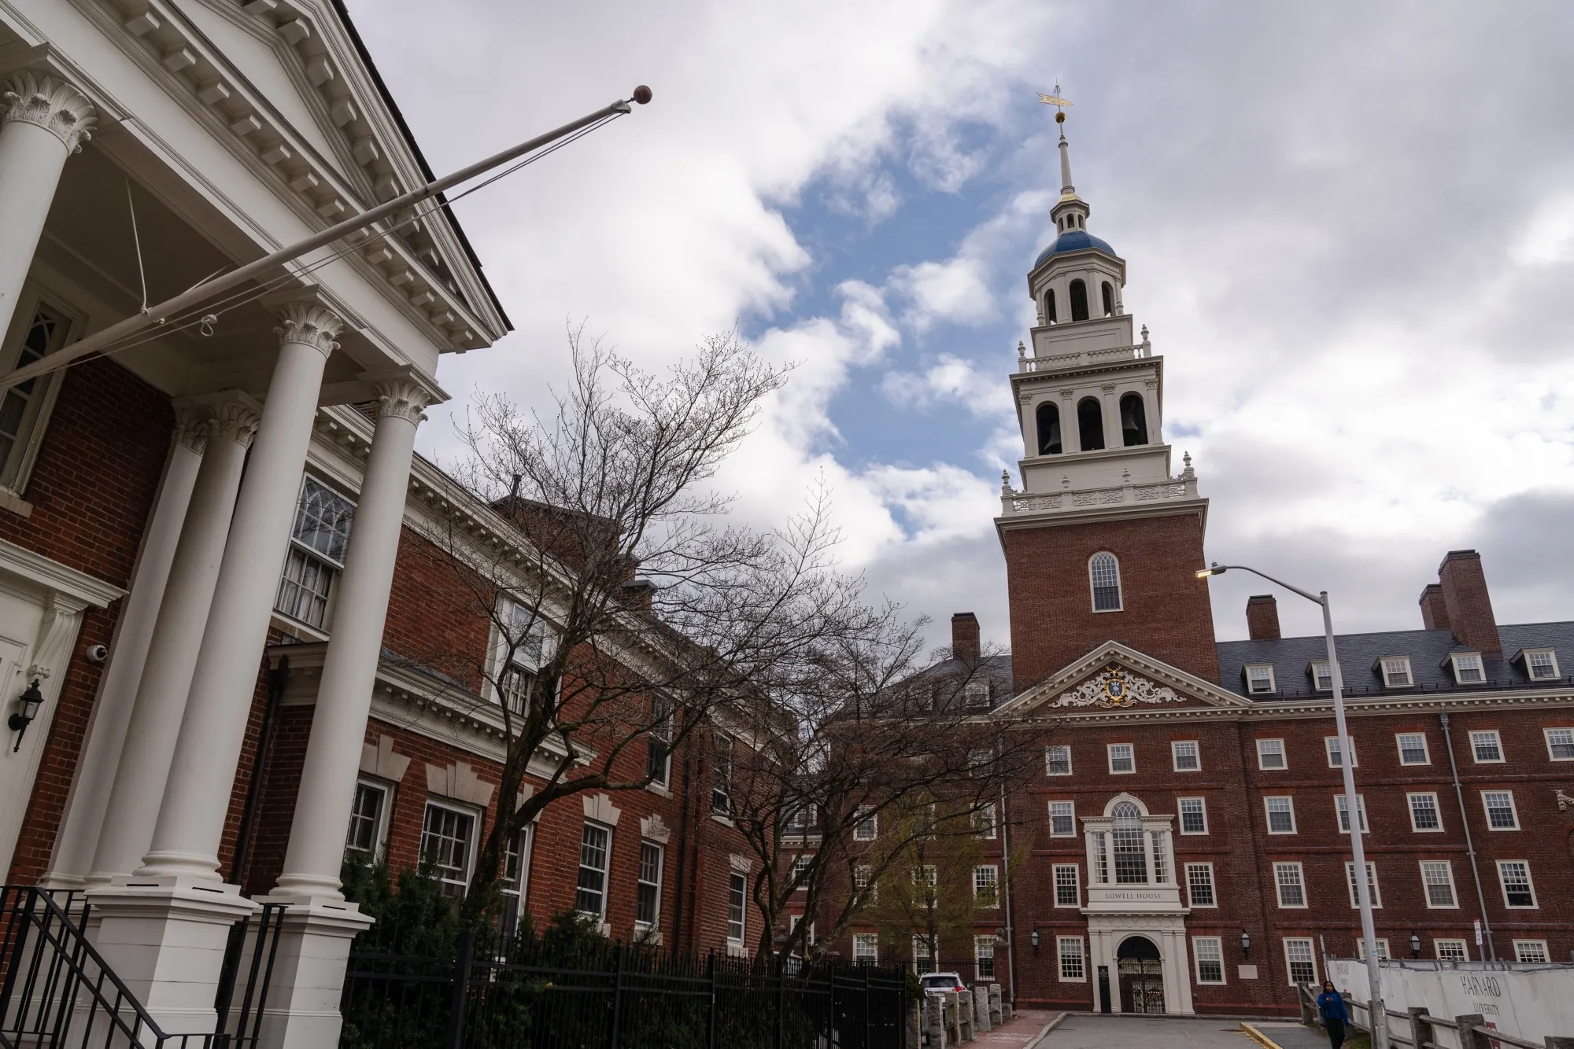
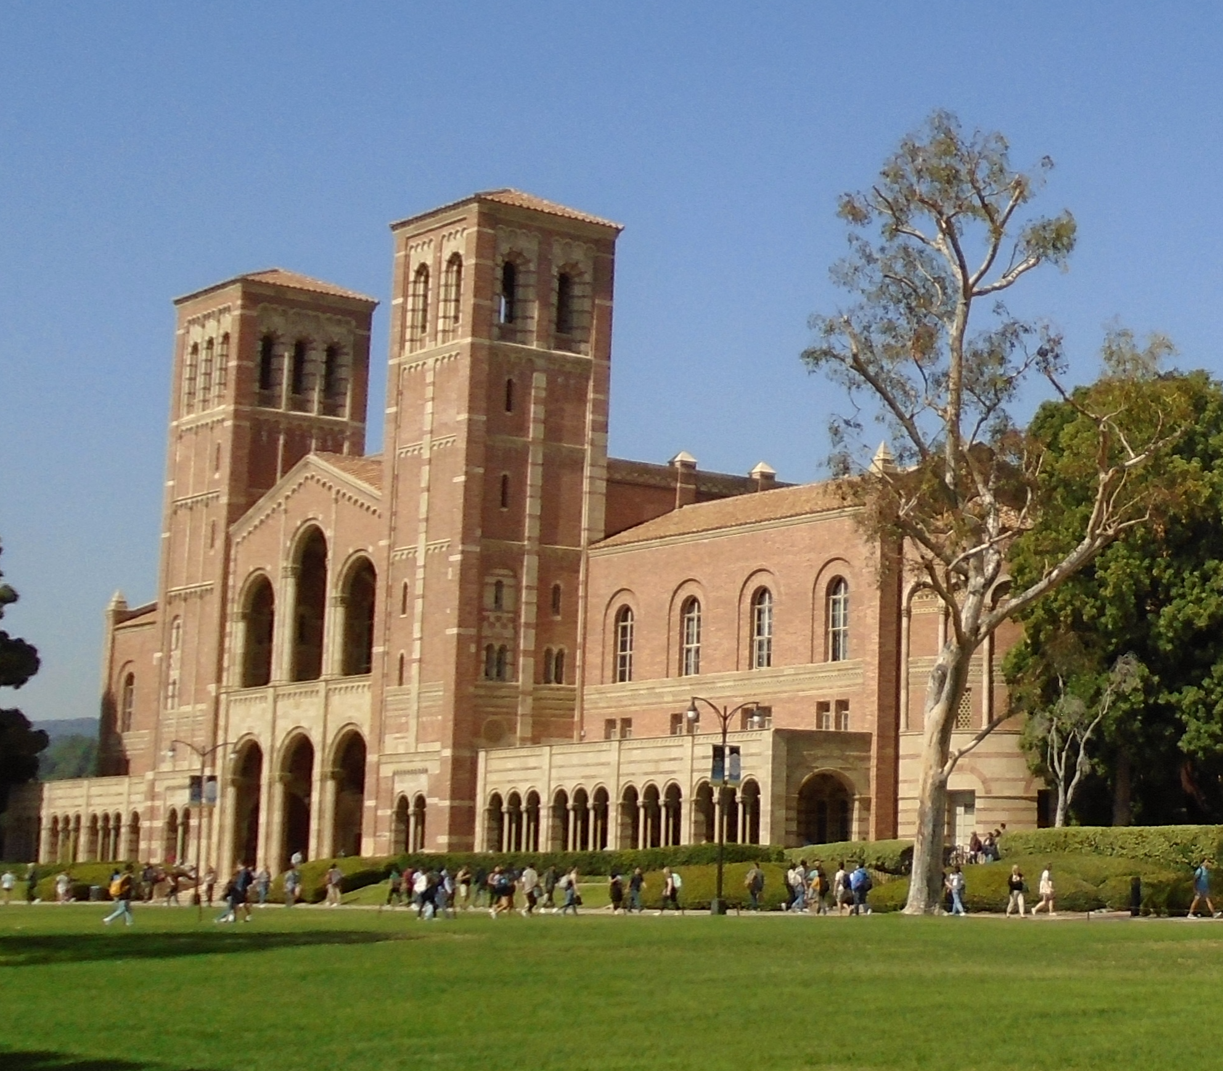
Universities Are the Enemy
So far - Interventionist Attacks on Autonomy/Science
Using Israel/Gaza Tragedy – co-opting charges of antisemitism
Using DEI – list of unmentionables – federal research grants, admissions - hiring - scholarship - student support services . . .

Slide 8
abortion; accessible; accessibility; activism; anti-racism; antiracist; at risk; autism; barrier; bias; Black; clean energy; climate crisis; climate science; community; continuum; Covid-19; cultural differences; cultural heritage; DEI; disability; discrimination; disparity; diversity; equality; equity;; environmental justice; ethnicity; evidence-based; female; feminism; fetus; fluoride; gay; gender; Gulf of Mexico; ideology; immigrants; implicit bias; inclusion; inequality; injustice; institutional; hate speech; Hispanic; Latinx; LGBTQ; marginalized; minority; multicultural; Native American; obesity; opioids; oppression; polarization; pollution; prejudice; privilege; promote; pronoun; pronouns; prostitute; race; racial identity; racism; science-based; segregation; sex; social justice; stereotypes; transgender; trauma; unconscious bias; underprivileged; underrepresented; vaccines; victims; women

Slide 9
Universities Are the Enemy
So far - Interventionist Attacks on Autonomy/Science
Leveraging DOJ and Department of Education to launch investigations into “civil rights” violations of reverse discrimination
60 universities targeted by the Department of Education's Office for Civil Rights for antisemitic discrimination and harassment
45 universities for alleged Title VI violations related to diversity initiatives by DOJ
+ Almost 40% of Americans now live in states where legislatures have enacted laws and authorized policies that censor colleges and universities

Slide 10
Universities Are the Enemy
So far - Interventionist Attacks on Autonomy/Science
Broad Cuts/Impounding of FY25 Science Funding - $8b+ in existing grants
University specific impounding of research $ and “Fines” – Harvard, UCLA $1.2b
Challenging governing boards and university leaders - UVA example
Deportation and creating barriers for international students and researchers – new “continuous vetting” of visas
Replacing the peer review process with approval by political appointees at science funding agencies to ensure that the research grants “advance the national interest”.

Slide 11
Science is the Enemy
The Science/University Financial Ecosystem
Planned cuts to indirect/overhead costs for university research to 15% - redirect some to technical training programs?
FY26 proposed 36% cut in federal R&D funding = $82b+
50% cut for NSF, 40% for NIH . . .
Proposal for federal government to take 50% of IP profits
US R&D Capacity
Appointing Trump loyalists as heads of science related agencies and associated boards
CDC terminating mRNA vaccine research
Ending Climate Change research
DOGE+ purging/firing of federal scientists and staff
Ending or limiting data access and gathering domestically and internationally – climate change etc.
New limits on Academic Freedom and a growing pattern of self-censorship

Slide 12
Science is the Enemy
Science Diplomacy
Ending USAID
Threatened end to Fulbright and other international exchange programs
Placing visa and other barriers on international students and researchers
Auditing international collaborations and agreements
Decoupling from international agencies and treaties – WHO, UNESCO, Paris Accords . . .
All part of a larger America First policy agenda – a mix of isolationist impulses and colonial/imperialistic desires - think Canada, Greenland - foreign policy by tariffs

Slide 13
Science is the Enemy
Severely degrading US science capabilities short and long-term
“Anticipatory Obedience”
Reducing graduate admissions
Cuts in research staff
Halt to some research labs
Chilling impact on pipeline of scientists/academics
Reducing the US’s global role and opportunities for collaboration
What’s to come? FY26 will pose more challenges
Stress on state budgets = reduce HE funding
Science funding/selective retribution

Slide 14
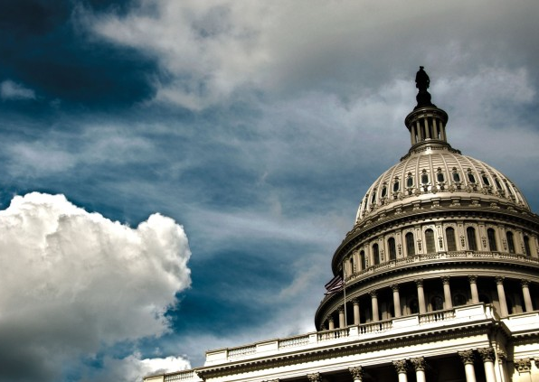
Fighting Back
US HE Lobbying and Advocacy Groups
Congress and Lawsuits
AAU, AAC&U, ACE, AAUP . . .
ACLU/NGO’s
Targeting Blue States / Red States Cabal
Evolving nature of making a deal – Harvard, Columbia, UCLA
To fight - reality of length of any legal recourse – mixed results
Hope for science funding in Congress – Sept 30
Shaping public opinion – hard, but some indications . . .
SCOTUS pending decision on executive authority/tariffs
Hope in the Mid-Term Elections – Nov 2026

Slide 15
Question:
Is the infrastructure, culture and norms of America’s university/science community able to withstand the Trump administration’s blitzkrieg . . . . and eventually recover?

Slide 16
The Emerging Neo-Academic Cold War
After a period of post-Cold War optimism in globalization and path toward more democratic/open societies (“the end of history) . . .
But now? Scientific and cultural diplomacy, collaboration and open access to data and research are declining as global values, shifting to a multi-polar and bifurcated model of transnational scientific/academic engagement shaped by contemporary geopolitics.

Slide 17
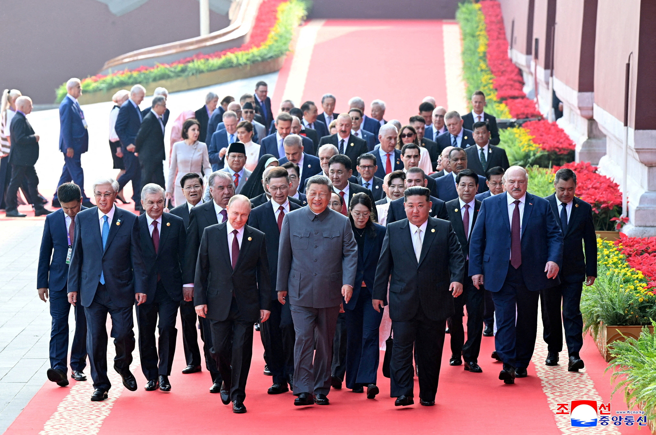
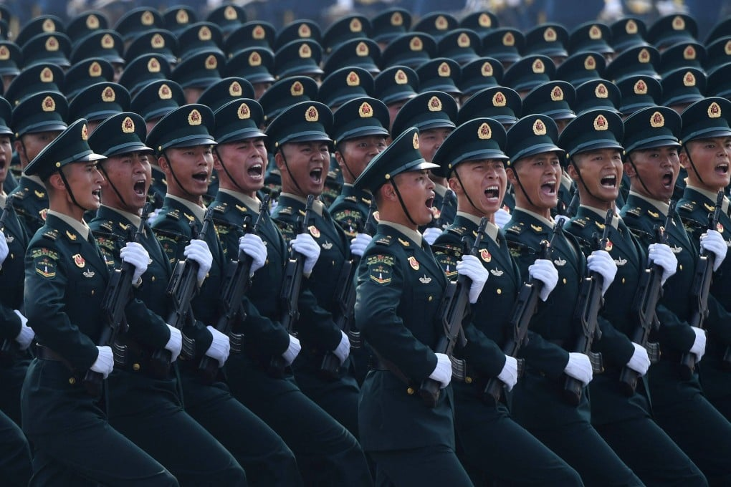
The Emerging Neo-Academic Cold War
US a big player but a global event related to a series of Traumas that resulted in the end of the Post-Cold War Consensus and optimism
September 11 – American Patriot Act/Heightened International Security Measures
The Global Recession
Brexit
Proliferation of Neo-Nationalism and Illiberal Democracies + Autocratic Revivals
US/Europe and China’s Geopolitical Rivalry/China’s ambitions in Asia/Belt & Road
Declining Trust in Public Institutions
COVID and a Divided World Response
Russia War on Ukraine
The Tragedy of the Israeli/Gaza War
Trump’s Return
Hardening Autocratic Alliances

Slide 18
The Emerging Neo-Academic Cold War
Indicators
Politicalization of funding of research
Limits on data exchange
Shifting ssilos of international co-authorship of papers – decline in US/China co-authorship
Constraints/limits on joint IP
Decline in joint research projects/collaborative programs
Anti-immigrant/international student/faculty visa restrictions
Shifting talent mobility patterns into hardening silos of exchange, alliances and influence . . . constraints on travel

Slide 19
The Emerging Neo-Academic Cold War
An Evolving Transnational Paranoia
Growth of illiberal democracies/alliances of autocratic regimes
EU removing Russia from EHEA and ERA, travel bans . . .
US bans of international students and researchers – now looking elsewhere
European reassessing data and other collaboration with US, China
Brain Drain/Gain patterns emerging
Increasing spending on military power – likely trend of cuts to HE
US withdrawal from alliances/tariffs reshaping global relationships
Evolving security states
Sharp power attacks/tech espionage
Diaspora + Anti-immigration shaping migration

Slide 20
The Emerging Neo-Academic Cold War
Shifting Multi-Polar Silos or Axes of scientific cooperation and exchange
What does it look like?
Europe Axes Asia/Global South
US = increasing isolation/diminished alliances and cooperation/diminished reputation
China Axes/Russia Axes
Multi-Aligned Nations Axes/India Brazil Turkey South Africa . . .
Competition for spheres of influence/emerging economies

Slide 21
US
EU/Liberal Democracies
Canada
Australia
Japan
South Korea
Taiwan
China
Russia
UK

Slide 22
US
EU/Liberal Democracies
Canada
Australia
Japan
South Korea
Taiwan
China
Russia
UK
Belt & Road
Israel
Multi-Aligned
India
Brazil
Turkey
South Africa
EU+ Axes
China/Russia
Axes

Slide 23
The Emerging Neo-Academic Cold War
Winners
Europe – an opportunity/also a global need for leadership/US academic refugees
China – self-sufficiency (Thousand Talents Program . . .) but also global ambitions
Some Multi-Aligned Nations in the Global South
Losers
US
Russia
Open Science, Science Diplomacy . . . World Health . . .

Slide 24
The Emerging Neo-Academic Cold War
How will it Evolve or Devolve?
What if?
UK – Reform UK Nigel Farage / Scotland
Germany – AFD
France – La Pen/National Rally
Netherlands/Sweden

Slide 25
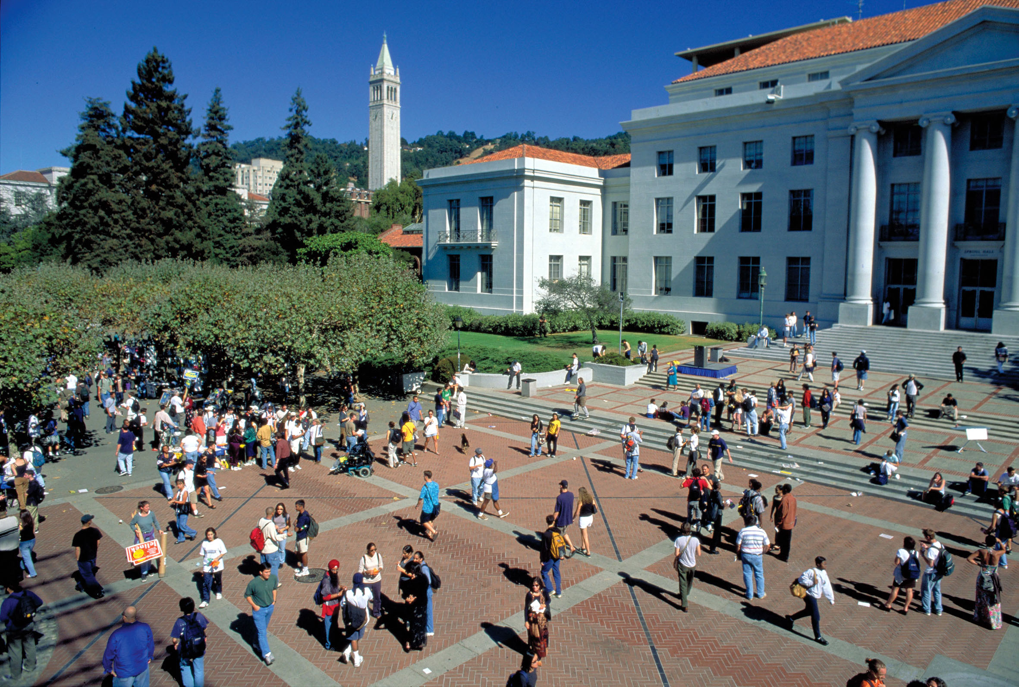
douglass@berkeley.edu

