Slide 1

US Higher Education Under the Second Trump Administration
30 September 2025
Centre for Global Higher Education
Oxford University
Eve Darian-Smith
University of California, Irvine USA

Slide 2
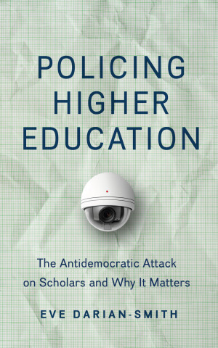
Eve Darian-Smith has produced a book of seminal importance. She offers a brilliant defense of the humanities, academic freedom, and scholars as critically engaged intellectuals. In addition, she integrates history, criticism, and a discourse of resistance and hope into essential reading for anyone concerned about the relationship between education and democracy. This book could not have appeared at a more crucial time.
— Henry Giroux
available open access – Johns Hopkins UP / Project Muse

Slide 3
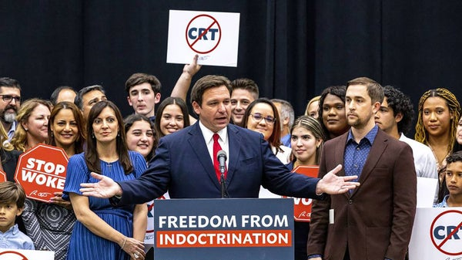

Slide 4
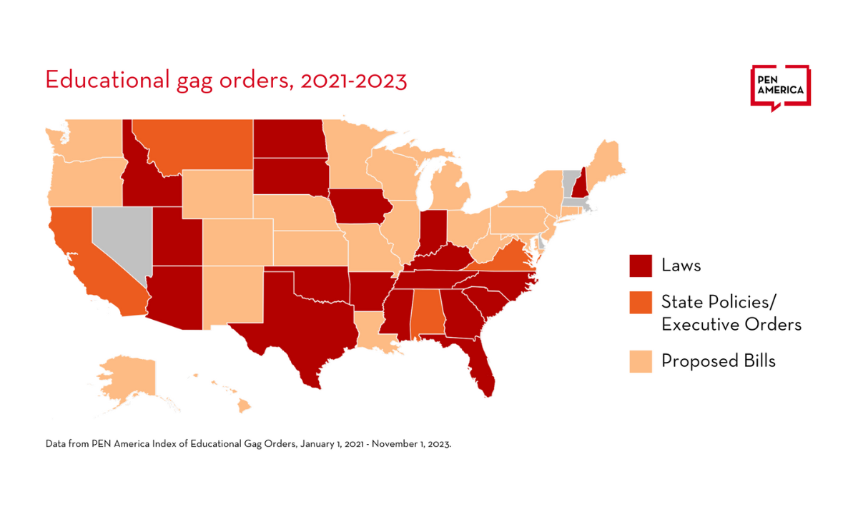
Notes:
Educational gag orders are legislative efforts to restrict the discussion or teaching of specific topics in educational settings, often related to race, gender, or sexuality. These measures aim to limit what can be taught or discussed in classrooms, potentially impacting academic freedom and open inquiry.

Slide 5


Slide 6
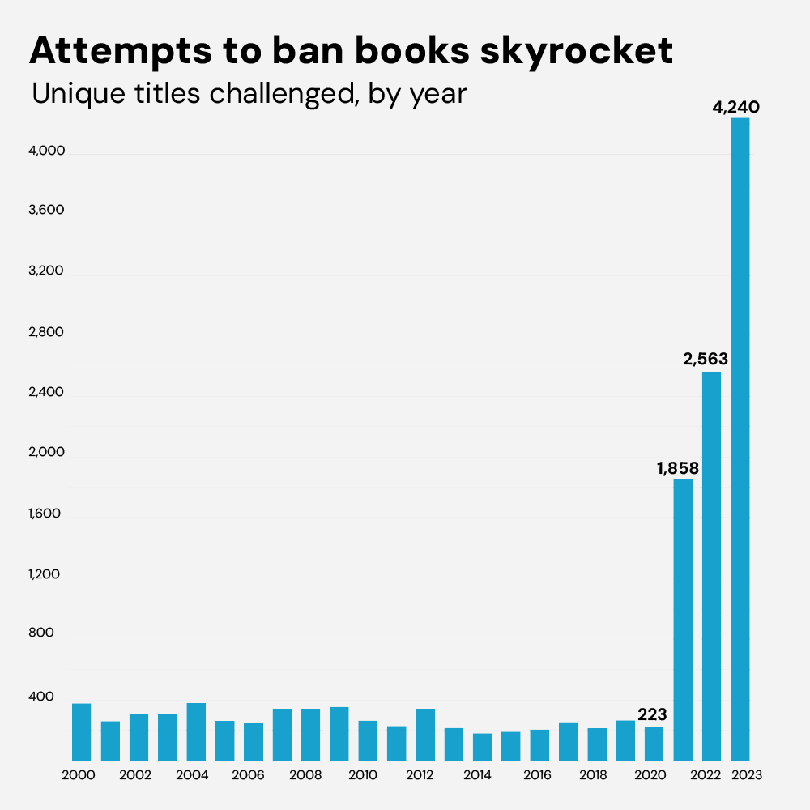

Slide 7

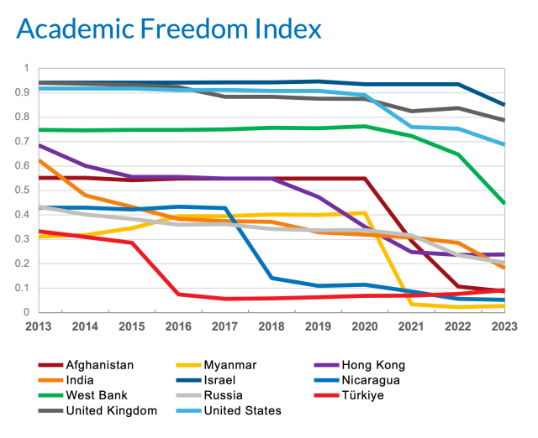

Slide 8


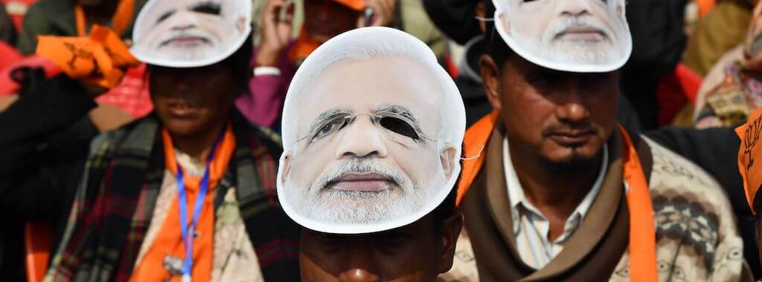
Notes:
The right-wing chorus of Hungarian Prime Minister Viktor Orbán, Syrian President Bashar al-Assad, Russian President Vladimir Putin and Italian Prime Minister Giorgia Meloni.

Slide 9

Notes:
2023 Late Fascism book by alberto toscano; some countries do it differently but ultimately arrive at same endpoint of some lives privelged over otherse

Slide 10
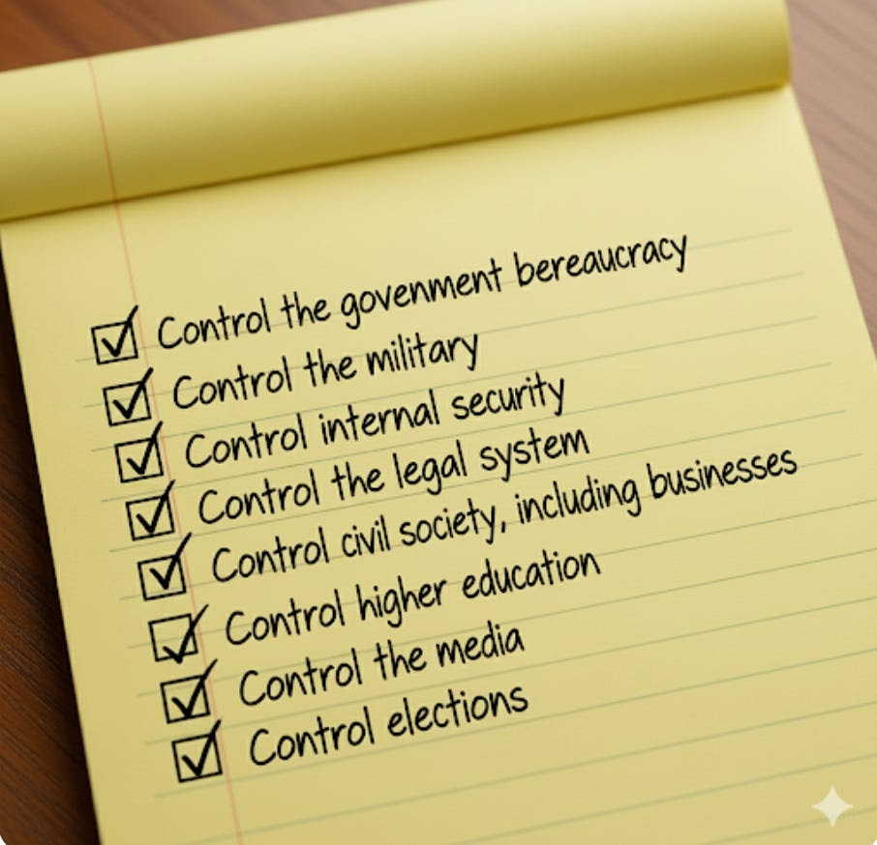
Authoritarian checklist

Slide 11

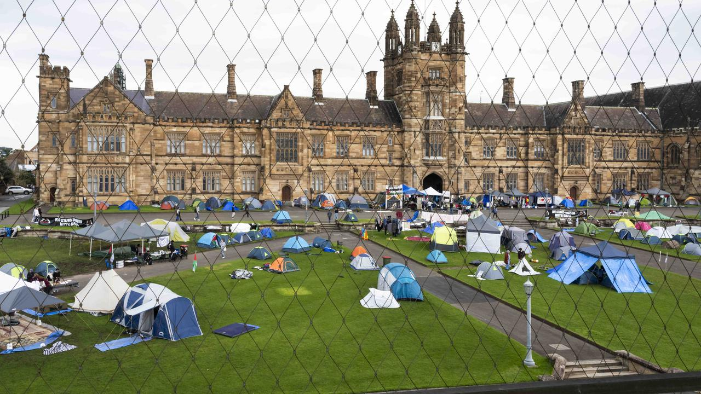

Notes:
Uni sydney

Slide 12
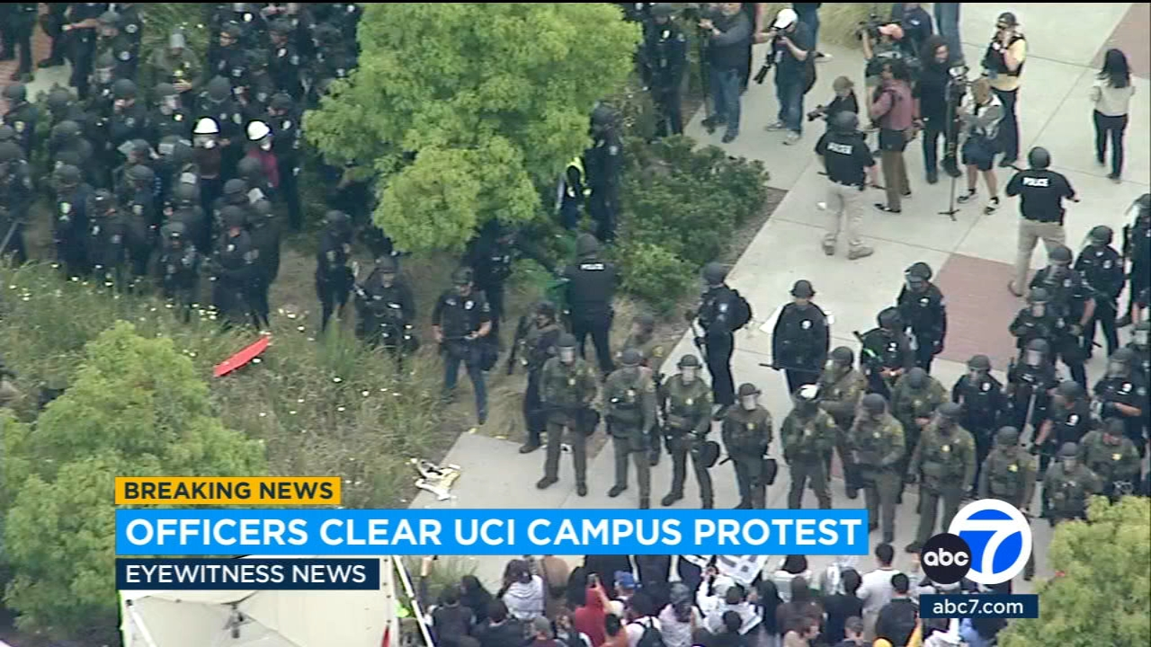
Notes:
May 2024 UCI

Slide 13
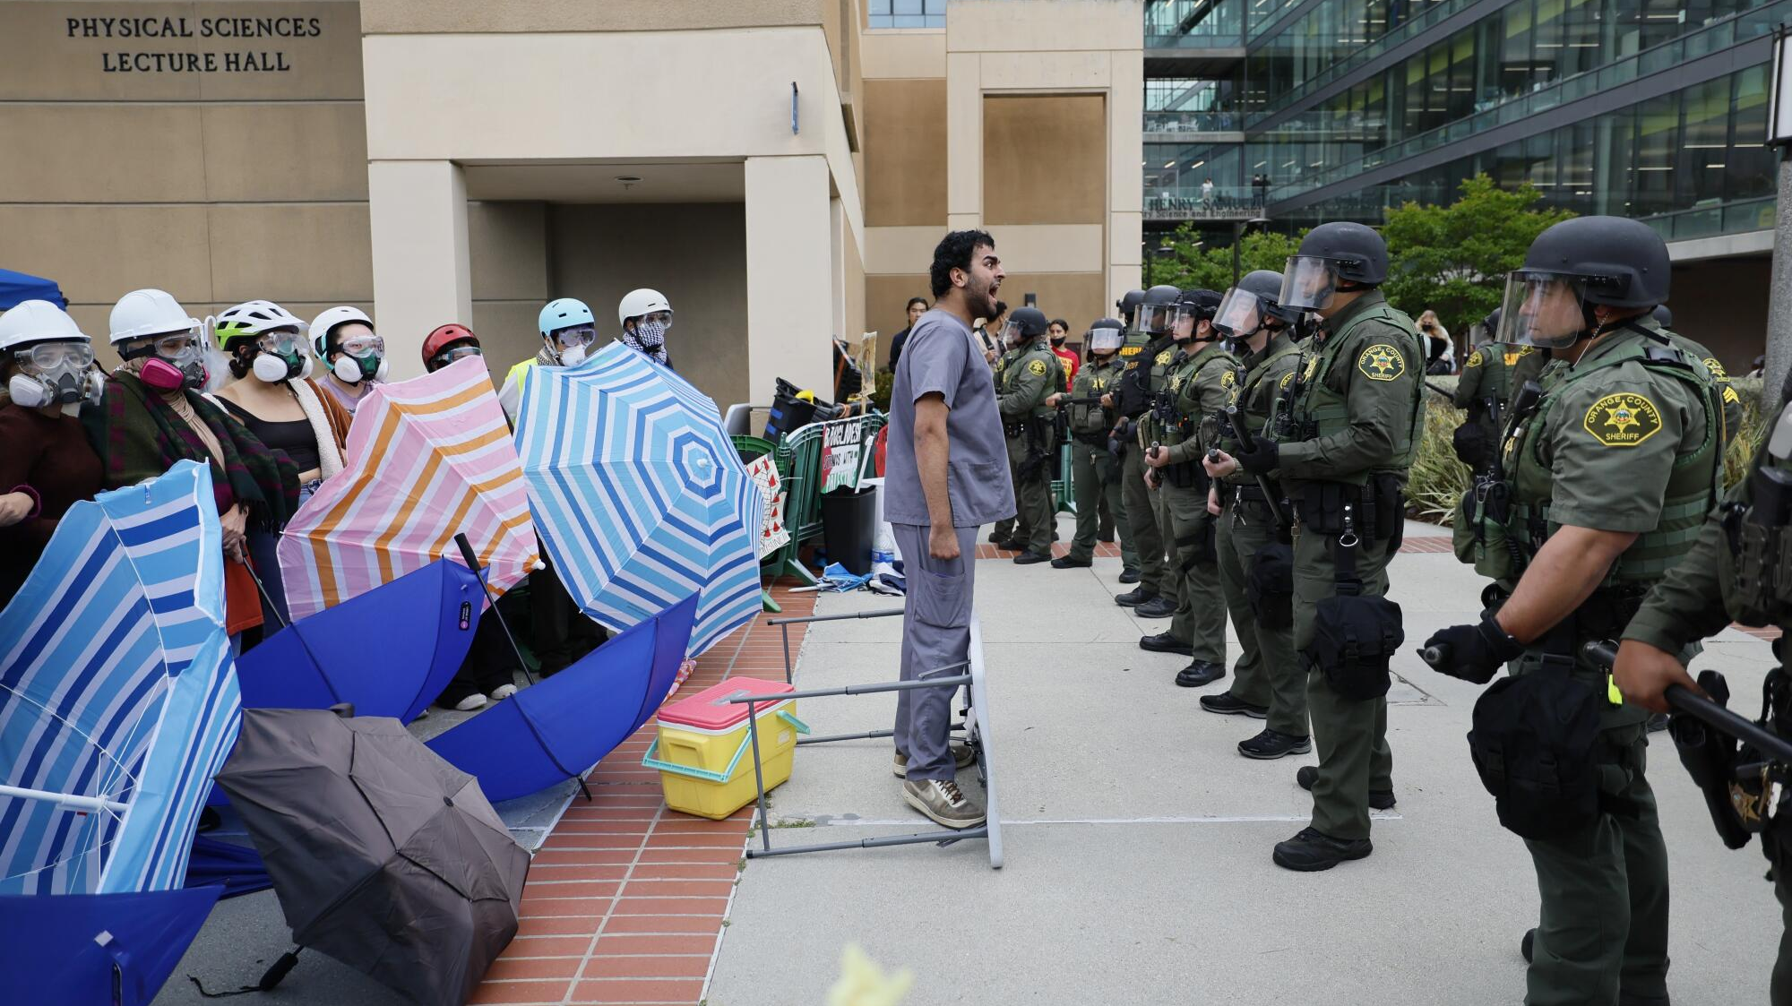

Slide 14
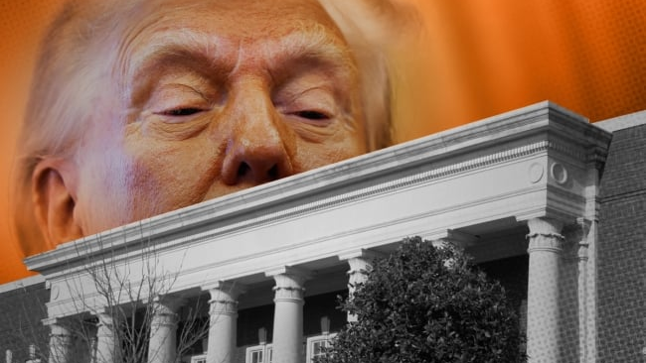

Slide 15
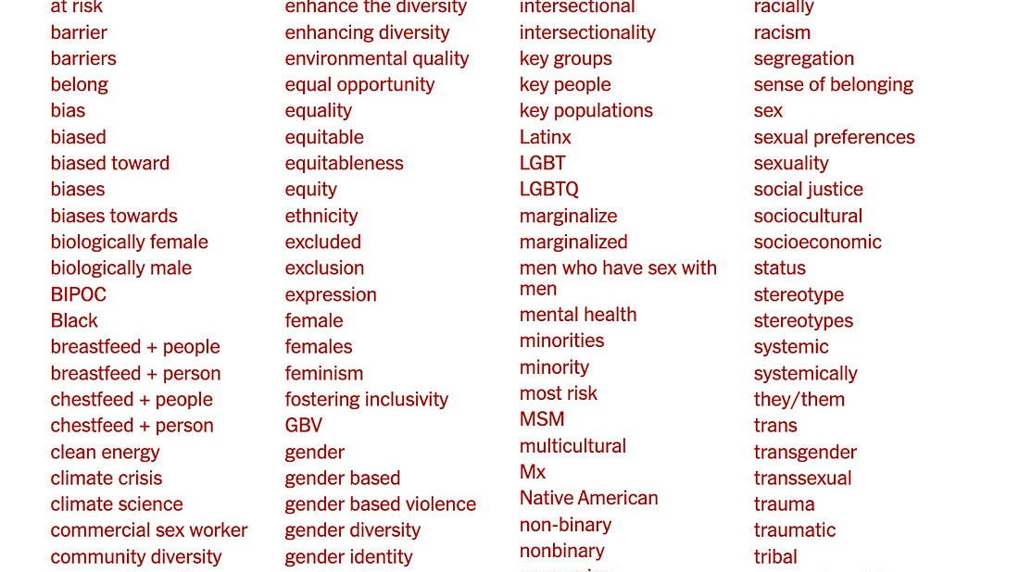

Slide 16


Slide 17


Slide 18
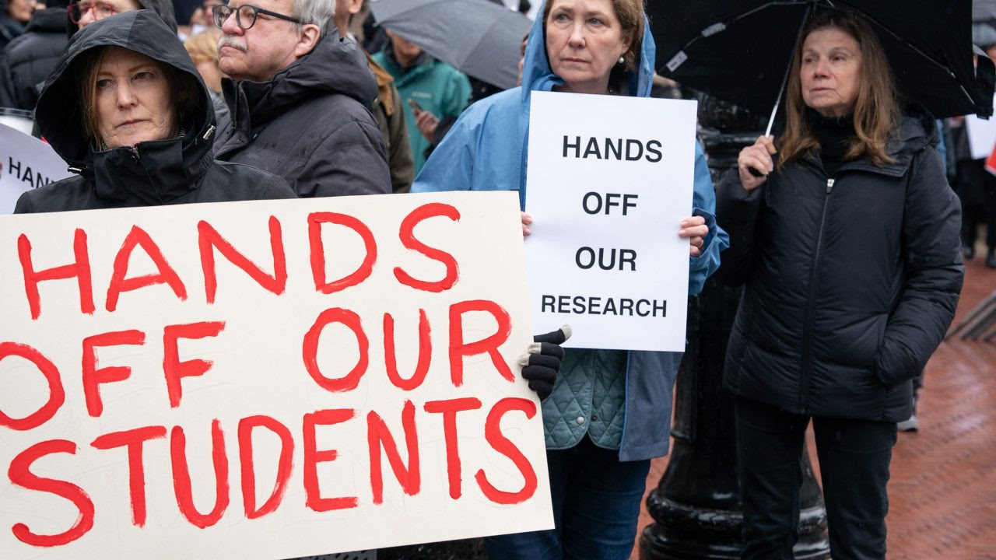

Slide 19
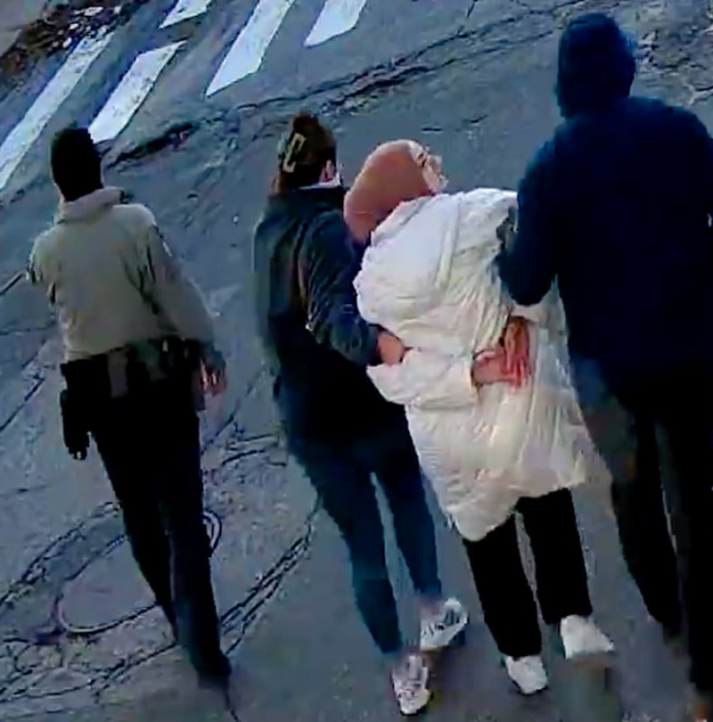

Notes:
https://www.linkedin.com/pulse/new-ice-agreements-florida-universities-what-students-elga-yjt3e/
https://www.aclufl.org/en/287g-campus-toolkit
https://www.bostonherald.com/2025/04/11/immigration-tufts-student-detention/
FILE- In this image taken from security camera video, Rumeysa Ozturk, a 30-year-old doctoral student at Tufts University, is detained by Department of Homeland Security agents on a street in Sommerville, Mass., Tuesday, March 25, 2025. (AP Photo)

Slide 20
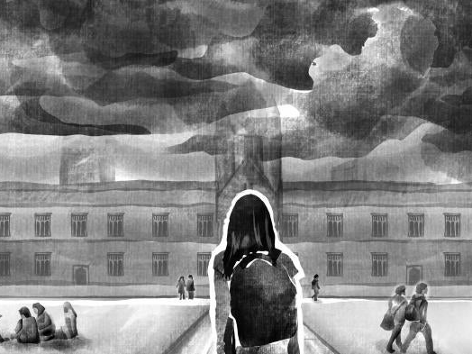


Slide 21

today’s educational crisis threatens a person’s right to pursue knowledge, think critically, and challenge the status quo
defunding research, issuing book bans, policing curriculum, censoring speech, attacking diversity initiatives, restricting campus protests, arresting students and faculty without due process
Notes:
And this comes on heels of Covid 19 impacts which have left a legacy of increasing inequality in levels of education

Slide 22
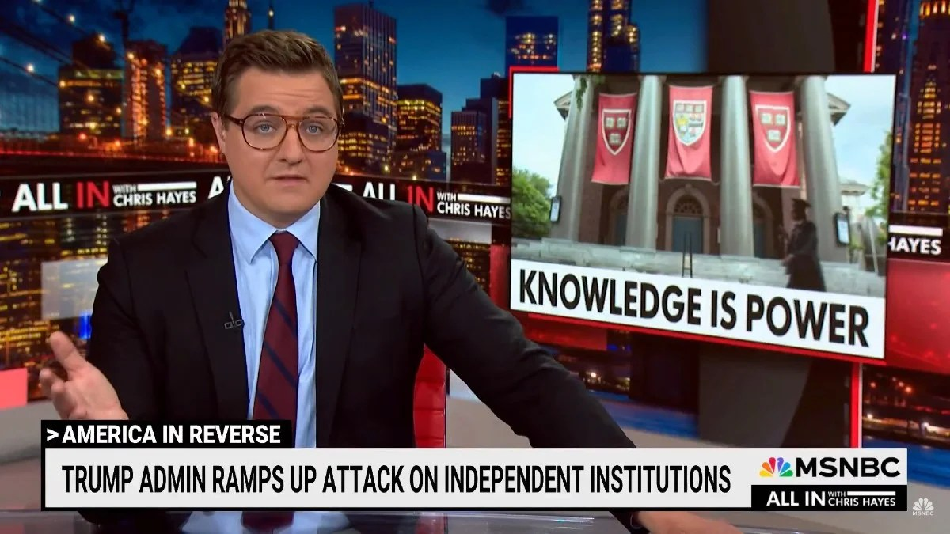

Slide 23
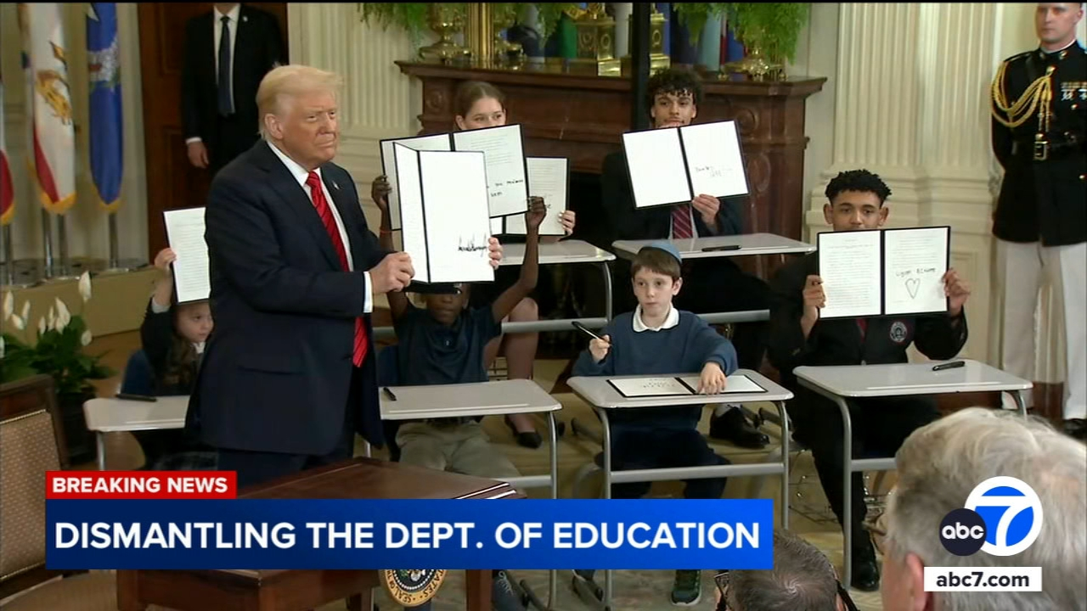

Slide 24
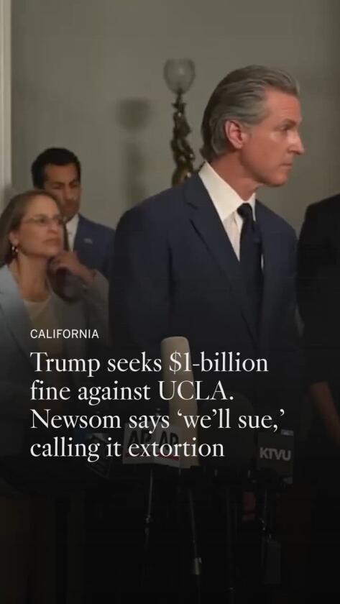


Slide 25
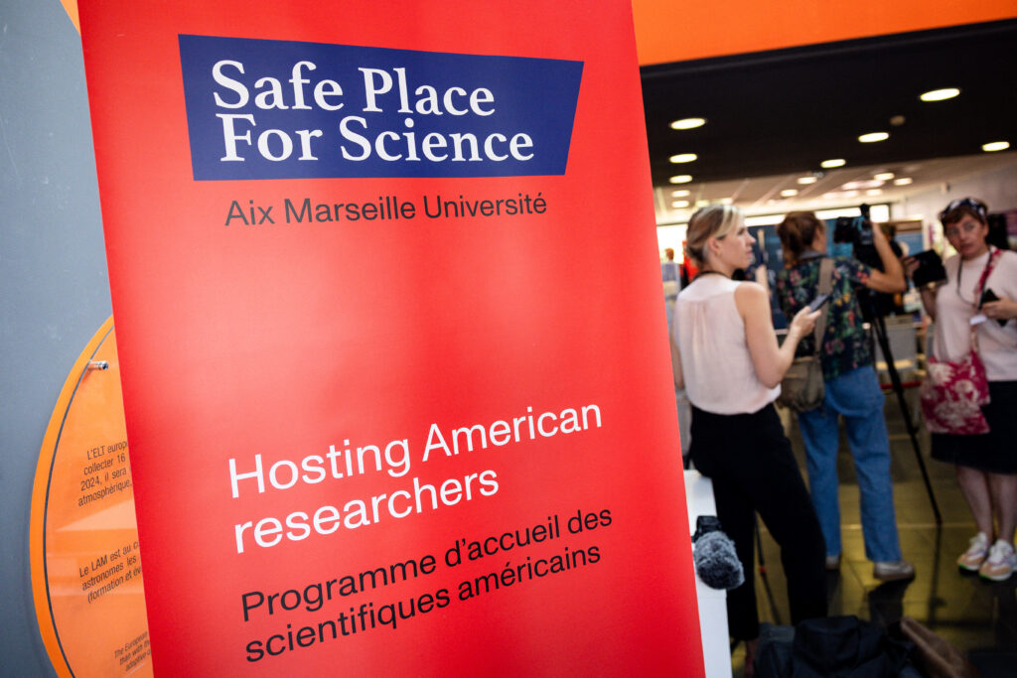
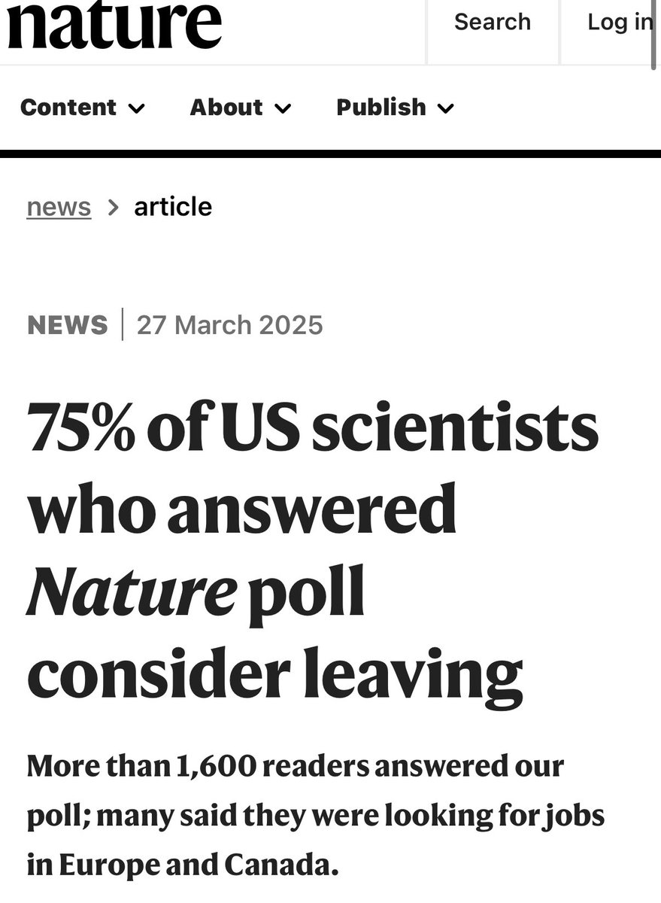

Slide 26
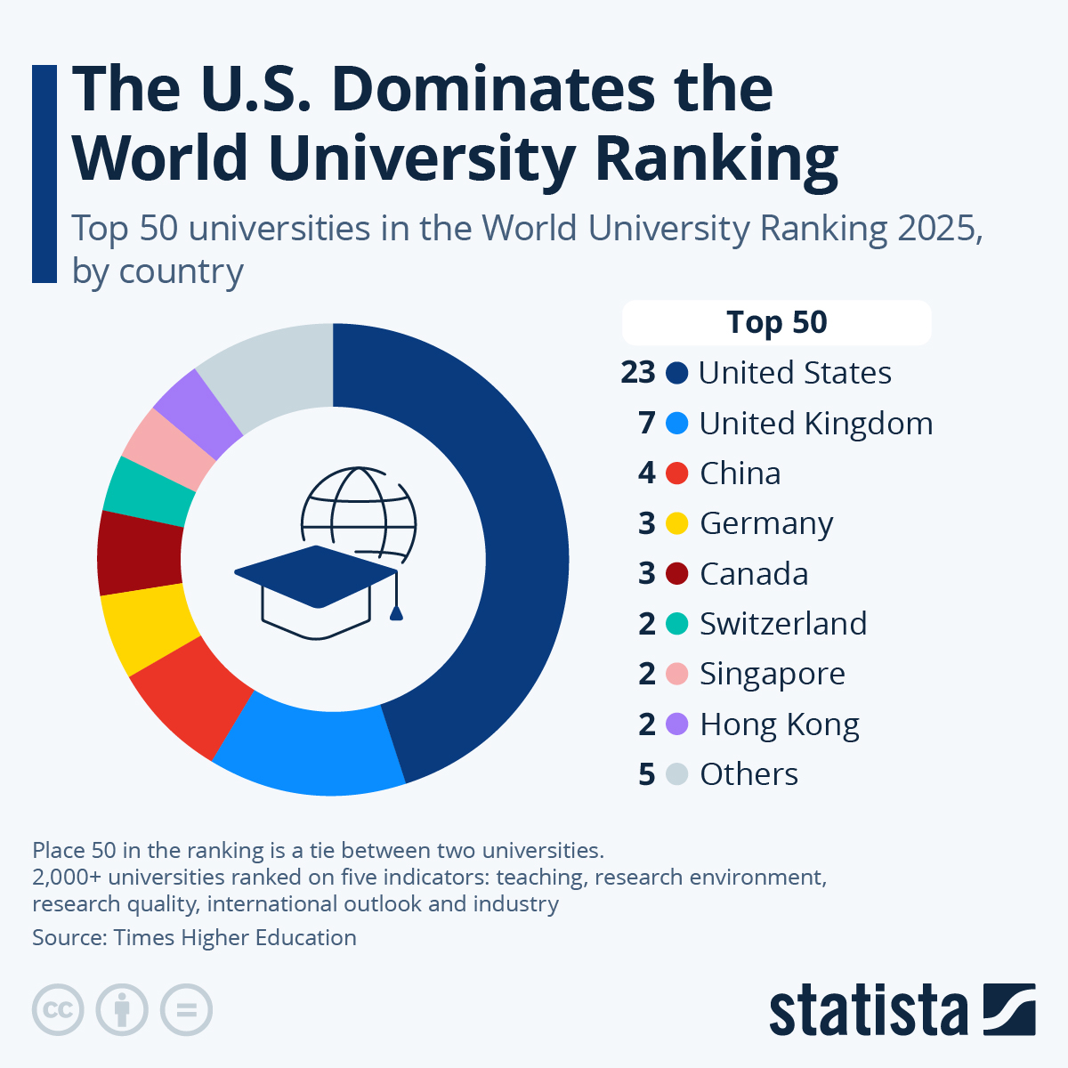
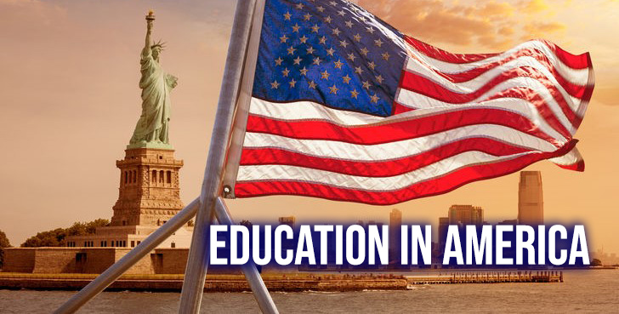
US higher education sector seriously destabilized

Slide 27

potentially massive shifts in global higher education

Slide 28
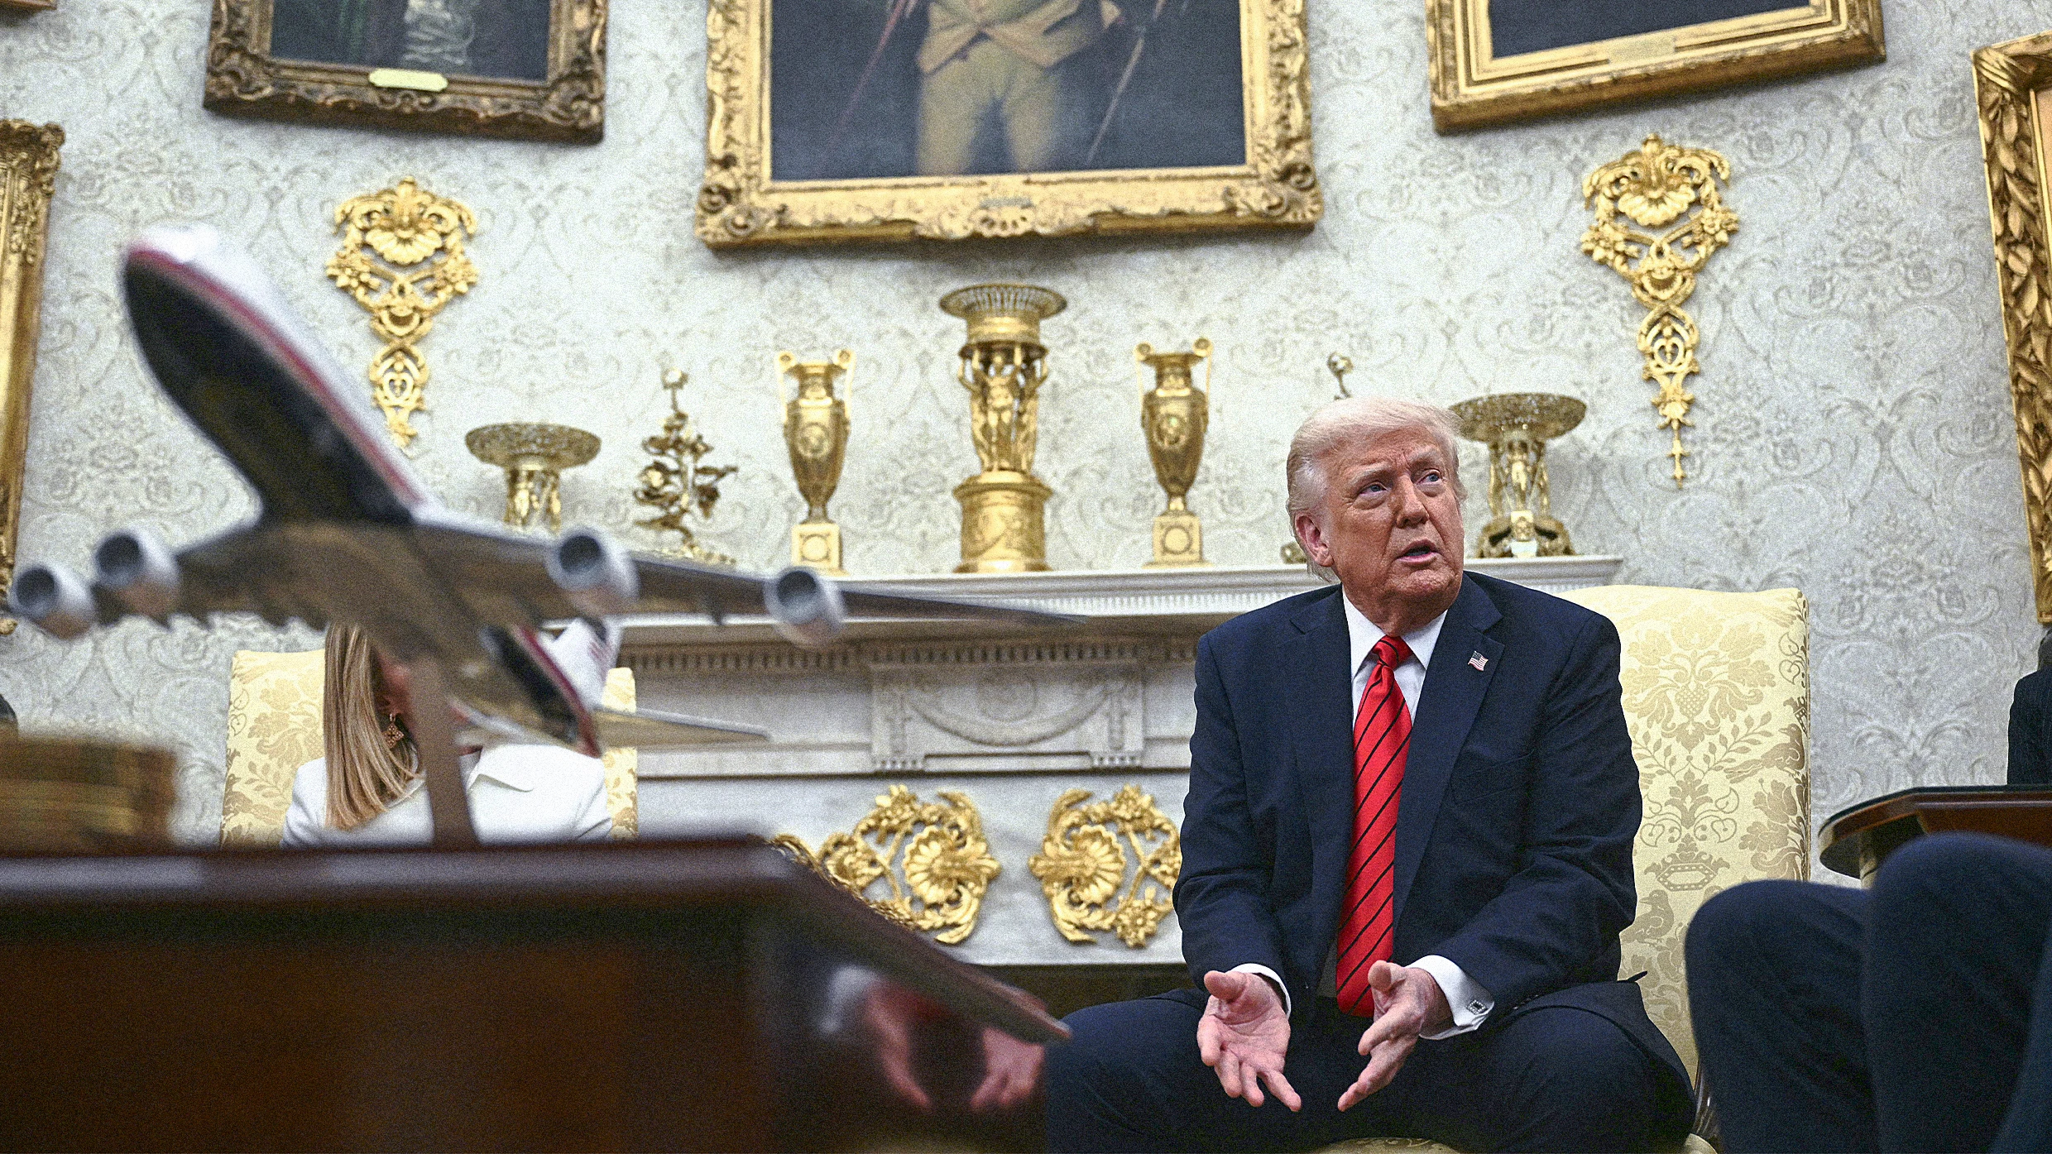

Slide 29
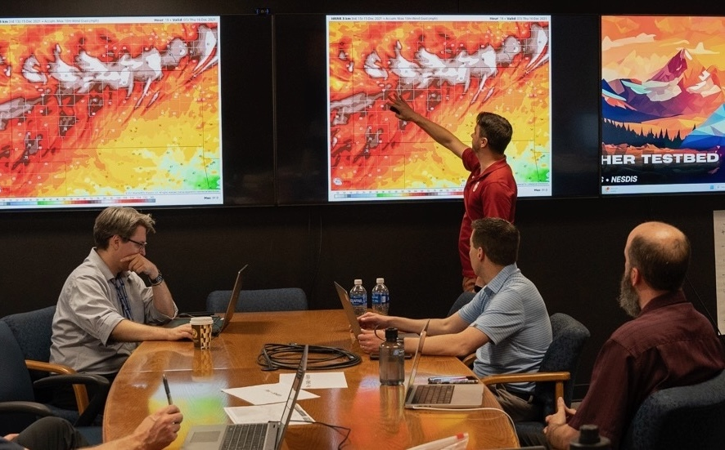
Attacking climate science expertise National Oceanic and Atmospheric Administration
Notes:
https://coloradonewsline.com/briefs/colorado-democrats-press-for-answers-on-trumps-dismantling-of-noaa/

Slide 30
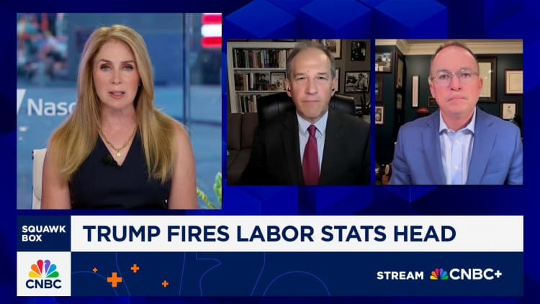
Attacking labor and employment expertise

Slide 31
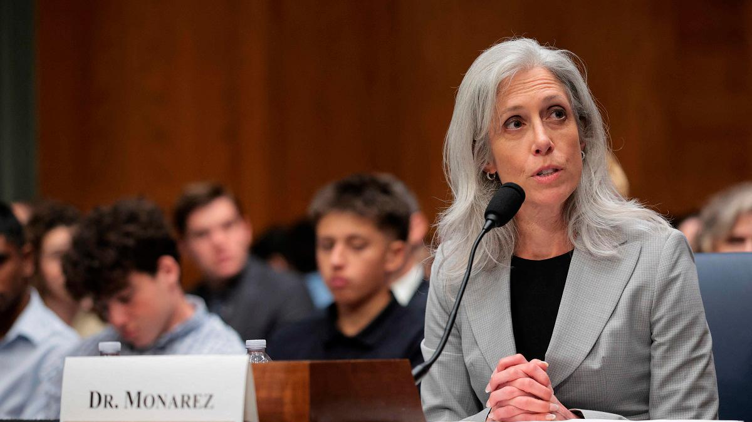
Attacking medical expertise

Slide 32
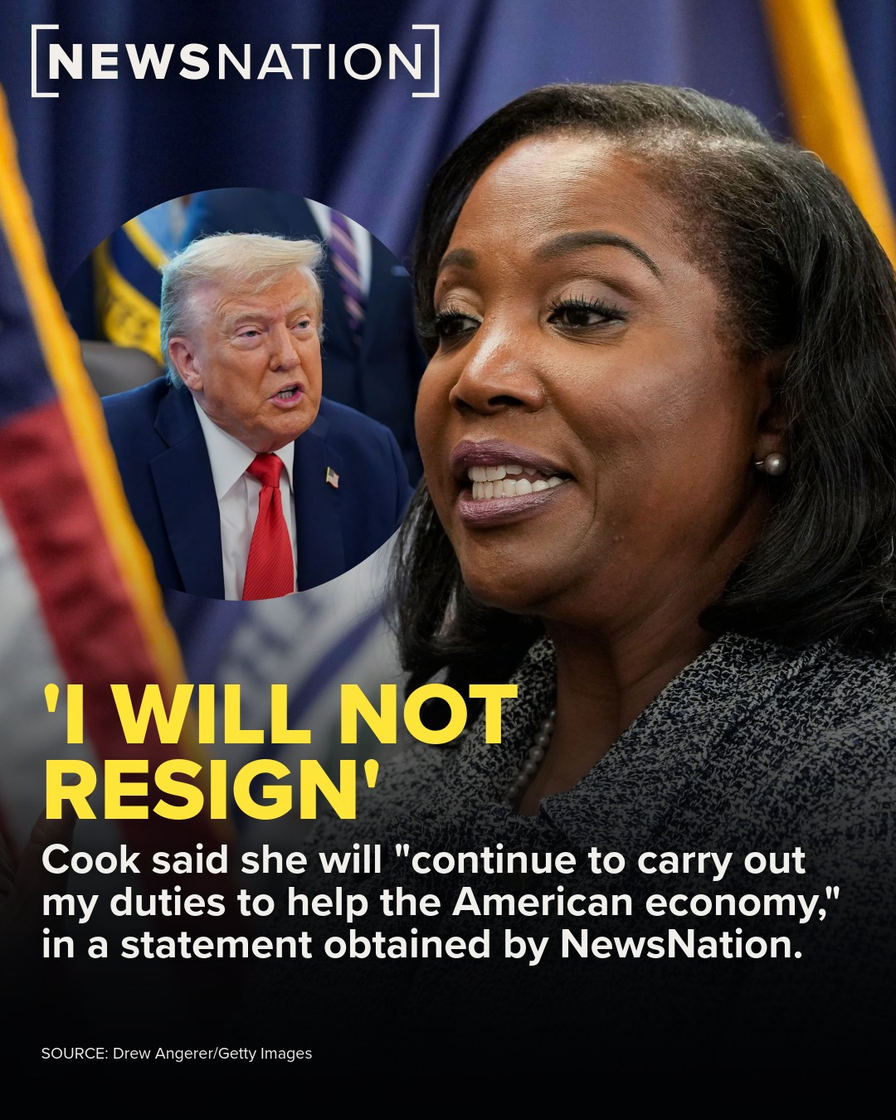
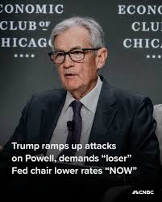
Attacking economic expertise

Slide 33

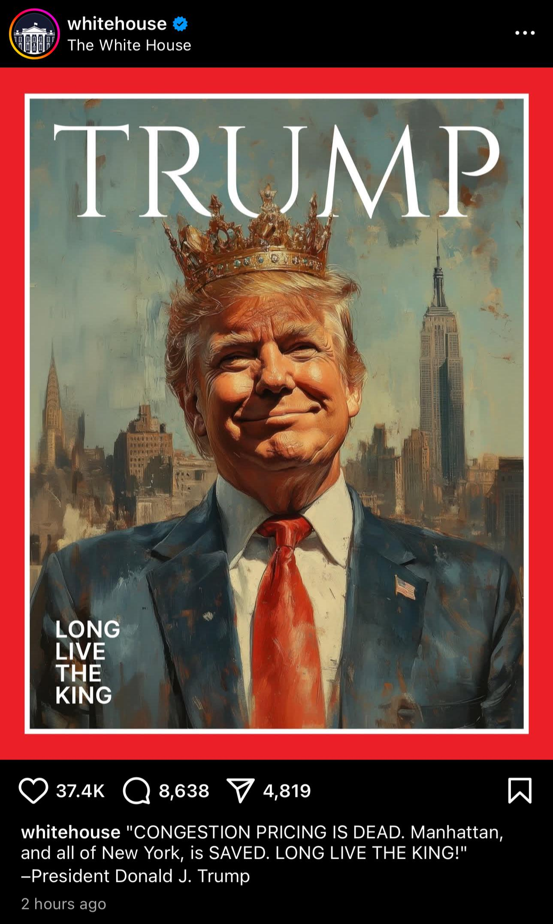

Slide 34


Slide 35
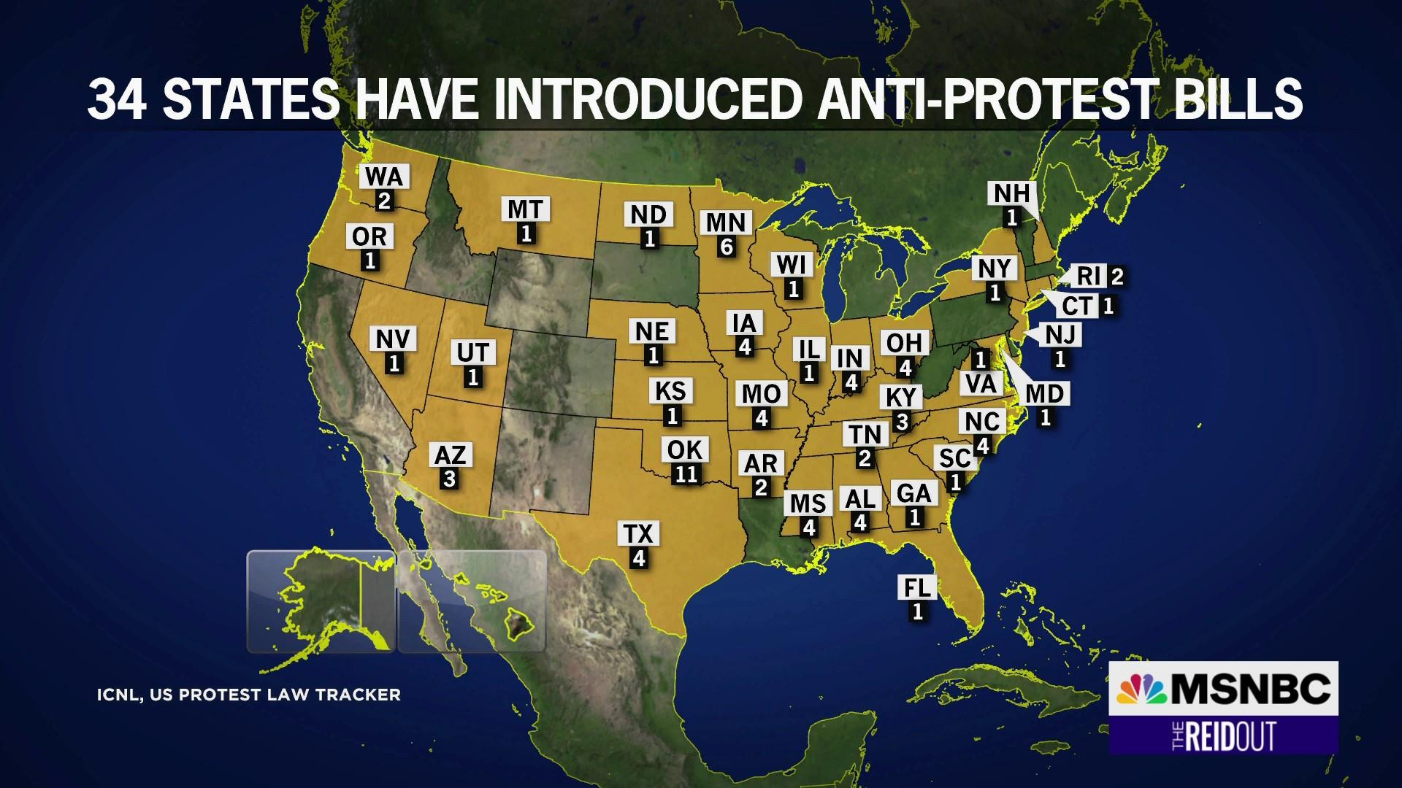

Slide 36
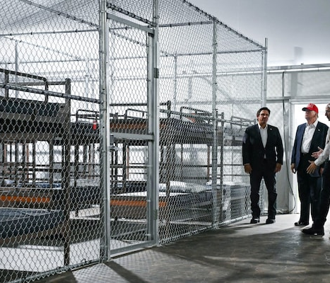
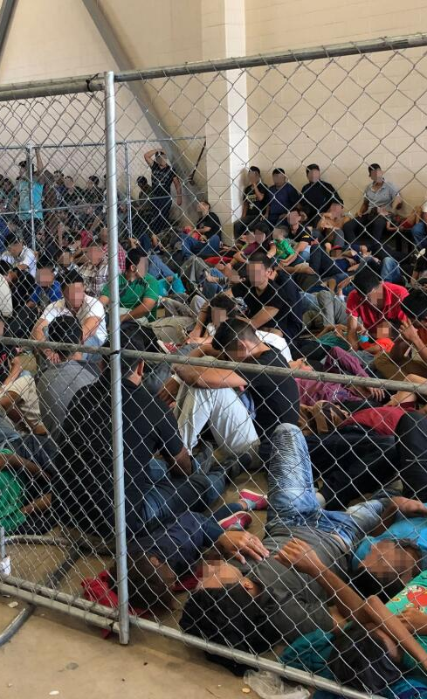

Slide 37
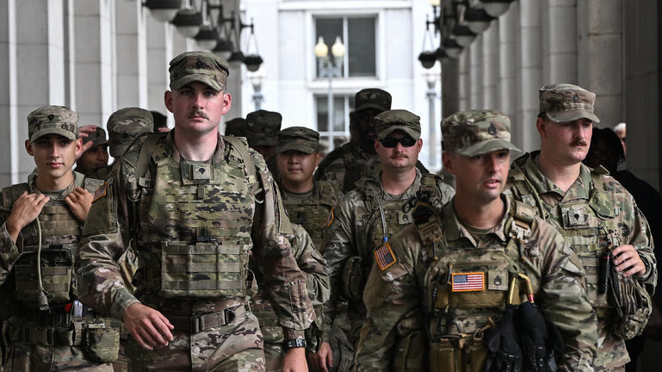
Notes:
https://mail.google.com/mail/u/0/#inbox/WhctKLbmnGCBxwGNTqVmzkfNJsMXgWzxPgPHngnKPMRWsChJcLTSnNqBpNFVjfSWTgWRBXB

Slide 38

thank you

