Slide 1


Towards Reparative Global HE?
Arathi Sriprakash
Professor of Sociology and Education
University of Oxford

Slide 2
A little bit about my journey in HE…
personal
political
intellectual

Slide 3
Reparative frameworks in education
Image: NPR
Structural injustice, education and social reproduction
From education ‘gaps’ to education ‘debts’ (Ladson-Billings 2006)
Towards ‘reparative futures’ of education

Slide 4
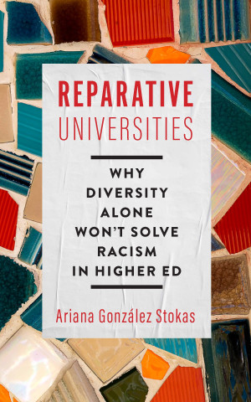
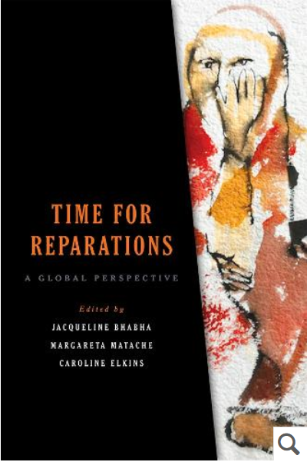
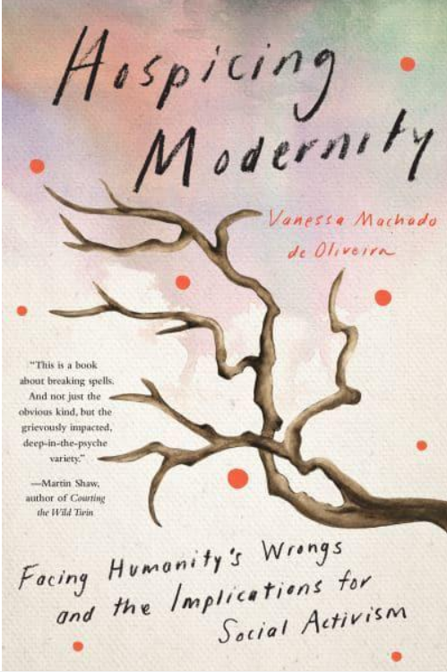

Reparative frameworks
Interconnections between past-present-future
A ‘future-making’ and action-oriented approach (Táíwò 2022)
A reconstructive agenda. It might involve the hospicing or abolition of certain norms, practices, institutions (de Oliveira 2021)

Slide 5
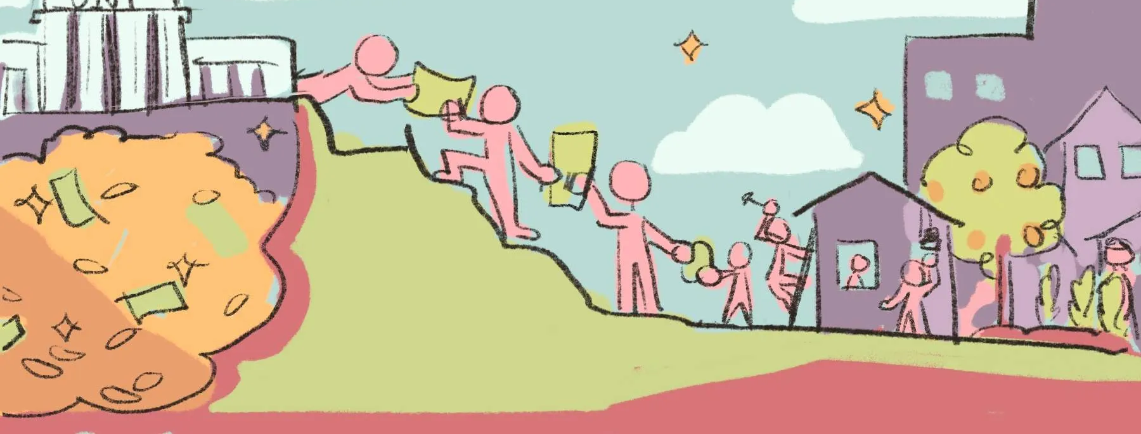
Reparative global HE…?
material reparations
epistemic repair
reparative pedagogies
Sriprakash, A. (2022). Reparations: theorising just futures of education. Discourse: Studies in the Cultural Politics of Education, 44(5), 782–795

Slide 6
Activity and Discussion
What have been some of the injustices that HE has been implicated in?
What would the repair of these injustices look like?

