Slide 1
Centre for Global Higher Education Autumn School
12 September 2025
Transforming the Academy through Policy Advocacy
Thandi Lewin
Ali Mazrui Centre for Higher Education Studies
Faculty of Education

Slide 2
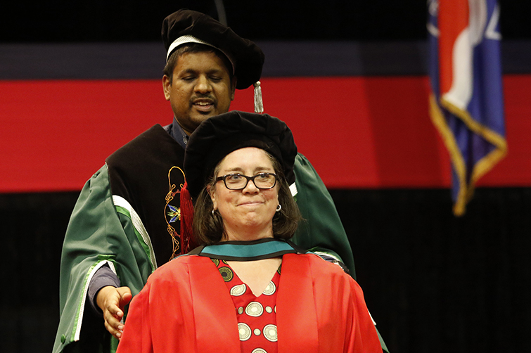
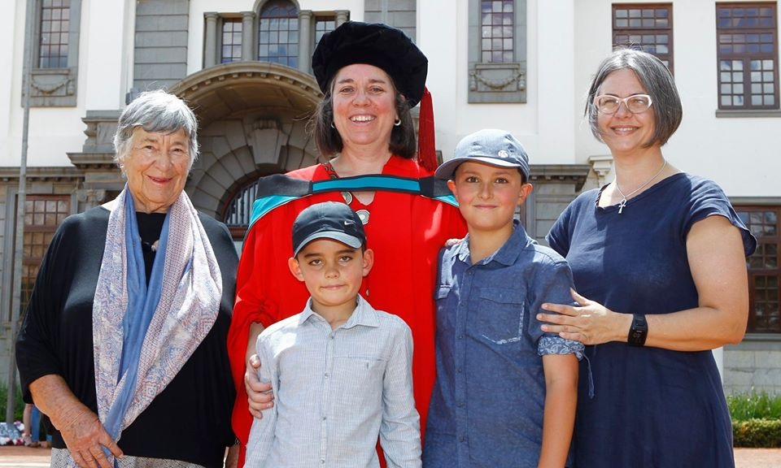
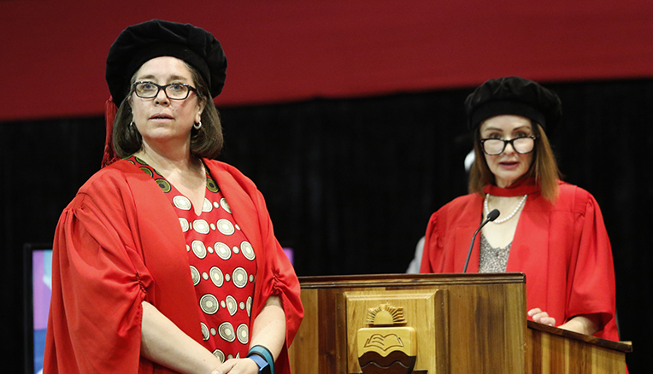
2019 PhD graduation.
Ali Mazrui Centre for Higher Education Studies, Faculty of Education

Slide 3
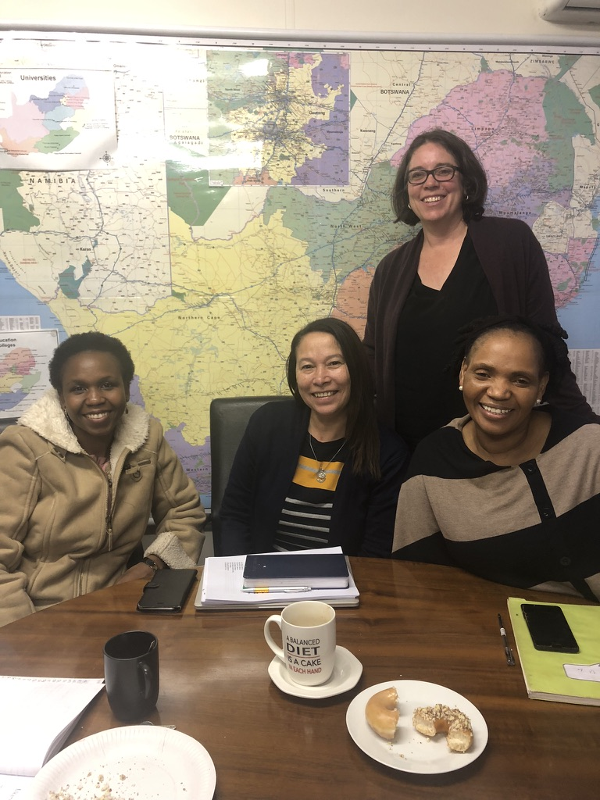
DHET
Ali Mazrui Centre for Higher Education Studies, Faculty of Education

Slide 4
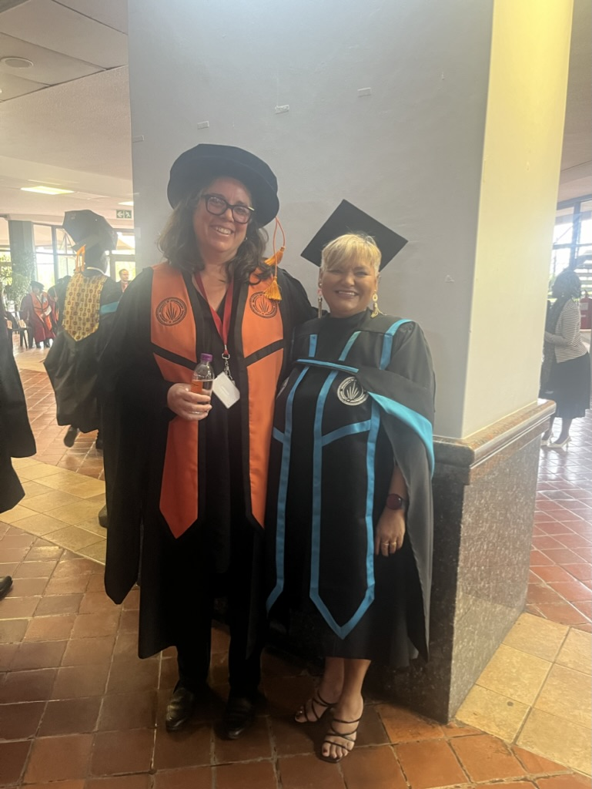
Graduation
Ali Mazrui Centre for Higher Education Studies, Faculty of Education

Slide 5
Presentation
How did I become an academic?
What kind of academic am I?
What am I working on?
What kind of academic do I want to be?
What is policy and policy research?
3 policy dilemmas
https://flourish-user-preview.com/2406596/7hiRVc4jp2uJCvitiC-OMOnGqD2ObX7ms1JRprQZh8OIjm6QQSknz_KeusTreiMv/
Ali Mazrui Centre for Higher Education Studies, Faculty of Education

Slide 6
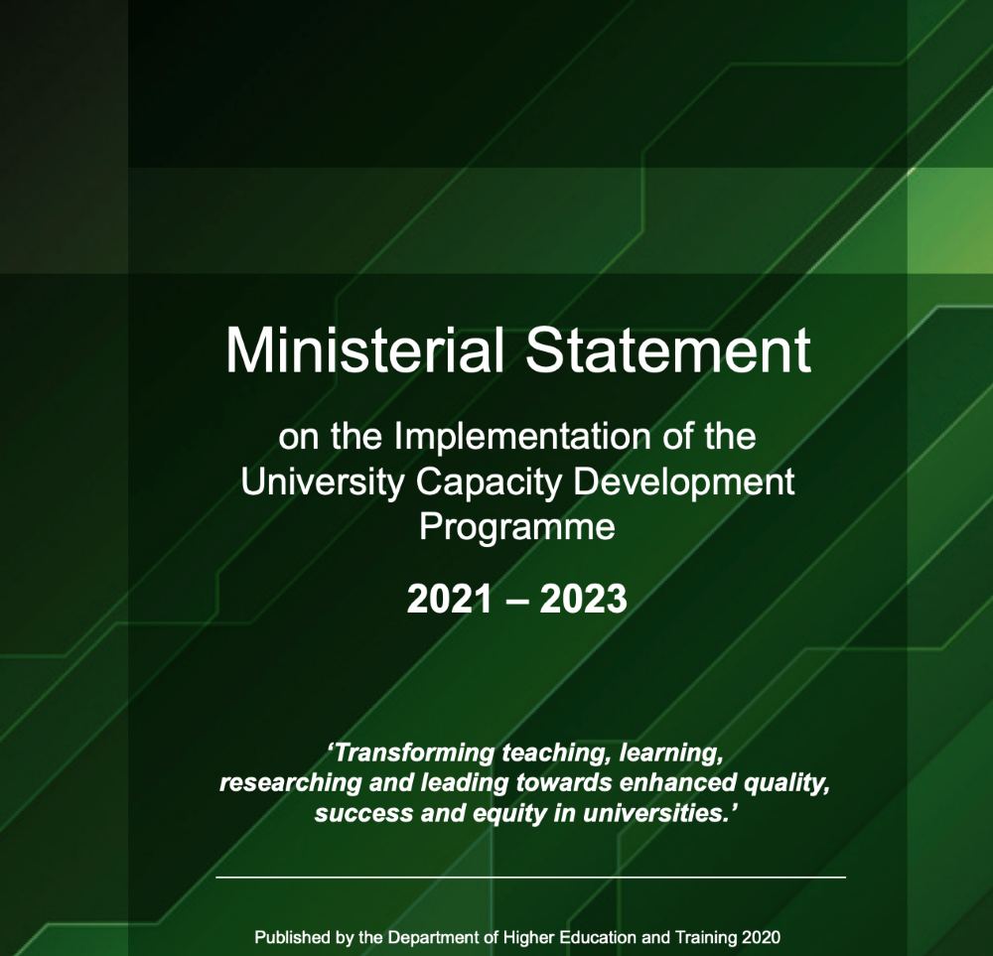
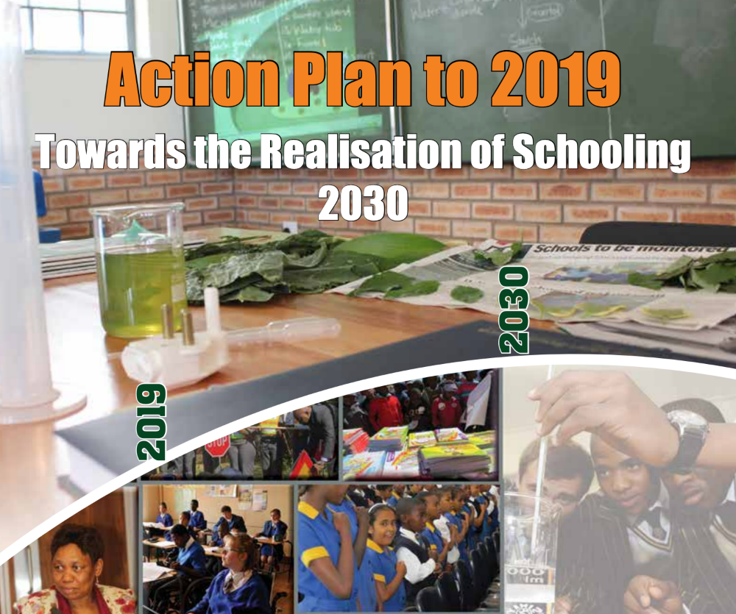
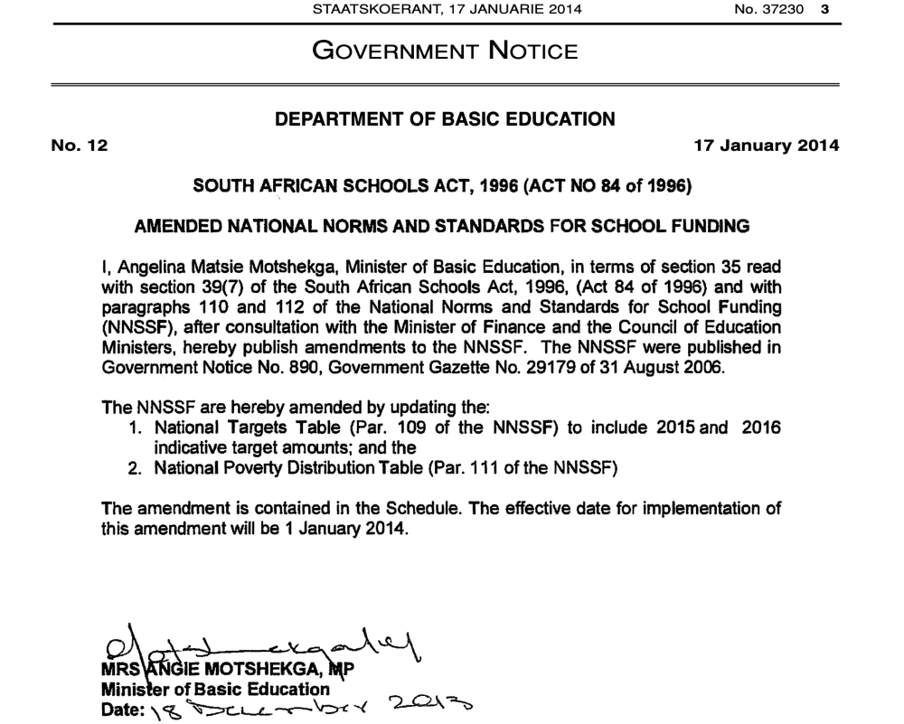
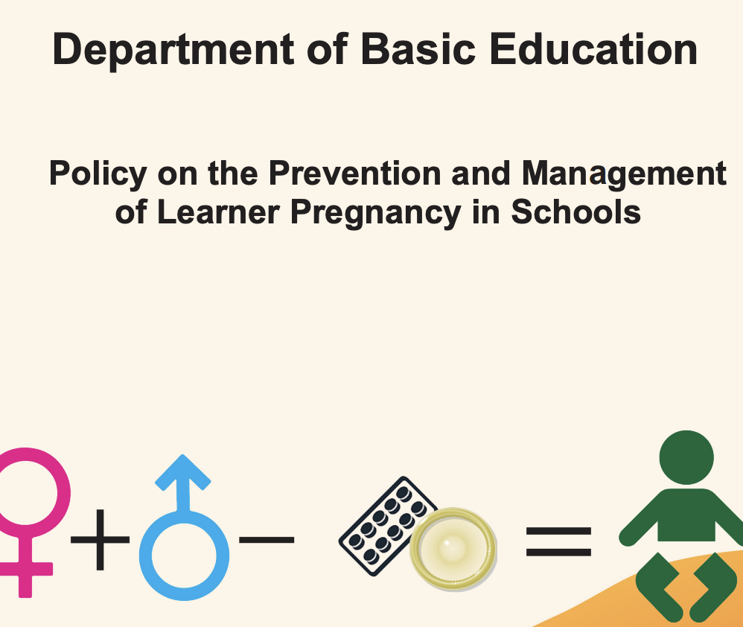
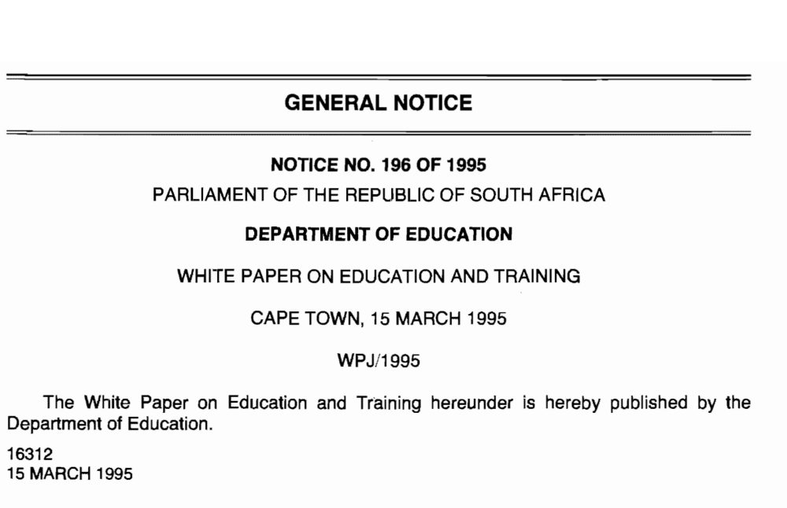
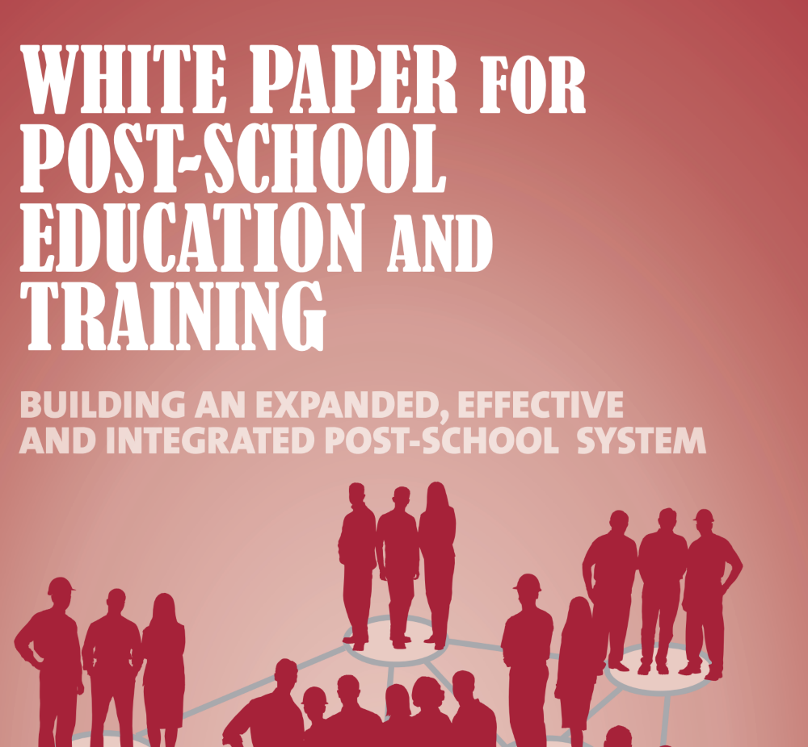

The nature of policy in education
“At the institutional level, as at the national, policy making and policy implementation are more likely to be the result of negotiation, compromise, and political processes than careful planning and the incremental realisation of coherent strategy. “ (Trowler, 2002)
Street-level Bureaucrats (Lipsky, 2010)- policy is interpreted and enacted by many players, institutions, organizations.
How policy is understood and interpreted (Bacchi, 2006)- this matters when doing policy analysis.
Big P of policy and small p of policy (Ball, 2008): “Policies are contested, interpreted and enacted in a variety of arenas of practice and the rhetorics, texts and meanings of policy makers do not always translate directly and obviously into institutional practices. They are inflected, mediated, resisted and misunderstood, or in some cases simply prove unworkable. It is also important not to overestimate the logical rationality of policy. Policy strategies, acts, guidelines and initiatives are often messy, contradictory, confused and unclear (Ball, 2008)
“Wicked” policy problems.

Slide 7





PUBLIC UNIVERSITY FUNDING FRAMEWORK 2025/26 (2026/27)
Teaching input grant
R26.165 bn (R27.286 bn)
Block Grant
(discretionary funding)
Teaching output grant
R8.040 bn (R8.434 bn)
88% (88%) of budget
R42.7 bn (R44.5bn)
Research output grant
R5.800 bn
(R6.034 bn)
R5.954 bn
(R6.100 bn)
Earmarked grants (steer transformation)
12% (12%) of budget
Institutional Factor
R2.654 bn (R2.783 bn)
R1.087 bn (R1.246 bn)
Infrastructure and efficiency
R0.551bn (R0.576 bn) R0.196 bn (R0.195 bn)
University Capacity Development
Foundation Provisioning
Veterinary Sciences Grant
R1.214 bn (R1.356 bn)
New Universities (C and Op)
R0.448 (R0.2)
Other: SMU and TUT
HDI
Development Grant
Clinical training grant
R1.194 bn ( R1.235 bn)
R0.582 bn (R0.598bn)
R0.682 bn (R0.694bn)
(Source: Annual Ministerial Statement: December 2024)

Slide 8
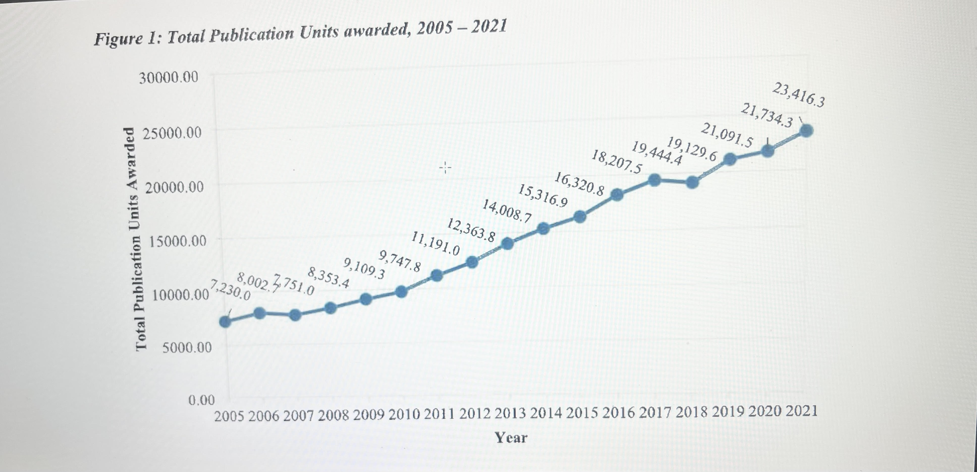
Research Outputs over time (From DHET report, 2023)
Ali Mazrui Centre for Higher Education Studies, Faculty of Education

Slide 9
Student funding policy implementation and instability
From 2018 shift in student funding policy. There were three key points of change: threshold; fully-subsidised (free for qualifying students); and expected time to completion (N+1). Accompanied by massive increase in budgets.
What did NOT change- not free education call of #feesmustfall- government has consistently argued (since WP3) that a free education model is not financially feasible.
Implementation of new model was extremely complex and there was no planning lead time. This, combined with the need for annual additional funding, has meant regular policy shifts and implementation changes
Learning material allowance and bank accounts (2019); limited postgraduate/pathway funding; increases limited; no threshold change since 2018; complexities of managing accommodation costs- how does NSFAS know what it is funding; capping costs of accommodation.
The initial distribution model was from the NSFAS to institutions- i.e. funding distributed via institutions.
Early on there was a call for a “student-centred model” where benefits should be distributed directly per student. This has been implemented with the new policy and is a significant shift, given the costs involved.
However, a “student-centred” distribution model, as envisaged by NSFAS has been an issue of complex contestation.
Direct payments to students are not currently possible: students qualify financially and through academic/registration status- only integrated data can work for direct payments. This integration does not exist. NSFAS did not conduct feasibility studies and went ahead despite concerns of universities.
What should NSFAS role be in relation to accommodation provision? What is NSFAS core job?
Collaboration is unavoidable.
Preventing fraud, ensuring adequate systems are built, and focusing on paying students on time so they can succeed.
Ali Mazrui Centre for Higher Education Studies, Faculty of Education

Slide 10
The future of higher education financing
Introduction of new policy did not resolve the question of how to sustainably fund access to higher education, within the context of an appropriately funded whole education system. Solutions require difficult political choices about where funding should be directed; joined-up social policy and spending; and long-term policy/funding stability.
Policy changes have been made without planning for the implementation of change and thinking through the implications of implementation.
Capacity to implement is weak, has weakened, and has had disastrous consequences for individual students and institutions. This capacity must be addressed.
Student funding policy is in some ways driving the funding of the HE system, rather than supporting the achievement of higher education policy goals.
The underlying question of higher education as a public good and how it should be funded is unresolved and remains a policy tension. What route should be taken into the future?
Tendency to reject policies as wrong because implementation didn’t work – this is not the way to make policy. The failures should not lead to a rejection of the core policy intent and its critical importance.
New institutions and campuses. Ad hoc policy making, with long term uncertainty.
Fee regulation: systemic inequality, transparency and affordability (for individuals and the State).
Continued austerity and low real growth in university subsidy with increasing cross-subsidization of other priorities.
Research funding also in decline.
Reviewing the research outputs policy?
Higher education inflation?
Ali Mazrui Centre for Higher Education Studies, Faculty of Education

