Slide 1
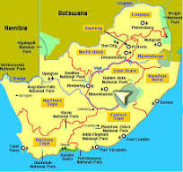

A research journey
Melanie Walker, Higher Education & Human Development research group (HEHD) University of the Free State, Bloemfontein, South Africa

Slide 2
Serendipitous careers: ‘conversion factors’
Place/country, generational (age?), gender, race/ethnicity
What matters/what is of ultimate value?
Academic ‘gift economy’
Archer: ‘reflexivity mediates between the objective structural and cultural contexts confronting agents, who activate their properties as constraints and enablements as they pursue reflexively defined ‘projects’ based on their concerns’ (Archer 2010). We need to see that [our academic career-making] agency works within a context, [e.g. a university dept/university], in which the action is structured by that context but not determined by it. We engage in ‘reflexive deliberations’, i.e. internal conversations, about the [objective] situation and our own [subjective, personal history, biographical and values-shaped] concerns. We determine our choices of practical action [our ‘projects’] in relation to our objective circumstances. A ‘mode of reflexivity’ is the manner in which we think about our thinking, our ‘inner conversations’ that then shape our actions.
Notes:
Archer outlines 4 ‘ideal types’: meta, autonomous, communicative, fractured. Meta reflexives are values driven over and above considering outcomes or consensus. Meta reflexives think about whether there is a correct course of action, what drives thinking before action. They will seek out an understanding of power structures and ethical positions. An 'autonomous reflexive' does not stop to consider how their decisions will be thought of by others, they act because they think it is the correct course of action for themselves. They act decisively, trusting themselves sufficiently to commit to the conclusions they have come to. They are outcomes driven, over and above issues of value and consensus.

Slide 3
My pathway
Non-linear, dynamic political context, not status or advancement but ‘how can I make a social justice difference?’
Initially worked in low-income schools then universities in SA, UK, then back to SA
Have had to create my own opportunities and community/
networks
Now: Significant capacity-building in/for SSA ECRs (epistemic justice)

Slide 4
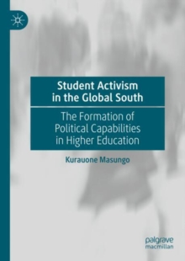

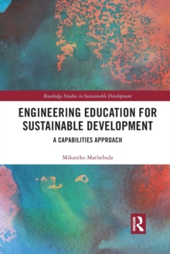
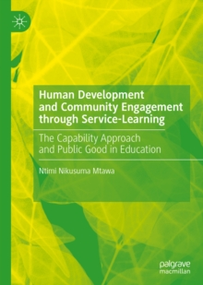
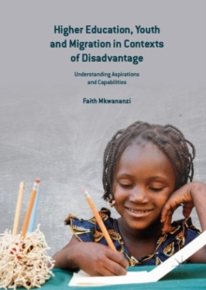
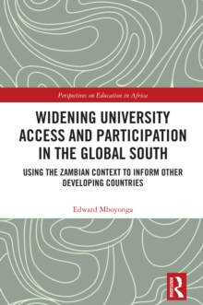

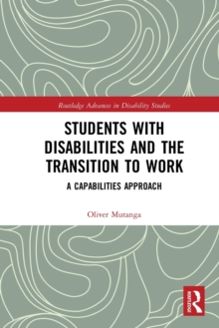
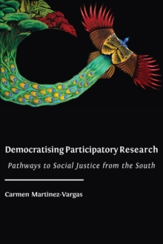

4 books coming up: Chimwemwe, Fenella, Judith, Daizy

Slide 5
Who am I as scholar
Capabilitarian scholar working in the human development and education space
Research projects have examined academic professionalism, public-good professionals, racism, gender equalities, employability, youth voices, access, participation & success of low-income youth. Emphasis on capabilities and functionings, critical agency, knowledge, dignity, epistemic justice.
Participatory research (photovoice, digital story telling)
Core capabilities for a fair and democratic society in and through HE policy and HE institutions and individual formation might be: capability to aspire, capability for voice, capability for critical plural knowledges and epistemic contributions………..

Slide 6
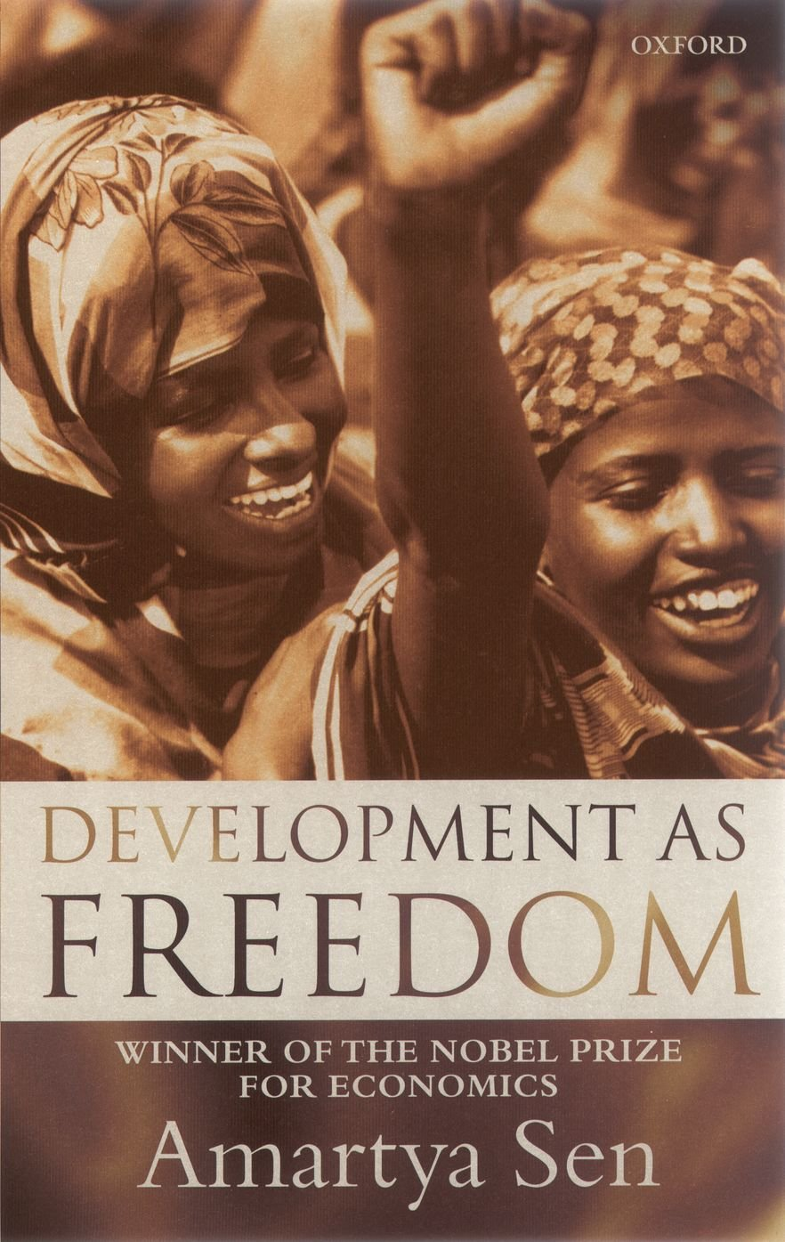

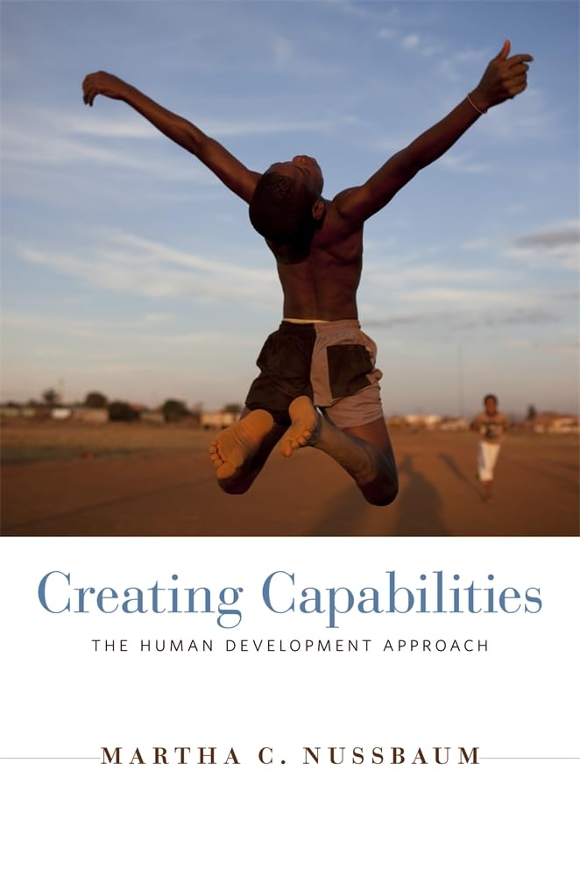

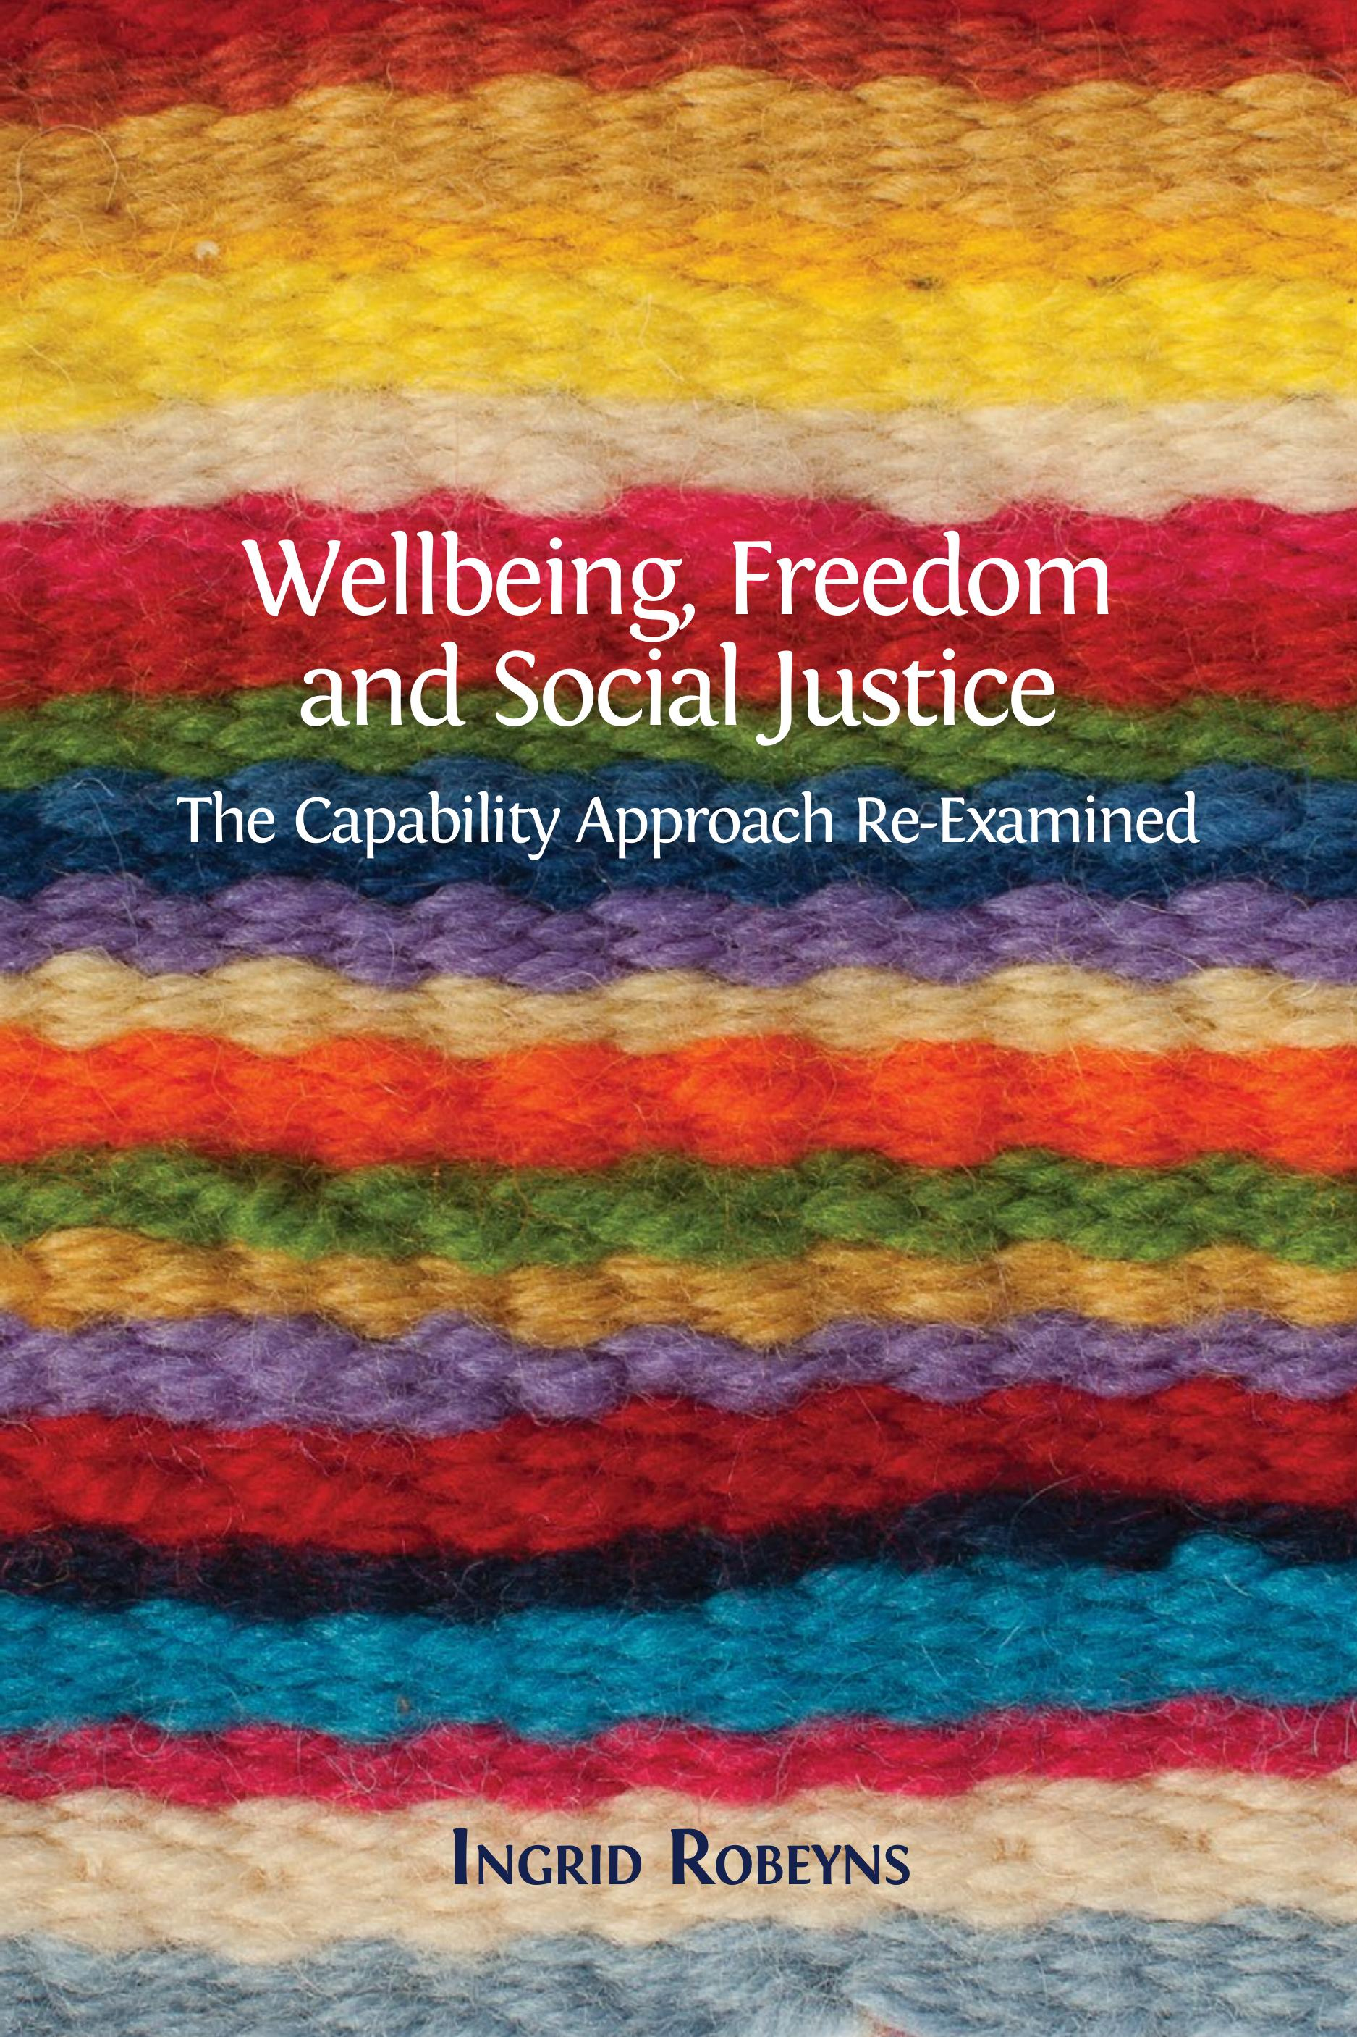
Human Development and Capability Association (HDCA) https://hd-ca.org/
Journal of Human Development & Capabilities
https://www.tandfonline.com/toc/cjhd20/current

Slide 7
Capability approach
‘Equality of what’? (Sen). For any approach to equity, equality, justice in HE you need to know what you want to put in the informational space of justice if you want to argue/evaluate what is more or less just (policy, institutions, individual formation etc): class, gender, race, disability, etc. For me it is capabilities and functionings (well-being).
Anchored normatively in human development
Open-ended & capacious: accommodates decolonial approaches, repair (past/present/future), planetary consciousness - by drawing on additional/complementary theorists
Non-ideal justice
Relational ontology (extended only to humans, however)
Context is crucial
[Relational] Capabilities are effective opportunities to be and to do in ways we value; functionings are realised achievements (what we can actually be and do); conversion factors account for enablers and constraints (historical, social, environmental, personal) ; agency involves working towards the goals you value [how are values formed/changed?].
Education includes but goes beyond human capital. Education is intrinsic, instrumental and social in its aims and effects. Overall undeveloped In CA except Martha Nussbaum, 2006. Education and Democratic Citizenship: Capabilities and Quality Education, Journal of Human Development and Capabilities, Taylor & Francis Journals, vol. 7(3), pages 385-395.)

Slide 8
Where I am now
Three linked projects on eco-flourishing and HE/lifelong learning contributions
SUSA (2023) Two university case studies
Uni-PRA (2025) Three ‘best’ cases at one university
PlanEd (pilot planned for 2026) two sites of professional eco-formation

Slide 9
Interwoven human and non-human flourishing: caps and functionings
An overlapping eco-conversation
An ecocentric paradigm
refined iteratively through
empirical and dialogic encounters…..
Repair/
reparative practices
Planetary consciousness/indigenous knowledges/ integral ecology
Transformative learning (indivs, institutions)

Slide 10
Community Case ACTORS | REPARATIVE LEARNING PRACTICES & PROCESSES
Student volunteers | dignity, compassion and care, truth-telling, multiple narratives, responsibility (to UFS, to community)
Scientist | truth-telling, compassion (response to exhibition, but some ambivalence) multiple narratives (scientific narrative different depts, different scientific expertise, collaborative inter govt panel), responsibility (to the public good, to environmental repair, to society)
CDS Research Project | dignity, compassion and care, truth-telling, multiple narratives, responsibility (knowledge for society, enabling community voices), creativity (flexibility of the project, organic interview methods)
CDS Arts-based Project | dignity, compassion and care, co-created truth-telling, creativity, multiple narratives, responsibility (to the community)

Slide 11
Uni-PRA VALUED CAPABILITIES AND FUNCTIONINGS (CONTINUOUS) FORMATION
STUDENT VOLUNTEERS | SCIENTIST | CDS RESEARCH PROJECT | CDS ARTS-BASED PROJECT
Gratitude
Care and compassion - working sensitively with victims of disaster and limited formal education | Compassion, empathy | Care and compassion, healing - working sensitively with victims of disaster and limited formal education | Care and compassion, healing - working sensitively with victims of disaster and limited formal education
Courage
Public spirit | Community service (public-good) | (Knowledge for the) public good | Community service (public good)
Knowledge (of toxicity, disaster response) | Collaborative knowledge making | Knowledge (of context, of disaster management, of mining, of people’s lives and experiences) | Co-creation of knowledge, memorialising
 |  | Political awareness and skills | Political skills
 |  | Trust building and rapport | Trust building, building connections, contribution to social cohesion
 |  | Research skills | Participatory (research)skills
 |  |  | Creativity
 |  |  | Fostering hope
 |  | Voice and recognition | Voice and recognition
Responsibility | Responsibility | Responsibility | Responsibility

Slide 12
Working on an institutions (policy paper)from the research, with colleagues
Bonvin and Laruffa (2024): Institutions should allow people to envision and realise more emancipatory futures. At the core of transformative social institutions there is, then, the cross-fertilising connection between capability to aspire and capability for voice. To promote such a connection, it is crucial to identify the factors that may impede the joint development of these two capabilities. Transformative social institutions as defined in this article not only expand objectively the sets of available opportunities and rights, but they also create in their beneficiaries an enhanced sense of opportunity and entitlement, striving to remove the subjective and objective barriers that impede the access to such opportunities and rights

Slide 13
Policy repair?
Interactive space of social (education) policy and universities (institutions).
If social policies are to be reparative-transformative and in turn produce reparative-transformative institutions which capabilities might be core to such policy repair? Bonvin and Laruffa (2024): capability to aspire, capability for voice
What might be the core capabilities and functionings to advance social justice in and through higher education? [What would univs need to look like to be more just?]
How persuaded are you by human development and/or the capability approach as a viable framework for researching HE?

