Slide 1

The mobility of students from China to UK amid the Geopolitics dynamic
Wenqin Shen
Graduate School of Education, Peking University CGHE Webinar: Ideas and Universities Dialogue Series, December 23,2025

Slide 2

Research Context : Geopolitics dynamic
1) The multi-polarization of the world and “the rise of the Rest”(Zakaria，2008）
2） US-China Competition and the rise of China
“This geo-political change – the rise of China, the most important geo-political change in my children’s lifetime. It is the most important geo-political change in the 21st Century”(Tony Blair,2020, quoted in Wye,2023）
3) The intertwined influence of geopolitics and geo-economics

Slide 3
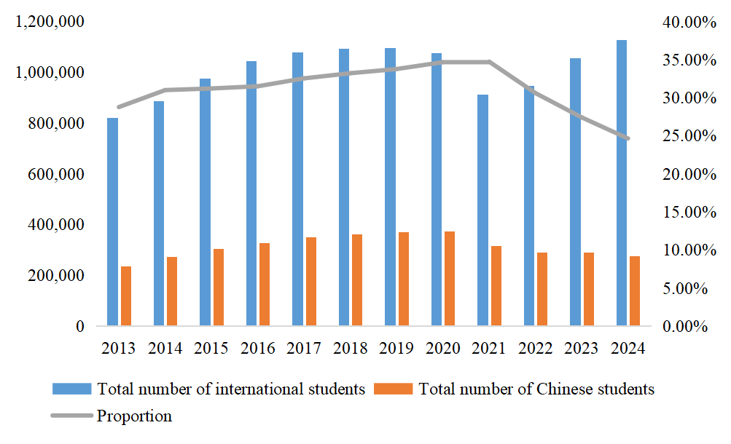
Research Context : Geopolitics & The changing landscape of ISM
Closed space & Open Space
1) Rising nationalism and protectionism globally challenge the neoliberal framework of international education (Westermann, 2024).
2) Since 2018, the previously hegemonic neoliberal multiculturalism is confronting challenges both within the domestic and from abroad in the United States (Lan et al.,2024). The Federal government has introduced a series of policies to restrict Chinese students, and it has become increasingly difficult for students in STEM fields to study in the United States. India overtook China as the top source of international students in 2024.
3）69 % of Republican voters and 42 % of Democratic voters supported limiting Chinese students studying in the U.S. (Silver et al., 2021)
4) Between 2019 and 2022, the number of Chinese students studying abroad worldwide fell by 4.7%, but the number going to the United States fell by 24.1% (Zweig,2024)
Figure: Total Enrollment of Chinese Students in the U.S. and Their Proportion of International Students (Data Source: IIE)

Slide 4
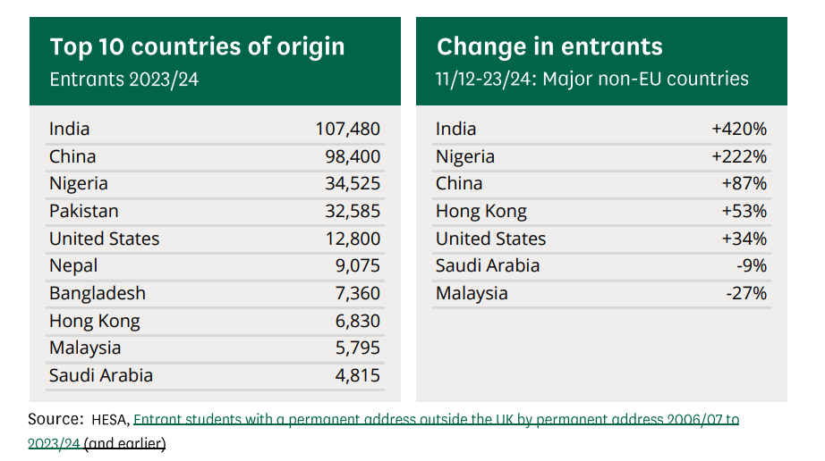
Research Context : Geopolitics & The changing landscape of ISM
Closed space & Open Space
Compared with the United States, the UK is more positive about recruiting Chinese doctoral students (Adams,2023) and continue research collaboration with China (Johnson et al,2021).
Between 2019 and 2022, the changes in Chinese students studying abroad in different countries are as follows: the United Kingdom (up 37.6%), Canada (up 9.4%), Japan (up 9.3%), Germany (up 8.1%) and Russia (up 33.3%). (Zweig,2024)
Source: Bolton et al,2025

Slide 5




Research Context : the evolution of Sino-British higher education relations
In the 1950s, British scientists visited China.
Sino-British relations in the 1960s included the exchange of visiting scholars.
British scientists who visited China in the 1970s include Kurt Mendelssohn (1971), Dorothy Hodgkin (1972), and John Sutton (1973).
Sino-foreign joint ventures in education include the University of Nottingham Ningbo China and Xi'an Jiaotong-Liverpool University.
In 2020, China was the UK's third largest research partner.

Slide 6

The dynamic changes in Sino-British relations amidst geopolitical shifts
The earliest record of Sino-British relations dates back to 1583, with the first letter sent by Queen Elizabeth I to Emperor Wanli of the Ming Dynasty (Liu, 2022).
“UK–China relationship is one that is in a process of transition, and that in many key areas it is untested, lacks an easy framework for new transformation, and carries great uncertainty”(Brown,2019)
negative and worsening perceptions of China in the UK during the Pandemic (Summers et al,2022)
Sino-British relations are greatly influenced by the United States. In terms of China policy, Boris Johnson's cabinet is more influenced by US pressure than by domestic pressure (parliament), see Xu & Wang (2025)

Slide 7
Literature Review: The Impact of Geopolitics on International Scientific Research Cooperation
The impact on international scientific collaboration, such as in Russia (Zhang et al., 2024)
Meanwhile, the number of researchers with joint US-China affiliations has decreased (Van Noorden, 2022).

Slide 8
Literature Review: The Impact of Geopolitics on International Academic Mobility
Overall, international education or international academic mobility has shown a tendency towards "geopoliticalization" and "weaponization" (Tran et al, 2024).
Shortly after Trump took office, some scholars predicted that the attractiveness of the United States to international students would decline (Altbach & De Wit, 2017). A difference-in-differences econometric analysis showed that the "America First" policy led to a decrease in international students (Song & Li, 2022).
Due to geopolitical influences, the number of Chinese students going to the United States has decreased, and there has been a shift in their destination countries (Mok, Shen & Gu, 2023).

Slide 9
Literature review :The flow of university students from China to the UK
Background & Motivation
Compared to Indian students, Chinese students are less affected by changes in UK immigration policies(Lomer, 2018). Tu & Nehring (2020) also find that few Chinese students in UK regarded gaining PR in a Western country as their main motivation for learning abroad.
Chinese students in the UK mainly come from relatively wealthy middle-class families, and they are primarily attracted by factors such as university reputation(Consoli,2024), international cities, Shorter academic programs(Zhai & Cao,2025) and culture.
Geopolitical factors and mobility decision
The geopolitical conflict between China and the United States has led some students to abandon their plans to study abroad or to transfer to other countries(Mok, shen & Gu,2024). Some interviewees in Yu & He (2024) also mentioned the Sino-US conflict as one of the reasons for choosing the UK.
Transition to Work and Migration
Chinese students who stay in the UK after graduation are not only motivated by economic factors, but also consider a lifestyle that offers a good work-life balance(Huang & Cohen, 2024).

Slide 10
Research Gaps
A geopolitical perspective is increasingly being incorporated into higher education research(Lee, 2015;Csaszar et al, 2023), but there is still a lack of a clear definition of the concept of geopolitics and a lack of utilization of geopolitics-related research.
In the context of international student mobility, it is unclear how relevant actors understand geopolitics and how geopolitics actually influences their decision-making.
Methodologically, existing studies have widely adopted bibliometric methods (Poitras & Larivière, 2023), questionnaire surveys (Gao, Shen & Xu, 2024), interviews (Mok, Shen & Gu, 2024), policy text analysis, and critical discourse analysis (Weimer & Barlete, 2020), but mixed-methods research is relatively uncommon.

Slide 11

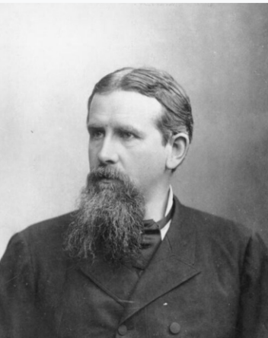

conceptual framework :Geopolitics lens
The term geopolitics was first used in the late 19th century (Agnew, 2004), and its rise originated in Germany before World War II. In the more than four decades since World War II, very few scholars have used the term geopolitics (Dodds, 2007:17).
“The term ‘geopolitics’ has long been used to refer to the study of the geographical representations, rhetoric and practices that underpin world politics …… examination of the geographical assumptions, designations and understandings that enter into the making of world politics.” (Agnew, 2004:5)
Geopolitics primarily refers to the changes in power and status of different countries in world politics, as well as the foreign policies adopted by these countries(Overholt,2007).
Friedrich Ratzel
Halford Mackinder

Slide 12
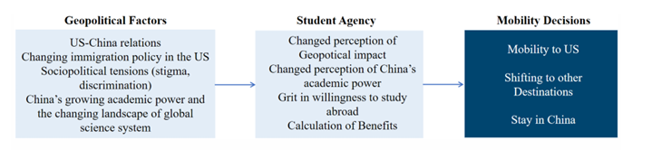
conceptual framework on Geopolitical factors and ISM
Mok, K. H., Shen, W., & Gu, F. (2024). The impact of geopolitics on international student mobility: The Chinese students' perspective. Higher Education Quarterly, 78(4), e12509.

Slide 13
Data & Research Design
Quantitative analysis:
Open Doors Report by the Institute of International Education (IIE)
Chinese undergraduate students’ study abroad data disclosed by universities themselves
National Survey Data of Chinese doctoral graduates between 2017-2024 (about 50,000 valid responses)
Faculty resume records from China’s elite universities (Data by Dr. Chen pei)
Interview data:
400+ interviews since 2020 with Chinese students who plan to study abroad
Interview team members: Shen Wenqin, Wang Jialu, Lin Fengyi, Li Guang, Zhang Kun, Gu Feifei, etc.
More than 60 of them choose UK as their first choice destination

Slide 14
Project publications
Mok, K. H., Shen, W., & Gu, F. (2024). The impact of geopolitics on international student mobility: The Chinese students' perspective. Higher Education Quarterly, 78(4), e12509.
Lin, F., Wang, J., & Shen, W. (2024). Staying away from the crowds: an analysis of factors influencing Chinese college graduates’ decision to study in the Nordic countries. Journal of Asian Public Policy, 1-23.
Wang, J., & Shen, W. (2025). Mobility in an Imagined Global Knowledge Space: Chinese STEM Undergraduates’ Decision to Study in Europe. Journal of Studies in International Education, 10283153241307966.
Wang, J., Lin, F., & Shen, W. (2025). Self-perceived identities of female doctoral students in mobility: empowered transformation or eroding academic commitment?. Studies in Higher Education, 1-16.
Chen, J., Fang, Y., & Shen, W. (2025). Broken Desire: Chinese Students’ Abandonment of Overseas Study Amidst the Changing Global Landscape and Geopolitical Tensions. Population, Space and Place, 31(7), e70109.\\
Gao, C. Y., Shen, W., & Xu, H. (2024). Will COVID pandemic intensify the inequality in transnational education participation?. Asia Pacific Education Review, 25(4), 1037-1050.

Slide 15
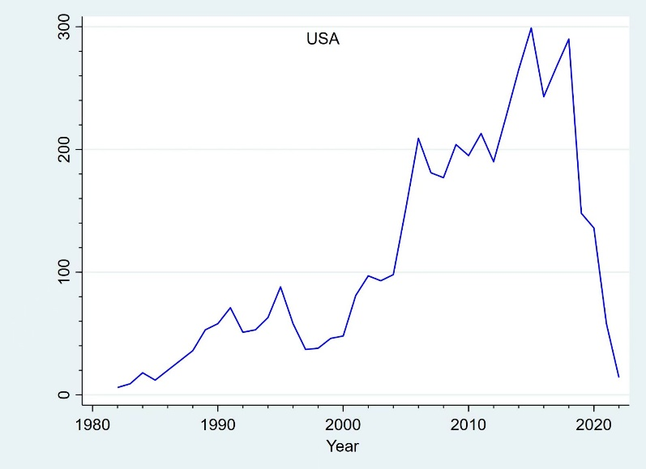
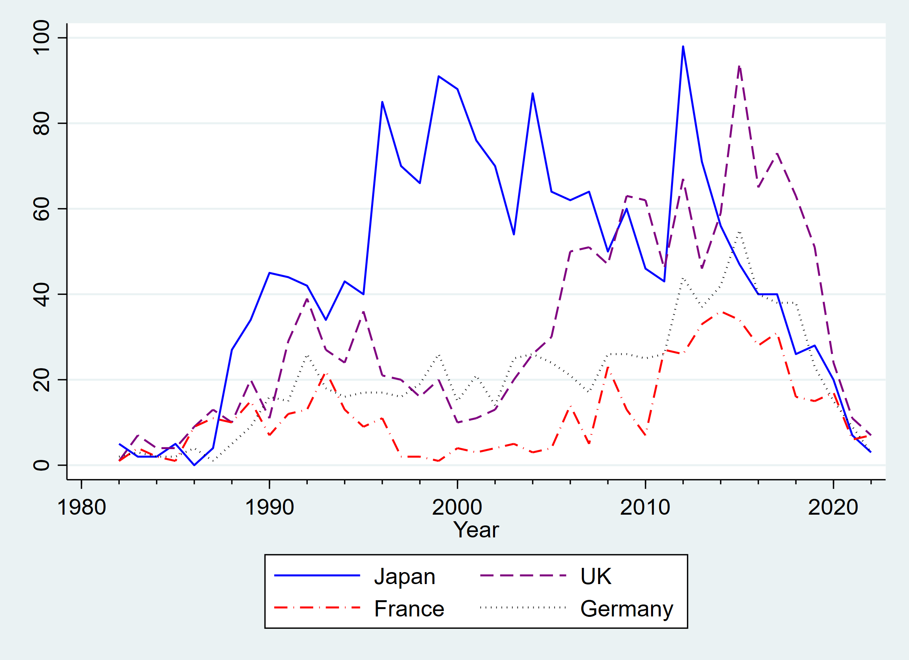
Research finding: the rising of Doctoral returnees from UK
Ph.D returnees in Chinese academia
In a few top universities in China, 40 - 70% of newly hired faculty are Ph.D. returnees.
These returnees obtained their doctoral degrees mainly in the United States, the United Kingdom, Japan, Germany and other countries.
Among the faculty members in China’s Double First-Class Universities, 5,470 of them received their doctoral degrees in the United States (source：CHEN pei & SHEN wenqin , work in progress).
Apart from the United States, Japan has always been the main source of overseas returnee PhDs in China’s elite universities, but in recent years the number of Japanese returnee PhDs has been surpassed by the United Kingdom. (source：CHEN pei & SHEN wenqin , work in progress).
Distribution of the years in which returnees from the United States and other countries received their doctoral degrees

Slide 16
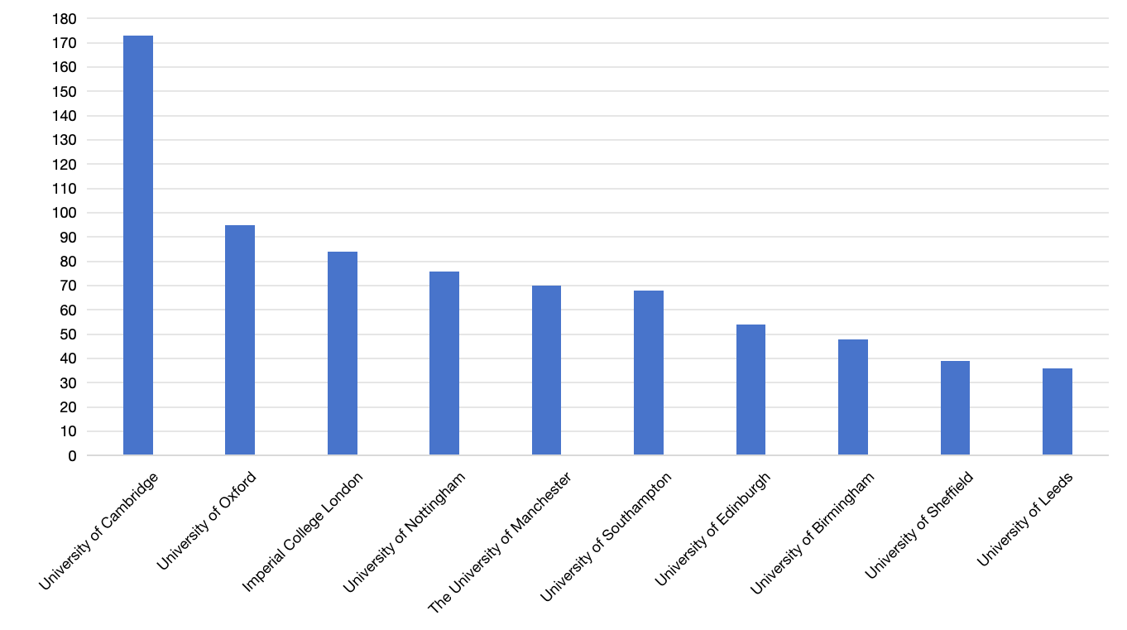
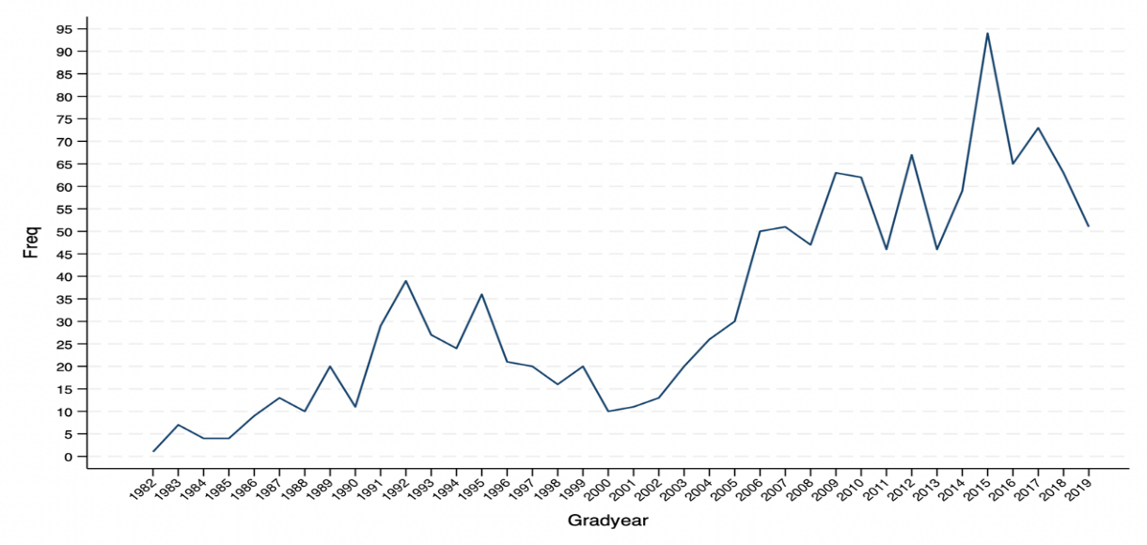
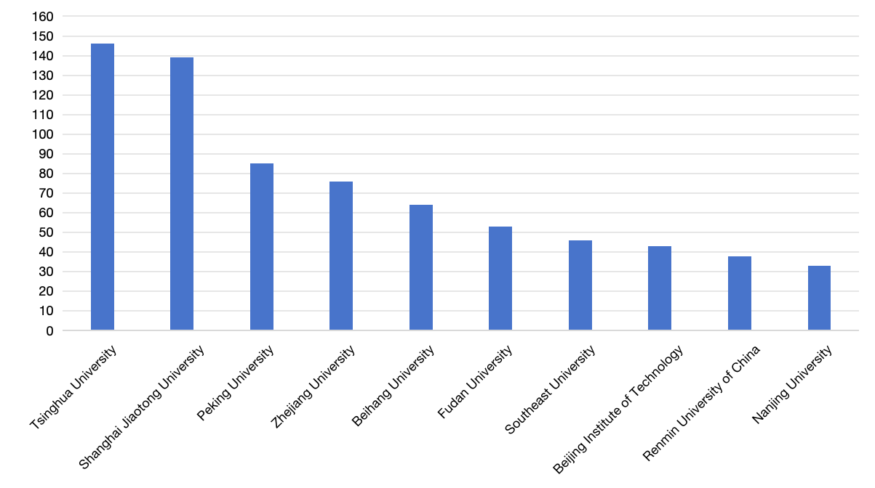
Research finding: the rising of Doctoral returnees from UK(2)
UK Ph.D returnees in Chinese academia
Since 2000, the number of returnees from the UK among China's top-tier universities has increased significantly. (source：CHEN pei & SHEN wenqin , work in progress).
These returning PhD graduates mainly come from elite universities such as Cambridge University and Oxford University, with 173 from Cambridge and 95 from Oxford . (source：CHEN pei & SHEN wenqin , work in progress).
Similarly, British-educated PhDs are mainly concentrated in 985 Project universities, with the top three being Tsinghua University (146 people), Shanghai Jiao Tong University, and Peking University (85 people). . (source：CHEN pei & SHEN wenqin , work in progress).

Slide 17
Research finding: UK in the Hierarchy of Knowledge Mobility Spaces
Hierarchy of Chinese students’ preferences for study abroad spaces for doctoral study abroad: USA > UK > other European countries > other countries (doctoral study abroad, research capacity, scholarship)
USA - UK -other European countries - other countries (master degree abroad, cost, time to degree)
In the fields of computer science, physics, mathematics, etc., American universities are sconsidered the best in the world and are the “world academic center”
The higher the ranking of the undergraduate institution of Chinese students, the more they tend to prefer prestigious American universities.
In addition to undergraduate school background, Chinese students’ choice of study abroad destination is closely related to their class background.
Wang, J., & Shen, W. (2025). Mobility in an Imagined Global Knowledge Space: Chinese STEM Undergraduates’ Decision to Study in Europe. Journal of Studies in International Education, 10283153241307966.

Slide 18
UK as a dominant destination :the attractiveness of British higher education
Among our 400 interviewees between 2020-2025, about 70 students chose the UK as their study abroad destination.
Reputation and Ranking
Time to degree
The shorter duration of the UK's academic program is one of the main reasons I chose it. A master's degree takes one year, and a doctorate takes three or four years. This is a very important factor. (Yi, University of Cambridge, 2020 interview)
Relationship with China
Question: We often ask students applying to the US about geopolitical issues; I wonder if this has affected you, especially regarding the UK?
Respondent: The relationship between China and the UK has always been good, basically without any problems. (2025 interview, Yuxin, Biopharmaceutical Sciences)

Slide 19
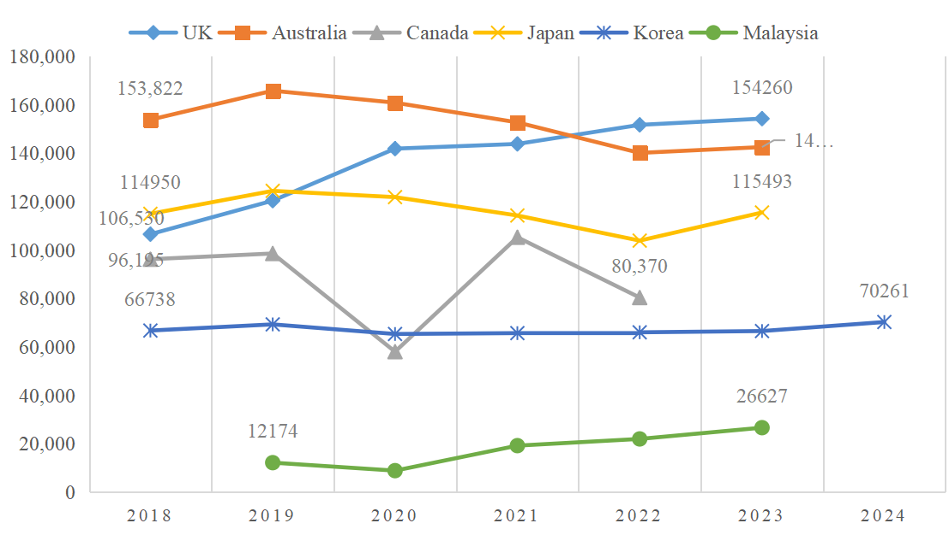
UK as Alternative Space: Shifting of learning abroad destinations of Chinese Students by IIE data
The number of Chinese students in the UK has steadily increased, even during the pandemic. While business education remains popular, international students in STEM fields have grown by 40% over the past eight years.
Figure : Changes in the Number of Chinese Students in Major Study Abroad Destinations, Unspecified by Degree Level (Data Source: IIE/HESA/Study in Japan/KOSIS)

Slide 20
Shifting from US to UK: case studies
Among our 400 interviewees between 2020-2025, 43 shifted their study abroad destination from the United States to other countries, with 16 of them choosing the UK, accounting for 37%. Additionally, more than 20 students abandoned their plans to study abroad altogether(Chen, Fang & Shen,2025).
Reasons for transferring from the US to the UK:
1)Geopolitical factors and US-China conflict, such as the 10043 Act and restrictions on sensitive majors (Ruijia, Yuxin, Yufei, QR)
2)Parental opposition to studying in the US (Xiaoyu, Yueyi, Ziyang)
3)Higher university rankings in the UK (Jiahe)
4)Pandemic and safety concerns (Yueyi, Yuxin, Ziyang, Leo)
5)Did not receive an offer from a US university (Yang Fan)
6) Parents' concerns: The proportion of Chinese students studying in the US who eventually immigrate is too high.

Slide 21
Geopolitical factors and the shifting of destination from US to UK
“Later, considering the political situation in the United States, especially in the field of biomedicine, they have some restrictions, so I ultimately didn't choose the US. ...If I were to pursue a Ph.D. in the US, every time I entered the country, they might question me or check my background, which would be quite troublesome. And now, with Trump in office, didn't he shut down a major foundation related to biomedicine? So, I feel quite fortunate that I didn't go to the US back then, otherwise I would be affected now.” (Yuxin, Biopharmaceutical major, 2025 interview)
“I'm studying computer science, and my first impression of the US in this field is because they have many universities... Plus, in the field of computer science, you have to admit that they are indeed leading. Because of Trump's 10043 regulation, our university is on his blacklist. ...Some of my classmates tried to apply to schools like Cornell or Columbia, but even after getting offers, their visas were blocked. So, we couldn't go.” (Yufei, 2024 interview, Telecommunications Engineering)
I'm applying to both the UK and the US. Originally, I only wanted to apply to the US because I felt the degree there might be more valuable. However, due to the current uncertain international situation, I'm applying to both the UK and the US. Also, my parents prefer that I go to the UK, so I'm applying to both countries. (2020 interview, Business Administration, Yuemin)

Slide 22
Parents' anti-immigration attitudes and the shifting of destination from US to UK: Xiaoyu’s case
Profile of Xiaoyu: BA degree from 211 project university, computer science, Male ; Middle class parents
Reason for Learning abroad: Getting accepted into a graduate program at a top Chinese university is too difficult.
Preferred study abroad destination: the United States (“You're studying computer science, where else would you go besides the US?”)
The reasons for transferring to the UK: The reason for moving to the UK: His parents opposed him going to the United States because they were worried about him immigrating there.
Quotation “My intention in going to the United States is quite clear: I want to live in a different country. However, my parents are quite resistant to this idea, so they think that if I go to the US, I'll stay abroad forever.”

Slide 23
Distinction Making: the unique elite status of Oxford and Cambridge and the shifting of destination from US to UK- wanhe’s case
My original plan was to study in the US, which seemed like a natural progression. So, when applying to universities, I applied to many in the US, I think seven in total. I only applied to three in the UK, specifically Cambridge and Oxford. At the time, I felt that if I wasn't accepted into a top-tier university, I wouldn't want to go to the UK. But then I was accepted into a university that I absolutely had to go to (referring to Oxford University)..

Slide 24
Shifting from UK to other destinations: case studies
Among our interviewees, 20 changed their study abroad destination from the UK to other destinations (Australia 7, South Korea 4; German 2; Netherlands 2; Singapore, 1, Hong Kong 1, Spain 1; France 1; Denmark 1)
The main reasons for relocating from the UK to other destinations.
1)Cost of learning abroad
2) Ranking
3) Academic Technology Approval Scheme,

Slide 25
Shifting from UK to other destinations- Academic Technology Approval Scheme-Xiaojun ‘s story
In 2007, the British government introduced the Academic Technology Approval Scheme (ATAS), a program that requires students in 41 subject areas to complete a questionnaire including information about their family background, and to undergo scrutiny by British security agencies before being granted entry. The intention of this regulation was to prevent sensitive knowledge from being transferred to certain countries (Brumfiel, 2007).
I also applied for a CSC scholarship, and the results came out. I received an offer from a university in the UK, but I still needed to pass the ATAS security clearance. However, this process was very complicated. The first time I applied for ATAS, I waited three months, but it was rejected. Then I communicated with my professor in the UK, and he helped me write an appeal letter. Ultimately, I got a new passport and applied again. I went through this process three times, each time waiting about three to four months, but I still didn't pass. Because ATAS is independent of the university, as long as it's the same major, you have to reapply. I finally decided to stop applying to the UK and considered other countries instead. (Interviewee, Physics major, studying in France, January 2025, pseudonym: xiaojun)

Slide 26
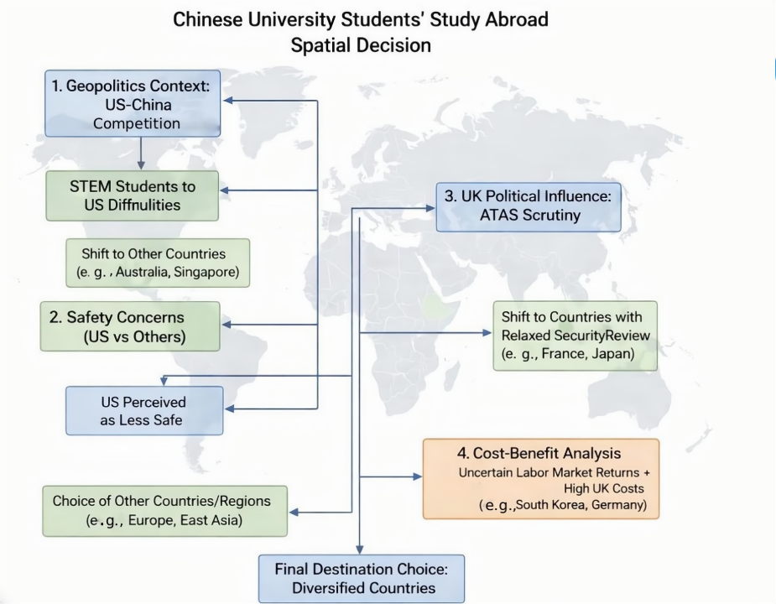
Summary
Geopolitical Factors matters
Other factors play a role
1)Safety concerns
2)Cost matters: UK also loses some potential Chinese students due to cost consideration
3)Immigration concerns
4)Ranking and reputation
Remaking of international education Space

Slide 27
The future of ISM between China and UK under geopolitics dynamics and beyond
The challenges of geopolitical competition
Against the context of deteriorating Sino-US relations and geopolitics dynamics , the number of Chinese students studying in the United States has been on a downward trend.
Britain's position in the geopolitical competition between the United States and China
1)The shifting of learning space from US to UK . Mainland China and Hong Kong are forecast to account for one third of all undergraduate acceptances through 2025-2030 (Neville et al,2025)
2) The UK's policy on Chinese students studying in the UK does not strictly follow the US approach. In recent years, the number of Chinese students studying in the UK has remained stable.
Leveraging Sino-UK student mobility to enhance global public goods and mutual understanding
1) Make full use of transnational social capital: leverage the growing cohort of UK-trained Chinese PhD returnees as a strategic asset to promote Sino-UK scientific collaboration, which in turn will foster greater doctoral student mobility between the two countries.
2) costs and affordability of Study abroad .

Slide 28


Thank you for your attention!
shenwenqin@pku.edu.cn
Graduate school of education, Peking University

