Slide 1



Unpacking persistence of first-generation students in Australia, Austria, Ireland and the UK
Franziska Lessky, Sally Patfield, Sarah O’Shea
CGHE Webinar, 20 January 2026

Slide 2

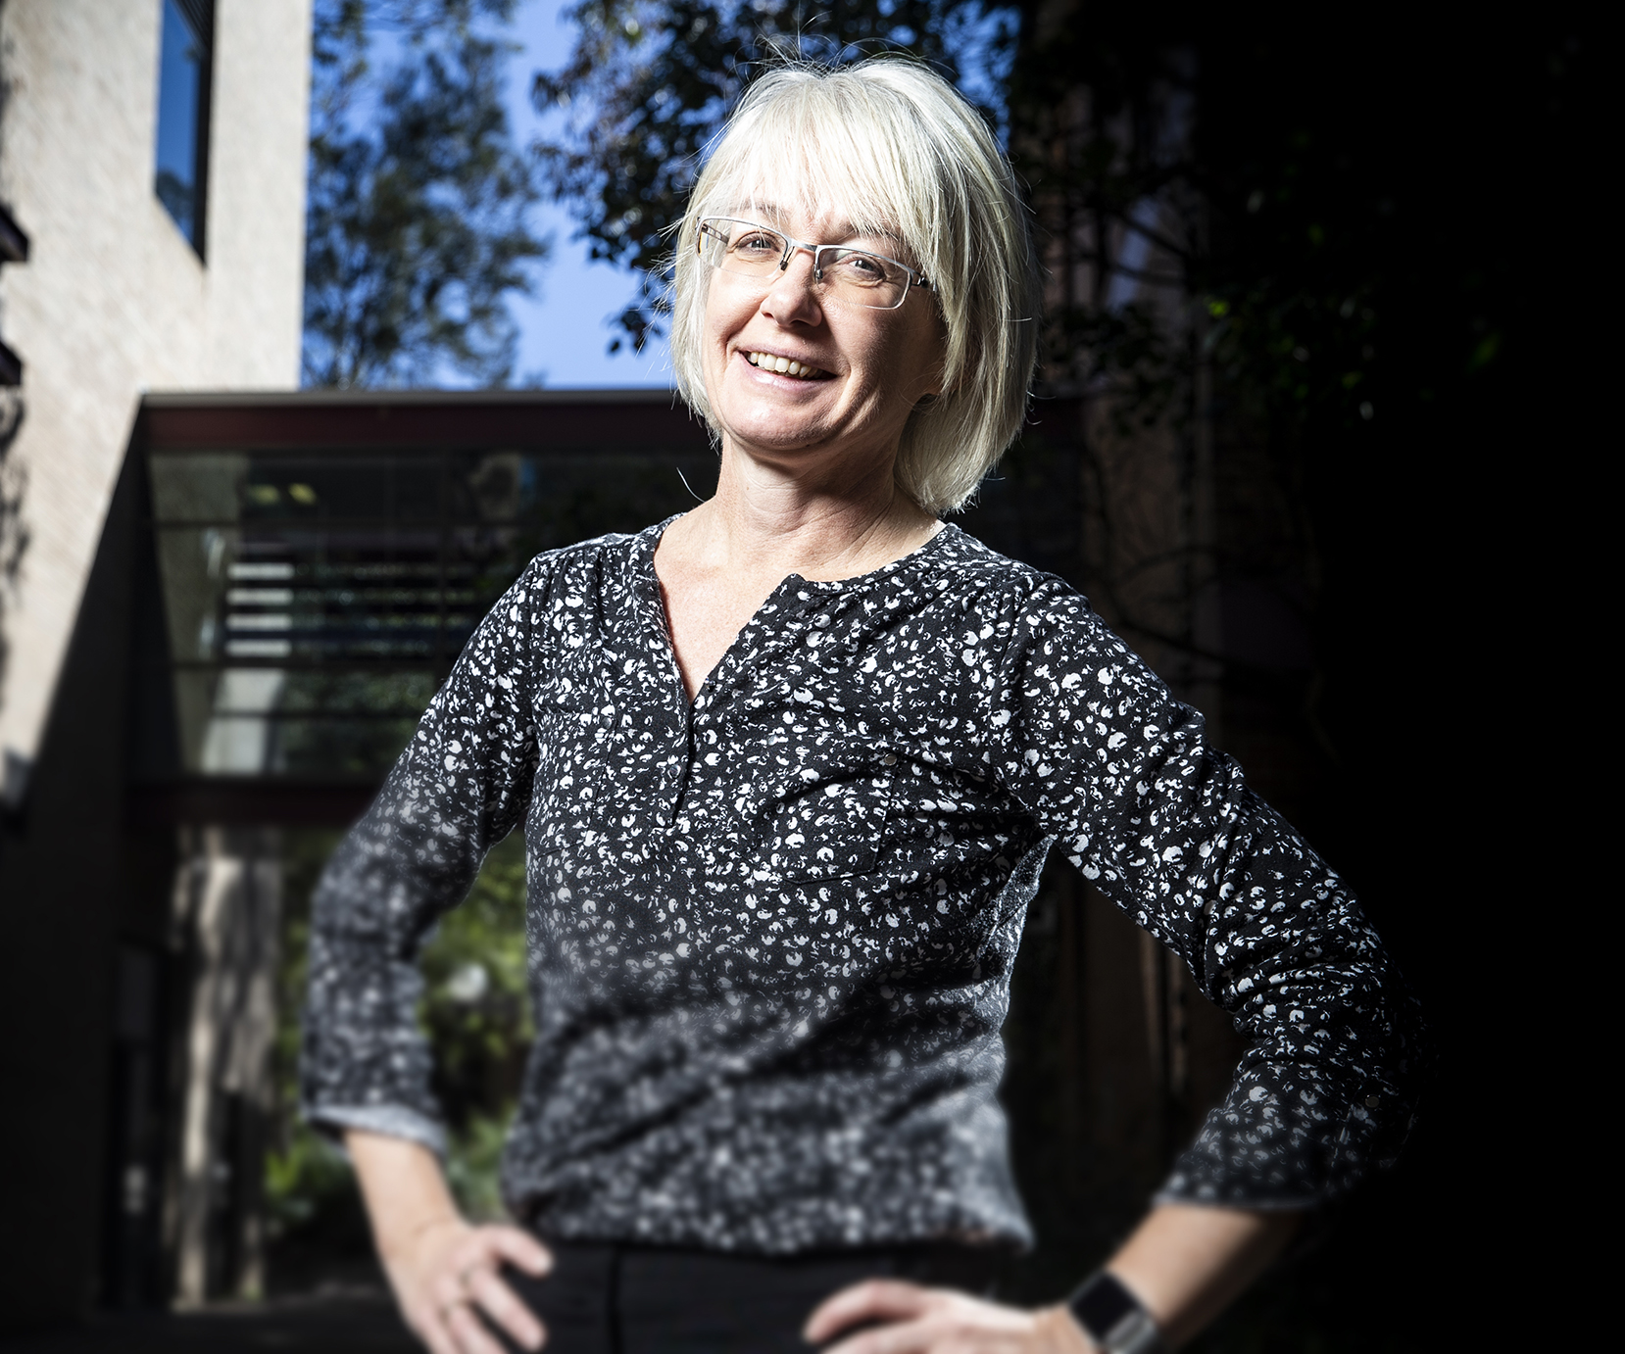

Three studies – shared focus
2
Notes:
The three studies took place at different times and in different locations but united by a common focus on first-in-family learners. A total of 174 participants from 17 universities engaged in in-depth interviews with questions that considered individual biographies, their rationale for enrolling in the degree and institution, their aspirations and goals, as well as barriers/enablers to achieving these aspirations and goals. Interviews took place either via Zoom, phone, or face-to-face on-campus, and lasted between one to four hours. Whilst these studies were separate, they were complementary, each striving to consider how social structures impact on the persistence of students from equity backgrounds
This kind of international analysis is something that is manifestly missing from the current literature and research in this field, which tends to focus on FIF students within distinct national contexts.

Slide 3
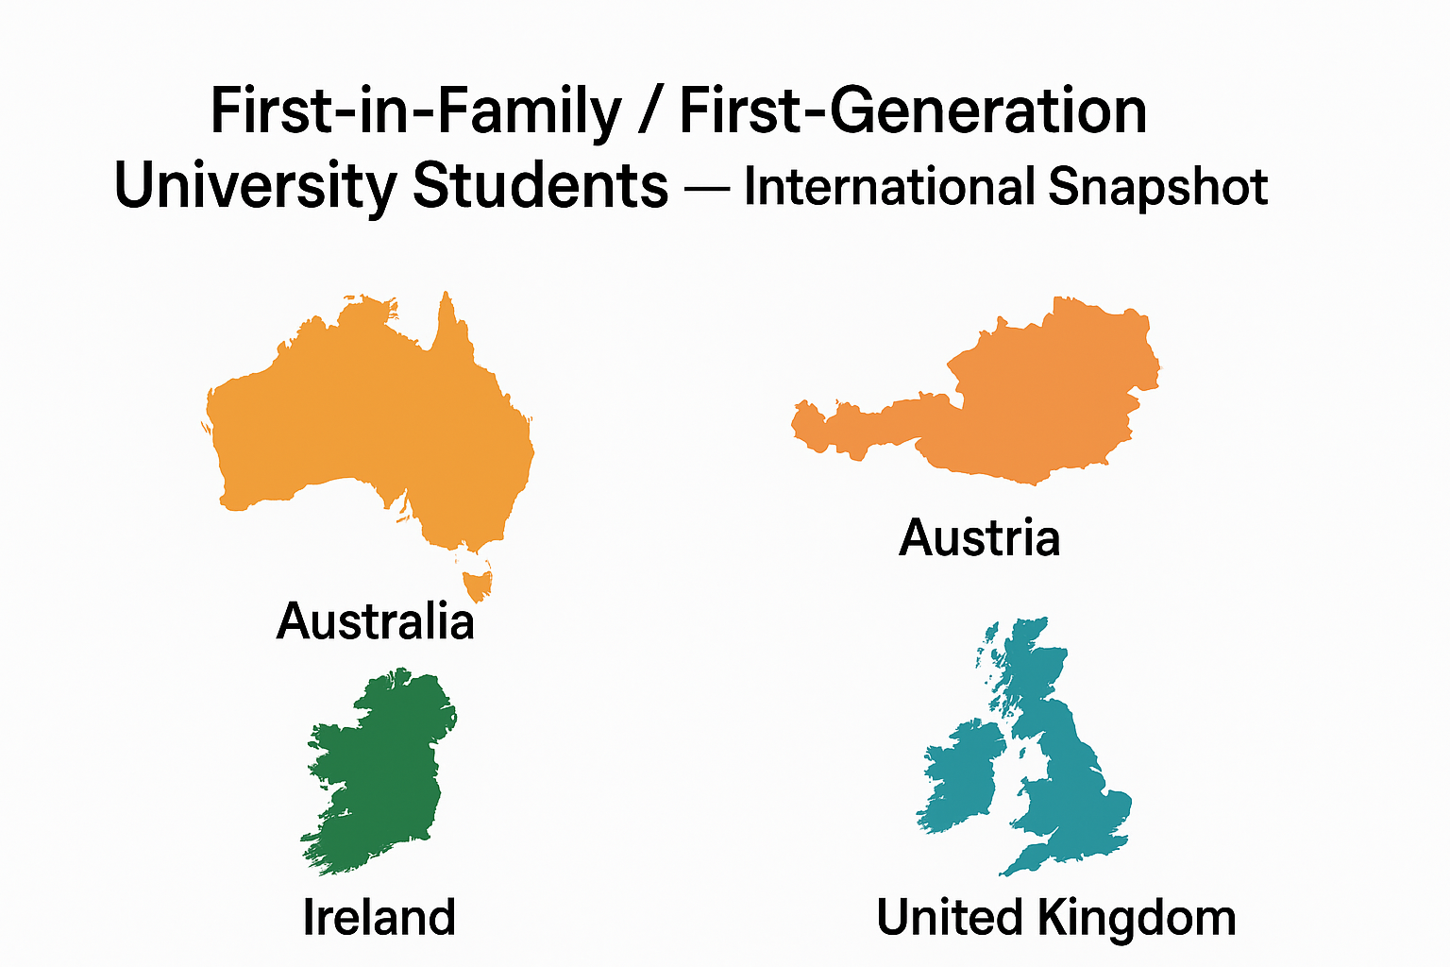
Three studies – different locations
3
Notes:
Australia: Approximately 51% of young people enrolled in Australian universities are classified as first-generation (i.e., no parent with a university qualification) – research has indicated how First-in-family students in Australia may face overlapping disadvantage (for example, more likely to be from regional/remote areas, Indigenous, or low SES).
UK In the UK, the total number of first-generation students increased by 24% between 2012 – 2022 (from ~526,000 in 2012-13 to ~652,000 in 2021-22)
In Austria: Though precise national participation %s for FiF in Austria are not readily available, the research indicates FiF students in Austria are a distinct group requiring targeted support.
In Ireland: 41 % of first-in-family graduates said they couldn’t have afforded to attend university without financial support.

Slide 4
But common issues
First-generation students are less likely to
Attend HE and attain a HE degree (OECD, 2025; Hauschildt et al., 2024)
Study at ‘elite’ institutions and prestigious field of study (Patfield et al., 2021; Henderson et al., 2019)
Lower graduate outcomes (Lessky & Binder, 2025)
Those who attend university are generally labelled as ‘educationally vulnerable’ (Beattie, 2018) not least due to the likelihood of first-generation students belonging to at least one equity group (Patfield et al., 2021)
Low retention rates (Henderson et al., 2019; Nuffield Foundation, 2020; QILT, 2022) and seen as ‘at-risk’ of early departure (Edwards & McMillan, 2015)
4
Notes:
Many governments worldwide have sought to improve higher education (HE) attainment – especially from historically underrepresented groups (Bradley et al., 2008; HM Government, 2025; Marginson, 2016)

Slide 5
Why does it matter?
Departing early can have
Short- and long-term financial, emotional and social repercussions (Norton & Cherastidtham, 2018; Pitman, 2013)
Critical role in (re)shaping the perceptions of family, friends, and even communities (Wainwright & Watts, 2021)
Critical moment to examine rationales for staying at university (Panthalookaran, 2022; Raciti, 2022)
Aim of this study was to unpack the complexity of persistence for first-generation students across Australia, Austria, Ireland and the UK
5
Notes:
Within the UK, total number of first-generation students has grown from 526,460 in 2012–13 to 651,965 in 2021–22, an increase of 24% over the last 9 years. (HESA, 2018)
‘…on average, the share of FGS (First Generation Students) in the student population in the West is about 50%, varying from 30% in Canada and the US to more than 70% in Italy and Portugal’.
(Forrest-Cataldi, Bennett, Chen & Simone, 2018,p.3)
HE attainment in Australia: If you have a family member that has attended university at ages 13-17 you are almost twice as likely to attend university within 5 years compared to someone with no biographical history of attendance (Tomaszewski et al., 2022).
Young people with at least one degree bearing parent are more than four times as likely to attend an Australian university compared to those with no parents with higher education qualifications (Marginson, 2015) – (a difference also noted in the UK, and the US).
Within Europe:
Students with tertiary educated parents are in the majority across European countries: 52 % of students have at least one parent with a Bachelor’s, Master’s, or doctoral degree; and 7 % have parents whose highest degree is at ISCED level 5 (short-cycle) (Hauschildt et al., 2024).
Based on fathers’ education, on average, the enrolment of students from non-tertiary backgrounds in Europe is 16 % lower than expected based on the educational levels within the general population (ibid.).

Slide 6
What do we know?
Hidden obstacles that shape first-generation students’ educational participation raging from material disadvantage to limited access to forms of capital that are tacitly required to succeed (Delahunty & O’Shea, 2024; Spiegler & Bednarek, 2013)
Much of this knowledge constitutes the ‘hidden curriculum’ – privileges those who possess cultural and linguistic familiarity to interpret subtle cues
Absence of a ‘knowledgeable other’ or ‘guide on the side’ means that the taken-for-granted practices of university life can appear exclusionary (Delahunty & O’Shea, 2024)
6

Slide 7
What do we know?
Counter-narrative: First-generation students’ persistence can be facilitated by various forms of capitals that they bring to the university environment
While first-generation learners might not have access to the dominant forms of cultural and social capital, they often draw on other forms of socialisation to foreground their journeys into, and through, university studies
7

Slide 8
Rethinking Persistence ‘with’ Mantras
Western nations: a ‘mantra’ is often taken to mean a slogan, catchphrase, or statement
Mantras act as an ‘instrument of the mind’ (Alper, 1991) or ‘internal conversation’ (Archer, 2003) to realise intentional thought (Gonda, 1963)
Not merely as an internal affirmation, but as culturally embedded (Thomson, 2009) and shaped by socialisation
A useful tool to unpack how first-generation status can underpin the ‘psychic’ work of persistence rooted within their life biographies
8

Slide 9
Data
Project | Country | Number of Universities | Date of data collection | Sample
Project 1 | Australia | 9 | 2017-2022 | 69
 | Ireland | 1 |  | 7
 | UK | 1 |  | 4
 | Austria | 1 |  | 12
Project 2 | Australia | 1 | 2023 | 44
Project 3 | Austria | 4 | 2018-2024 | 38
Total |  | 17 |  | 174
9

Slide 10
What we found
Three dominant mantras embedded in students’ narratives and biographies:
Mantra of strong work ethic: “If you start something, finish it”
Mantra of defiance: “I’ll prove them wrong”
Mantra of hopeful imaginings: “I’m not doing it just for a piece of paper”
10

Slide 11
Strong work ethic
Strong desire not to give up embodied through familial environment
Built on the belief that hard work and perseverance are important
Can lead to pressure and some start to question this mantra
I like to talk about the fact that I’m persistent. It’s probably a strength of character that I did get from my working-class family.
(Brett, 3rd (final) year, B. Business, aged 33, Australia)
Very strong work ethic – got that from my parents, got them to thank for that.
(Donna, 3rd (final) year, B. Arts, aged 39, Australia)
11

Slide 12
Defiance
Symbolises students’ capability to translate challenging experiences, e.g. with teachers, into a source of power
Own journey provides inspiration for others or is an act of defiance relative to gender expectations
You see, you patriarchal warriors! You thinking I should have married and celebrated Christmas! No. I did it. I got my diploma.
(Boja, 3rd (final) year, B. Community Youth Work, aged 48, Ireland)
There were some teachers of mine who didn't think much of me, let's say, who didn't believe I would go to university. That's why I thought to myself: no, I'll prove them wrong.
(Laura, 2nd year, B. Education, aged 23, Austria)
12

Slide 13
Hopeful imaginings
Captures the hopes attributed to higher education in terms of having a better life
Linked to intergenerational opportunity within the family
I just have to convince myself every now and again of the reasons why I chose to go to university and then remember that I’m not doing it just for a piece of paper – there’s a reason why I want to be a primary school teacher, there’s a reason for my family why I want to have the opportunity to have a successful career and be able to contribute to society.
(Jennifer, 3rd year, B. Primary Education, aged 28, Australia)
So, I was already predestined by the whole family: “You have to study. That's the only thing that helps. […] So I never really had the choice to decide what I want to do.
(Peter, 4th Year, B. Medicine, aged 25, Austria)
13

Slide 14
Discussion
Aim was to interrogate the complexity of persistence for first-generation students
Students draw on internalised mantras as lived, agentic strategies that help them to persist in HE
But these mantras
Also signal the hidden affective work that students often engage in
Are interwoven with neoliberal relations of power
Underpinned by an ‘independent learner’ discourse or an ‘aspirational individualism’
Include the assumption that university is the (only) route to a ‘good life’
14

Slide 15
Conclusion
Conceptualising ‘mantras of persistence’ recognises the complex ways life biographies interact with the university environment, thus avoids treating persistence as a one-dimensional ‘choice’ (Delahunty & O’Shea, 2024)
Findings help to understand the longstanding challenges of improving the retention rates of first-generation students
15

Slide 16
What next…
Some of the interviewed students realised that their existing mantras did not necessarily lead to the rewards they expected
The importance of validating learner’s previous life experiences (and that of their family), not as a problem that needs to be fixed but as a source of strength and resilience that can have real currency within the university environment
16

Slide 17

Questions / Comments
This presentation is based upon the following article:
Lessky, F., Patfield, S & O’Shea, S (accepted). “We’ve got a bit of a family mantra that you don’t give up”: A cross-national study of first-in-family students’ persistence at university. Higher Education.
17
This Photo by Unknown Author is licensed under CC BY-SA-NC

Slide 18
(Selected) References
Adamecz-Volgyi, A, Henderson, M., & Shure, N., (2019). Is ‘First in Family’ a Good Indicator for Widening University Participation?
Alper, H. (1991). Understanding mantras. State University of New York.
Capannola, A. L., & Johnson, E. I. (2020). On Being the First: The Role of Family in the Experiences of First-Generation College Students. Journal of Adolescent Research, 37(1), 29-58.
Forrest Cataldi, E., Bennett, C.T., Chen, X., Simone, S.A. (2018) First Generation Students: college access, persistence, and postbachelor’s outcomes, Stats in Brief, U.S. Department ofEducation. Available online at: https://nces.ed.gov/pubs2018/2018421.pdf
Hauschildt, K. (2024). Socio-economic background of students. In K. Hauschildt (Ed.), Social and economic conditions of student life in Europe. EUROSTUDENT 8 Synopsis of indicators 2021–2024. wbv Publikation. DOI:10.3278/6001920ew002
Henderson, M., Shure, N., & Adamecz-Volgyi, A. (2019). ‘First in Family’ University graduates in England. Discussion Paper Series. Retrieved from https://docs.iza.org/dp12588.pdf
HESA (2018). Higher Education Student Statistics: UK, 2016/17 - Qualifications achieved. Available online at: https://www.hesa.ac.uk/news/11-01-2018/sfr247-higher-educationstudent-statistics/qualifications
Marginson, S. (2015). The landscape of higher education research 1965‐2015: Equality of opportunity: The first fifty years. SRHE 50th Anniversary Colloquium, Valuing Research into Higher Education.
Patfield, S., Gore, J., & Fray, L. (2021). Stratification and the illusion of equitable choice in accessing higher education. International Studies in Sociology of Education, 1-19. doi:10.1080/09620214.2021.1912633
Patfield, S., Gore, J., & Weaver, N. (2021). Odds are against ‘first in family’ uni students but equity policies are blind to them. Retrieved from https://theconversation.com/odds-are-against-first-in-family-uni-students-but-equity-policies-are-blind-to-them-155647
QILT, (2022). The 2021 Student Experience Survey. Available from https://www.qilt.edu.au/surveys/student-experience-survey-(ses)#report
Tinto, V. (2017). Through the Eyes of Students. Journal of College Student Retention: Research, Theory & Practice, 19(3), 254–269. https://doi.org/10.1177/1521025115621917
Tomaszewski, W., Perales, F., Xiang, N., Kubler, M. (2022). Differences in Higher Education Access, Participation and Outcomes by Socioeconomic Background: A Life Course Perspective. In: Baxter, J., Lam, J., Povey, J., Lee, R., Zubrick, S.R. (eds) Family Dynamics over the Life Course. Life Course Research and Social Policies, vol 15. 133-155. Springer, Cham. https://doi.org/10.1007/978-3-031-12224-8_7

Slide 19
Aim of the study
Shed light on lived, agentic strategies first-generation students employ to persist in higher education
Focus on the social and discursive resources utilised to foreground their educational journeys (Thomson, 2009)
Provides a deep focus on the actual ways that learners navigate what can often be alien and difficult environments
Move beyond institutional metrics and develop a more empathetic and humanising understanding of how – for this cohort – persistence is shaped by a complex amalgam of identity and social location

