Slide 1
Performance Assessment in Science
RAE/REF‘s effects on academic life

Slide 2
Outline
1. Introduction
2. State of research
3. Theoretical Framework
4. Empirical procedure
5. Summary

Slide 3
1. Introduction
Global research competition for an increase in scientific performance and the recruitment of research stars (cf. Münch 2011; Schäfer 2012; Münch 2014; Münch und Schäfer 2014; Wieczorek und Schäfer 2016)
Search for institutional models designed to raise research performance (cf. Münch 2014)
Reforms to enhance economy, efficiency and effectiveness of higher education systems (cf. B. Clark 1998:2)
Redefinition of the academic field into markets on both national and global level (cf. Marginson 2006)

Slide 4
1. Introduction
Stratification of universities (cf. Marginson und Wende 2007:324; Hazelkorn 2008, 2009; Hazelkorn und Ryan 2013; Hazelkorn 2014; Münch 2011, 2014)
Through the audit culture (cf. Strathern 1997; Power 1999)
Concentration of research resources in the top institutions (cf. Henkel 1999)
Instrument used to raise scientific performance in the UK is the Research Assessment Exercise (RAE) and Research Excellence Framework (REF)
Political tool has an impact on academic life in the UK

Slide 5
1. Introduction
Research questions:
What are the RAE/REF's effects on academic life?
…on research performance?
... on inequality ?
…on diversity?
…on academic freedom?
…on research and teaching?
…on recruitment policies?

Slide 6
2. State of research
Academic life
Burton Clark understands academic life as stratification, disciplinary differentiation, academic community and academic freedom. The overarching goal is the increase in quality of research and teaching (cf. Clark 1989)
This model is extended along the theoretical basis of Richard Münch's previous scientific work (cf. Münch 2007, 2011, 2014)

Slide 7
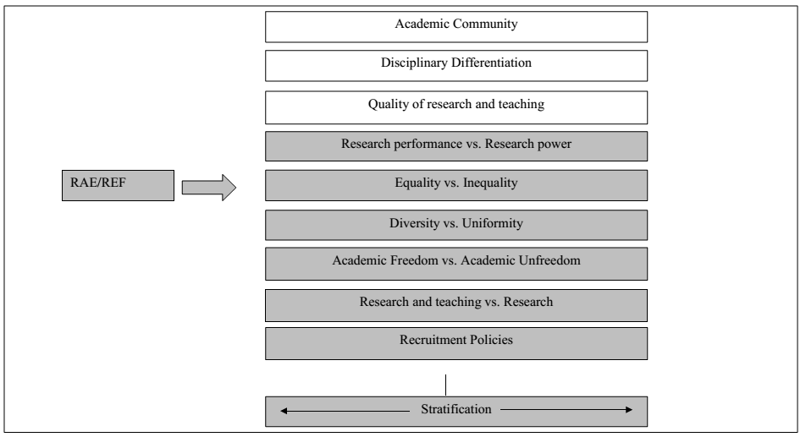

Slide 8
2. State of research
Research performance
While citation rates are rising (cf. King 2004; Adams 2011; Bornmann und Leydesdorff 2013),
the proportion of papers in the Web of Science are decreasing (cf. Adams 2011:7; Münch 2014:112)
Decreasing impact of British science (cf. King 2004; Adams 1998:615)
Decreasing efficiency in an international comparison (cf. Auranen und Nieminen 2010:830) and on the disciplinary level (cf. Münch 2014:227–228; 242)

Slide 9
2. State of research
Inequality
Inequality is rising in a whole series of STJU indicators (cf. Münch und Schäfer 2014:64)
Inequality of staff through administrative workload for teachers and research freedom for researchers
Inequality of publications in top journals (cf. Harley 2000:565)
Funding of established institutions instead of new universities (cf. Orr, Dominic 2003:45–46)

Slide 10
2. State of research
Diversity
Short-term publication work is encouraged by the RAE/REF
Innovative and interdisciplinary contributions are inhibited (cf. Oancea 2010:260)
Research topics correspond to the preferences of panel members
Speculative and long-term scientific work is inhibited (cf. Talib 2002:264)

Slide 11
2. State of research
Academic Freedom
Increasing managerial autonomy (cf. Melo, Sarrico, und Radnor 2010:251; Teelken 2012:282)
British academics feel free (cf. Pritchard 2005:446), yet the RAE/REF generates administrative burden so that the academics wish to spend more time on research (cf. Pritchard 2005:445)
Contributions to a vital academic community are inhibited (cf. Talib 2002:359)

Slide 12
2. State of research
Research and teaching
Separation of the British university landscape into research and teaching institutions (cf. Meier und Schimank 2009:55)
Drop of teaching quality (cf. Jenkins 1995)
Knowledge transfer between research and teaching is decreasing (cf. Broadhead und Howard 1998:10)
Decreasing status of lecturers (cf. Pritchard 2005:447)

Slide 13
2. State of research
Recruitment policies
Recruitment of scientists who publish in top journals
Recruitment of scientists with a vast research potential
Research has gained considerable weight over teaching (cf. McNay 1997:65–67)
List of economic core journals determining recruitment decisions (cf. Harley und Lee 1997:1431)

Slide 14
3. Theoretical framework
Educational alterations that affect the performance assessment of British science in the UK
Six different functions of performance assessment in science

Slide 15
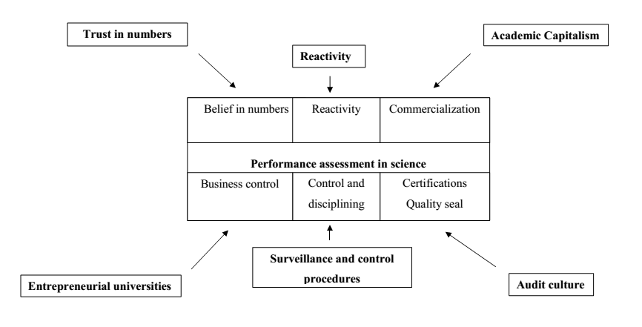
3. Theoretical framework

Slide 16
3. Theoretical framework
Trust in numbers
Use of numbers in the political and bureaucratic state machinery
Enforcement of economic criteria
Impersonal measurement of scientists through indicators
Authority of numerical values
Belief in numbers (cf. Porter 1996)

Slide 17
3. Theoretical framework
Reactivity
Behavioural change in the direction of numerical values
Optimizing scientific behavior towards numerical values
Automated procedures
Governance through numerical models (cf. Espeland und Sauder 2007)

Slide 18
3. Theoretical framework
Academic Capitalism
Increasing financing through tuition fees
Privatization and commercialization of universities
Managerialism of resource allocation
Profit and rationalization techniques are implemented
Monopoly positions and increasing inequality
Competition of students for academic products (cf. Rhoades und Slaughter 1997; Münch 2011, 2014)

Slide 19
3. Theoretical framework
Entrepreneurial Universities
Business control of university entities
Global economic and symbolic competition
Cooperations with the industry
Disentanglement from governmental income resources
Pressure to meet investors' expectations (cf. B. R. Clark 1998)

Slide 20
3. Theoretical framework
Surveillance and control procedures
Surveillance and control of research performance through indicators
Data collection and input into mathematical functions
Material and performance-related classification system
Power of mathematical regularity
Data template of individual performances (cf. Foucault 1976, 2000)

Slide 21
3. Theoretical framework
Audit culture
Implementation of economic, efficient and effective structures
Quality assurance and internal control procedures
Motivational structures and conformity with the procedures
Formal inspections define the standards of the auditors
Auditors as judgemental entities who have an impact on university managements

Slide 22
3. Theoretical framework
Two theoretical models as explanation strategies
Functional model of performance assessment
Conflict theoretical model
In the first case, British performance assessment can be understood as a measure to strengthen the top performers in the British university system
In the second case, historical structures determine capital accumulation of British performance assessment

Slide 23
3. Theoretical framework
Functional model of performance assessment
The society consist of functional entities
The entities are in a positive relationship to the whole organism
There are specific behavioural patterns, which are essential for the system to survive
It is assumed that the RAE/REF system ensures the functionality of the British university system However, there are also dysfunctional effects

Slide 24
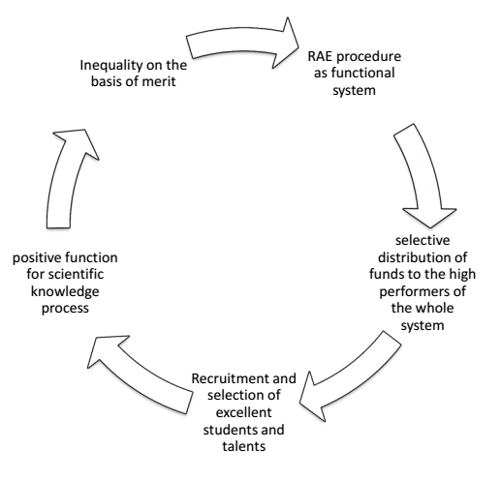
3. Theoretical framework

Slide 25
3. Theoretical framework
Conflict-theoretical model of performance assessment
Concentration of attention on elite universities
Definition of performance criteria through monopoly positions
Discussions and publications are restricted to lighthouses/beacons
Social exchange between elite institutions
Accumulation of capital and establishment of ranking positions

Slide 26
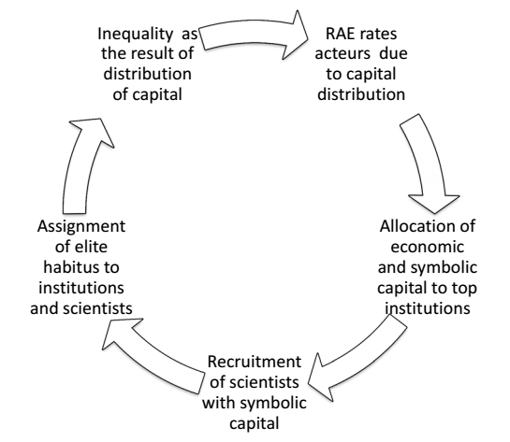
3. Theoretical framework

Slide 27
3. Theoretical framework
Hypotheses
Research performance and research efficiency: decrease of top institutions following input of grants and selective resource allocation or increase of top institutions due to higher research strength
Inequality: increase for RAE/REF over the period 1986 – 2008 (cf. Münch und Schäfer 2014:64) or decrease due to the realization of new public management goals (cf. Halffman und Leydesdorff 2010).

Slide 28
3. Theoretical framework
Hypotheses
Diversity: decrease due to administrative burden and orientation to panel members' research themes or increase through subject specialization
Academic freedom: decrease due to bureaucracy and quality management implementation or increase as a result of managerial autonomy and resource competition

Slide 29
3. Theoretical Fframework
Hypotheses
Research and teaching: are divided due to a concentration of resources on research universities and rewards for research publications or a profitable system with a separation of teaching and research
Recruitment policies: selective research criteria are more important than teaching experience

Slide 30
3. Empirical procedure
Gini coefficient for quantitative analysis of inequality in chemistry:
Year | High Impact Journals per year | Publications per professor per High Impact Journal article | Citations per year | Funds per year | Professors
1992 | 0.5251972 | 0.4112869 | 0.4489527 | 0.5181599 | 0.2978194
1996 | 0.5264205 | 0.3704472 | 0.5559366 | 0.4925935 | 0.3372292
2001 | 0.5196468 | 0.2858127 | 0.6494248 | 0.4175832 | 0.285111
2008 | 0.5455179 | 0.1881431 | 0.6178622 | 0.39775 | 0.285111
2001/2008 | 0.0203207 | -0.2231438 | 0.1689095 | -0.1204099 | -0.0127084

Slide 31
3. Empirical procedure
Multiple regression analysis of independent variables on research performance
Fixed and random effects regressions indicate that universities with the following characteristics gain more block grants, research grants, publications in High Impact Journals, citation rates
Regressions on academic performance show that there are negative effects

Slide 32
3. Empirical procedure
High research ranking
High amount of professors
Affiliation to Cambridge or Oxford
Centrality in networks
High amount of Royal Society members
Awards

Slide 33
4. Summary
State of Research
Academic life theory is extended
Indicates intended and unintended effects of performance assessment in science on academic life
Theory
Educational alterations affect performance assessment in science
There are unintended effects of performance assessment in science

Slide 34
4. Summary
Performance increase versus capital concentration with unintended effects
Empirical Analysis
Indicates increasing concentration of resources and decreasing performance
This leads to the assumption that the RAE/REF does not only favour the science game on the basis of merit
It creates processes of economic and symbolic capital accumulation

Slide 35
5. Further research
Quantitative analysis
Inequality and research performance analysis for sociology and history
Multiple regression analysis for sociology and history

Slide 36
5. Further research
Qualitative analysis
Interview with 2 professors from three different disciplines, namely sociology, history and chemistry and three university ranks N=18
Analysis of discussions with regard to the implementation of RAE/REF in the starting (1986, 1989), the central (1992,1996) and the end phase (2001, 2008) of the RAE

Slide 37
6. Literature
Adams, Jonathan. 1998. „Benchmarking international research“. Nature 396(6712):615–18.
Adams, Jonathan. 2011. GLOBAL RESEARCH REPORT UNITED KINGDOM. Leeds: Evidence. Abgerufen 10. Juni 2015 (http://researchanalytics.thomsonreuters.com/m/pdfs/globalresearchreport-uk.pdf).
Auranen, Otto und Mika Nieminen. 2010. „University Research Funding and Publication performance—An International Comparison“. Research Policy 39(6):822–34.
Bornmann, Lutz und Loet Leydesdorff. 2013. „Macro-Indicators of Citation Impacts of Six Prolific Countries: InCites Data and the Statistical Significance of Trends“. PLoS ONE 8(2):e56768.
Broadhead, Lee-Anne und Sean Howard. 1998. „‚The Art of Punishing‘: The Research Assessment Exercise and the Ritualisation of Power in Higher Education“. education policy analysis archives 6:8.
Clark, Burton. 1998. „University transformation for the twenty-first century“. in World Conference on Higher Education. Abgerufen 30. September 2014 (http://portal.unesco.org/education/fr/files/10371/10384906150Burton.pdf/Burton.pdf).
Clark, Burton R. 1989. „The Academic Life Small Worlds, Different Worlds“. Educational Researcher 18(5):4–8.
Clark, Burton R. 1998. Creating entrepreneurial universities. Oxford: IAU Press.
Espeland, Wendy Nelson und Michael Sauder. 2007. „Rankings and Reactivity: How Public Measures Recreate Social Worlds“. American Journal of Sociology 113(1):1–40.
Foucault, Michel. 1976. Überwachen und Strafen. Frankfurt am Main: Suhrkamp.
Foucault, Michel. 2000. „Die Gouvernementalität.“ in In: Ulrich Bröckling, Susanne Krasmann und Thomas Lemke (Hg.): Gouvernementalität der Gegenwart. Studien zur Ökonomisierung des Sozialen. Frankfurt am Main: Suhrkamp Verlag.
Frølich, Nicoline. 2008. The politics of steering by numbers: debating performance-based funding in Europe. Oslo: NIFU STEP.
Halffman, Willem und Loet Leydesdorff. 2010. „Is Inequality Among Universities Increasing? Gini Coefficients and the Elusive Rise of Elite Universities“. Minerva 48(1):55–72.

Slide 38
6. Literature
Harley, Sandra. 2000. „Accountants divided: research selectivity and academic accounting labour in UK universities“. Critical Perspectives on Accounting 11(5):549–82.
Harley, Sandra und Frederic S. Lee. 1997. „Research Selectivity, Managerialism, and the Academic Labor Process: The Future of Nonmainstream Economics in U.K. Universities“. Human Relations 50(11):1427–60.
Hazelkorn, Ellen. 2008. „Learning to Live with League Tables and Ranking: The Experience of Institutional Leaders“. Higher Education Policy 21(2):193–215.
Hazelkorn, Ellen. 2009. „Rankings and the Battle for World-Class Excellence“. Higher Education Management and Policy 21(1):1–22.
Hazelkorn, Ellen. 2014. „Reflections on a Decade of Global Rankings: What We’ve Learned and Outstanding Issues“. European Journal of Education 49(1):12–28.
Hazelkorn, Ellen und M. Ryan. 2013. „The Impact of University Rankings on Higher Education Policy in Europe: A Challenge to Perceived Wisdom and a Stimulus for Change.“ in In: Zgaga, P., Teichler, U. and Brennan, J. (Hg.) The Globalization Challenge for European Higher Education: Convergence and Diversity, Centres and Peripheries. Frankfurt: Peter Lang.
Henkel, Mary. 1999. „The Modernisation of Research Evaluation: The Case of the UK“. Higher Education 38(1):105–22.
Jenkins, Alan. 1995. „The Research Assessment Exercise, funding and teaching quality“. Quality Assurance in Education 3(2):4–12.
King, David A. 2004. „The scientific impact of nations“. Nature 430(6997):311–16.
Kreckel, Reinhard. 2008. „Zwischen universeller Inklusion und neuer Exklusivität.“ S. 181–94 in In Barbara M. Kehm (Hg.): Hochschule im Wandel. Die Universität als Forschungsstand. Festschrift für Ulrich Teichler. Frankfurt/New York: Campus Verlag. Abgerufen 26. November 2015 (https://books.google.com/books?hl=en&lr=&id=moDlAgAAQBAJ&oi=fnd&pg=PA181&dq=%22In+den+Augen+von+Ulrich+Teichler+(2005,+S.+165)+ist+f%C3%BCr+Deutschland+das+Erreichen%22+%22an+Boden+(vgl.+Kreckel+2006,+M%C3%BCnch+2007).+Das+Hauptaugenmerk+gilt+dabei+der%22+&ots=c8V5tTBWLP&sig=GQG0ceUXXrMjOkQ4r3wT7o9iWtU).

Slide 39
6. Literature
Marginson, Simon und Marijk van der Wende. 2007. „To Rank or To Be Ranked: The Impact of Global Rankings in Higher Education“. Journal of Studies in International Education 11(3-4):306–29.
McNay, Ian. 1997. The impact of the 1992 RAE on institutional and individual behaviour in English higher education The evidence from a research project. HEFCE M 5/97, May.
Meier, Frank und Uwe Schimank. 2009. „Matthäus schlägt Humboldt? New Public Management und die Einheit von Forschung und Lehre“. Beiträge zur Hochschulforschung 31(1):42–61.
Melo, Ana Isabel, Cláudia S. Sarrico, und Zoe Radnor. 2010. „The Influence of Performance Management Systems on Key Actors in Universities“. Public Management Review 12(2):233–54.
Münch, Richard. 2007. Die akademische Elite. Frankfurt am Main: Suhrkamp.
Münch, Richard. 2011. Akademischer Kapitalismus. Berlin: Suhrkamp.
Münch, Richard. 2014. Academic Capitalism: Universities in the Global Struggle for Excellence. London und New York: Routledge.
Münch, Richard und Len Ole Schäfer. 2014. „Rankings, Diversity and the Power of Renewal in Science. A Comparison between Germany, the UK and the US“. European Journal of Education 49(1):60–76.
Oancea, Alis. 2010. „Research assessment in the United Kingdom“. in In: UNESCO (Hg.): World social science report: Knowledge Divides. Paris: UNESCO Publishing.
Orr, Dominic. 2003. „Verfahren der Forschungsbewertung im Kontext neuer Steuerungsverfahren im Hochschulwesen: Analyse von vier Verfahren aus Niedersachsen, Großbritannien, den Niederlanden und Irland.“ A1/2003. Hannover: HOCHSCHUL-INFORMATIONS-SYSTEM.
Palfreyman, David. 2006. „Is academic freedom under threat in UK and US higher education?“ Abgerufen 19. Oktober 2015 (http://oxcheps.new.ox.ac.uk/MainSite%20pages/Resources/OxCHEPS_OP23ii.pdf).

Slide 40
6. Literature
Porter, Theodore M. 1996. Trust in numbers: The Pursuit of Objectivity in Science and Public Life. 2. Auflage. Princeton: Princeton University Press.
Power, Michael. 1999. The Audit Society. Rituals of Verification. New York: Oxford University Press.
Pritchard, Rosalind. 2005. „The Influence of Market Force Culture on British and German Academics“. Comparative Education 41(4):433–54.
Rhoades, Gary und Sheila Slaughter. 1997. „Academic Capitalism, Managed Professionals, and Supply-Side Higher Education“. Social Text (51):9–38.
Schäfer, Len Ole. 2012. The Construction of Rankings in Science: Chemistry in Germany and the USA. Unveröffentlichte Diplomarbeit. Bamberg: Universität Bamberg.
Science and Technology Committee. 2002a. „House of Commons - Science and Technology - Second Report“. Abgerufen 15. September 2015 (http://www.publications.parliament.uk/pa/cm200102/cmselect/cmsctech/507/50702.htm).
Science and Technology Committee. 2002b. THE RESEARCH ASSESSMENT EXERCISE: GOVERNMENT RESPONSE to the Committee’s Second Report. Fifth Special Report of Session 2001-02. London: The Stationery Office Limited. Abgerufen (http://www.publications.parliament.uk/pa/cm200102/cmselect/cmsctech/995/995.pdf).
Science and Technology Committee. 2004a. Research Assessment Exercise: a re-assessment. Eleventh Report of Session 2003–04. London: The Stationery Office Limited. Abgerufen (http://www.parliament.the-stationery-office.co.uk/pa/cm200304/cmselect/cmsctech/586/586.pdf).
Science and Technology Committee. 2004b. Research Assessment Exercise: a re – assessment: Government Response to the Committee’s Eleventh Report of Session 2003–04. London: The Stationery Office Limited. Abgerufen (http://www.parliament.the-stationery-office.co.uk/pa/cm200405/cmselect/cmsctech/34/34.pdf).
Strathern, Marilyn. 1997. „‘Improving ratings’: audit in the British University system“. European Review 5(03):305–21.
Talib, Ameen Ali. 2002. Performance Measures and Resource Allocation: The Behavioural Consequences of the University Research Assessment Exercise in England. University of Warwick, Warwick Business School.

Slide 41
6. Literature
Teelken, Christine. 2012. „Compliance or pragmatism: how do academics deal with managerialism in higher education? A comparative study in three countries“. Studies in Higher Education 37(3):271–90.
Wieczorek, Oliver und Len Ole Schäfer. 2016. „Verwaltungspraktiken: Konstruktion von Leistungsindikatoren. Das Beispiel des britischen Research Assessment Exercise.“ in In: Nina Baur, Cristina Besio, Maria Norkus und Grit Petschick (Hg.): Wissen - Organisation - Forschungspraxis. Der Makro‐Meso‐Mikro‐Link in der Wissenschaft. Landsberg: Beltz Juventa.

