Slide 1

EDUCATION
DAVID WILLETTS
A UNIVERSITY
January 2018

Slide 2
First there was Oxford and then Cambridge

Slide 3
Number of universities in European Countries (1300-1790)

Slide 4
Why not have more universities?
“ Why universities and colleges should only be at Oxford and Cambridge I know no reason. It would be more advantageous to the good of all the people, to have Universities or Colleges, one at least in every great town or city in the nation as in London, York, Bristow, Exceter, Norwich and the like; and for the State to allow to these Colledges an honest and competent maintenance for some godly and learned men to teach the Tongues and Arts, under a due reformation.”
William Dell, Puritan master of Caius College, Cambridge speaking to the Westminster Assembly of Divines. 1643

Slide 5
What is excellence and what is producer power?
“The privileges of graduates in arts, in law, physick and divinity, when they can be obtained only by residing a certain number of years in certain universities, necessarily force a certain number of students to such universities, independent of the merit or reputation of the teachers.”
Adam Smith

Slide 6
Government Legislation on Universities: A case study
1854 The Oxford University Act
1856 The Cambridge University Act
1857 Oxford University Act 1857
Universities of Oxford and Cambridge Act 1859
Oxford University Act 1860
Oxford University Act 1862
Oxford University Vinerian Foundation Act 1865
Universities Tests Act 1871
1877 Universities of Oxford and Cambridge Act
1880 Universities of Oxford and Cambridge (Limited Tenures) Act

Slide 7
Challenging the Edusceptics – the benefits of higher education

Slide 8

How to pay for it?

Slide 9
Median Wages: post-graduates, graduates, and non-graduates 2016

Slide 10
Marx was right.
“If…higher education institutions are also “free”, that only means in fact defraying the cost of education of the bourgeoisie from the general tax receipts.”
Karl Marx, Critique of the Gotha Programme 1875.

Slide 11
So was Robbins
"I have little doubt that, as time goes on and the advantages of higher education are more generally perceived, and the burdens of financing its expansion are more severely felt, there may easily come a change in attitudes such that the equitable arguments for a considerable replacement of grants by loans will become practically relevant."

Slide 12
Four reasons for the current system
The Principle – it is progressive
The Economics – investing in human capital
The Challenge – tackled under-funding of higher education and cutting public spending
The Opportunity – End of number controls

Slide 13
“Why don’t we have price competition?”
Income contingent repayment
Competition for student numbers is a powerful incentive
No good criterion for price differentiation

Slide 14
Ranking universities (1 of 2)
University of Oxford | University of Leeds
University of Cambridge | University of Birmingham
University of Durham | University of Southampton
University of St Andrews | Cardiff University
University of Bristol | University of East Anglia
University of Exeter | University of Liverpool
Imperial College | University of Strathclyde
University of Edinburgh | Heriot-Watt University
University of Warwick | King's College London
University of York | Oxford Brookes University
University of Sheffield | University of Surrey

Slide 15
Ranking universities (2 of 2)
University of Dundee | Edge Hill University
Bournemouth University | University of Salford
University of Kent | Brunel University London
University of Portsmouth | Teesside University
Nottingham Trent University | University of Huddersfield
University of Hull | University of Bedfordshire
University of Brighton | London South Bank University
University of Worcester | London Metropolitan University
Queen Mary University of London | University of East London
University of Lincoln | University of Wolverhampton
University of Derby | University of Bradford

Slide 16
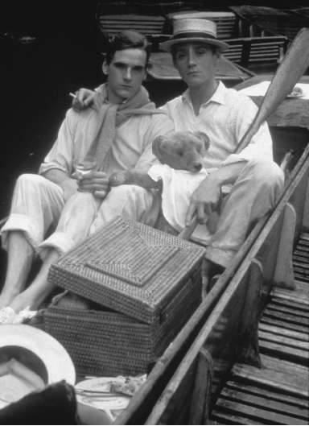
A clue to the rankings

Slide 17
Percentage of first degree full time entrants from NS-SEC 4-7, 2014-15 (1 of 2)
University of Oxford | 10% |  | University of Leeds | 23%
University of Cambridge | 10% |  | University of Birmingham | 23%
University of Durham | 14% |  | University of Southampton | 23%
University of St Andrews | 14% |  | Cardiff University | 24%
University of Bristol | 15% |  | University of East Anglia | 25%
University of Exeter | 16% |  | University of Liverpool | 26%
Imperial College of Science | 16% |  | University of Strathclyde | 26%
University of Edinburgh | 19% |  | Heriot-Watt University | 26%
University of Warwick | 20% |  | King's College London | 26%
University of York | 20% |  | Oxford Brookes University | 28%
University of Sheffield | 21% |  | University of Surrey | 29%

Slide 18
Percentage of first-degree full time entrants from NS-SEC 4-7, 2014-15 (2 of 2)
University of Dundee | 29% |  | Edge Hill University | 39%
Bournemouth University | 31% |  | University of Salford | 42%
University of Kent | 33% |  | Brunel University London | 43%
University of Portsmouth | 33% |  | Teesside University | 46%
Nottingham Trent University | 33% |  | University of Huddersfield | 46%
University of Hull | 33% |  | University of Bedfordshire | 50%
University of Brighton | 34% |  | London South Bank University | 51%
University of Worcester | 37% |  | London Metropolitan University | 51%
Queen Mary University of London | 37% |  | University of East London | 55%
University of Lincoln | 37% |  | University of Wolverhampton | 57%
University of Derby | 39% |  | University of Bradford | 58%

Slide 19
“Good universities should charge more.”
But what makes a university “good”?
Graduates earn more because of
Social background of parents
Prior attainment of students
Geographical location
Move up rankings also because of
Research Excellence

Slide 20
“Students on high paying courses should pay more”
Law, Economics and Management
Medicine and STEM
Arts and Humanities

Slide 21
Some bad ideas to change this system
Differential fees – on what basis?
Cut fees and cut resource
A graduate tax – back to public spending
Raise repayment threshold – is this the problem?
Reallocate the “spending” to non-HE

Slide 22
Some better ideas to improve it
A regular five year review
Maintenance grant - more cash for students
More funding for part time students
A pupil premium for disadvantaged students
More funding for high cost courses – STEM
The interest rate?

Slide 23
Innovation: The British Problem
“many of our industries have since the outbreak of war suffered through our inability to produce at home certain articles and materials required in trade processes, the manufacture of which has become localised abroad, and particularly in Germany, because science there has been more thoroughly and effectively applied to the solution of scientific problems bearing on trade and industry…A great part of all research will necessarily be done in Universities and Colleges which are already aided by the State…” Scheme for the organisation and development of scientific and industrial research Cd 8005, July 1915. Paragraphs 1 and 5

Slide 24
Dual funding
Low trust transactional Research Council funding (£2.7b)
High trust patient substitute for endowment from HEFCE (£1.6b)
But a gap – no high trust funding outside universities.

Slide 25
Types of R&D as % of GDP
 | United Kingdom | France | Germany | United States
Total Gross Expenditure on R&D (GERD) | 1.7 | 2.26 | 2.84 | 2.74
Business Sector R&D (BERD) | 1.1 | 1.46 | 1.93 | 1.94
Higher Education R&D (HERD) | 0.44 | 0.46 | 0.49 | 0.39
Government R&D (GovERD) | 0.13 | 0.3 | 0.42 | 0.31

Slide 26
HE R&D % of Gross R&D
COUNTRY | HERD%GERD
China (People's Republic of) | 6.9
Korea | 9.1
Japan | 12.6
United States | 14.2
Germany | 17.3
France | 20.6
Finland | 22.9
United Kingdom | 26.1
Sweden | 29.0
Norway | 31.1
Denmark | 33.2

Slide 27
The British Model
High on autonomy
Low on application
Good for the university rankings
Bad for Innovation

Slide 28
Future Challenges
Where: Brexit & Globalisation
How: Technology
What: The problems of specialisation

Slide 29
Where: Brexit & Globalisation
Student flows :post-study work and the MAC opportunity
Taking fee loans abroad
Staff flows
Horizon 2020 and after
A campus in the EU?

Slide 30
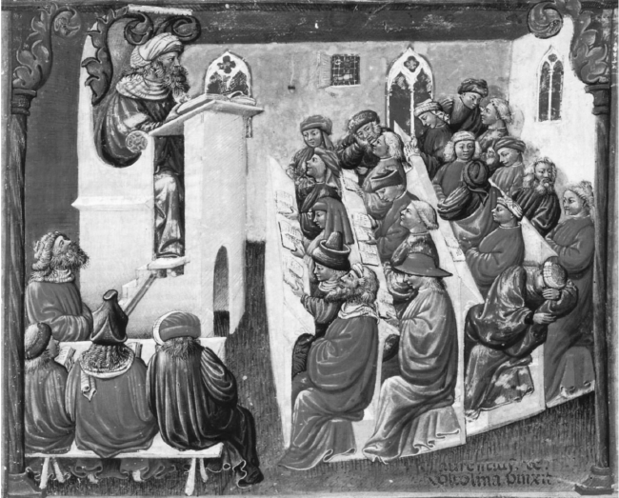
Education Technology today

Slide 31
Education Technology tomorrow
Disintermediated or disintermediator?
MOOCS v SPOCs. The 2U model for masters
Data Analytics – No back row

Slide 32
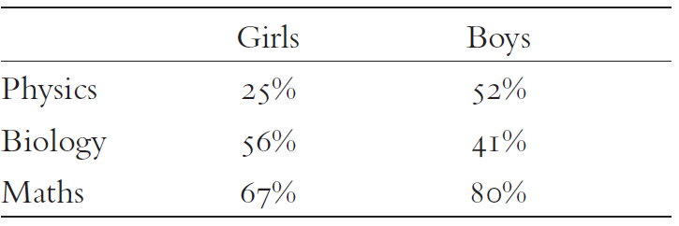
What: A broader education
Percentages of girls and boys with GCSE A* doing that subject at A Level

Slide 33
EDUCATION
DAVID WILLETTS
A UNIVERSITY
January 2018

