Slide 1
Academic Professionalism & Academic Innovationism
Accretion and/or Transition?

Slide 2
Growth of Scientific Research Output of Top 188 U.S. Universities, 1980-2010
1980
2010
R&D Expenditures (all sources):
$4.4 billion
Web of Science Publications:
191,000
Web of Science Citations:
4.3 million (1980 articles measured in 2015)
R&D Expenditures (all sources):
$46.9 billion
Web of Science Publications:
555,000
Web of Science Citations:
10.7 million (2005 articles measured in 2015)

Slide 3
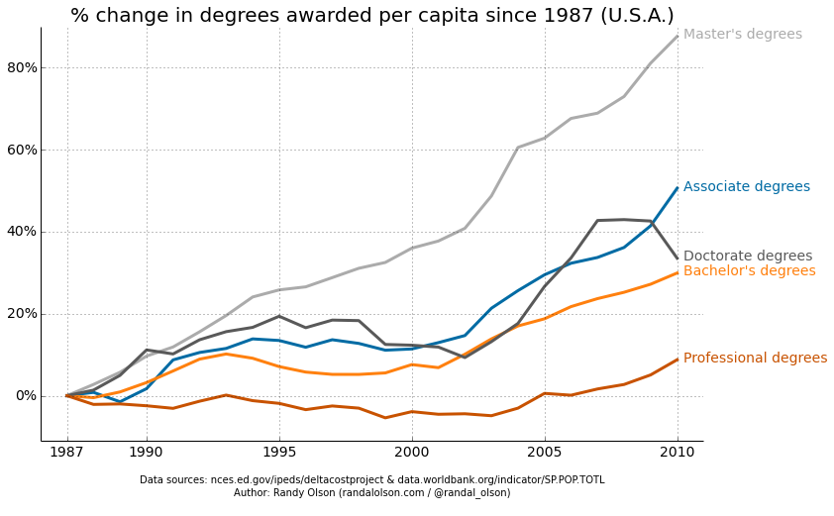
Growth of U.S. Adult Population with Postsecondary Degrees, 1987-2010
As of 2015:
Bachelor’s Degrees: 68.9 m. (32.5% of population age 25+)
Advanced Degrees: 25.5 m. (12% of population age 25+)
First Professional/Doctorate Degrees: 10.1 m. (5% of population age 25+)
Source: National Center for Education Statistics (2015)

Slide 4
Historical Context
Context
Key Legislation
Explanations

Slide 5
Context of Competitiveness Policy
R. Solow (1956, 1957) comparative studies of economic growth: 87% residual after primary factors of production (land, labor, and capital) taken into account. E. Denison (1985): ~66% of residual due to technological innovation; ~33% due to improvements in human capital.
U.S. competitive situation in 1970s: After-tax profits 10% in 1965; 4.5% in 1975. Productivity gains plateauing at 1% per year. Japanese industry surging in steel, automobiles, machine tools, and consumer electronics.
Boyer/Cohen discovery of gene splicing technology (1973) creates an entirely new industry in late 1970s and early 1980s from academic science.

Slide 6
Key Legislation of the 1980s
Bayh-Dole Act of 1980: Reduces restrictions on university patenting of discoveries made with federal funds and encourages licensing of patented discoveries to private firms.
Stevenson-Wydler Act of 1980: Required federal laboratories to actively participate in technology transfer activities.
National Cooperative Research Act of 1984: Provided special anti-trust status to R&D joint ventures and encouraged broad government-industry-university cooperative funding.

Slide 7
Actors, Ideologies, & Policy Windows
The corporate influence argument: S. Slaughter and G.R. Rhoades (1996)
The state interest/ideological convergence argument: E.P. Berman (2012)
The policy window argument: J. Kingdon (1984)

Slide 8
Mechanisms
Patenting/Licensing
University-Industry Research Centers
50 State Mobilization
Grand Challenges
Interdisciplinary Cluster Hiring

Slide 9
Licenses and Licensing Income
Licenses Executed
Licensing Income (in millions)

Slide 10
University-Industry Research Centers
1980: first NSF funding of University-Industry Research Centers.
Cohen, Florida, and Goe (1990): Estimate of 1,100 UIRCs and $1 b. in external support by 1989.
Notable examples: Cal Tech’s Silicon Structures Program, MIT’s Polymer Processing Center, Microelectronics Center of North Carolina (MCNC), Minnesota Microelectronics and Information Sciences (MEIS).
About 70% of industry funding for university research channeled through UIRCs.

Slide 11
Mobilization in the 50 States: Examples
New York STAR Centers for Advanced Technology (1983)
Georgia Research Alliance (1984)
California Institutes of Science and Innovation (2000)
UStar (2006)

Slide 12
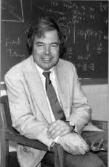
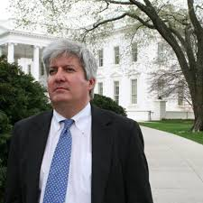
Grand Challenges
Kenneth Wilson (1989): Advocacy of supercomputering as “grand challenge”
Bill and Melinda Gates (2003): Global Health Challenges ($458 m. initially)
2001-2015: Huge growth in federal “grand challenge competitions.” As of 2015, 440 challenges had been conducted by federal agencies with over $150 million in prizes awarded.
Obama’s “21st Century Grand Challenges” included: (1) mapping the human brain, (2) making solar energy cost competitive, (3) mapping asteroids and preventing damage to Earth, and (4) saving newborns lives in poor communities.
Xprizes: Multimillion dollar prizes fielded on topics such as low-cost robotic space exploration, conversions of carbon emissions, wireless devices for remote diagnosis of illnesses, ocean discovery, advances in adult literacy, and contributions to artificial intelligence.

Slide 13
Interdisciplinary Cluster Hiring
Duke University (1988): “Crossing Boundaries”
University of Southern California (1994)
University of Wisconsin-Madison Cluster Hiring Program (1998)
Perhaps 50 research universities have engaged in large-scale cluster hiring programs over last 15 years.

Slide 14
Consequences & Import
Entrepreneurial Universities
Industrial clusters
Universities role in top inventions
Corporate dominance
New University Designs?

Slide 15
Two Entrepreneurial Universities Others Hope to Emulate
Stanford University
Mass. Institute of Technology
~5,000 companies started by Stanford faculty, students, or alumni
53 largest of these firms had $267 b. in sales in 2010
Same firms had market capitalization of $650 b.
Source: Stanford University (2011)
~35,000 firms started by MIT faculty, students, or alumni, 30,000 still active.
Estimate that these firms generate $19 trillion in annual revenues
~4.6 m. people employed in these firms, 30% of which are located in Massachusetts.
Source: Roberts, Murray, and Kim (2016)

Slide 16
Universities & Industrial Clusters
Virtually all large research universities are trying to create them, but not all have succeeded.
Notable examples: Research Triangle, UT-Austin Silicon Hills, UC San Diego telecommunications and biotechnology clusters, University of Michigan biotechnology corridor
Location in sparsely populated regional areas, with poor transportation networks and limited venture capital, hurts efforts. Examples: University of Illinois, University of Wisconsin-Madison, Penn State, and Cornell University.
Private universities with strong orientation to “knowledge for knowledge sake” also lag. This group includes, e.g., the University of Chicago.

Slide 17
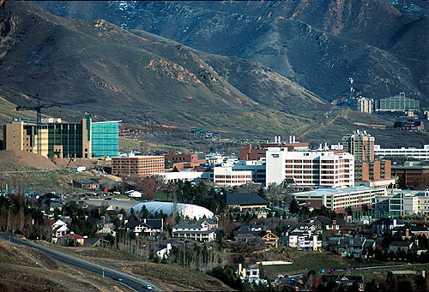
University of Utah Example
Located in Salt Lake City, a small city of fewer than 200,000 people, the University of Utah was the leading producer of patents in the region during the period 2009-2013.
In the two decades between the mid-1990s and mid-2010s, University of Utah researchers spun off 180 companies, the 9th highest rate in the country.
The patents and companies produced by the University of Utah helped to create regional clusters in information technology, aerospace, medical devices, and biopharmaceuticals.
In 2006, the state government pledged $180 million in support for hiring eminent scholars interested in commercialization and by setting new priorities for future technology-based development in the areas of medical therapies, clean energy, and sensor technologies.

Slide 18
Findings on University Role in 50 Top Inventions, 1955-2005
In 40 percent of cases, university researchers were the most important contributor or a “very important” contributor.
University researchers did not come exclusively from top universities. Instead, spread out throughout the world and at a wide range of universities.
University researchers were not involved exclusively at early research stage. Instead, roughly equal distribution in early research, refining research, and development.
In at least 60 percent of cases, state funding was instrumental in research and development of the invention.

Slide 19
Corporate Dominance in R&D
The majority of technological innovation comes from corporations.
Corporations played the “most important” or a “very important” role in 70 percent of R&D in top 50 inventions (not counting production).
R&D spending is dominated by corporations in the U.S.: 66 percent of total R&D is corporate. Much discussed disinvestment of corporate R&D is limited to a few industries, such as pharmaceuticals and chemicals.
Universities that succeed in regional economic development are typically aligned with pre-existing industrial concentrations. Examples of Eli Lilly and UC San Diego and Microsoft and University of Washington.
Corporate funding continues to constitute well under 10 percent of total university R&D funding.

Slide 20
Cumulative Patent Data, 1980-2015
In U.S. Total
In U.S. Universities
Disclosures: ???
Patent Apps: 11,024,471
Patents Awarded: 5,430,787
Source: USPTO (2015)
Disclosures: 380,000
Patent Apps: 206,000
Patents Awarded: 84,000
Source: AUTM (2015)

Slide 21
The New American University Design?
Michael Crow’s Arizona State University wants to be a model of the future.
Focus on use-inspired research with potential economic impact.
Very large size (80,000 plus students on four campuses). Large online teaching component. Justified as providing social innovation to accompany technological innovation.
Very few traditional departments. Schools and centers are all interdisciplinary.
Rapid failure and rapid scaling of “successful innovations” are seen as part of organizational innovation. Large-scale use of technology for instruction and advising.

Slide 22
Conclusions
Weaknesses & Compatibilities
Main Points

Slide 23
Weaknesses and Compatibilities
Weaknesses
Compatibilities
Both states and corporations have short time horizons and can be unreliable partners.
Delays in publication, conflicts of interest, and conflicts of commitment have not yet been fully resolved.
“Gold rush mentality” by university administrators can lead to poor investment decisions.
Entrepreneurial scientists and engineers publish as much or more than other scientists and engineers.
Universities that have pursued an entrepreneurial path have been among the most upwardly mobile in total scientific output since 1980.
In so far as it is possible to determine, curiosity-driven basic research has not been imperiled.

Slide 24
In Sum…
Universities’ role in technology-based economic development is still quite limited, but much more consequential than many realize.
In general, academic innovationism does not appear to threaten academic professionalism, but instead is compatible with it and could be an aid to it.
However, some new university designs represent a larger challenge.
Both states and corporations have short time horizons and are consequently unreliable partners. Corporations remain the dominant force in innovation.
Many universities are not favorably situated ecologically to play an important role in regional economic development.
Universities will be distended by academic innovationism, but not transformed.

Slide 25
Questions??

