Slide 1
The world-wide trend to high participation societies and what it means
Higher education anywhere
and everywhere
Simon Marginson
ESRC/HEFCE Centre for Global Higher Education
UCL Institute of Education, University College London
Bath Spa University, 2 May 2017

Slide 2
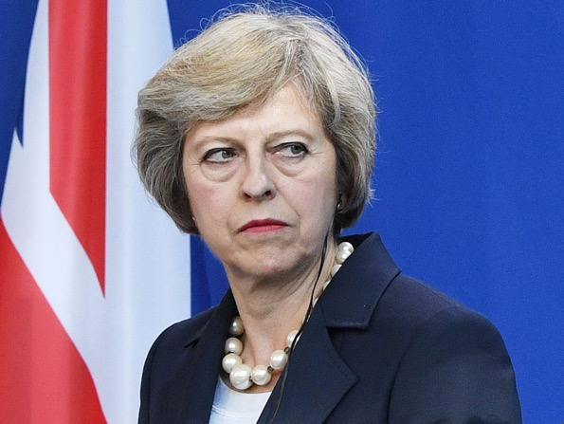
There’s politics, there are political issues … and there are long term trends shaping both
The election: ’Strong and stable leadership’ but for what?
Brexit: Looks like a v. big boo-boo, but life goes on

Slide 3
The long-term social trends are often more global than national in form
This includes the massive worldwide growth of higher education

Slide 4
Higher education anywhere and everywhere: coverage of topic
The worldwide growth of higher/tertiary education
What is driving educational growth?
Growth, social mobility and inequality
What is a high participation society?

Slide 5
Gross Tertiary Enrolment Ratio (GTER, %): World, UK, North America/Western Europe,
1971-2014

Slide 6
Regional Gross Tertiary Enrolment Ratios (%), 1970, 1990, 2010 and 2014
 | 1970 | 1990 | 2010 | 2014
World | 10.0 | 13.6 | 29.3 | 34.5
North America/ W. Europe | 30.6 | 48.6 | 76.9 | 76.4
Central and Eastern Europe | 30.2 | 33.9 | 67.9 | 74.4
Latin America and Caribbean | 6.9 | 16.9 | 40.9 | 44.7
East Asia and Pacific | 2.9 | 7.3 | 27.3 | 39.1
Arab States | 6.0 | 11.4 | 25.5 | 28.9
Central Asia | n.a. | 25.3 | 26.7 | 25.7
South and West Asia | 4.2 | 5.7 | 17.4 | 22.8
Sub-Saharan Africa | 0.9 | 3.0 | 7.7 | 8.2
Notes:
.

Slide 7
Tertiary participation rate in Indonesia, China, India
1974, 1994, 2014 (%)
In India the UNESCO data are for 1973, 1995, 2014

Slide 8
GTER and urbanisation in Indonesia
1990-2013 (1)

Slide 9
GTER and urbanisation in Indonesia
1990-2013 (2)

Slide 10
Comparative tertiary-level participation in the UK:
The Clancy Index for OECD countries

Slide 11
Effect of international students on rate of entry into degree programmes by age 25
OECD average includes international students

Slide 12
What is driving the near universal growth of tertiary and higher education?

Slide 13
The spread of higher education through the workforce
‘What mass higher education does is to break the old rigid connection between education and the occupational structure’ that prevented graduates from taking non-graduate jobs.
  ~ Martin Trow, Problems in the Transition from Elite to Mass Higher Education, Carnegie Commission on Higher Education, Berkeley, 1973.

Slide 14
The dynamic of open-ended growth
‘It seems to me very unlikely that any advanced industrial society can or will be able to stabilize the numbers going on to some form of higher education any time in the near future.’
  ~ Martin Trow, Problems in the Transition from Elite to Mass Higher Education, Carnegie Commission on Higher Education, Berkeley, 1973.

Slide 15
World GDP, population and tertiary enrolment, 1970-2012 (1970 = 1.0)
1970 = 1.0. Constant price GDP. Data from World Bank, UNESCO Institute of Statistics

Slide 16
GDP and GTER, 2013 or nearest year
GDP per head in nation (2011 USD, PPP) | Number of countries at each level of massification, as measured by the GTER (Gross Tertiary Enrolment Ratio)
 | GTER above 50% | GTER 15-50% | GTER below 15%
Above $30,000 per head | 25 | 10 | 0
$20,001-30,000 per head | 15 | 3 | 1
$10,001-20,000 per head | 14 | 17 | 2
$5001-10,000 per head | 2 | 13 | 7
$5000 or less per head | 0 | 13 | 32
total | 56 | 56 | 42

Slide 17
Proportion of population living in urban areas (%) and Gross Tertiary Enrolment Ratio (%), 2011
World’s largest nations by population, arranged in order of intensity of urbanisation
Selection of countries was based on 20 largest by population. 2011 GTER data not available for Brazil, Nigeria, Philippines and Ethiopia. Next countries in order of size were Thailand, UK, Italy, South Africa, Myanmar and South Korea. Full data were not available for South Africa and Mynmar

Slide 18
Breaking through? Disadvantage facing 20-34 year olds without tertiary-educated parents, 2012
For example in Poland, a 20-34 year old person with at least one tertiary-educated parent is 9.5 times as likely to participate in tertiary education, as a person whose parents had less than upper secondary education. Data: OECD

Slide 19
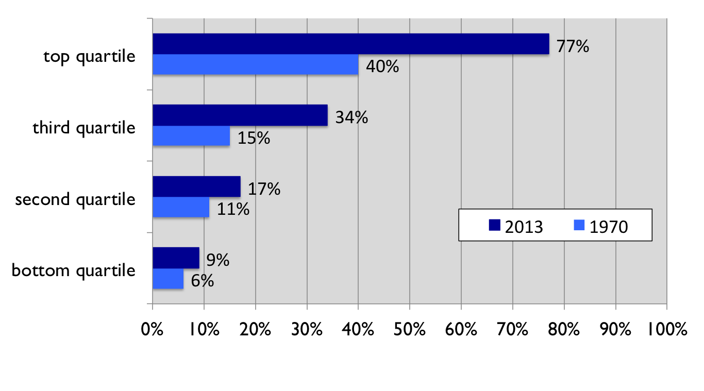
Social inequality in achieved college degrees
USA, 1970/2013
Bachelor degree by age 24, family income quartile
Source: The PELL Institute and Penn Ahead, 2015

Slide 20
Stratification within high participation: UK
Rate of entry to university tiers, by school background combined entry data for 1996, 1998, 2000, 2002, 2004 and 2006
Source: Boliver 2011
Entrants to higher education | Russell Group universities % | Other pre-1992 universities % | Post-1991 universities %
All entrants | 22 | 20 | 58
Private school entrants | 53 | 24 | 23
State school entrants | 20 | 20 | 60

Slide 21
Different higher education system settings change patterns of social equality/inequality

Slide 22
Research finds people with tertiary education, on average …
Have a larger range of employment options
Are more likely to be in good health, as are their families
Have more advanced levels of skill in the use of information and communications technology
Are more geographically mobile, independent of income level (suggesting greater personal confidence and agency freedom)
Report higher levels of inter-personal trust (again suggesting greater personal agency)
Are more likely to state that they have a say in government (likewise suggesting greater personal agency)
Are more positive about migration and cultural diversity
Walter McMahon, Higher Learning, Greater Good (2009)
OECD, Education at a Glance (2015)
OECD, Perspectives on Global Development 2017: International migration in a shifting world (2016)

Slide 23
Educational level and ICT and problem solving skills, OECD survey, selected countries
Country | GTER 2013 (%) | Proportion of 25-34 year olds with ‘good ICT and problem solving skills’, by highest completed educational qualification, nine countries, 2012
 |  | below upper secondary education (%) | upper secondary or post-school non-tertiary (%) | tertiary education (%)
Finland | 91 | 9 | 29 | 57
United States | 89 | 3 | 21 | 51
Australia | 87 | 15 | 33 | 56
Russia | 78 | 13 | 16 | 27
Norway | 76 | 15 | 32 | 59
Poland | 71 | 2 | 7 | 37
Japan | 62 | 8 | 24 | 49
England (UK) | 57 | 10 | 30 | 53
Canada | n.a. | 5 | 26 | 47

Slide 24
Level of education and interpersonal trust (%)

Slide 25
Level of education and belief that the person has a say in government (%)

Slide 26
The new politics of higher educated societies?

Slide 27
Brexit and educational level, June 2016
 | LEAVE | REMAIN
Total (same for men and women) | 52 | 48
EXIT POLLS
18-24 years | 27 | 73
Higher degree | 36 | 64
First degree | 43 | 57
Secondary education | 64 | 36
Primary education | 72 | 28
KINGS COLLEGE LONDON STUDY
Degree holders | 26 | 74
No qualifications | 78 | 22

