Slide 1
Central European University, 29 January 2017
Higher education and public goods
Simon Marginson
Director of the ESRC/HEFCE Centre for Global Higher Education Professor of International Higher Education
UCL Institute of Education
University College London, UK

Slide 2
Three questions about public good
Is the public/private line a distinction between
- non-market or market forms of education (economic distinction),
- state or non-state controlled forms of education (juridical-political distinction)?
What are ‘public goods’ in higher education? How are they defined, observed, measured and improved?
What if anything is normatively ‘good’ about public goods in higher education?

Slide 3
This paper
A theorisation of public/private in general, that combines the Paul Samuelson economic distinction (non-market vs market) with the juridical-political distinction (state vs non-state). See also
Marginson, S. (2016). Private/public in higher education: A synthesis of economic and political approaches. Studies in Higher Education. DOI 10.1080/03075079.2016.1168797
Application of this framework to higher education and research
Some public goods in higher education are common goods, advancing relational society and human rights
The questions of national variation in approaches to national public/private goods in higher education, and global public goods in a nationally-bound world

Slide 4
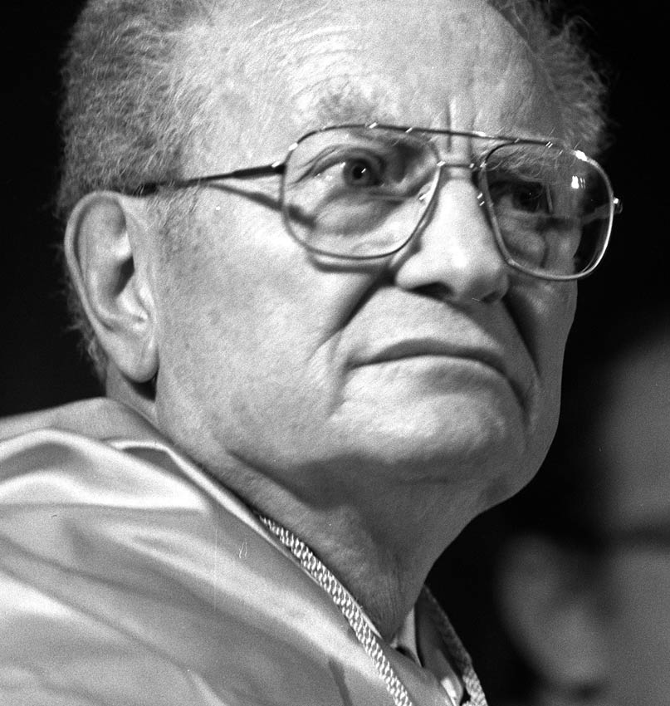
Economic definition of public/private—based on market vs. non-market production
Samuelson (1954)
Public goods are non-rivalrous and/or non excludable. They are under-produced or unproduced in economic markets. All other goods are private goods
Notes:
Goods are non-rivalrous when consumed by any number of people without being depleted, for example knowledge of a mathematical theorem, which sustains its use value everywhere, indefinitely, on the basis of free access. Goods are non-excludable when the benefits cannot be confined to individual buyers, such as clean air regulation. Private goods are neither non-rivalrous nor non-excludable. Public goods and part-public goods cannot be produced on a profitable basis, and normally require government funding or philanthropic support.
Here is an enduring fiscal principle for limited liberal states: state funds public goods, family/individual funds private goods
However, Samuelson’s framework is not very helpful in dealing with collective goods,, because it is hard to define collective goods in economic terms
Another key weakness of Samuelson’s definition is that it naturalises the public/private distinction. In reality some ‘public goods’ are shaped by policy. Teaching can be either a public or a private good. Learned knowledge is non-excludable and non-rivalrous. However, whenever student places confer value in comparison with non participation, there is rivalry; and in HEIs with a surplus of applications over places, participation is excludable. Private goods are created and it is possible to have a market in tuition. The extent to which it is a private good is shaped by state policy-- , it depends on the approach to tuition, institutional stratification and so on.

Slide 5
Economic public goods: non-rivalrous and non-excludable
Goods are non-rivalrous when consumed by any number of people without being depleted, e.g. knowledge of a mathematical theorem, sustains use value everywhere, globally, indefinitely, on the basis of free access
Goods are non-excludable when benefits cannot be confined to individuals, e.g. clean air regulation, defence
Private goods are neither non-rivalrous nor non-excludable. They can be produced, sold and bought as individualised commodities in economic markets. This public/private distinction is between non-market production and market production
Research is primarily a public good. Teaching/student places can be either public or private; depends on policy

Slide 6
McMAHON’S ESTIMATE Of PRIVATE NON MARKET BENEFITS OF COLLEGE EDUCATION (direct benefits, average college graduate, 4.5 years of education, 2007 US dollars)
Own health benefits | 16,800
Own longevity | 2179
Spouse’s health | 1917
Child’s health | 4340
Child’s education and cognitive development | 7892
Management of fertility and lower family size | 1551
Better consumption and saving patterns | 3401
Total value of quantified private non-market benefits p.a. | 38,080
Other positive non-market private effects (unquantified) related to job conditions and location amenities, better tastes, less obsolescence of skills due to better general education, greater well-being via enhanced income, etc. See McMahon 2009.

Slide 7
McMAHON’S ESTIMATE Of DIRECT SOCIAL EXTERNALITIES OF COLLEGE EDUCATION (average college graduate, 4.5 years of education, 2007 US dollars)
Democratization and political institutions | 1830
Human rights and civic institutions | 2865
Political stability | 5813
Community life expectancy | 2308
Reduced inequality (greater opportunity, less poverty, etc.) | 3110
Less crime | 5647
Reduced health costs and prison costs | 544
Environment (cleaner air and water, less deforestation) | 5609
Total social benefits | 27,726
Other positive social benefits (unquantified here) related to higher tax receipts, social capital, the dissemination of the outcomes of R&D. See McMahon 2009.

Slide 8
McMAHON’S ESTIMATE Of TOTAL BENEFITS OF COLLEGE EDUCATION (average college graduate, 4.5 years of education, 2007 US dollars)
Net private earnings benefits p.a. | 31,174
Non-market private benefits p.a. | 38,080
Direct social benefits (direct externalities) p.a. | 27,726
Total p.a. | 96,980
Direct social externalities constitute 29 per cent of the total benefits of higher education. However, total externalities include the indirect social benefits. These are the contributions of externalities to the value generated in private earnings and private non-market benefits. Once this indirect element is included, McMahon estimates that externalities total 52 per cent of the average value of higher education.

Slide 9
The economic public/private distinction
Non-market goods
Teaching:
Private learning in Internet, libraries, or
in institutional HEIs,, low cost or free, high access, low value differentials
Research:
Self-made scholarship and inquiry, or
In institutions, publicly funded, integral to researcher
Teaching:
Commercial market in tuition/degrees, or
Government controlled quasi market in student places/degrees
Research: Commercial research and consultancy, or
State quasi-market, competition between HEIs, product formats
Market-produced goods
Notes:
The four quadrants constitute four different political economies of higher education: Civil Society, Social Democracy based on universal public provision (Nordic model), State Quasi-market (now the UK model, isn’t it great!), Commercial Market
The state is active in all four. On the right hand side it shapes production more comprehensively and directly, through public services in Q1 and state quasi-markets in Q2 (both Dewey public activities). On the left hand side it sets regulatory frameworks for conduct (civil and commercial law).
Q1 combines economically public goods with politically private goods. As also in Q2, research and education are non-rivalrous and non-excludable, Samuelson public goods. In Q1 these activities are in Dewey’s private domain, outside politics and regulation. I call this zone civil society and it includes families, communities, social movements. In HE faculty and students pursue unpaid and unregulated activities between more formal agendas.
Q 2 research is research supported from general university funding. Projects are driven by curiosity and merit, not competitive acumen or university status. Much of what we do still sits in Q2. Including this paper. It is not part of a funded research project.
The neo-liberal era has moved action in higher education from Q1 and Q2 to Q3. In Q3 there is a tension between economic (private) and political (public). All is ‘public’ in Dewey’s political sense. Quasi-markets are policy controlled
Educational or research activity in higher education can be positioned on this diagram, according to the extent it is ‘public’ in Samuelson’s economic sense; and the extent it is ‘public’ in Dewey’s political sense, recognised as a matter of common interest and state regulation.
The 4-quadrant diagram makes explicit the political choices associated with economic provision, for example whether or not to produce higher education on a non-market basis—and if non-market, whether to do this in the regulated funded public sector or leave it to civil society.
The 4-quadrants also highlight the question of who should pay, whether the state through taxation or the individual beneficiaries. In matters defined as public in the political sense, it poses the question ‘how public can we afford to be?’ in economic terms.

Slide 10
Political definition of public and private—state vs. non-state
“The line between public and private is to be drawn on the basis of the extent and scope of the consequences of acts which are so important as to need control, whether by inhibition or by promotion… The public consists of all those who are affected by the indirect consequences of transactions”
~ John Dewey, The Public and its Problems, 1927, pp. 15-16
Matters with ‘consequences’ for others include market transactions, organisation of education systems, etc
This public/private distinction is between state-controlled and non-state controlled production

Slide 11
The political public/private distinction
Teaching:
Private learning in Internet, libraries,
or
Commercial market in tuition/degrees
Research:
Self-made scholarship and inquiry,
or
Commercial research and consultancy outside close state regulation
Teaching:
High access, free places, low value differentials between HEIs and places, or
Quasi market in student places/degrees, with competition, some fees but not full commercialisation
Research:
Publicly funded research programmes in HEIs in which peers drive knowledge with limited competition for funds,
or
State quasi-market, highly competitive, use of product formats in research
Non-state sector goods
State sector goods
Notes:
The four quadrants constitute four different political economies of higher education: Civil Society, Social Democracy based on universal public provision (Nordic model), State Quasi-market (now the UK model, isn’t it great!), Commercial Market
The state is active in all four. On the right hand side it shapes production more comprehensively and directly, through public services in Q1 and state quasi-markets in Q2 (both Dewey public activities). On the left hand side it sets regulatory frameworks for conduct (civil and commercial law).
Q1 combines economically public goods with politically private goods. As also in Q2, research and education are non-rivalrous and non-excludable, Samuelson public goods. In Q1 these activities are in Dewey’s private domain, outside politics and regulation. I call this zone civil society and it includes families, communities, social movements. In HE faculty and students pursue unpaid and unregulated activities between more formal agendas.
Q 2 research is research supported from general university funding. Projects are driven by curiosity and merit, not competitive acumen or university status. Much of what we do still sits in Q2. Including this paper. It is not part of a funded research project.
The neo-liberal era has moved action in higher education from Q1 and Q2 to Q3. In Q3 there is a tension between economic (private) and political (public). All is ‘public’ in Dewey’s political sense. Quasi-markets are policy controlled
Educational or research activity in higher education can be positioned on this diagram, according to the extent it is ‘public’ in Samuelson’s economic sense; and the extent it is ‘public’ in Dewey’s political sense, recognised as a matter of common interest and state regulation.
The 4-quadrant diagram makes explicit the political choices associated with economic provision, for example whether or not to produce higher education on a non-market basis—and if non-market, whether to do this in the regulated funded public sector or leave it to civil society.
The 4-quadrants also highlight the question of who should pay, whether the state through taxation or the individual beneficiaries. In matters defined as public in the political sense, it poses the question ‘how public can we afford to be?’ in economic terms.

Slide 12
Putting the two definitions together
The economic distinction is non-market vs market
The political distinction is state vs non state
Thus for Paul Samuelson higher education is public, unless it can be produced in a market outside the state. For John Dewey public or private is decided by states and/or democratic communities
The economic and political definitions each have virtues, but also gaps, and each is ambiguous
Putting them together creates four unambiguous categories (four political economies) that can be used to explain higher education and research
Notes:
Samuelson’s economic approach to ‘public’ focuses on the market/non-market distinction. It is stronger with individual-level than collective goods.
Dewey’s political approach focuses on the state/non-state distinction. It is stronger in the handling of collective public goods, or public good
The economic definition identifies the minimum necessary public goods, but posits a zero-sum relation between public and private, and constrains policy choices.
The political definition makes the public/private relation a political choice, not a natural event, enabling zero-summism to be overcome. It also makes explicit the implicit economic assumptions, subjecting them to open choice. It is more comfortable in the normative domain
But the political definition has no limits. This suggests that Dewey’s understanding of ‘public’ should be subjected to the discipline of the economic approach, based on scarcity and costs.

Slide 13
Public and private goods: four political economies of education
Non-market goods
Quadrant 1: CIVIL SOCIETY
Quadrant 2: SOCIAL DEMOCRACY
Teaching: Private learning in Internet, libraries
Research: Self-made scholarship and inquiry
Teaching: Free places, low value differentials
Research: Publicly funded, integral to researcher
Non-state sector goods
State sector goods
Quadrant 4: COMMERCIAL MARKET
Quadrant 3: STATE QUASI-MARKET
Teaching: Commercial market in tuition/degrees
Research: Commercial research and consultancy
Teaching: Quasi market in student places/degrees
Research: State quasi-market, product formats
Market-produced goods
NOTE: State, institutions and individuals are active agents in all four quadrants
Notes:
The four quadrants constitute four different political economies of higher education: Civil Society, Social Democracy based on universal public provision (Nordic model), State Quasi-market (now the UK model, isn’t it great!), Commercial Market
The state is active in all four. On the right hand side it shapes production more comprehensively and directly, through public services in Q1 and state quasi-markets in Q2 (both Dewey public activities). On the left hand side it sets regulatory frameworks for conduct (civil and commercial law).
Q1 combines economically public goods with politically private goods. As also in Q2, research and education are non-rivalrous and non-excludable, Samuelson public goods. In Q1 these activities are in Dewey’s private domain, outside politics and regulation. I call this zone civil society and it includes families, communities, social movements. In HE faculty and students pursue unpaid and unregulated activities between more formal agendas.
Q 2 research is research supported from general university funding. Projects are driven by curiosity and merit, not competitive acumen or university status. Much of what we do still sits in Q2. Including this paper. It is not part of a funded research project.
The neo-liberal era has moved action in higher education from Q1 and Q2 to Q3. In Q3 there is a tension between economic (private) and political (public). All is ‘public’ in Dewey’s political sense. Quasi-markets are policy controlled
Educational or research activity in higher education can be positioned on this diagram, according to the extent it is ‘public’ in Samuelson’s economic sense; and the extent it is ‘public’ in Dewey’s political sense, recognised as a matter of common interest and state regulation.
The 4-quadrant diagram makes explicit the political choices associated with economic provision, for example whether or not to produce higher education on a non-market basis—and if non-market, whether to do this in the regulated funded public sector or leave it to civil society.
The 4-quadrants also highlight the question of who should pay, whether the state through taxation or the individual beneficiaries. In matters defined as public in the political sense, it poses the question ‘how public can we afford to be?’ in economic terms.

Slide 14
Common goods
Not all public goods are necessarily progressive in distribution or in their social effects (e.g. national military offensives are a ‘public good’ in both the economic and political senses, but do we like them?)
Collective goods are a particular kind of political public good. These are relational goods that provide for such qualities as social solidarity, equity, human rights, democratic self-determination, and social and geographic mobility (freedom of movement) in populations
The provision of higher education on the basis of equal social opportunity and maximum social mobility is one such common good

Slide 15
Published 19 December 2016, Melbourne University Publishing
https://www.mup.com.au/items/199659

Slide 16
National variations in ’public’ goods
 | United States | Nordic | Post-Confucian (East Asia and Singapore)
Nation-state | Limited liberal state, federal, separate from economy and civil order, constraints on state intervention. HEIs in civil society? | Comprehensive Nordic welfare state, unitary, equated with society, fosters cooperative and egalitarian HEIs | Comprehensive Sinic state, politics commands economy. Unitary. High status state (top graduates enter state service)
Educational culture | Meritocratic and competitive market. Highly stratified, but education seen as common road to wealth/status within advancing prosperity | Egalitarian, free of charge, cooperative, universal, public. Low stratification of HEIs. State guaranteed medium for equal opportunity | Education for filial duty and social status in stratified system. Confucian commitment to self-cultivation at home plus state belief in economic benefits.
State and family role in higher education | State frames hierarchical market and steps back. Middle class family increasingly invests private resources | State supervises high quality egalitarian provision. Autonomy of HEIs. Family citizen right to free education | State supervises, shapes and drives the sector. Managed autonomy. Family invests much energy, time, money

Slide 17
Global public goods
‘Global public goods are goods that have a significant element of non-rivalry and/or non-excludability and made broadly available across populations on a global scale. They affect more than one group of countries, are broadly available within countries, and are inter-generational; that is, they meet needs in the present generation without jeopardizing future generations.’
~ Inge Kaul, I. Grunberg and Marc Stern (Eds.), Global Public Goods: International cooperation in the 21st century, New York, Oxford University Press, 1999, pp. 2–3
.

Slide 18
Whose public goods? Are there generic public goods in higher education?
Is there a generic/worldwide ‘public good’ in higher education? Or is public good just in the eye of the beholder and incapable of generic form… ? e.g. whose global public good
Also, which tradition of ‘state’ and ‘public’ should we use—Anglo-American, Nordic, German social market, Chinese, Latin American, etc? Or should we use a combined idea of ‘state’?
If there are generic goods, can we separate the generic goods from those subject to national variation? If so what factors shape national variations?
Certain global public goods, and common goods pertaining to human rights, social solidarity and equality, might be among the generic public goods in higher education.
A key problem at world level is that it needs a state to maximise distributional equity of public goods and there’s no global state

Slide 19
Closing points
Both the state/non-state and the non-market/market distinction are relevant
Public goods in higher education are in danger of elite capture: the role of the state is key to this problem
Common goods (goods that sustain and augment sociability on the basis of equality and rights) have a special importance
The state’s role in higher education and research is specific to national political and educational cultures
Global public goods in higher education need more explicit attention

