Slide 1


International Student Migration:
Evidence from Finland
Charles Mathies
Centre For Global Higher Education: Seminar 74
UCL Institute of Education
22.3.2018
Migration, Mobilities & Internationalization
(miGroup)

Slide 2
Support of Research
Academy of Finland Research Fellowship: International student migration and mobility in Finland & Europe; Research Council for Culture and Society – Grant #310508, 9.2017-8.2022
Part of research project HCLA-RED (Human capital, labour markets, & regional development) @ JSBE

Slide 3
ISM: Evidence from Finland on who stays, why, and returns in labour market
Source: 3 papers
Do they stay or go? Analysis of international students in Finland
What if they stay? International students and returns in labour market
Private sector employability of international students: Evidence from Finland
With Hannu Karhunen

Slide 4
ISM: Evidence from Finland on who stays, why, and returns in labour market
Order of Presentation:
Overview of Finland & HE
Theoretical framework – International student migration (ISM)
RQs & Data
Results
Conclusions/Implications

Slide 5
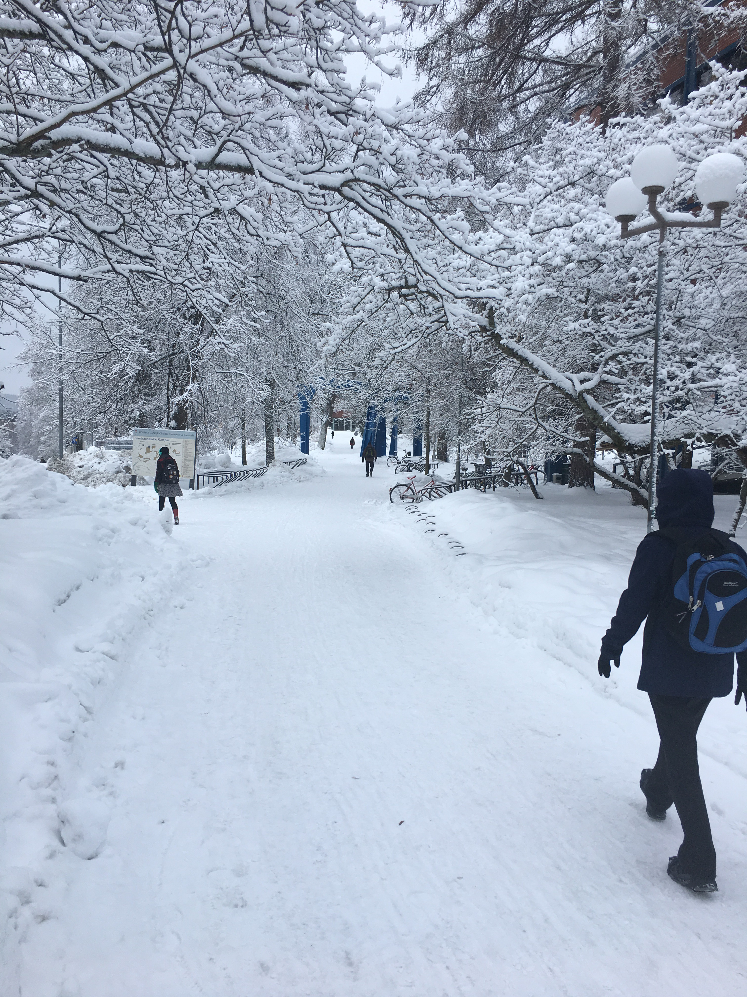
Beast from the East?
No, just an average Wednesday in winter (14.3.2018)

Slide 6
Overview - Finland
Population: 5.5 million in 2016 (World Bank 2018)
  0.28% growth (2016)
  UK: 65.6 Million
  % population migrants:
    2010: 4.6%
    2015: 5.7%
Has Europe’s fastest ageing population (Myklebust 2015)
Geographic Area: 2017 303,890 km² (World Bank 2018)
  UK: 241,930 km²
Economy →
  GDP 2016: $238.5 Billon (World Bank 2018)
  GDP Growth 2016: 1.6% (World Bank 2018)

Slide 7
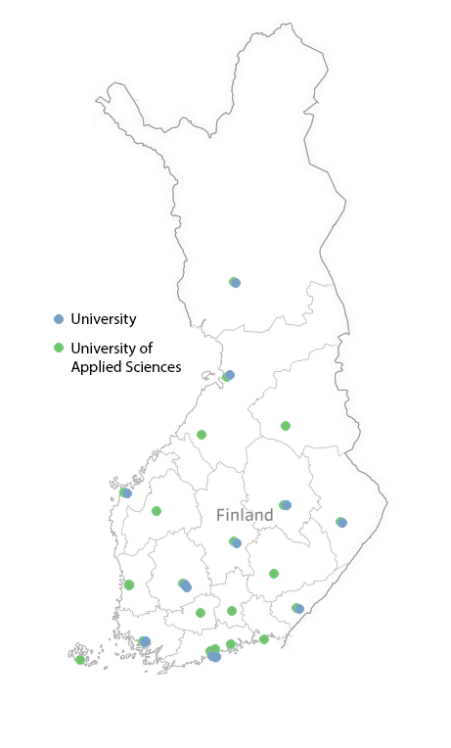
Finnish HE
Binary System
  14 Universities & 24 UAS
Univ – 2016:
  153k students, 7.2% Intl
UAS – 2016:
  143k students, 7.0% Intl
Funding Formula
  ~1.6 Billion €s (core Univ.)
  Primarily output based
Tuition Fees Fall 2017

Slide 8
Theoretical Framework
International student migration (ISM) is a relatively new theoretical framework within global migration & human capital literatures (King & Sondhi 2018)
ISM theorised as a subset within four larger conceptual frameworks (King & Sondhi 2018)
  Highly Skilled Worker Migration
  Product/Mechanism of the Globalisation of HE
  Global Youth Mobility Cultures
  Product/Driver of Class Distinction
Notes:
Highly skilled worker migration
Globalisation of higher education
Global youth mobility cultures
Product and driver of class distinction

Slide 9
ISM
Studying abroad has been previously positioned as a temporary endeavour but research is now framing studying overseas as a form of labour migration and a precursor to subsequent migration (Robertson 2013, Tremblay 2005)

Slide 10
Student Perspective
International students desire to acquire skills (“career-enhancing investment” p.178; i.e. human capital investment) to compete in global/regional labour markets (King & Sondhi 2018)
ISM is a dynamic process where an individual student’s agency is simultaneously constrained and enabled by external factors such as government or institutional policy, family considerations & labour market opportunities (Mosneaga & Winther 2013)
ISM recognizes international students having the freedom of traveling and living in different places and cultures as a desirable lifestyle (King & Sondhi 2018)

Slide 11
Gov’t/Univ Perspective
Countries/Regions seek to attract international students to increase the supply of highly-skilled workers into their labour markets (King & Sondhi 2018, Ziguras & Law 2006)
Counter-act concerns over decreasing or low-birth rates and ageing population
Training (educating) international students within national boarders is cheaper (& easier) than recruiting skilled workers … students are trained (more readily employable) for that national labour market (Ziguras & Law 2006)
Want for academic prestige (i.e. rankings)

Slide 12
Theoretical Framework
We hypothesize that family ties and labour market opportunities influence international students’ staying in Finland and outcomes in the Finnish labour market and society.
We also hypothesize that post-financial crisis international graduates experienced decreased levels of employment and earnings (i.e. labour market outcomes) which impacts family outcomes (marriage rates, having kids, etc.)

Slide 13
2 Basic Questions:
  “What influences international students to stay in Finland after graduation?”
  “What happens if they stay?”
Follow-up Questions:
  “Differences between International & Finnish students?”
  “Differences pre/post-FC?”

Slide 14
Research Design
Data Protections!

Slide 15
Research Design
Samples:
  Staying: All international students who completed their degree in a university (14) or university of applied sciences (24) in Finland from 1999 to 2011 (N=10,273)
    Controlled for various conditions in data
  Returns: All international students who completed their degree in a university (14) & university of applied sciences (24) in Finland from 2006 to 2011 (N=7,416)
  Removed individuals who:
    Completed secondary education in Finland (2,222)
    Speak Finnish/Swedish as first/native lang. (167)
    Over 45 years old at start of studies (170)
    Bachelors degree earners in Univ. (224)

Slide 16
Research Design
Combined data from national registries
  By Finnish personal ID via Statistics Finland
  Track for 3 years after graduation
  Use highest degree earned for cohort placement
Student Registry Files
Finnish Longitudinal Census Files
Finnish Employment Files
Income Distribution Statistics

Slide 17

Research Design
Staying:
  Logistic regression model(s) & Interactions
  $P\left(y=1\right)=P\left(y_{i}\right)={F(β}_{0}+{βi}_{1}X_{1}+ ... +β_{J}X_{J}+u_{i})$
    $y_{i}$ is a binary indicator showing if an international student stays in Finland 3 years after graduation
    $β_{1 },β_{2}, …, β_{J}$ coefficients of family ties/labour market opportunities
    $X_{1}, X_{2}, …, X_{J}$ variables of family ties/labour market opportunities
    $u_{i}$ is the error term
  Note: If we would make causal claims, then the error term would not be allowed to correlate with other covariates. But we make no causal claims (!) we just show conditional correlations. When we show coefficients, they are marginal effects evaluated at the means

Slide 18
Research Design
Returns:
  T-Test
    Comparisons international vs. Finnish graduates
    Pre/Post Financial crisis (2008)
    Returns in labour market/society
  Oaxaca-Blinder Decomposition
    Explain differences in total wage gap (between Finnish and international graduates) 3-years after graduation using observed background factors (gender, age, field of education, etc.)

Slide 19
Results: Staying

Slide 20
Do International students stay (Finland) after graduation?
Finland has a high rate of international students staying 3-years after graduation (~66%, 1999-2011)
 | Graduates by institution |  |  |  | Staying 3 years after graduation
 | Applied university | Univ - Master | Univ - Doctoral |  | Applied university | Univ - Master | Univ - Doctoral
Panel A: All international students
Total | 3705 | 5049 | 1519 |  | 0.74 | 0.67 | 0.65
Panel B: Those who did not live in Finland before enrolment
Total | 2281 | 3963 | 1145 |  | 0.67 | 0.64 | 0.63
Panel C: Those who did not live in Finland before enrolment year and originate outside EU28
Total | 1936 | 2917 | 721 |  | 0.67 | 0.65 | 0.62

Slide 21
Factors influencing to stay
Age: Older +
Level of Education: Higher –
Gender: No impact
Marriage: +
Children: +
Parents: +
Employment: +
HEI Region: Other +
Discipline: STEM+
Nationality: - Asian,
+ Non-EU/Turkey

Slide 22
Martial Status and Employment

Slide 23
HEI Region and Degree Type

Slide 24
Results: Returns

Slide 25
Returns & Compare w/Finns
3 years after graduation
Differences in family life by degree types
  Marriage → Higher level of degree = higher rate
    Little change post-FC; Differences for UAS, LC, Other
  Kids →Drop in rates of having kids for all post-FC
Home ownership → large differences
  Grew post-FC (12-25% pre; 24-33%post)
Living in Study Region →
  Small differences by degree type
  Little change pre/post FC (across degree types/regions)
  Region → Capital had highest retention (over 85%), Large City (over 60%), other region (30-50%)

Slide 26
Returns & Compare w/Finns
3 years after graduation
Finnish grads employed at higher rate than Intl grads pre-FC (6-14%) and post-FC (9-11%) regardless of degree type/region
WC employment →
  Finns= Roughly similar pre-/post-FC (degree/region)
  UAS=WC employ dropped 16% post-FC (27% difference between Finn/Intl)
  Mast & PhD= No difference (Finn/Intl) pre/post-FC
  Regions: Differences grew all regions pre-FC (4-9%) and post-FC (9-19%), other intl biggest drop

Slide 27
Returns & Compare w/Finns
3 years after graduation
In general, Finns earn more than Intl graduates
  Regardless of degree type/region and pre/post-FC
No major changes in earnings pre/post-FC (all groups)
WC employment only → differences reduce (UAS Post, masters, Phd, Capital region, Large City post) or go away (UAS pre, other region, Large City pre)
Private vs. Non-Private sector earnings
  Private sector had higher earnings (all areas)
  Differences in private sector earnings between Finns & Intl for all degree types and regions, except for PhD
  Earnings differences in non-private sector increased with higher level of degree; similar difference by regions

Slide 28
Decomposition
  The analysis: The unexplained difference with positive sign indicates that international graduates are paid less annually than similar Finnish graduates (i.e. those who have similar observed characteristics)
  Private Sector: Unexplained difference dropped post FC across all degree types
  Public Sector: Unexplained differences increased for UAS & masters, while PhD deceased

Slide 29
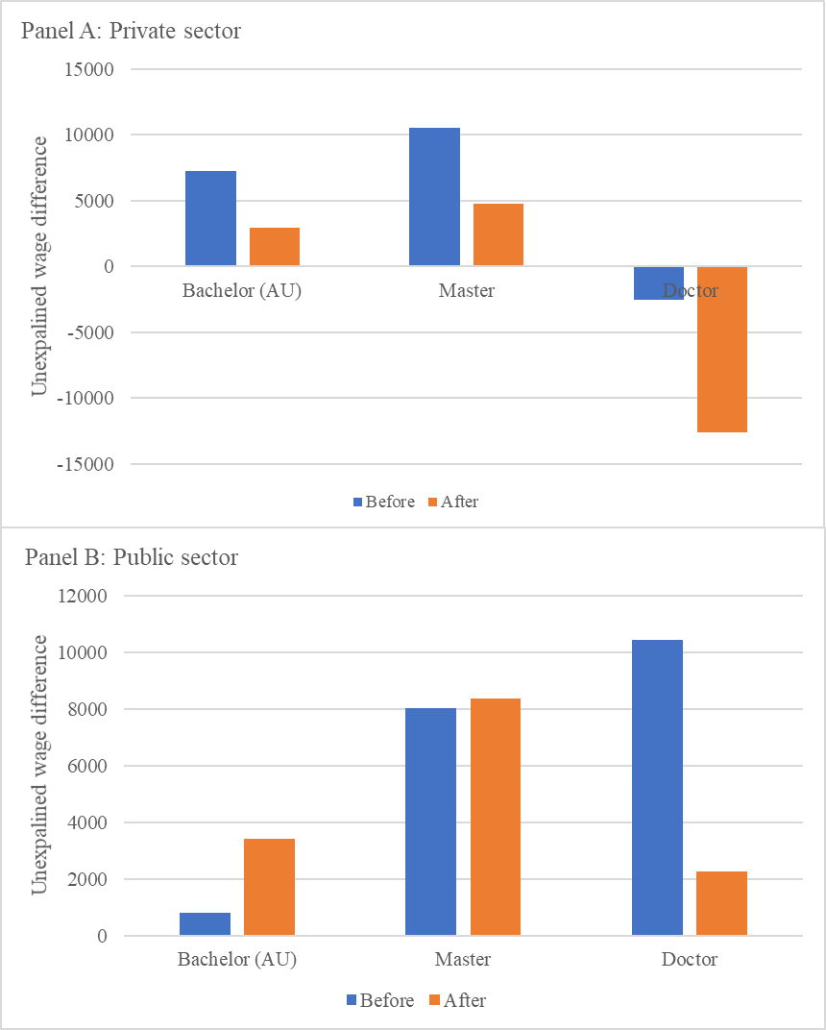
FIGURE 1: Unexplained wage difference by degree and sector before and after the financial crises

Slide 30
Decomposition
  Private sector: Unexplained differences dropped post-FC across all regions
  Differences post-FC were insignificant (@0.05) for all regions
  Public Sector: Unexplained difference deceased for Large City region, increased for Capital & Other

Slide 31
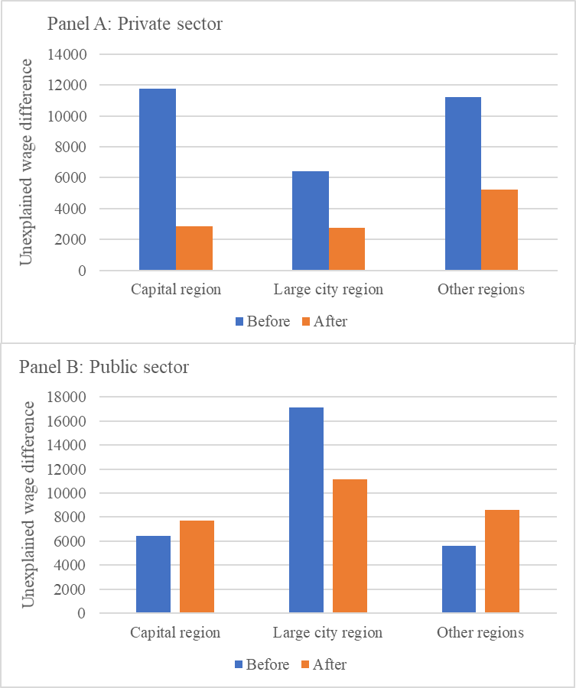
FIGURE 2: Unexplained wage difference by graduation region and sector before and after the financial crises

Slide 32
Returns & Compare w/Finns
3 years after graduation
Finns, in general, pay more (€) transfer payments (e.g. taxes) than International graduates across degree types/regions
  Likely due to Finns having higher avg. earnings
UAS Intl grads have higher rates of receiving & amounts (€s) transfers payments
Intl Grads → masters, PhD, all regions either no difference or Finns received transfer payments at slightly higher rate or amount

Slide 33
Returns & Compare w/Finns
3 years after graduation
Considering tax revenue/transfers received only, Intl grads pay less for every euro received than Finns in every grouping (degree type & region)
  UAS: Finn= 2.80, Intl= 1.72| Finn= 2.80, Intl= 1.69
  Masters: Finn= 3.77, Intl= 3.10| Finn= 3.80, Intl=2.88
  Doctoral: Finn= 5.01, Intl= 4.18| Finn= 4.15, Intl=3.51
All Intl degrees are economical positive (€2,390 - €9350), FC reduced (€400-1,200) amount
  Cost educating Intl = €7000 year (CIMO 2015)

Slide 34
Conclusions/Implications
ISM, as a theoretical framework worked well in explaining why international graduates stay in Finland
  Family ties and labour market opportunities positively influenced Intl graduates to stay
While Finland has high stay rate, the overall # of Intl students is quite low
  Impact of Intl graduates on Finnish labour market/society is muted due to small overall size

Slide 35
Conclusions/Implications
Location of HEI has a impact on staying
  Even though other region graduates were more likely to stay in Finland, they were the least likely to stay in study region (particularly Masters & PhD Post-FC)
  Suggests labour opportunities for other region Intl grads are in not located where they studied
    Capital/large cities have largest labour markets
  Results in other region likely at a disadvantage in keeping Intl grads in region after graduation
  Suggests networks (professional/social) likely influences where Intl grads live/work as well
  Q: Intl students studying in other region different?

Slide 36
Conclusions/Implications
  Financial Crisis → impacted family life
    Decrease in having children (4-10%) of all graduates
    Increase in differences between Finnish & International graduates home ownership (12-25% pre, 24-33% post)
    Q: International graduates financial/social capital?
  Financial Crisis → appears to have limited impact on employment and earnings, but greatly impacted WC employment for some
    WC employment dropped for UAS (16%) and other (13%) region international graduates

Slide 37
Conclusions/Implications
While Intl grads have lower employment rate than Finns, if they can get WC job, differences in earnings (except PhD) goes away, is reduced, or reverses (earn more)
  All international graduates are economic positive (€2390 to €9350) – though post-FC it was reduced (€400-1200)
    Cost educating Intl = €7000 year (CIMO 2015)

Slide 38
Conclusions/Implications
  Private sector employ: Evidence suggests that the relative position of international graduates improved post-FC
    Post-FC has been difficult globally→ Finnish labour market appears to be relative stable (minimal differences in earnings) which might have changed the selection of students staying
  Public sector employ: International graduates have a great deal of unexplained differences pre & post
    Suggests international graduates face diminished opportunities & returns → underlines the role of public sector and barriers faced (language & networks)

Slide 39
Concluding Points &
Policy intersections
Focus on integrating International students into labour market, particularly preparing them for WC employment → differences in employment/earnings are reduced or go away
Education on Finnish labour market → importance of building professional network & prior work experience
Finnish Language acquisition → language of education is English while language of labour market is Finnish
Attention needed on integrating UAS & other region international graduates → post FC drop in employment

Slide 40
charles.f.mathies@jyu.fi
@charles_mathies

