Slide 1
Higher Education Admission in Europe in the early 21st century – What are the challenges and how can they be addressed?
Dr. Graeme Atherton, Director National Education Opportunities Network (NEON)

Slide 2
Background
European Commission Project - looks at the impact of admission systems on higher education outcomes
Jan 2016 – July 2017
Aim: Understand better what makes an effective, equitable and efficient higher education admission system.
Policy concerns:
Expanding HE
Inequality in Europe
Graduate unemployment/economic growth

Slide 3
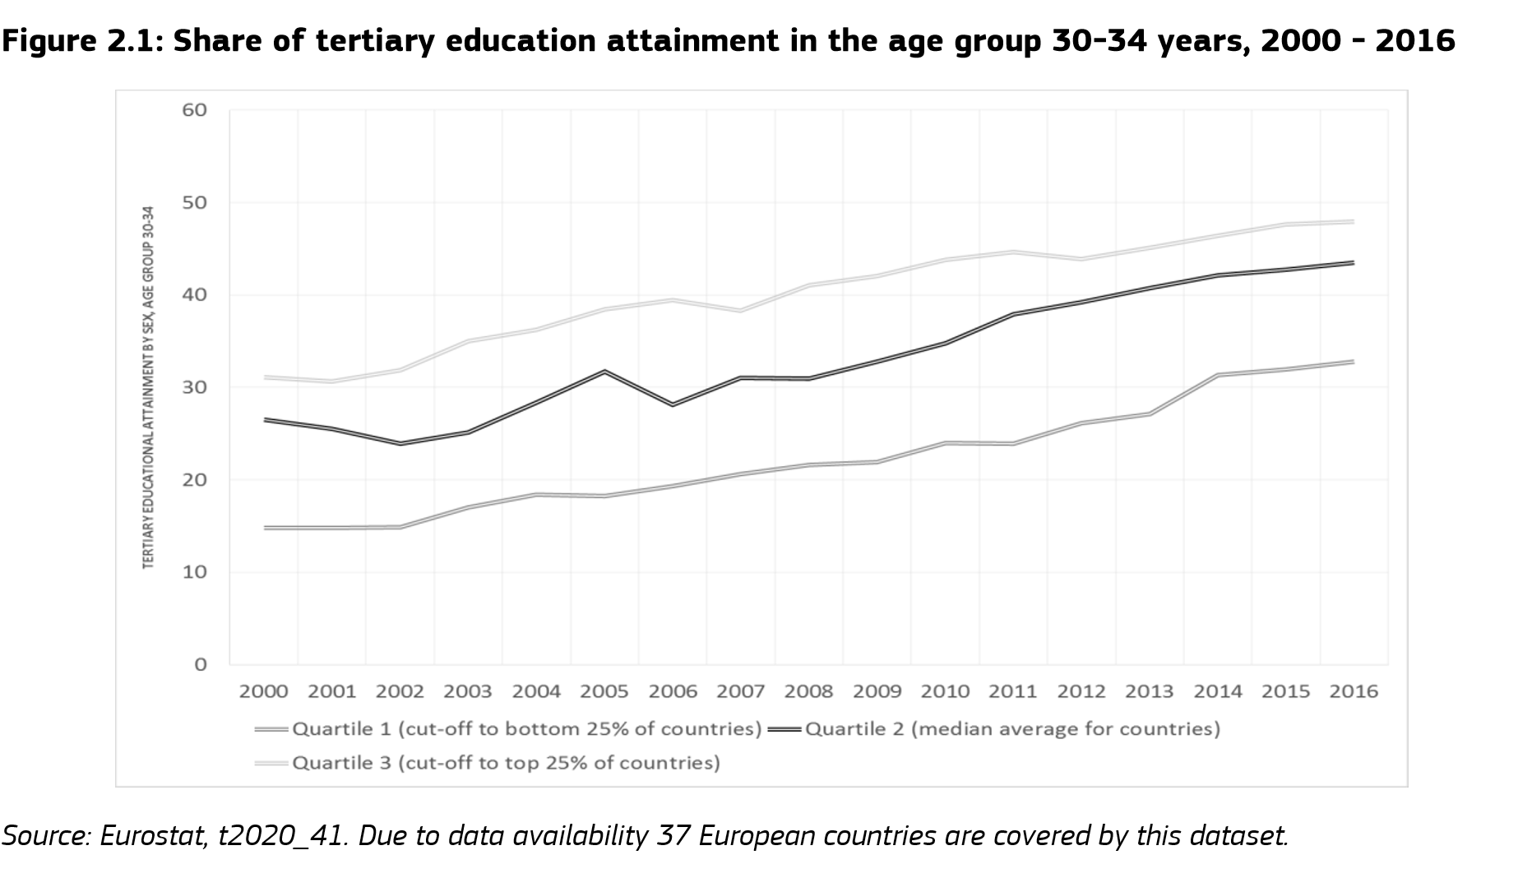

Slide 4
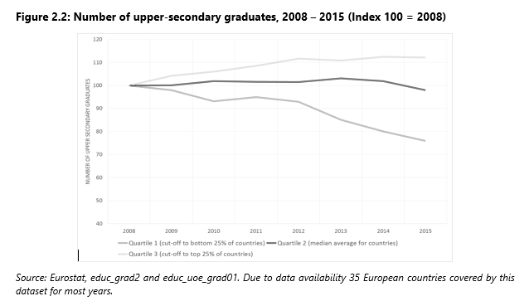

Slide 5
How to approach the aim

Slide 6
The methodology used
A system-level mapping of EU Member States, EEA/EFTA countries and candidate countries
8 national case studies (France, Norway, Ireland, Germany, Spain, Romania, Lithuania & Netherlands).
8 focus groups with young people at last year before entry into HE & first year of HE

Slide 7
Dimensions of admission
Admission is not a simple process which occurs at the end of secondary education. It is, rather, a process which can take up to a decade, from the moment a student is streamed by ability until – in some instances – a post-admission selection phase that occurs at the end of the first year of studies.
Two key dimensions
Streaming in schools, or not
The autonomy of HEIs to select students

Slide 8
Classifying countries?
Selection Streaming | (Nearly all) HEIs can select with additional criteria | HEIs cannot select with additional criteria (in normal circumstances)
At least one pathway through the school system does not lead to a qualification enabling higher education entry (to some part of the system) | Type 4: Double selection Czech Republic, Iceland, Montenegro Norway, Romania, Serbia, Slovakia, Spain, United Kingdom | Type 1: Selection by schools Austria, Belgium, Denmark, Germany, Hungary, Italy, Luxembourg, Netherlands, Poland, Slovenia
In general, all pathways may lead to higher education entry (in some part of the system) | Type 2: Selection by HEIs Bulgaria, Croatia, Cyprus, Estonia, Finland, Portugal, Lithuania, Latvia | Type 3: Least selection Albania, France, Greece, Ireland, the former Yugoslav Republic of Macedonia, Malta, Sweden, Turkey

Slide 9
Findings from mapping
Entry rates are higher where HEIs have increased autonomy
Social inclusion higher for graduates in least selective systems
Participation of mature students is higher for more selective systems
Completion rates are linked to selectivity
More flexible enrolment, but higher unemployment rates for least selective systems

Slide 10
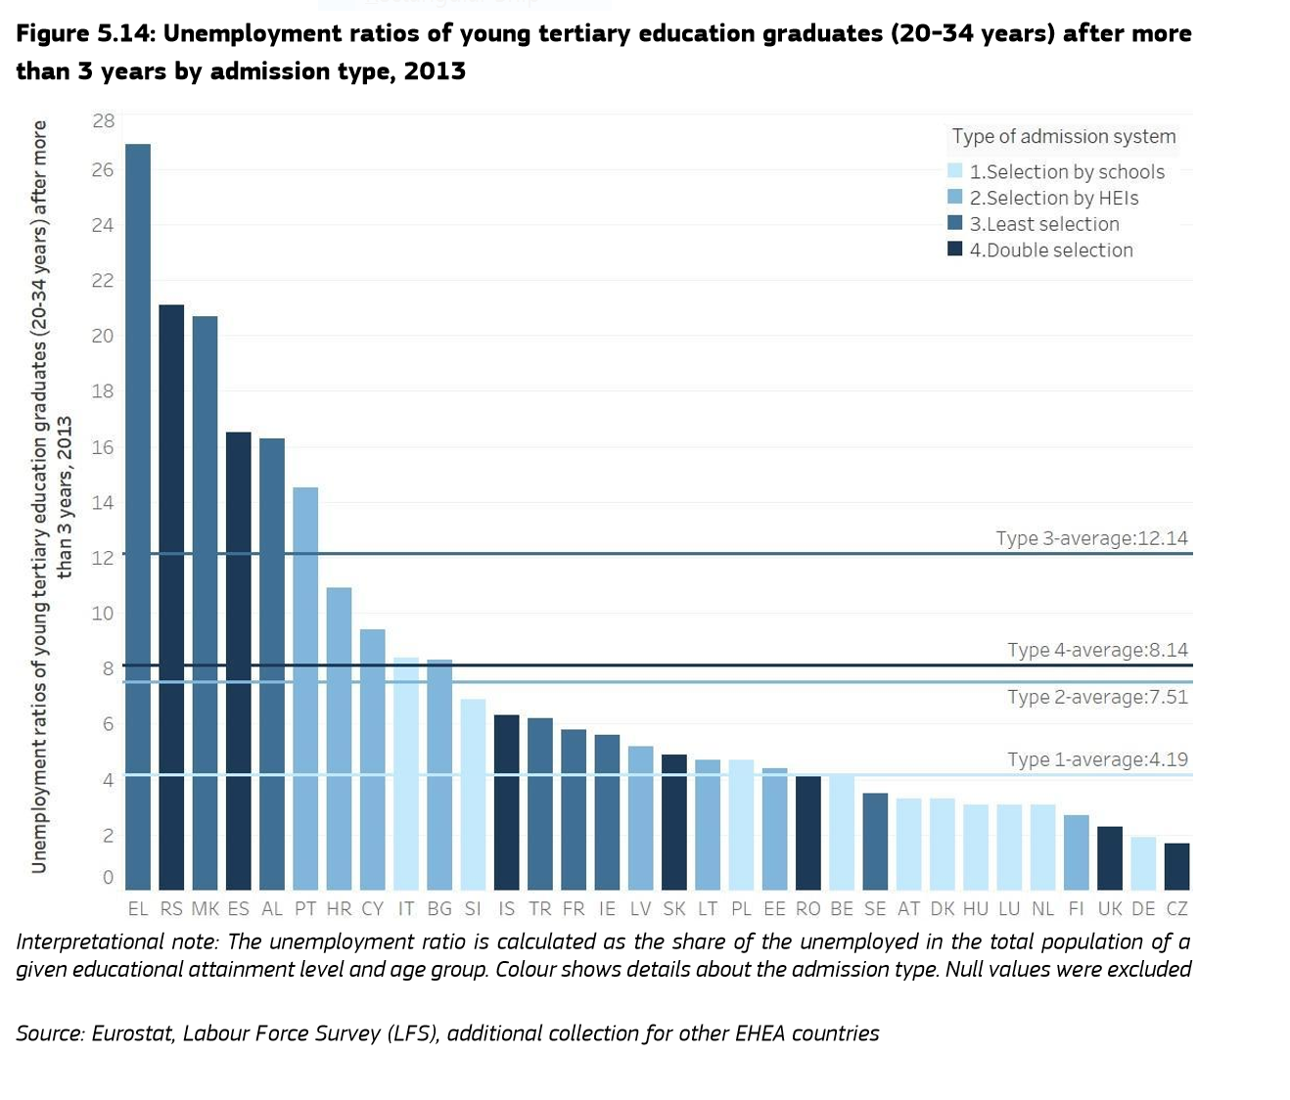

Slide 11
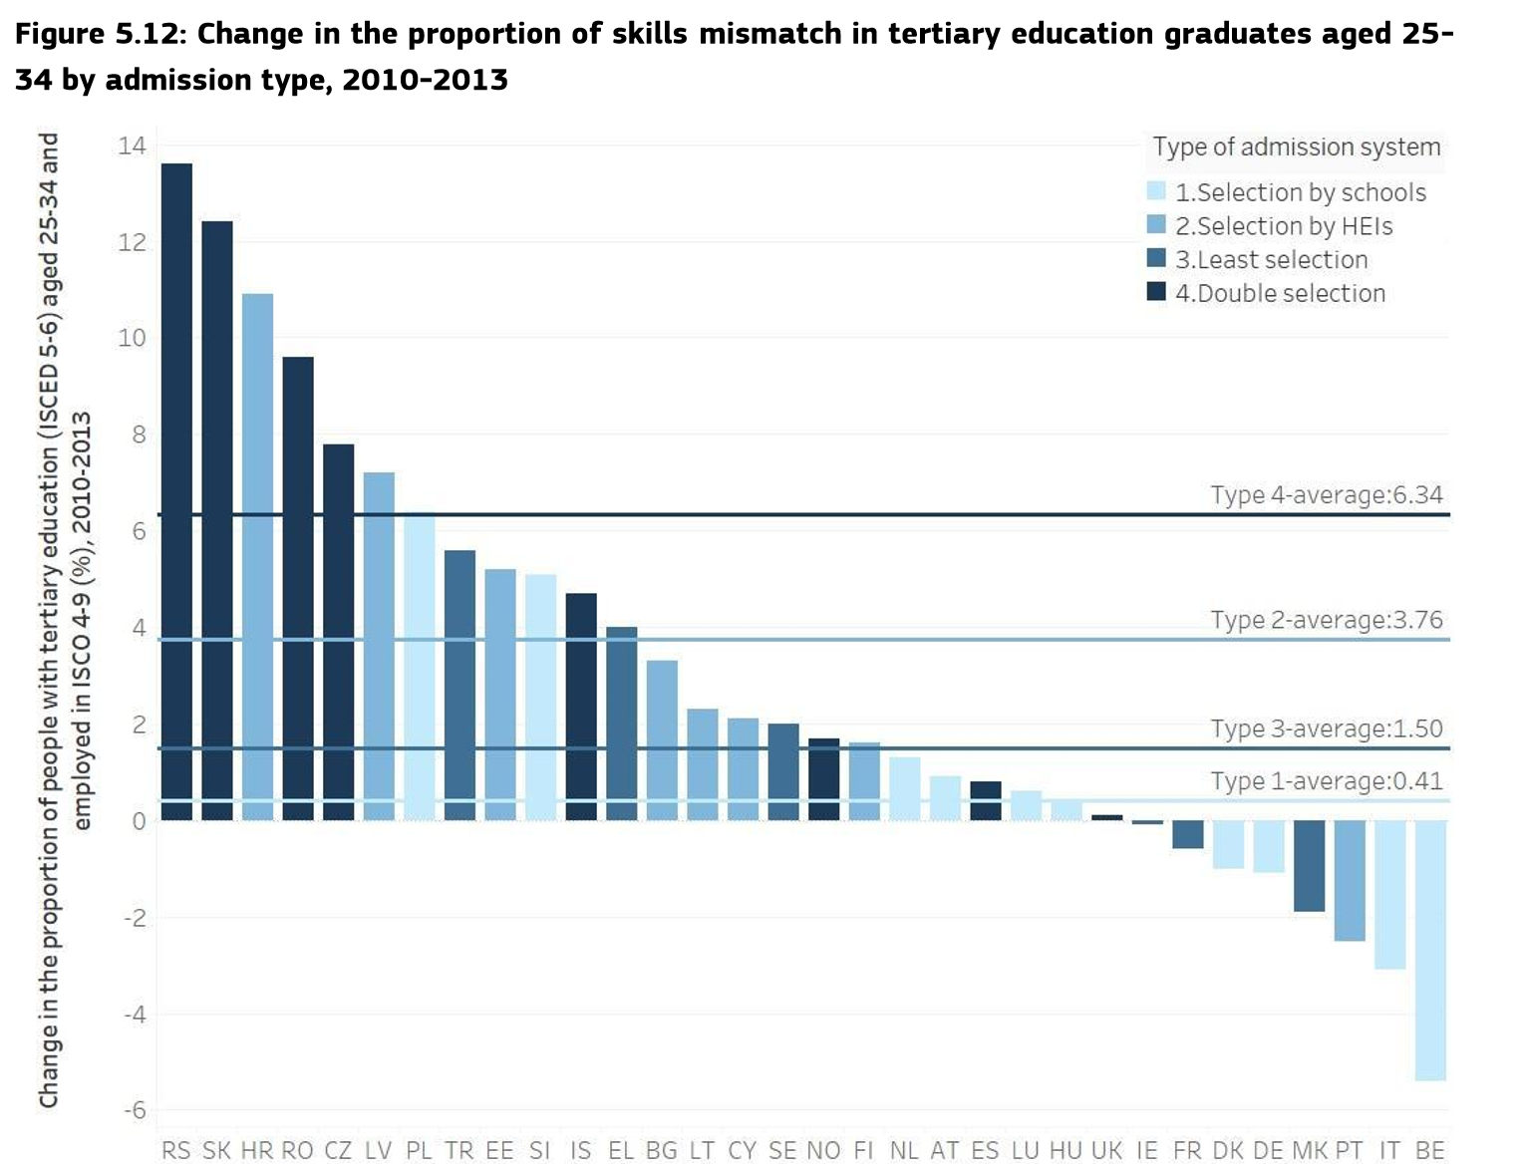
Notes:
BE – IT – PT - mismatches are defined as the percentage of young people aged 25-34 with tertiary education occupying a job not traditionally regarded as requiring a tertiary qualification (International Standard Classification of Occupations (ISCO) occupation levels 4 to 9). A higher value indicates that the proportion of tertiary graduates employed in jobs not traditionally regarded as requiring a tertiary qualification has increased, while a low score implies the opposite.

Slide 12
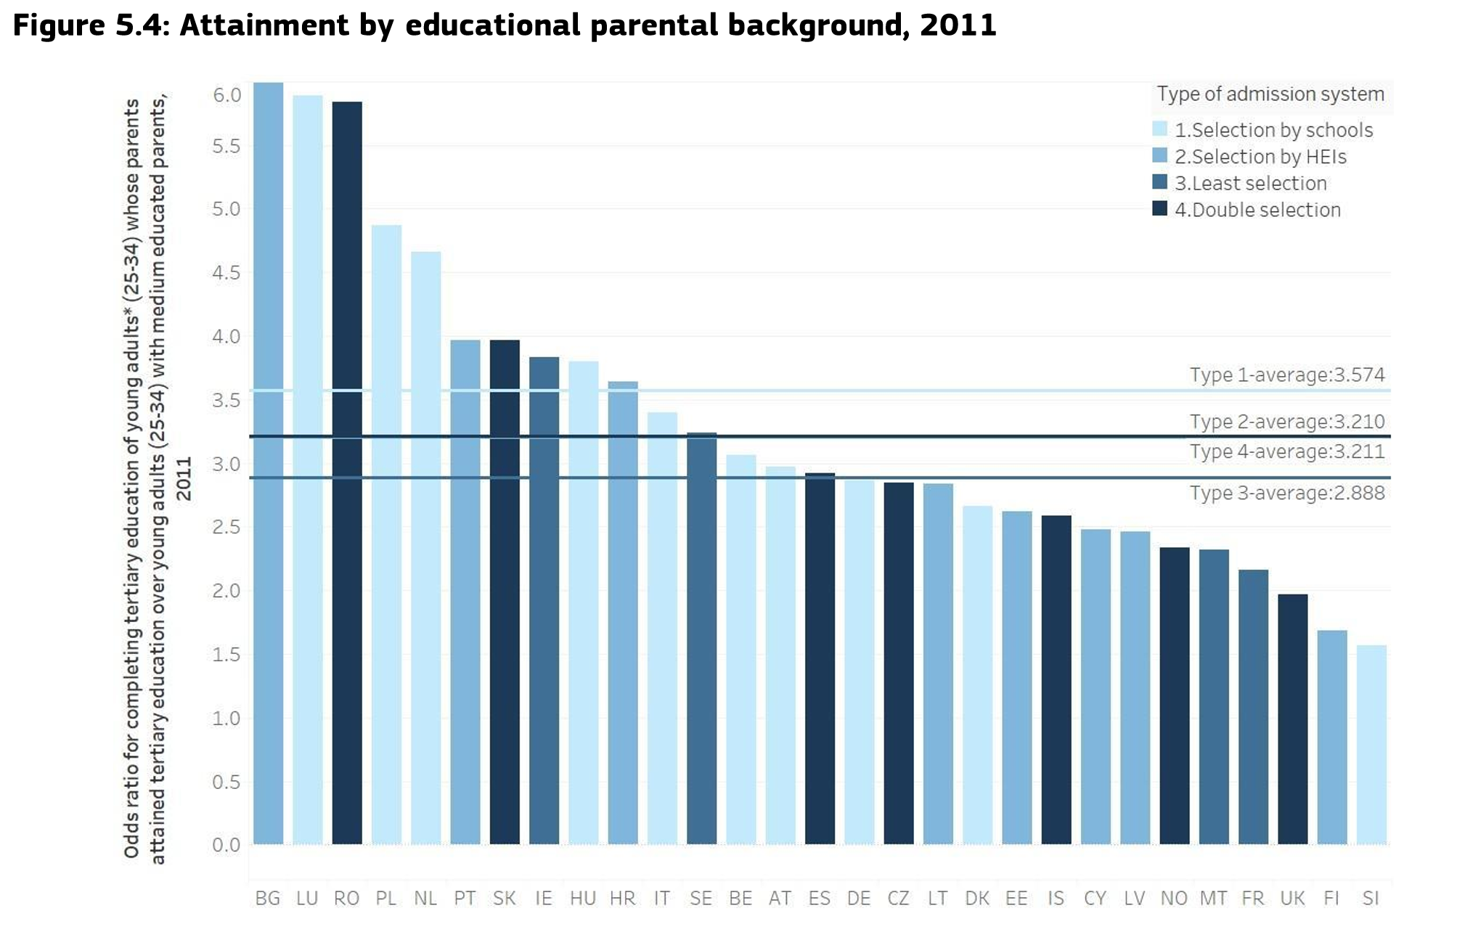

Slide 13
Key Findings from Case Studies

Slide 14
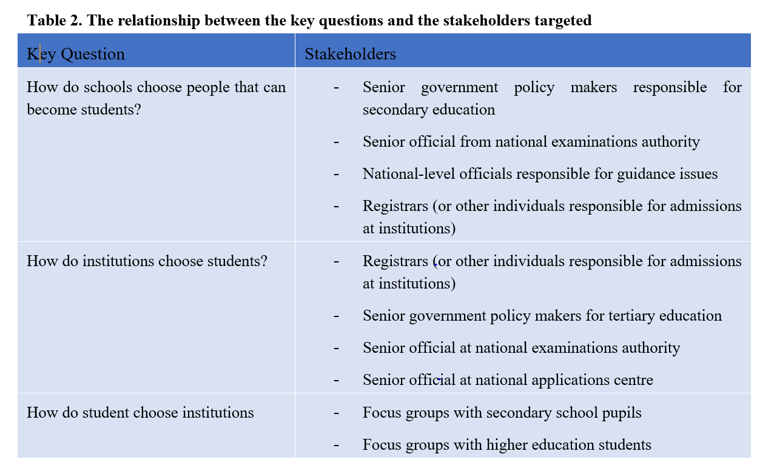
Case Study Methodology

Slide 15
How do schools choose students?
Streaming tends to reinforce social stratification
‘Teachers often are more cautious in the advice given to a child from a lower educational background. Parents with low educational attainment, on the other hand, follow the advice of primary school carefully. Especially when the advice of the school is lower than the final exam score, lower educated parents are less likely to do the adjustment they are entitled to.” – Netherlands
‘The best students select the best schools, and additionally the best teachers select the best schools (based on their tenure exam grade they can select the school where they wish to teach).” Policy maker responsible for secondary education’. - Romania

Slide 16
How do schools choose students?
Matriculation examinations may not be ‘fit for purpose’ where higher education entry is concerned
“The needs of the tertiary education system are not taken into account in the design of the tests as the objective of the Baccalaureate exam is not considered to be the admission into higher education but rather as a final exam which guarantees that the student has the needed competencies.” - Romania
“The Leaving Certificate is an assessment of what people do in school, it is not a mechanism to admit students to higher education.” Representative of State Examination Commission – Ireland

Slide 17
How do schools choose students?
Information, advice and guidance is under-developed
‘90 minutes are not enough to present about 60,000 degree programmes. Experts from the Job Centre would need to come much more often and with information related to specific fields.’ Final year pre HE student Germany
‘I saw a careers advisor once for 10 minutes. He told me to look at some books on what I wanted to do in the future. So, it was no good really.’ Higher education student at large HEI outside Dublin
Second chance routes are peripheral
‘only 3% of all entrants to higher education have entered without the Abitur’.

Slide 18
How do HEIs choose students?
Social inclusion is rarely a central goal for HEIs/HE systems
‘In disadvantaged areas, there are no targeted efforts to highlight higher education benefits in terms of student support services (scholarships, facilities – dormitories, canteens, etc.).”Official responsible for secondary school guidance’, Policymaker, Romania
Links between distribution of places and labour market demand is weak
‘Our policy is to take all of the students from our region and enrol them (in their study programme of choice) no matter what. That means it can get crowded. Students from our region will never face a lottery…. we just admit them and figure out how to manage later. It can become very expensive.” University official, public university outside Paris
“We accept everyone to HEIs. If you have money, you will be admitted. It does not matter if you can’t cope with the studies. It is the fault of HEIs that the [quality of the] system of general education has declined. Everyone knows they will be able to study in HEIs, no matter if they do or do not learn [at school]. If they don’t, their fathers will find the money and pay for the studies.” Lithuania, Official, Ministry of Education and Science

Slide 19
How do HEIs choose students?
Links between distribution of places and labour market demand is weak
‘Our policy is to take all of the students from our region and enrol them (in their study programme of choice) no matter what. That means it can get crowded. Students from our region will never face a lottery…. we just admit them and figure out how to manage later. It can become very expensive.” University official, public university outside Paris
“We accept everyone to HEIs. If you have money, you will be admitted. It does not matter if you can’t cope with the studies. It is the fault of HEIs that the [quality of the] system of general education has declined. Everyone knows they will be able to study in HEIs, no matter if they do or do not learn [at school]. If they don’t, their fathers will find the money and pay for the studies.” Lithuania, Official, Ministry of Education and Science

Slide 20
How do HEIs choose students?
HEIs can support students through admission –
“We know the value of meeting first-year students early. The transition to academia is central in our approach: everything from focus on investing time in getting acquainted, creating a social environment, and making them see the value of belonging, as well as arranging courses in study technique and teaching them about time allocation as a student.” specialist HEI, Norway
but generally don’t

Slide 21
How do students choose HE?
Young people are making decisions under great pressure in some countries
’I’m in conflict about whether I should continue to work so hard that I get a burn-out in order to optimise my grades or not.” (Germany)
“It is not right to make people feel like this. Some of my friends are getting ill with stress.” (Ireland)
“Sometimes I feel panic, I ask myself why did I pick a certain exam, I think I won’t be able to pass it…There is such fear and lack of confidence.” (Lithuania)
Cost shapes decision making to an extent
“I would not have been able to go to uni without HEAR – the extra financial support was what made it possible.” Higher education student at large HEI outside Dublin

Slide 22
How do students choose HE?
Friends and family are crucial in decision making
“My sister studies Environmental Engineering at an [other HEI], and she inspired me to do something similar.” First year student at [HEI]
“The role model of my father, who is a mechanical engineer” First year student at [HEI]
“I am not decided yet, but I talk to friends about it. I take my own decision, but I receive inspiration from them.” Final year student at [higher vocational school leading to higher education entry]Germany
Young people want choice but choice is difficult
‘I don’t really understand APB. I get the impression that admission decisions are more or less random.’ Student in France
‘Actually, when I had to fill all this data applying for LAMA BPO, there was chaos, even my sister, who entered the university one year ago, could not understand many things and what was needed. Maybe if you go there for a second / third time it all seems clearer, but you have to ask a lot, find out a lot, where and what should be filled in’. First year students at [City] University of Applied Sciences, Lithuania

Slide 23
Interesting/innovative practice

Slide 24
Study Choice Check - Netherlands
As of 2017, it became mandatory that every student applying to a Dutch HEI or HBO who completed their prior education in the Netherlands, Aruba, Bonaire, Curacao, Saba, St Eustatius or St Maarten, must undergo a “check” to evaluate their fit with their selected study programme.
‘Our study choice check is set up as a trial study day at the HEI: a day in the life of a student. They have to do some homework ahead, attend lectures, do a test, follow a session in a working group and reflect on the day. On that basis, they can check if it was as exciting as they thought it would be, or not so much… And also important, have a chance to reflect: “can I do this?”
Dutch HEI
“I found it [selection day] a very exciting day. Many people had signed up and it was possible that you would not be selected for this study at the end of the day. Besides that, I was very happy with this whole day because it showed how studying here would look like and you could find out if it really suited you.”
“The new way of selecting does take a lot of time in a period already so full with other school stuff. But I do understand why it helps and a lottery would be worse!”

Slide 25
Higher Education Access Route (HEAR)
The Higher Education Access Route (HEAR) is a preferential HE admissions programme. Institutions reserve circa 10% of places available each year for students who meet “a range of financial social and cultural indicators’.
HEAR applicants a receive a range of social and academic support both prior to entering higher education, and when they enter higher education.
Prior to entering higher education these include mentoring from existing higher education students and additional tuition to help examination achievement.
In the first year of HE, HEAR or DARE students have access to advice on financial matters, and dealing with academic or pastoral challenges.

Slide 26
Admission Changes – France
Plan Étudiants: Accompagner chacun vers la réussite
Aim is to combat ‘selection by failure and lottery’ as failure rate of first degree up to 60%
New investment in HE places
Schools will prepare reports and recommendations for each student, to which higher education institutions will have access & 2 weeks devoted during the school year to helping them choose the right studies - then either:
the candidate will have the necessary competences and be accepted for the course.
If the student does not meet the required standard but there are free places, they could be accepted after taking refresher courses
If the student wanted to follow an oversubscribed course, either they might be admitted immediately, or put on a ‘waiting list’. If no place became available, the university would be obliged to offer a place on another course, as close as possible to the student’s original request.
Notes:
n most cases, the candidate will have the necessary competences and be accepted for the course.
If the student does not meet the required standard but there are free places, they could be accepted after taking refresher courses; but, said ministers, no student would be turned away if there were places available.
If the student wanted to follow an oversubscribed course, either they might be admitted immediately, or put on a ‘waiting list’. If no place became available, the university would be obliged to offer a place on another course, as close as possible to the student’s original request.

Slide 27
Emerging questions
When does admission really start and end?
How much can the ‘admission system’ do?
Why is equity/widening access/social inclusion/social dimension such a low priority?
Tensions exist between policy goals – e.g. higher completion = more selectivity but implies less equity

Slide 28
Recommendations
Improve the IAG available on HE
Link admission policies to labour market demand
Incentivise HEIs to be more inclusive
Use Bologna tools to each transition i.e. improve credit transfer within/across HEIs
Re-structure streaming processes during secondary school
Pilot changes in final year of school
Experiment with different methods of identifying potential
Prioritise joint working across schooling:HE:employment

Slide 29
Contact details:
graeme.atherton@londonhigher.ac.uk
Full report:
https://publications.europa.eu/s/dyym

