Slide 1
Canada's Incomplete Conception Of International Student Mobility: Are We Missing The Boat?
Diane Barbarič
Ontario Institute for Studies in Education (OISE)
University of Toronto
Centre for Global Higher Education (CGHE)
UCL Institute of Education (IOE)
28 April 2016

Slide 2
Acknowledgements
This research was supported by the Government of Ontario through the Ontario Human Capital Research and Innovation Fund.
This research was supported by the Social Sciences and Humanities Research Council of Canada.

Slide 3
OUTLINE
Background
Problem
Methodology & Methods
Conceptualization
Preliminary Findings
Final Thoughts

Slide 4
BACKGROUND: OSM
Doubling since 2000:
in 2013, over 4M students studying abroad (OECD, 2015; UIS, 2016)
Since 2009: outward mobility targets & strategies
EU, UK, FR, DE
US, AU
Erasmus Impact Study (EC, 2014):
Half as likely to face long-term unemployment
1 in 10 started own business

Slide 5
BACKGROUND: CANADA IE
What we heard:
Budgets 2006, 2007
Attract international students
International marketing: $2M over 2 years
Budget 2011
Advisory Panel on Canada’s IES
Develop an IES; establish Canada as a country of choice
$10M over 2 years

Slide 6
BACKGROUND: CANADA IE
What we heard (cont’d): 2012
Economic Impact of International Education in Canada -- An Update
Over $8bn to the economy, over 86k jobs
International Education: A Key Driver of Canada’s Future Prosperity

Slide 7
BACKGROUND: CANADA IE
What we heard (cont’d):
Budget 2013
$23M over 2 years for IE
$10M for international marketing activities
$13M to Mitacs Globalink Program: "to attract highly promising students from around the world to Canadian universities and to allow Canadian students to take advantage of training opportunities abroad" (p. 87)
Study, work, and residence permit facilitation
Recruit. Train. Retain.

Slide 8
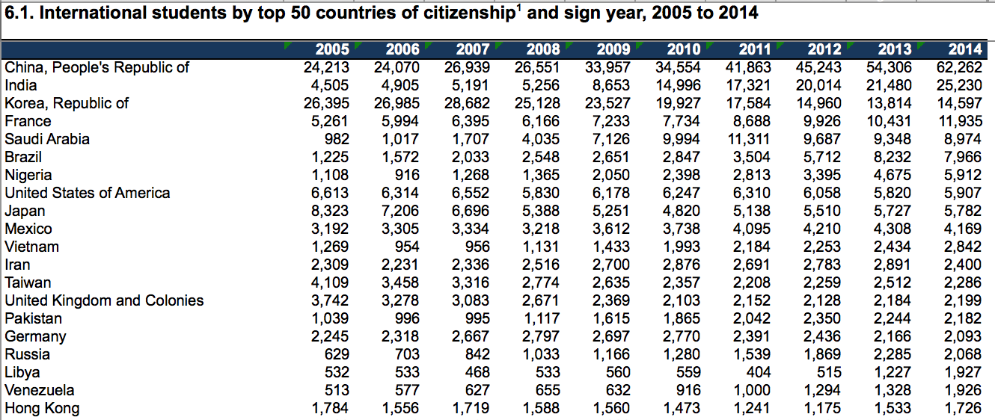
BACKGROUND: CANADA IE

Slide 9
BACKGROUND: CANADA IE
International Education Strategy, 2014

Slide 10
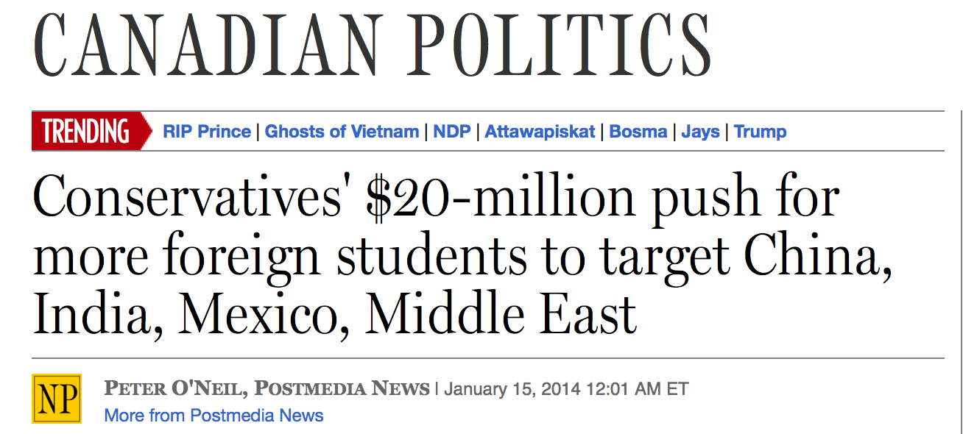

Slide 11
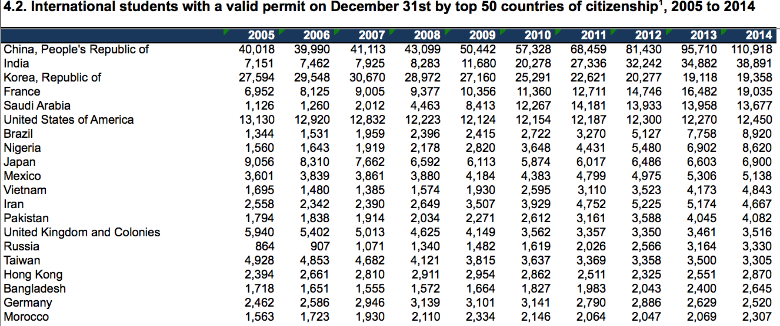
BACKGROUND: CANADA IE

Slide 12
BACKGROUND: CANADA
What we didn’t hear:
Advisory Panel Report:
Recommendation 2: Introduce an International Mobility Program for Canadian Students to serve 50,000 students per year by 2022
Between 1.9% and 3% of Canadian students enrolled abroad (OECD, 2015; UIS, 2016)
45, 813 in 2013 (UIS, 2016)

Slide 13
PROBLEM: RHETORICAL REBALANCING
What about our students?
Is anybody advocating for them to gain an international experience abroad?
What’s feeding into our IE policy-making process?
What kind of a society are we creating?

Slide 14
RESEARCH QUESTION
What are the politics behind and the value of outbound student mobility (OSM) in Canada, and how do they compare to three leading OSM countries in Europe?

Slide 15
METHODOLOGY & METHODS
Scope and limitations
Analytical approaches
Data sources

Slide 16
UK OM Strategy-Making
OM Strategy (HE IU)
National Gov & Devolved Admins
Academic Research
EU
HEFCE-funded HEIs
Academic Orgs
Mobility Sector Orgs
Professional Orgs
Employers
Intl Org
Research

Slide 17
Jurisdictional Policy-Making
OSM Policy
HE Sector
IE Sector
Business Sector
Student Unions
OGDs
Funding Councils
Reports

Slide 18
METHODOLOGY & METHODS
Data collection
Data analysis
Conceptualization
Intersection of public policy, politics, philosophy
“Value”

Slide 19
PRELIMINARY FINDINGS

Slide 20
PRELIMINARY FINDINGS: FEDERAL 1/4
Commissioned Reports
Expert Panel on Commercialization (2006)
Competition Policy Review Panel (2008)
Economic Impact of International Education in Canada (Kunin, 2009)
Illuminate Consulting Group (2011)
Economic Impact of International Education in Canada (Kunin, 2012)
Advisory Panel on Canada’s International Education Strategy (2012)

Slide 21
PRELIMINARY FINDINGS: FEDERAL 2/4
Policies
Budgets 2006-2016: 50%
Global Markets Action Plan (2013):
IE priority sector for Trade Commissioners
IES (2014)
“Benefits to Canadians of International Education: Creating Jobs, Economic Growth and Long-term Prosperity”
Promote two-way student and research mobility

Slide 22
PRELIMINARY FINDINGS: FEDERAL 3/4
Programs
15 + Mitacs 6: global, regional, country-specific
Funding:
Undergraduate to Doctoral
Study, research study, field research, full degrees, internships
$4,000 - $35,000/yr
CSLP
Tri-Council, EDC, GAC, IDRC
IEC

Slide 23
PRELIMINARY FINDINGS: FEDERAL 4/4
Advocacy/Partner Documents
Business
HE
IE
Students
Provinces

Slide 25
PRELIMINARY FINDINGS: ONTARIO 1/4
Commissioned Reports
Rae Report (2005)
Drummond Report (2012)
Murray Report (2012)
Herbert Report (2015)

Slide 26
PRELIMINARY FINDINGS: ONTARIO 2/4
Policies
Budgets 2005-2016: 4

Slide 27
PRELIMINARY FINDINGS: ONTARIO 3/4
Programs
16 bilateral (MTCU): Germany, France, India, China
Undergrad & Grad; Study, language, co-op, summer
$1,000 - $3,000
1 global (MEDEI)
work placement in SMEs
1 eliminated in 2012 (MTCU/OIEOS):
study, co-op
$1,250 / $2,500
Disadvantage students (Aboriginals, Francophones, students with disabilities)

Slide 28
PRELIMINARY FINDINGS: ONTARIO 4/4
Advocacy Documents
Business
HE
IE
Students

Slide 30
FINAL THOUGHTS
Semantics
“What’s in a name?”
Conundrum
No data!
“Value”

Slide 31
Are we missing the boat?

Slide 32
Questions?
diane.barbaric@mail.utoronto.ca
@dianebarbaric

