Slide 1
Governance challenges across sectors and globally, and their relevance to higher education [Literature review]
Aniko Horvath
Research Associate
CGHE Project 1.4
The Governance of Higher Education in Europe and the UK

Slide 2
Focus of the presentation
The presentation examines patterns of governance emerging across a variety of sectors globally, in Europe and the UK and critically examines the ways in which different academic fields reflect on and respond to such trends in their theoretical models and research practices.
It aims to explore the extent to which these competing and/or complementary theoretical and methodological models are relevant to higher education governance regimes.

Slide 3
Structure of presentation
Main issues & questions:
Why is this important/interesting (for us, at CGHE project 1.4)?
Why is it interesting for HE (governance) studies more broadly?
[What can HE bring to debates in ‘governance studies’?]
Methods and data sets used for the literature review
(Some of the) Main disciplinary fields that focus on ‘governance’
(Some of the) Frequent issues/topics that emerged
(Some) Definitions
(Some of the) Most common theoretical frameworks
(Some) Trends in scholarship over time?
HE - what should/could we take away from all this?
Two case studies: European Modernization Agenda (in HE)
White Paper

Slide 4
1. Main issues & questions
Why is this important/interesting (for CGHE project 1.4)?
In order to 1) highlight issues, ideas and approaches in the broader field of governance studies that are relevant to HE, and 2) sharpen our focus and methodology for the fieldwork, we felt that we needed to do an extensive, systematic and comprehensive review of governance of: 1) global organisations; 2) the modern state; 3) institutions like business corporations, charities and para-statal organisations like hospitals and modern regulatory bodies.
[As will be seen, these three initial (institution-centred) categories can be ‘fine- tuned’/opened-up/nuanced by the literature review.]
Why is it interesting for HE (governance) studies more broadly?
We ask whether and how can broader ‘governance studies’ inform policy and academic debates that attempt to establish the best constitutional and organizational frameworks for the conduct of research, scholarship and teaching in universities.
[Corollary Q] What can HE bring to debates in ‘governance studies’?

Slide 5
2. Methods and data sets
Handbooks – content & as starting point for identifying further literature:
Some of the most comprehensive/relevant ones so far:
The Oxford Handbook of Governance (2012)
The Oxford Handbook of Corporate Governance (2013)
The Oxford Handbook of Public Management (2007)
The Oxford Handbook of Public Accountability (2014)
The Palgrave International Handbook of Higher Education Policy and Governance (2015)
EC Report (2008). Progress in HE Reform across Europe: Governance and Funding Reform. Volume 2. [The introduction is a comprehensive literature review of governance and HE governance literature.]

Slide 6
2. Methods and data sets
2. Library – advanced search – search word ‘governance’ –– IOE, UCL
subject
title
separately for books and journals:
- Books: from 1980 (app. 2115 hits UCL; 303 IOE – looked through all IOE hits and app. 60% of UCL, starting with the newest)
also tested for ‘government’ & subject – even when only from 2010 – 5960 hits UCL, 173 IOE – as UCL data set was too big to handle (at least for now), I used only the IOE sample so far, assuming that it would include more books that are relevant to education/HE;
- Journal articles: advanced search, only from 2010 (when ‘governance’ was used as a search word there were 132 IOE and 12 UCL hits; I extended it to include ‘govern’ 562 hits UCL, 1018 IOE; and ‘government’ – resulted in 260 hits UCL, 279 IOE – since there were many overlaps, I worked with the IOE list and checked/cross-referenced for additional entries)

Slide 7
2. Methods and data sets
3. Sorting – some texts excluded based on title (e.g. many natural science ones); some excluded based on abstract as not relevant – e.g. too narrow/particular; the ones found relevant – ‘quick read’ (e.g. structure, introduction, conclusion); the most relevant texts selected for detailed reading (app. 200 books and 200 articles).
4. Bibliographical cross-referencing from the articles we found most relevant.
5. Files on individual authors (those who write most frequently on certain ‘governance’ issues).
6. Files by countries (not yet completed/needs a separate search as well).
7. Internet search for university courses on ‘governance’ to cross-reference my own findings – only most recent ones (past 5 years)
8. Internet search for news articles (most recent, only past one/two years) – to see emerging new concerns/topics.
Bias and limitations:
English language!!!!
The keyword(s) used might not capture a significant part of the relevant literature; e.g. some of the empirical research might be missing/be limited (one way to balance this is via consultations with experts in the field later in the project).
Researcher’s subjectivity/ignorance.
Not all data processed yet!

Slide 8
3. (Some of the) Main disciplinary fields that focus on ‘governance’
‘Governance’ seems to be a frequent/reoccurring focus for the following academic disciplines/fields of study:
International Relations
Political Science
Management/Business/Economics
(International) Law
Public Policy/Administration
(Sociology)
Less frequent, but also a focus for the following fields:
Anthropology
History
Regional Studies/Geography
(Development Studies)
(Higher Education Studies)
NOTE:
Recently, there seems to be an increase in the nr of studies/books/courses on the subject across all disciplines – however, this might be a result in ‘changes to the academic game/publishing’ and not an increased interest.
There is a high level of interdisciplinarity (and overlaps) in terms of theories, methods and approaches across these fields. As a result, many of the terminologies (and theoretical frameworks) are used and ‘adjusted’ across disciplinary fields. However, understandings might differ as contexts vary across the board. Also, the ‘Description problem’ and ‘Prescription problem’ (Burries 2008).

Slide 9
4. (Some of the) Frequent issues/topics that emerged
Theories of governance
Levels/layers of governance (e.g. global, regional, local, European, transnational, international, interregional, horizontal/vertical/diagonal, etc.)
Types of governance (interactive, complex, intersecting, innovative, ‘new’, ‘good/effective’, hierarchical, heterarchic, public/private, etc.)
Topic/issue-focused approaches
Corporate governance
Healthcare governance
Non-profit governance
Public sector governance
Education governance
HE governance
Research organizations governance
Energy (sector) governance
Climate change/environmental governance
Pension funds governance
Financial/fiscal/markets governance
Central banks governance
Development governance
Cooperative/collaborative/self-governance
‘Alternative’ views/fields in governance (e.g. governance of risk, social enterprise, governance through social learning, governance through epistemic communities/creative commons, etc. – however, often the theoretical frameworks used are more or less similar to the ones used in other topics/fields)

Slide 10
5. (Some) Definitions
Huge variety in definitions, but most can be placed on a continuum from more theoretical/conceptual to more practical/instrumental/operationalized approaches .
Some examples:
A. Public affairs scholar Robbie Waters Robichau (2011) argues that:
there are at least 50 separate governance concepts used in the literature. One way to counter-balance such a level of complexity is to focus on commonalities: ‘Defining governance frequently involves the use of words like networks, rules, steering, order, control, new, good and corporate governance, governing, and authority… other useful phrases that provide insight of what governance is: “ordered rule” and “collective action or decision making” (e.g., Ansell & Gash, 2008; Löffler, 2009; Milward & Provan, 2000; Stoker, 1998, 2004), “all patterns of rule” whether formal or informal (e.g., Bevir, 2009, 2010; Imperial, 2005; Löffler, 2009), and “exercise of authority” (Denhardt & Denhardt, 2007; Stivers, 2008)….
We can uncover a domain of agreement based on the mechanisms of or patterns of rule in the governance. Three of the most commonly discussed resource allocation mechanisms of governance are networks, hierarchies, and markets (Dixon & Dogan, 2002; Jordan, 2008; Kjær, 2004; Lynn, 2011; Osborne, 2010).
Bell and Hindmoor’s (2009) state-centric relational approach incorporates persuasion (i.e., how governments persuade behavioural changes in their citizens) and community engagement as other forms of governance (see also Löffler, 2009).
Kooiman (2010, p. 79) describes what others call “modes” of governance as “subsystems of the governing system” where the main components are states, markets, civil society, and hybrids (i.e., the intersections of the state, markets, and civil society).
Löffler suggests that for there to be good governance there must be good government. As such, the state must initially answer what its role should be in various contexts (e.g., as co-producer or as sole supplier of services), and then, choose the best mechanism—via networks, hierarchies, or markets—for properly dealing with problems (2009, pp. 229–230)…
The paradox of governance is resolving what is with what should be. Conceivably, we as scholars fall short by examining governance from a perspective of finite processes and structures of governing, managing, leading, and representing, rather than from a holistic approach emphasizing democratic ideals and practices at every meaningful opportunity.’

Slide 11
5. (Some) Definitions
Anthropology scholars Julia Eckert, Andrea Behrends and Andreas Dafinger (2008?) define governance:
as the administration of access to and provision of rights, services and goods that imply also the definition of categories of inclusion and entitlements that are explicit or implicit in governmental practices. The concept of governance focuses our attention on processes of ordering and capacities of steering and allocation in which various organizations have a claim. Increasingly new agents of governance share in the administration of everyday life, in the organization of access to and provision of services and goods. They all explicitly or implicitly involve themselves also in the definition of rights and entitlements. We would thus like to use the concept of governance to assess these different processes of “de-centralization” and “privatization”, and the various practices of exerting governmental power under one analytical concept.
This concept of governance leaves behind conventional distinctions between state, civil society and the economy, between public and private and does not privilege one organization or institution, like the state, as the “natural” or “right” centre of governance. Rather, it opens up the analysis of domination, rule or government to the interdependencies between different actors that shape these, the processes within which constellations of power between such governmental actors emerge and consolidate.
It is important to us to relocate the analysis of governance from “the state” or “government” into a field shaped by various actors that produce specific governmental regimes through interaction... The concept of governance is thus well suited both to understand different specific forms of stateness, as well as to describe situations in which ordering is not restricted to state, but can also not be captured by its “other”, traditional or local/indigenous institutions. … the relations between state and non-state agencies in governmental regimes are not necessarily oppositional and competitive, but might be cooperative, hierarchical, complementary or simply parallel…
The autonomy of the individual agencies within such constellations can differ; the state is not necessarily the one that regulates the relations among the others. The state, and its various agencies, however, are often deeply involved in the production of specific governmental regimes, and thus in the drawing of its own boundaries and limits.

Slide 12
5. (Some) Definitions
Legal scholar Scott Burris (2008):
‘Aiming for a level of abstraction on which we can move across many literatures, we take governance to mean “the management of the course of events in the social system”.
To the same end we will reduce the complexity of governance structures to three main elements: institutions – organizational sites where governing resources are gathered and mobilized (government agencies, corporations, foundations, NGOs, street gangs); methods of power – tools that governors use to project influence (deliberation, bribes, military force, claims of legitimate right to rule, forum-shifting); and constrains on governors – limitations on the freedom of action of governors that may arise from laws (like a constitution or treaty), competition from other governors (as in a market), or from culture (social norms).
Much of what is meant by governance has to do with manipulating the elements of governance to achieve effective and efficient management – i.e., governance that works. In the political science literature (especially that associated with the science of public administration), well-functioning management and control is referred to as the ‘governability’ of the system.
A system of governance that is high on governability is equipped with appropriate tools and capacities to manage itself (e.g. clear lines of information transfer) and to intervene effectively in various policy domains of interest (e.g. clear and effective legal powers, adequate and well-managed resources, etc.)…
Good governance is not merely about governability or management, however. It also implies goals towards which systems are being directed, and so governance as a process is inextricably linked to normative questions of what the governor is seeking to accomplish.” (p. 9-11)

Slide 13
5. (Some) Definitions
According to international organizations governance is:
The way “ … power is exercised through a country’s economic, political, and social institutions.” – the World Bank’s PRSP Handbook.
“The exercise of economic, political, and administrative authority to manage a country’s affairs at all levels. It comprises mechanisms, processes, and institutions through which citizens and groups articulate their interests, exercise their legal rights, meet their obligations, and mediate their differences.” UNDP.
“In general, governance issues pertain to the ability of government to develop an efficient, effective, and accountable public management process that is open to citizen participation and that strengthens rather than weakens a democratic system of government.“ The USAID, Office of Democracy & Governance
“how any organization, including a nation, is run. It includes all the processes, systems, and controls that are used to safeguard and grow assets.” (UNDP, 1997)
“The systems, processes and procedures put in place to steer the direction, management and accountability of an organization.” Birmingham City Council. When applied to organizations that operate commercially, governance is often termed "corporate governance"
"promoting fairness, transparency and accountability" – World Bank
"a system by which business organizations are directed and controlled"- OECD
NOTE: Often there is a visible discrepancy between definitions/models used by organizations and the academic scholarship. Many of the academic approaches that attempt to deconstruct for example ‘nation-state’ approaches ‘clash’ with policy-makers views – and policies - where they see nations-states are their main terrains of action.

Slide 14
5. (Some) Definitions in HE studies
Higher educations scholars Emanuele Reale and Emilia Primeri (2015):
‘examine issues related to both politics and polity. By ‘politics’ we mean the focus on the resolution of conflict and development of consent, resulting in decision-making processes (the procedural dimension). By ‘polity’ we mean the focus on the state organization and the management of the system to obtain political order and stability, through laws, regulations and institutions in different types of politically organized communities…
The aim is to guide the readers systematically through key concepts used in the general policy and governance literature and in the HE literature as ‘steering’, ‘government’ and ‘governance’, highlighting the differences between them when appropriate. By ‘steering’ we refer to the instruments and arrangemnets externally developed and aimed at controlling academic institutions and behaviours. With the term ‘government’ we consider the actions of governing taken by institutional actors in charge of decision-making process while the concept of ‘governance’ underlines a change in the meaning of government and a new process of governing…
In the HE context, the term ‘governance’ refers to modes of social coordination undertaken by actors, that is, academic institutions, in the making and implementation of rules to provide a collective good.’ (p. 20)

Slide 15
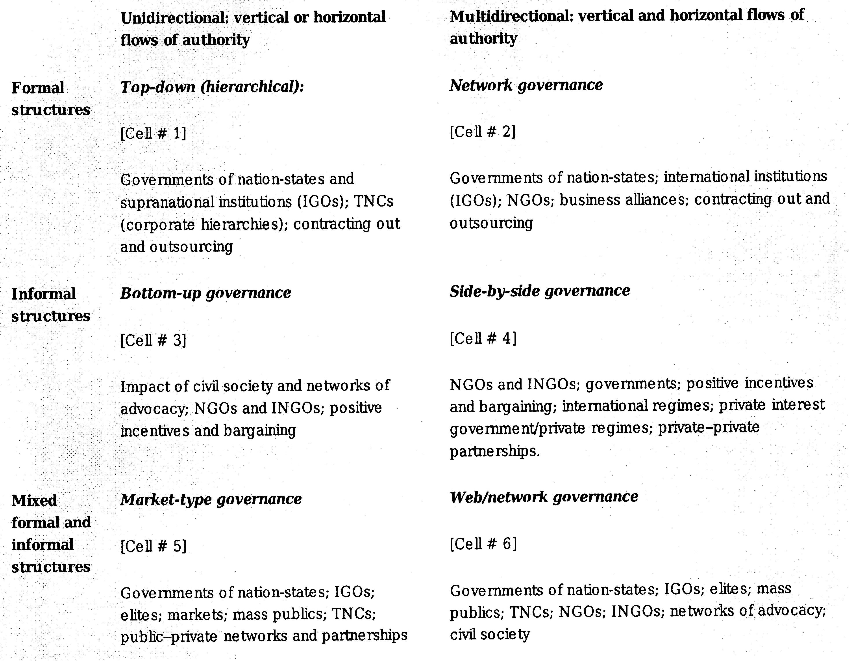
6. (Some) Theoretical frameworks Arie M. Kacowicz. (2012) ‘Global Governance, International Order, and World Order’. In The Oxford Handbook of Governance.

Slide 16
6. (Some) Theoretical frameworks Ulrika Mörth. (2006) ‘Self regulation and global democracy’. In Transnational Governance. Institutional Dynamics of Regulation.

Slide 17
6. (Some) Theoretical frameworks Volker Schneider. (2012) ‘Governance and Complexity’. In The Oxford Handbook of Governance.

Slide 18
6. (Some) Theoretical frameworks Jenny Harrow and Susan D. Phillips. (2013) ‘Corporate Governance and Nonprofits: Facing up to Hybridization and Homogenization’. In The Oxford Handbook of Corporate Governance.

Slide 19
6. (Some) Theoretical frameworks Jenny Harrow and Susan D. Phillips. (2013) ‘Corporate Governance and Nonprofits: Facing up to Hybridization and Homogenization’. In The Oxford Handbook of Corporate Governance.

Slide 20
7. (Some) Trends in scholarship (over time)
Centrality/marginality of the state (and ‘government(s)’) and the role of ‘statecraft’ over time; shifts in understandings/representations of ‘world order’ and its ‘hierarchical/non-hierarchical ordering – from nation states to transnational/international/global/multilevel/heterarchic ‘world/global orders’.
Centrality/marginality of organizational/governance structures and their impact on institutional dynamics and performance, as well as comparative studies of their ‘viability’ in differing socio-economic, legal and political contexts (e.g. role of CEO, boards, leadership, inter and intra organizational competition, soft and hard law, new public management, etc.).
Questions of public/private (dynamics) and ways out of such dichotomies (some anthropological approaches argue that ‘technologies of governance’ used traditionally by (state) bureaucracies are being ‘turned’ into ‘public goods’ – e.g. transparency, fiscal discipline, decentralization, accountability – this shifts the debate on ‘public goods’ – and (the) ‘public’ more broadly – and has consequences for ‘governance’.)
Coen & Pegram (2015) call for a third generation of global governance research, arguing that an interdisciplinary new research field should emerge from EPP, IR and IL where scholarship could aim to have a much better understanding of what ‘global’ actually means in ‘global governance’.
Innovation through new disciplines turning to ‘governance’ (e.g. anthropology and understandings of the ‘public good’) and/or governance scholars opening towards new fields (e.g. governance complexity theory opening towards natural sciences; or examination of recurrent crisis in financial governance and the resulting patterns of structural/institutional/organizational innovations that emerged).
NOTE: Often there are no direct links between theory/innovation and implementation/practice. More (and more diverse) empirical research is needed.

Slide 21
One approach in more detail: Streeck & Thelen (2005) attempt to explain ‘change’ [and ‘innovation’] in western democracies over time. Their approach is to conceptualize ‘institution(s) as a social regime(s)’ – ‘formal institutions do not fully determine the uses to which they may be put. This is one important reason why major change in institutional practice may be observed together with strong continuity in institutional structures.’ ‘Agency and structure’ do not only matter sequentially – the aim is to understand ‘the way actors cultivate change from within the context of existing opportunities and constraints’. They argue that this approach helps to identify five broad modes of transformative change:
Displacement: ‘happens as new models emerge and diffuse which call into question existing, previously taken-for-granted organizational forms and practices’.
Layering: the older a system, the more costly it becomes to dismantle it, so ‘reformers learn to work around those elements of an institution that have become unchangeable.’
Drift: institutions often ‘need to be reset and refocused , or sometimes more fundamentally recalibrated and renegotiated, in response to changes in the political and economic environment in which they are embedded. Without such ‘tending’ they can be subject to erosion or atrophy through drift. As with layering, change through drift, while potentially fundamental, may be masked by stability on the surface.’ (e.g. some attributes of welfare states – policymakers often deliberately decline to close emerging gaps in coverage allowing systems to erode/atrophy via ‘drift’ – e.g. some healthcare provisions in the US – but also what happened to HE funding as the system expanded and student numbers increased exponentially).
Conversion. ‘Different from layering and drift, here institutions are not so much amended or allowed to decay as they are redirected to new goals, functions and purposes. Such redirection may come about as a result of new environmental challenges, to which policymakers respond by deploying existing institutional resources to new ends. (e.g. HE massification, restructuring of global economies – and the ‘knowledge society/knowledge triangle in EU HE?).
Exhaustion. The processes we have in mind here strictly speaking lead to institutional breakdown rather than change – although the collapse is gradual rather than abrupt. Institutional exhaustion is a process in which behaviours invoked or allowed under existing rules operate to undermine these. (e.g. early retirement regimes in some countries).

Slide 22
8. Higher Education – what should/could we take away from this?
Two case studies:
The European Modernization Agenda in Higher Education (2003-2011)
The UK White Paper: Success as a Knowledge Economy: Teaching Excellence, Social Mobility and Student Choice (May 2016)
Thank you!

