Slide 1
Investigating the transformative potential of MOOCs for professional development on the large scale
Professor Diana Laurillard and Dr Eileen Kennedy

Slide 2
Outline
The global context for HE’s role in CPD
Online pedagogies for PD on the large scale
Quantitative analysis: the example of peer review
Qualitative analysis via surveys, participant contributions, interviews
Making it affordable and sustainable - costs
The digital cascade model for enabling HE to address the large-scale educational challenges
Summary
Slide 3
Slide 5
Slide 11
Slide 16
Slide 25
Slide 32
Slide 34
Notes:
Mental health professional in India, doing it while waiting for the bus.
Young professional learning about new skills for her career.
PG who felt degrees were not teaching what she would need in practice. What MOOCs do well to give a window on professional practice.
Market researcher learning in the MOOC about research skills to extend her practice, and can then create new insights into her business world, she is improving her company.
BLE consultant – MOOC good for company?
LT at uni to
Realisation of the value of the social experience of learning – will be of value in the cascade.
Engaging tutors are as important as engaging lecturers; appropriate window on the world
Costs are part of the design decision – appropriate costing and videos

Slide 3
The global context for HE’s role in professional development

Slide 4
The global context: how do we meet the global demand for higher education?
Higher Education
By 2025, the global demand for higher education will double to ~200m per year, mostly from emerging economies [NAFSA 2010]
Teacher professional development
To achieve universal education for 263 million children and youth who are out of school, the number of teachers needed by 2030: 68 million [UNESCO 2016]
Professional development
85% hard-to-fill jobs are due to lack of digital skills [UK, 2016]
How do we teach all students the skills for a digital workplace?
Notes:
CGHE is investigating how HE contributes to society, nationally and internationally.
In 3.4 we look at this in terms of the responsibility for teaching and capacity building.
Here are some of the challenging statistics:
The global demand for HE far outstrips our capacity to meet it: 200m per year by 2025; 68m new teachers by 2030,
vast under-provision of digitally skilled graduates.
And yet we have a teaching model that depends on a 1: 25 staff:student ratio. How can we possibly bridge that gap in our capacity?
http://www.uis.unesco.org/Education/Documents/FS39-teachers-2016-en.pdf
TECH. (2015). Employer Insights: skills survey 2015. London, UK: Tech Partnership.

Slide 5
The global context: how do we meet the global demand for higher education?
HEI missions for ‘internationalization’ → ‘global flows’ have led to ‘growing and shifting imbalances and inequalities’ (Wende, 2016:7)
Conflicting agendas of public good mission and development of individuals → need to balance the
demands of ‘democracy, equity, economy and the environment’ (Unterhalter & Carpentier, 2010: 5)
Rising concern with HE quality because:
the globalised job market means graduates must be able to trade their qualifications
governments and students want in value for money for their investment in HE
massive growth of HE providers, including for-profit and TNE (Hazelkorn, 2016)
Notes:
Wende, M. v. d. (2016). Opening up: higher education systems in global perspective. Retrieved from UCL Institute of Education: http://www.researchcghe.org/perch/resources/publications/wp22.pdf
Unterhalter, E., & Carpentier, V. (2010). Introduction: Global inequalities and higher education: whose interests are we serving? In E. Unterhalter & V. Carpentier (Eds.), Global inequalities and higher education: Palgrave Macmillan.
Hazelkorn, E. (2017). Rankings and higher education: reframing relationships within and between states. Retrieved from London: www.researchcghe.org

Slide 6
Online pedagogies for professional development on the large scale

Slide 7
Online learning for professional development on the large scale
MOOCs reach very large numbers globally (7m on FutureLearn)
So can be a mechanism for addressing the big challenges
They can support
free access to new knowledge: video windows into a professional world
social learning
automated testing
peer review
→ They do not support personal nurturing for students
→ These are good pedagogies for professional development

Slide 8
TPD@Scale: Over 20,000 teachers have actively engaged with this series of MOOCs
Course

Slide 9
Video update and social learning: on dementia
Video presentation of new approaches and methods in the field
Course
Dynamic links to other resources and tools
Discussion and debate between professionals and families

Slide 10
Social collaboration: on the use of VLEs for blended learning

Slide 11
Peer review: collaborative learning and knowledge building
A teacher’s contribution
Teachers are sharing tested digital practices
building on the work of others
reviewing against criteria
collecting exemplary practice
The model for ‘science’
Website for collecting exemplars of TET competences

Slide 12
Quantitative analysis of effectiveness: peer review

Slide 13
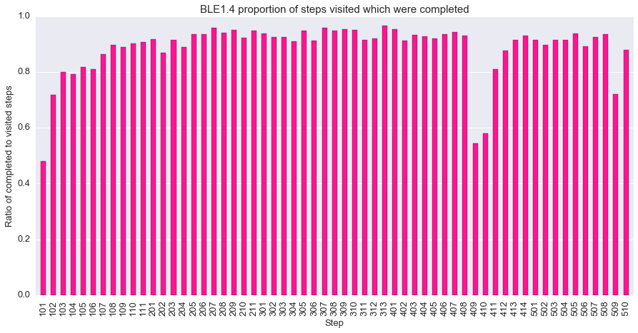
Platform data to test pedagogical effectiveness of peer review
BLE1.1 to B:E1.4
Ave inc. in step completion
5%
PR step inc. in completion
32%
Challenging steps
Respond with scaffolding and modelling
Notes:
But we also have to look at how well peer review works for everyone in a MOOC. This is where we can use the learning analytics, the big data collected on the platform that tells us, for example, which of the activities were completed, and which were not.
Here is the data from one of our MOOCs, where there is a significant drop at these two steps – which are the peer review activity. So – it may be valued, but it’s also more time-consuming than most, and this really shows up in the data.
That provides the impetus for redesigning the step – basically to spread the work over more steps, and check the data in the next run.
- And this showed a pleasingly significant increase in completion for the key steps [switch between the two].
So these different kinds of small-scale and large-scale qualitative and quantitative data combine to provide a fuller picture on the value of digital pedagogies for professional development.

Slide 14
Collaborative learning and knowledge building
Peer review is valued by the teaching community
Course
Strongly agree
Agree
Agree
Strongly agree
SA
Agree
Neutral

Slide 15
A teaching community co-developing innovative methods
92% rated participants’ contributions as good/very good
Very much so

Slide 16
Data on pedagogy for peer review from forum
My feedback was informative and to the point. [It] really did make sense. I will be including this in my practice moving forwards. I must err on the side of caution, not cram too much in, losing opportunities to review and consolidate.
Assignments I had the chance to review were an eye opener as it highlighted areas where I should pay more attention.
Each participant
creates first draft using rubric
reviews 2 student drafts
checks their feedback
revises their draft
comments in a forum
tutor comments on these
Run by the platform for any number of participants
I found the peer review really informative. Looking at the … approaches of others has provided a number of reflective triggers for considering my own work. Very valuable! Keen to integrate peer review into my own delivery.
Notes:
The peer review process is one of the most important online pedagogies because it offers a form of personalized assessment of each participant on a MOOC, and it is something that regularly came up in the interviews. Tutor assessment is not possible because of its high per-student cost. But peer review is valuable because in professional development courses your peers are the knowledgeable others you can genuinely learn from, and whose assessment participants are likely to value.
This is how it can work in a large online course, for example:
Each student
Creates their first draft using a given rubric
Then is sent 2 drafts by other students to review
They are then sent the 2 reviews of their own draft
Then they check their feedback
revise their draft
and submit it to the tutor
The tutor will receive 1000s, but can select just a few and gives general feedback on the basis of this
So all the participants have the value of reviewing 2 other drafts, getting personalized feedback on their own draft, and general feedback from the tutor’s overview.
The tutor has a manageable number of selected submissions as the basis for their feedback to all.
And the whole process is run by the platform for any number of students.
So it is a viable and potentially valuable pedagogy.
What the participants think comes from 2 kinds of data – interview data, for example this comment made while discussing peer review:
“I found the peer review more interesting in the terms of what kind of writing it made me do, rather than the feedback I received”.
And this comment from a post-course survey:
“Giving feedback to my colleagues gave me the opportunity to reflect on my own planning and how effective my text was and whether I was applying technology to really add value to my learner's learning. Great opportunity”.
Two very different perspectives, the one valuing the drafting process, the other valuing the reviewing process.

Slide 17
Qualitative analysis of learning on a MOOC

Slide 18
Qualitative interviews using repertory grid technique
The poles of the constructs they derived from comparing courses
Repertory Grid Technique for how participants construe their experience
Derives from Personal Construct Theory (Cohen et al, 2007)
Interviewee selects 4 MOOCs as learning experiences + 1 ideal course
Compares 3 of them as learning experiences
How are 2 similar and different from 3rd?
→ Poles are their own constructs as their evaluation scale for all their MOOCs
Participants’ constructs guide the interview
Virtual 1-1 workshop: Realtimeboard.com
Documented summative final assessment
Informal formative assessment – no right or wrong
The online courses and MOOCs they have taken
Notes:
This means that for understanding how to scale up education, our initial focus has to be on scaling up the professional development that can be done via MOOCs. But we need to understand better how learning for professionals works on a MOOC.
For this we collect both qualitative and quantitative data – each complementing the other.
- Here is an example of a technique for interviewing, where we use Repertory Grids, derived from Personal Construct Theory, to find out how MOOC participants construe their experience of the pedagogies of online learning.
For each interviewee, we ask them to select 4 online courses as learning experiences (and they also consider their ideal course)
Then we go through these in 3s to ask what makes 2 of them similar to each other, and different from the third?’
Their answer defines a personal construct about online learning, and the two poles of that construct.
For example, a construct might be defined in terms of ‘these 2 had very boring videos, but this one had really interesting real-life situations’
In one interview the participant might define up to 10 different constructs.
And these can then be used as a personal evaluation scale for the MOOCs and online courses they have experienced.
- So it’s a useful technique because the participants’ constructs guide the interview
- And it runs as a kind of virtual 1-1 workshop, even though it’s conducted online, using the virtual interactive whiteboard ‘Realtimeboard.com’
This is how the interview performs their evaluation of the 5 courses they’re talking about.
- On this board are the two poles defining each construct
- And these are cards representing the 5 online courses, which they have to place somewhere on the dimension between the two poles.
- For example, there is a construct about the nature of assessment as either ‘Documented summative final assessment’ OR ‘Informal formative assessment with no right or wrong’, OR somewhere between the two.

Slide 19
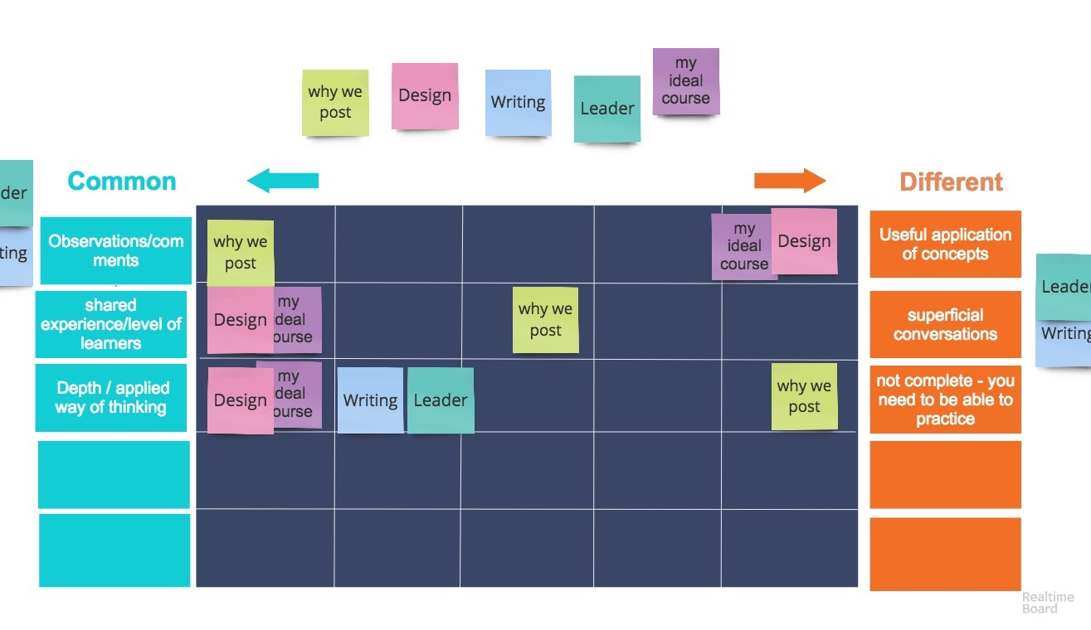
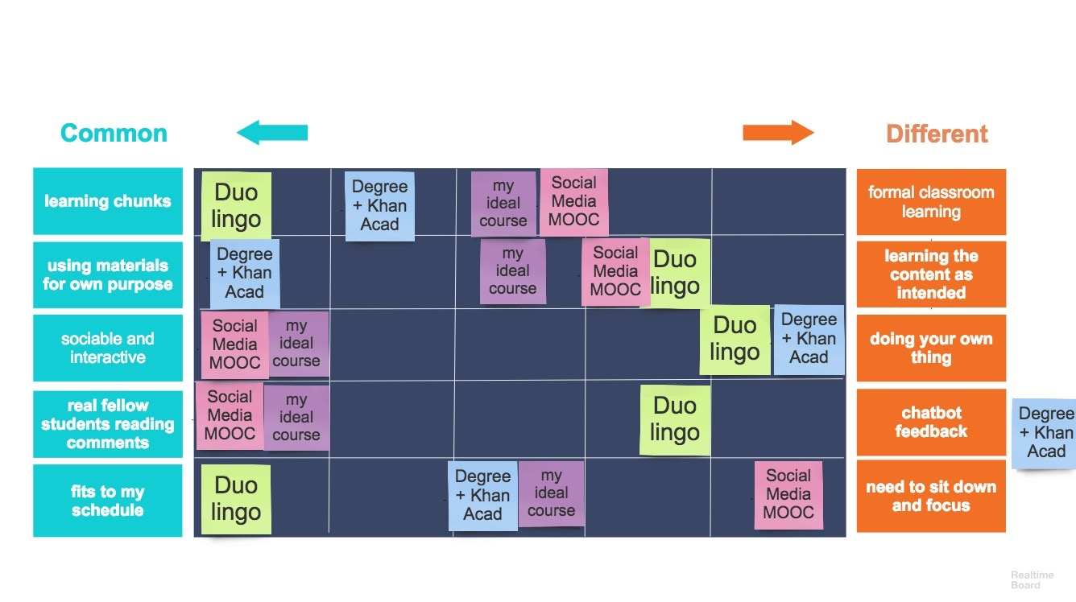
How do professionals evaluate MOOC pedagogy?
Laurie – trainer
Walter – civil engineer (retired)
Hanna – translator
Yvonne – market researcher
Notes:
We think of MOOCs as primarily video-based learning and some of the interviews did start by talking about the content and the videos first. But I want to take a closer look at 4 grids from different kinds of professionals and you can see that they don’t just talk about videos. There are some similar concerns around discussion and social learning, and its quality – particularly in relation to applied learning (the phrase ‘real world’ is used by two of them) and multimedia and interactivity more generally.

Slide 20
How do professionals evaluate MOOC pedagogy?
Laurie – trainer
Non-collaborative
High level interaction
Real world knowledge
Theory
Notes:
For example, Laurie didn’t like MOOCs where the participant number was too low because they lacked interactivity, which was a characteristic he valued. He contrasted this with being non-collaborative, and placed his ideal course (purple) clearly at the high interaction end of the scale. He also emphasised the importance of applied, ‘real-world’, knowledge, in contrast with ‘theory’ and placed his ideal course clearly at the real-world end of the scale.

Slide 21
How do professionals evaluate MOOC pedagogy?
Laurie – trainer
Walter – civil engineer (retired)
Many students
Fewer students
Hanna – translator
Yvonne – market researcher
Observations/ comments
Useful application of comments
Shared experience/ level of learners
Sociable and interactive
Superficial conversations
Real fellow students reading comments
Notes:
Similarly, Walter made the number of participants the focus of one pole on his grid – and put his ideal in the middle
Hanna emphasised interactiviity too, and discussion – valuing authenitic feedback from real people as opposed to chatbots
Yvonne also focused on applied learning, not just observations and comments, placing her ideal course at the applied end, and, because of this, her ideal course was a group of learners with a shared experience, who were at the same level to make that happen.

Slide 22
Social learning: practical value is crucial
“I have actually given up reading the comments, because there are just so many, people saying things like “wow isn’t this wonderful.
But meaningful comments can be very helpful. If you can get a dialogue stream going that can actually be quite enlightening…
… if a student does actually point you in a new direction or says ‘have you seen this youtube video’ and you click on it and you find that’s enlightening, that’s something I hadn’t thought about, I’ll save that” (Walter)
“… it really depends on the level of comments there that's why I feel with design, it is to a very specific group of people that, regardless, they will still be able to share comments that I find useful, or at least I can learn or have a conversation with” (Yvonne)
“… somebody says, okay, the tool, this is how it works, okay, well, that’s great, but in the real world, will it deploy in practice, how does that actually perform” (Laurie)
Notes:
The first set of quotations here come from Walter – but they are echoed by other participants – about the value of meaningful discussion for learning. He suggests the level of discussion needs to be high – and it shouldn’t be like “facebook” with people saying “isn’t this wonderful”
He really valued a dialogue stream with participants sharing their knowledge and providing links to new content
The level of conversation is a focus of Yvonne’s explanation of her constructs – she felt that if participants weren’t at the same level, or on one of her MOOCs the participants couldn’t have had experience of what was being taught, so the discussion was too low.
Laurie also pointed to the way that participants themselves if they had experience of putting the knowledge into practice could add to the content being presented.
These comments all coalesce around the practical value of the conversations, as a practitioner.

Slide 23
High level and authentic interaction
“I would like that if you were going to make me pay for something that I want that level of discussion, I want that level of clarity that I can’t get from a book itself. A lot of times they ask you to pay for something that has no real ... be effective in learning or be effective in application” (Yvonne)
“… it feels good to … know the fact that there are other students that are reading what you're writing, they don’t have to necessarily agree with you but it just feels great to have people read what you think about the course content. In terms of feedback, [by contrast] Duolingo kind of provides a feedback in its own way, it’s the robotic-like, chat bot kind of thing, it says, oh, good job, you did like five in a row and that kind of stuff, [laughs], and so it’s not human” (Hanna)
Notes:
So to take this further – Yvonne was thinking about further study and we discussed whether she would pay for certificates. What was interesting was that having the capacity for high level discussion was what she thought she would be willing to pay for – it was a mark of the quality of the learning and the potential for effective application.
Hanna also highlighted the value of participants responding to your comments, whether they agreed or disagreed. She made a distinction between having this kind of ’real’ human feedback and the automated kind that you can get in apps like duolingo or from chat bots.
Again, these are professionals seeking practical high-level value from their interactions online, not just from the video presentations.

Slide 24
Active learning: multimedia & interactivity
I think multimedia is one of the things these courses have to offer…that’s what the internet offers, it gives you that option, whether its following someone doing some equations on whiteboard, following two people having a conversation about something, giving you a bit of text to read, pointing you to something, and I think many of the insights I have had have been more from leads given to the other websites” (Walter)
“Nowadays, you can produce new content, stop and ask a question to the audience, you can then write things over it, do things over it, you know, you yourself are very interactive now, using colours, you know, you can get several people to share this board, well, there's none of that, it was all very much black and white, very much what I'd call 2D” (Laurie)
Notes:
MOOCs don’t just feature discussion, and it is interesting to see what these professionals focused on aside from discussion. They discussed other multimedia aspects, not just the videos but the capacity for interactivity through technology.
Laurie called this interactivity, whereas Water considered it to be multimedia, but their descriptions of the way their preferred learning environment is remarkably similar. Laurie felt he was missing interactivity in some of the MOOCs – he compared them to live webinars, or even the virtual workshop using realtimeboard – he says it is colourful and shareable and interactive – he enjoyed using it and wanted his online learning experiences to have this kind of dynamic, collaborative element.
He showed an appreciation for the way you can combine different things online – writing over something, sharing it and that is how Walter describes what he wants from online learning – part of the many things the internet offers for learning, and he wanted his courses to make the most of it.

Slide 25
Resourcing a MOOC
“That’s an interesting thing because there are good features about a one-man band as well as something that is fully resourced, so I would probably go in the middle to be absolutely honest.
I don’t think there is an ideal there – potentially slightly more towards the fully resourced, because one has slightly more opportunity of having one’s questions answered and the course materials are probably more comprehensive…DNA and Antarctica exceeded my requirements” (Walter)
Notes:
But that is not to say that for him everything had to be extremely high tech. The videos in one of the MOOCs he discussed had location filming in Antarctica. This contrasted with another from a maths lecturer with an overhead camera working out maths puzzles on a whiteboard by hand. Another of his Moocs appeared to be an undergraduate course converted to MOOC format with a lot of extra readings and resources. But it didn’t mean for him that these very highly resourced MOOCs were necessarily better, He saw that the ‘one man band’ approach was also very effective in his focus, and the others were excessive.
This is important to think about in terms of resources and costs of MOOCs. Both these participants and many others showed an appreciation of the overall technology enhanced learning design rather than just the videos, and this gives us a way of thinking about how we can create courses that professionals need, as well as helping professionals to become effective learners like these participants - by emphasising learning design over glossy content, by designing discussions differently to elicit deeper responses, and maybe by improving participants understanding of what it takes to learn.
And this also helps to think about the rationale for investments in scaled up learning, and how to keep them financially sustainable whilst simultaneously offering quality content, which we come to next.

Slide 26
Making online professional development affordable and sustainable

Slide 27
A modelling tool for analyzing teaching costs and learning benefits of a course
http://bit.ly/2gMATPe
Notes:
The tool is downloadable from the website, and is free and open to all.
The Resources include a User Guide.

Slide 28
A modelling tool for analyzing teaching costs and learning benefits of a course
Estimate learner numbers, fees for teaching, and teaching costs
Define learner time and teacher time needed for each type of activity:
Video lecture
Peer discussion
Using digital tools
Assignments
Peer reviews
Tutor-supported forums
Returns feedback on learner experience and teaching costs
Notes:
The tool consists of several forms for the user to complete with data about the planned course (estimated student numbers, for two types of student; estimated portion of course fee that pays for teaching costs; staff costs for two levels of staff per day), and about the teaching-learning activities (TLAs) to be used (types of learning activity promoted, duration of learning time per week or over the course, amount of staff time to create and deliver the course, for each run, and for each type of staff).

Slide 29
Modelling learning benefits vs teaching costs
Learning experience and…
Teaching hours
Break-even by Run 2 on these assumptions
Notes:
Once there is sufficient data, the tool uses this to produce a Summary of the learning experience and the associated teaching costs for the 3 runs, modelled by the user. If the bottom line of costs, or the overall learning experience is not acceptable, then the user can modify any of the input data, until an acceptable summary is achieved.
Please contact d.laurillard@ucl.ac.uk for further details.

Slide 30
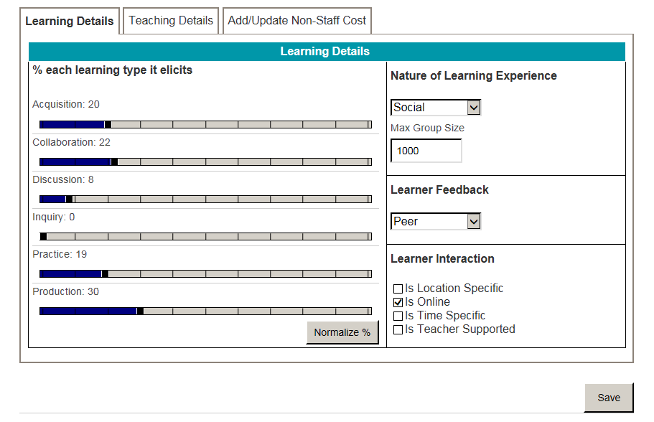
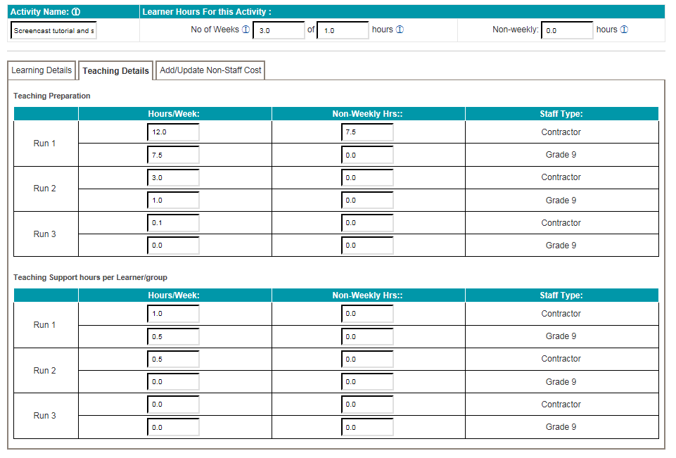
CRAM linked to UCL financial costing tool
Notes:
An online version of the tool has been created as a UCL enterprise tool, linked to all the current financial costs for staffing.

Slide 31
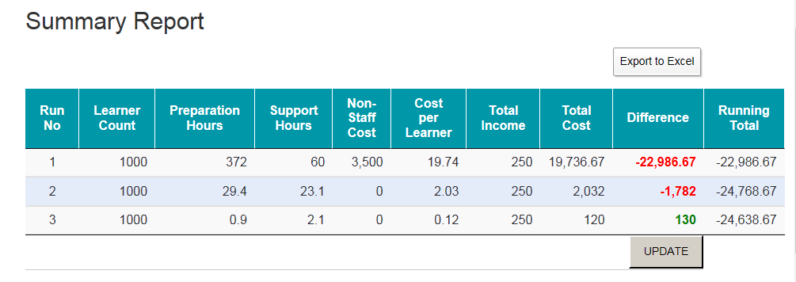
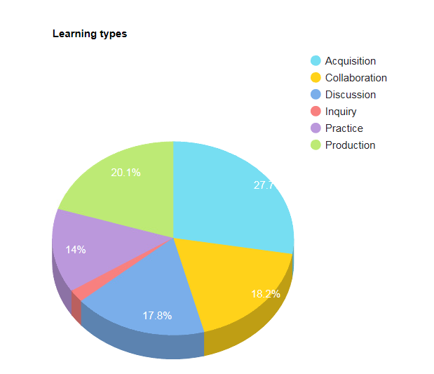
CRAM linked to UCL financial costing tool
Notes:
This screen shows the Summary screen for the user’s current model of the course.

Slide 32
Can we afford to scale up without losing quality?
MOOCs could be part of the public good mission of HE
Free to enrol, quality learning, can be low cost for high value return
Currently viable for professional development, not for U/G
MOOCs must be both financially sustainable and high quality
Activity based costing + analysis of learning experience for planning
Test the Course Resource Appraisal Modeller for usability
Models multiple runs – so efficiencies of scale can be realised

Slide 33
What is the potential? The digital cascade model to address large-scale global challenges

Slide 34
The digital cascade model for the large scale: from MOOCs for professionals to local student groups
MOOCs for local professionals who need new skills
Co-design professional development MOOCs to support local needs
MOOC co-design and delivery
10
Impact
Ideas
MOOC participants using resources and sharing ideas
10,000
MOOC resources also support local blended learning in small groups
So the cascade model impacts small local groups on the large scale
Impact
Ideas
Each active MOOC participant using resources with local group
250,000
25x10,000
Notes:
To come back to our initial issue – of tackling the large-scale challenges in global education, how might MOOCs help us, if they cannot be used to teach children and young people?
Here we’re experimenting with the ‘cascade model’ for professional development, to:
develop MOOCs for local professionals who need new skills
and co-design them so that they do support local needs
- then in the MOOC, you have thousands of professionals who can use the resources, interact with each other, share ideas and potential solutions
- they can then use those resources with their own local groups – maybe other professionals, or young adults lacking education, or for children in schools
- and each of those levels will contribute back their experience of the impact of the ideas and resources in their local context – thereby contributing to their own community knowledge, and to our research understanding.
And the reason we call it a cascade model is that the design of the MOOC is done with just a small group - 10
But via the MOOC they reach thousands - 10,000
And each of those with their own group of 25 using the MOOC ideas and resources - 250,000
is building up to a quarter of a million people reached.
And we begin to see how, in time, HE might find ways of using something like the cascade model and the best digital pedagogies, to begin meeting some of those large-scale global challenges.

Slide 35
Summary
The global context for HE’s role in CPD
Online pedagogies for PD on the large scale
Quantitative analysis of peer review
Qualitative analysis via interviews
Making it affordable and sustainable
The digital cascade model
Universities could and should address the moral imperative of SDGs
Online pedagogies can work for large scale professional development
Peer review is low cost and highly valued
Technology enhanced social learning is integral to professional development
Modelling teaching costs and learning benefits is essential
Scaling up is feasible with a 2-step digital cascade from global to local

