Slide 1
@jameswilsdon

Slide 2
1. Continuity or change?
2. Headlines
3. Purposes
4. Burden
5. Portability
6. Metrics
7. Impact
8. Environment
9. Where next?

Slide 3
“Believe me, I have no intention of replicating the individual and institutional burdens of the REF. I am clear that any external review must be proportionate and light touch, not big, bossy and bureaucratic.” Jo Johnson, July 2015

Slide 5
30 years of pain: the evolution of UK research assessment
Date | Exercise | Coordinating body | Key features
1986 | Research Selectivity Exercise | Universities Grants Committee | 37 cost-centres; 4-part questionnaire on research income, expenditure, planning priorities & output
1989 | Research Selectivity Exercise | Universities Funding Council | 152 units of assessment; 70 peer review panels; 2 outputs per member of staff
1992 | Research Assessment Exercise (RAE) | HEFCE | HEIs select which staff to submit; 5-point scale; 2800 submissions to 72 UoAs; introduction of census date
1996 | Research Assessment Exercise (RAE) | HEFCE | Up to four outputs per researcher; 69 UoAs
2001 | Research Assessment Exercise (RAE) | HEFCE | 2600 submissions to 69 units of assessment; 5 umbrella groups of panel chairs for consistency
2008 | Research Assessment Exercise (RAE) | HEFCE | 67 subpanels under 15 main panels; results presented as quality profiles
2014 | Research Excellence Framework (REF) | HEFCE | 4 main panels; 36 subpanels; introduction of 20% impact element
2021 | Research Excellence Framework (REF) | UKRI (Research England + devolved FCs) | All research active staff included? Non-portability

Slide 6
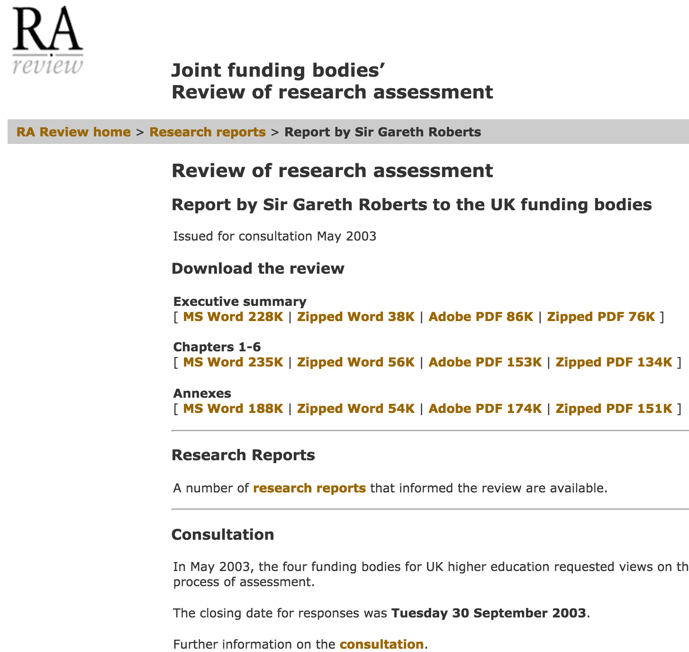

Slide 7
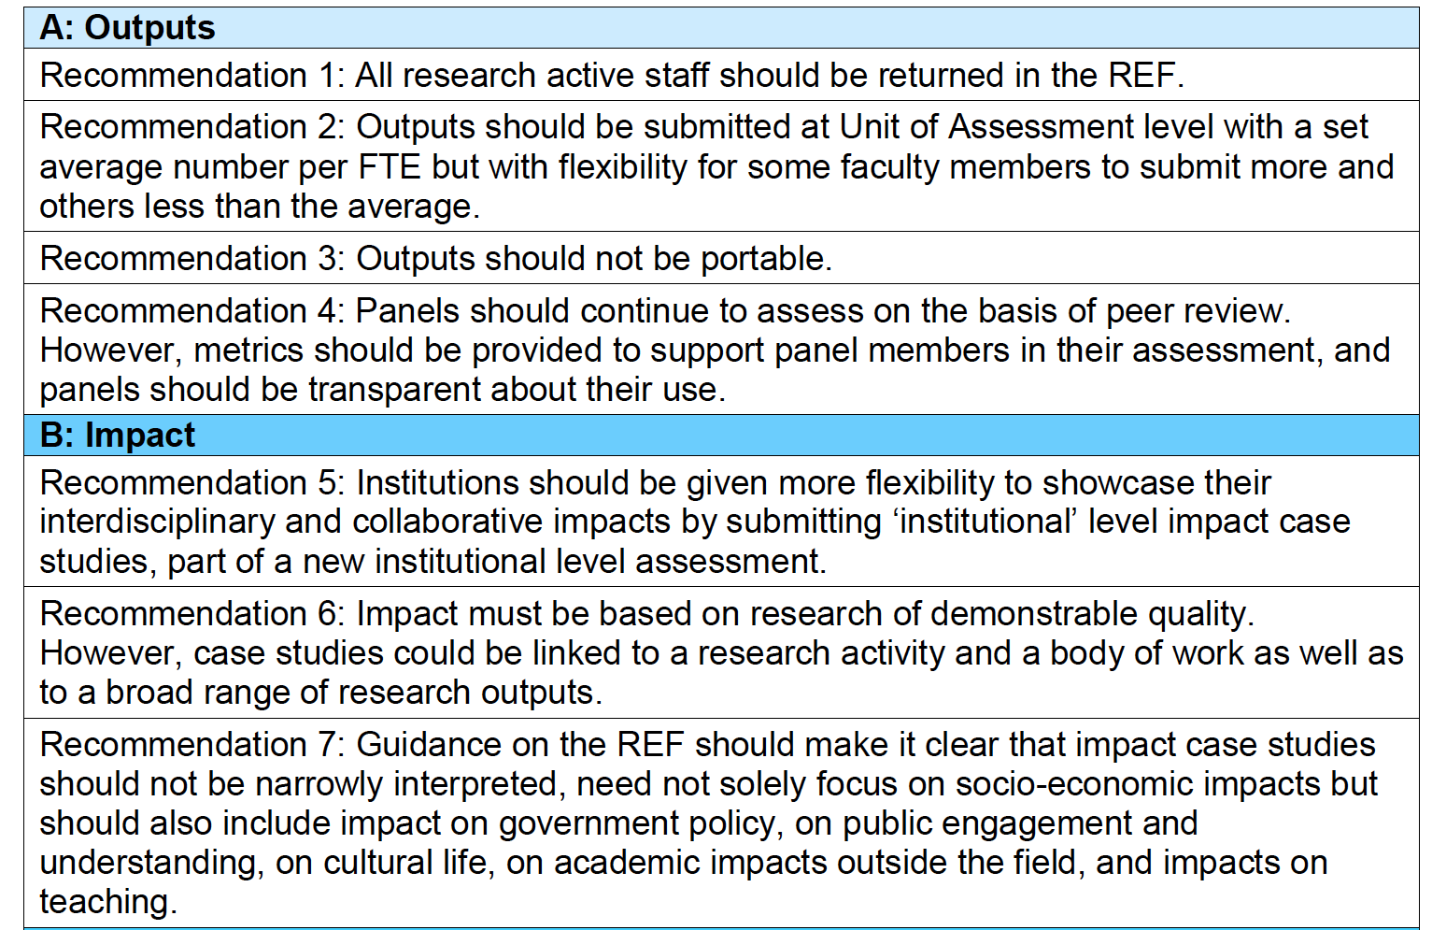
Headlines “should be taken as a complementary package where the logic of one depends on and is strengthened by the others.”

Slide 8
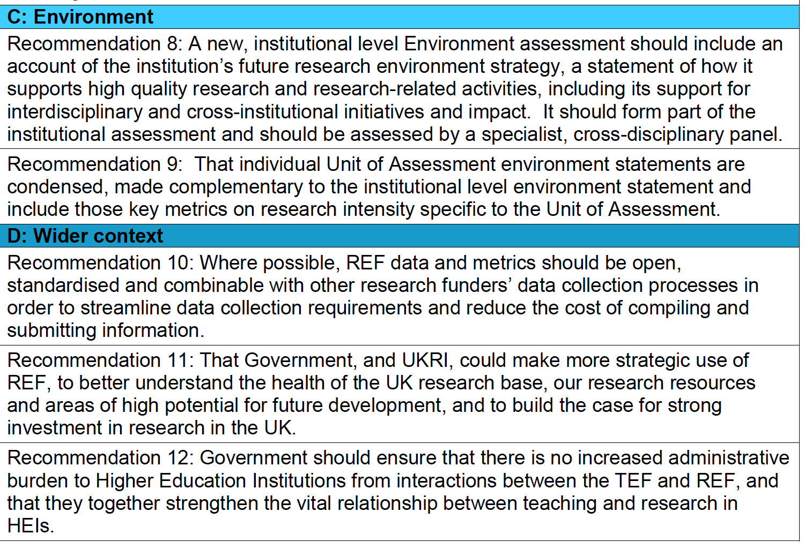
Headlines (cont…)

Slide 9
Purposes

Slide 10
Purposes

Slide 11
Burden
Overall, Stern reforms are more likely to move burden around, than reduce it!
Implemented sensibly, they should succeed in making the REF less of an omnipresent feature of everyday academic life;
But the management responsibility – and burden – continues to grow (not least in implementing the Stern reforms themselves);
Trade-offs & pressures around selection of outputs will intensify at UoA level;
Environment statement assumes more importance;
Institutional level impact cases also require greater management input & coordination.

Slide 12
Portability & ECRs

Slide 13
Portability & ECRs

Slide 14
Metrics: concerns over a metric-based REF
Coverage & robustness – esp across AHSS – but in any field, we need to preserve a role for judgement alongside measurement;
Impact definitely cannot be measured using metrics (cf Kings/Digital Science report);
Equality and diversity considerations e.g. gender & citation, ECRs;
Cost savings are exaggerated; HEIs would still manage research (& most likely purchase additional analytical services);
Timing implications of a radical rule-change to REF 2021 & need for piloting and testing;
REF has evolved to be about much more than allocation of QR – what of those wider purposes do we value and want to preserve, and what are we happy to discard?

Slide 16
Portability & ECRs

Slide 18
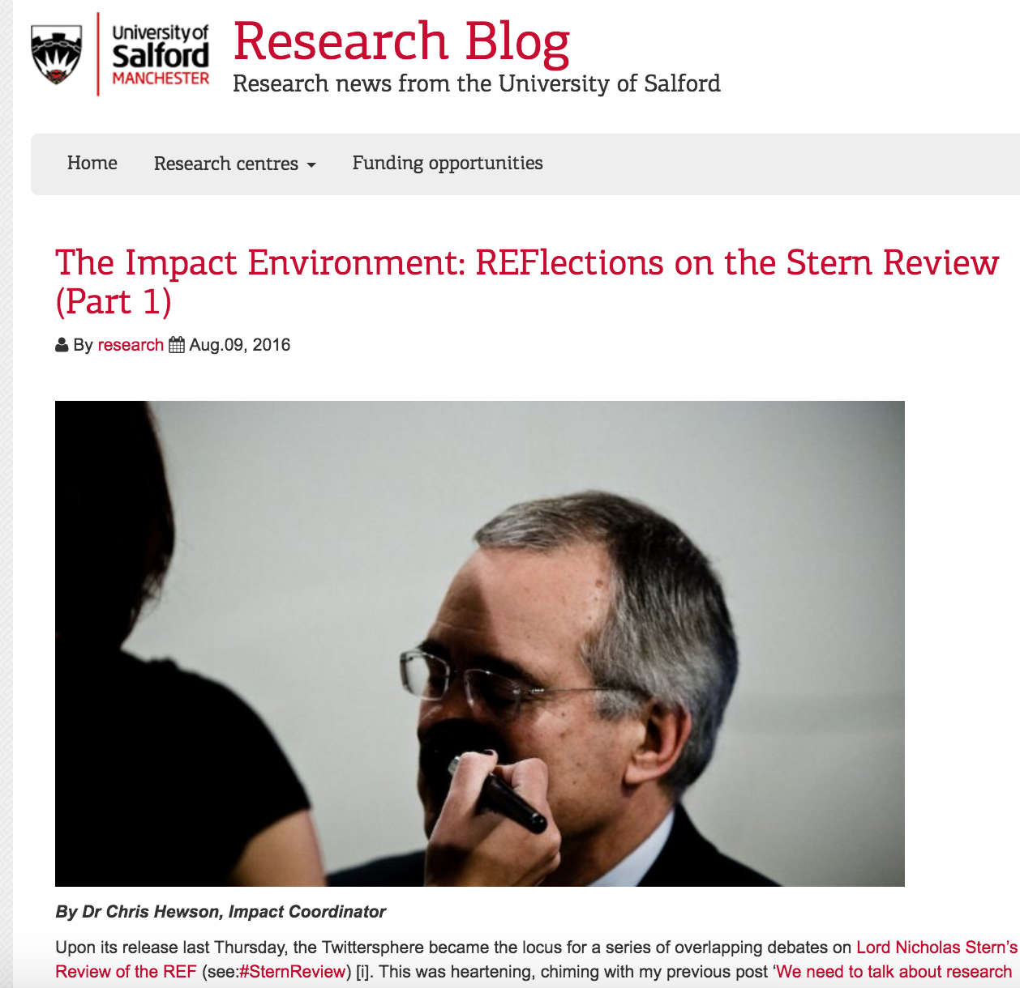
Impact

Slide 19
Next steps
Beneath the headline recommendations, a great deal of detail still to work out inc:
precise definition of research active; output/FTE ratio; portability & ECRs; impact definitions
HEFCE will issue a technical consultation in mid-late November
Responses by end Feb; new rules in place & guidance issued in July
Key qu. is how far community pulls back towards REF2014, and where resistance to that lies (BEIS, Johnson, Borys?)
In background, questions over how UKRI will administer REF2021; assumption of transfer of Sweeney/Hill et al

Slide 20
http://blog.history.ac.uk/2016/07/stern-review-an-initial-bibliography/

Slide 22
Launch event: The road to REF 2021: is the UK leading or lagging in its approach to research assessment’?
Wednesday 7 December, 16:00-18:00 at SpringerNature London King’s Cross campus

Slide 23
@jameswilsdon

