Slide 1
IIEP Strategic debate, UNESCO, 12 March 2018 Higher education as a common good
Simon Marginson
Director of the ESRC/HEFCE Centre for Global Higher Education Professor of International Higher Education UCL Institute of Education University College London, UK

Slide 2
Worldwide growth of enrolment in tertiary education since 1970

Slide 3
Research finds that people who achieve higher education, on average …
Have a larger range of employment options
Are more likely to be in good health, as are their families
Have more advanced skill in the use of information and communications technology (electronic agency)
Are more geographically mobile, independent of income level (personal confidence and agency freedom)
Report higher levels of inter-personal trust (also = greater personal agency)
Are more likely to state that they have a say in government (also = greater personal agency)
Are more positive about migration and cultural diversity
Walter McMahon, Higher Learning, Greater Good (2009); OECD, Education at a Glance (2015); OECD, Perspectives on Global Development 2017: International migration in a shifting world (2016) etc

Slide 4
Individual or collective benefit? Both?
individualised
1 Individualised national goods
Greater agency freedom
Better social position
Augmented earnings and employment rates
Lifetime health and financial outcomes, etc
2 Individualised global goods
Cross-border mobility and employability
Communications facility
Knowledge of diverse languages and cultures
Access to global science
3 Collective national goods
Ongoing development of professions/occupations
Shared social literacy, opportunity structure
Inputs to government
Stronger regions, cities
4 Collective global goods
Universal global science
Diverse knowledge fields
Common zone of free critical inquiry
Systems for exchange, collaboration, mobility
national
global
collective

Slide 5
How do we understand, monitor and enhance these outcomes? Using ‘public good’ and ‘common good’
Is the public/private line a distinction between
- non-market or market forms of education (economic distinction),
- state or non-state controlled forms of education (juridical-political distinction)?
What if anything is normatively ‘good’ about public goods in higher education?
Does higher education as a ‘common good’ provide a more useful policy framework than ‘public good’?

Slide 6
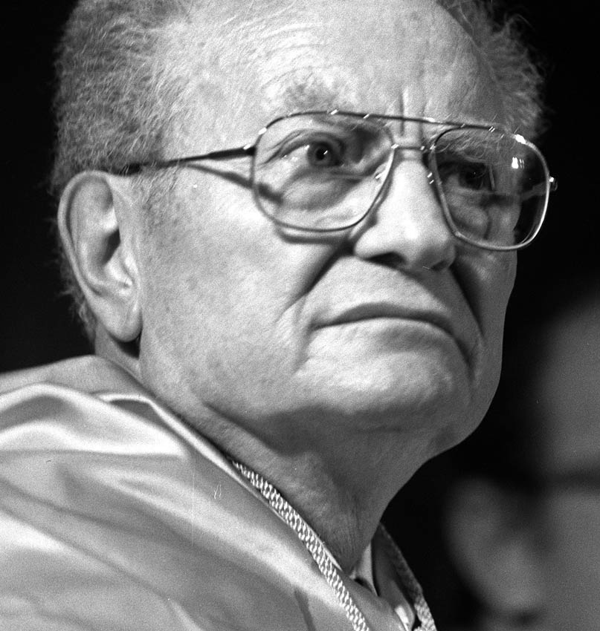
Economic definition of public/private—based on market vs. non-market production Samuelson (1954)
Public goods are non-rivalrous and/or non excludable. They are under-produced or unproduced in economic markets. All other goods are private goods
Notes:
Goods are non-rivalrous when consumed by any number of people without being depleted, for example knowledge of a mathematical theorem, which sustains its use value everywhere, indefinitely, on the basis of free access. Goods are non-excludable when the benefits cannot be confined to individual buyers, such as clean air regulation. Private goods are neither non-rivalrous nor non-excludable. Public goods and part-public goods cannot be produced on a profitable basis, and normally require government funding or philanthropic support.
Here is an enduring fiscal principle for limited liberal states: state funds public goods, family/individual funds private goods
However, Samuelson’s framework is not very helpful in dealing with collective goods,, because it is hard to define collective goods in economic terms
Another key weakness of Samuelson’s definition is that it naturalises the public/private distinction. In reality some ‘public goods’ are shaped by policy. Teaching can be either a public or a private good. Learned knowledge is non-excludable and non-rivalrous. However, whenever student places confer value in comparison with non participation, there is rivalry; and in HEIs with a surplus of applications over places, participation is excludable. Private goods are created and it is possible to have a market in tuition. The extent to which it is a private good is shaped by state policy-- , it depends on the approach to tuition, institutional stratification and so on.

Slide 7
Economic public goods: non-rivalrous and non-excludable
Goods are non-rivalrous when consumed by any number of people without being depleted, e.g. knowledge of a mathematical theorem, sustains use value everywhere, globally, indefinitely, on the basis of free access
Goods are non-excludable when benefits cannot be confined to individuals, e.g. clean air regulation, defence
Private goods are neither non-rivalrous nor non-excludable. They can be produced, sold and bought as commodities in economic markets. This public/private distinction is between non-market production and market production
Research is primarily a public good. Teaching/student places can be either public or private; depends on policy
The economic definition draws attention to goods which are subject to market failure (such as educational equity)

Slide 8
Political definition of public and private— state vs. non-state
“The line between public and private is to be drawn on the basis of the extent and scope of the consequences of acts which are so important as to need control, whether by inhibition or by promotion… The public consists of all those who are affected by the indirect consequences of transactions”
~ John Dewey, The Public and its Problems, 1927, pp. 15-16
Matters with ‘consequences’ for others include market transactions, organisation of education systems, etc
This public/private distinction is between state-controlled and non-state controlled production
‘Public goods’ are whatever the state (or democratic communities) say they are. Arbitrary, eclectic, but flexible!

Slide 9
Putting the two definitions together
The economic distinction is non-market vs market
The political distinction is state vs non state
In the economic definition higher education is public, unless produced in a market outside the state. In the political definition public or private is decided by states or democratic communities
The economic and political definitions each have virtues, but also gaps. Each is ambiguous
Putting them together creates four unambiguous categories (four political economies) that can be used to explain higher education and research
Notes:
Samuelson’s economic approach to ‘public’ focuses on the market/non-market distinction. It is stronger with individual-level than collective goods.
Dewey’s political approach focuses on the state/non-state distinction. It is stronger in the handling of collective public goods, or public good
The economic definition identifies the minimum necessary public goods, but posits a zero-sum relation between public and private, and constrains policy choices.
The political definition makes the public/private relation a political choice, not a natural event, enabling zero-summism to be overcome. It also makes explicit the implicit economic assumptions, subjecting them to open choice. It is more comfortable in the normative domain
But the political definition has no limits. This suggests that Dewey’s understanding of ‘public’ should be subjected to the discipline of the economic approach, based on scarcity and costs.

Slide 10
Public and private goods: four political economies of higher education
Non-market goods
Quadrant 1: CIVIL SOCIETY
Quadrant 2: SOCIAL DEMOCRACY
Teaching: Private learning in Internet, libraries
Research: Self-made scholarship and inquiry
Teaching: Free places, low value differentials
Research: Publicly funded, integral to researcher
Non-state sector goods
State sector goods
Quadrant 4: COMMERCIAL MARKET
Quadrant 3: STATE QUASI-MARKET
Teaching: Commercial market in tuition/degrees
Research: Commercial research and consultancy
Teaching: Quasi market in student places/degrees
Research: State quasi-market, product formats
Market-produced goods
NOTE: State, institutions and individuals are active agents in all four quadrants
Notes:
The four quadrants constitute four different political economies of higher education: Civil Society, Social Democracy based on universal public provision (Nordic model), State Quasi-market (now the UK model, isn’t it great!), Commercial Market
The state is active in all four. On the right hand side it shapes production more comprehensively and directly, through public services in Q1 and state quasi-markets in Q2 (both Dewey public activities). On the left hand side it sets regulatory frameworks for conduct (civil and commercial law).
Q1 combines economically public goods with politically private goods. As also in Q2, research and education are non-rivalrous and non-excludable, Samuelson public goods. In Q1 these activities are in Dewey’s private domain, outside politics and regulation. I call this zone civil society and it includes families, communities, social movements. In HE faculty and students pursue unpaid and unregulated activities between more formal agendas.
Q 2 research is research supported from general university funding. Projects are driven by curiosity and merit, not competitive acumen or university status. Much of what we do still sits in Q2. Including this paper. It is not part of a funded research project.
The neo-liberal era has moved action in higher education from Q1 and Q2 to Q3. In Q3 there is a tension between economic (private) and political (public). All is ‘public’ in Dewey’s political sense. Quasi-markets are policy controlled
Educational or research activity in higher education can be positioned on this diagram, according to the extent it is ‘public’ in Samuelson’s economic sense; and the extent it is ‘public’ in Dewey’s political sense, recognised as a matter of common interest and state regulation.
The 4-quadrant diagram makes explicit the political choices associated with economic provision, for example whether or not to produce higher education on a non-market basis—and if non-market, whether to do this in the regulated funded public sector or leave it to civil society.
The 4-quadrants also highlight the question of who should pay, whether the state through taxation or the individual beneficiaries. In matters defined as public in the political sense, it poses the question ‘how public can we afford to be?’ in economic terms.

Slide 11
Common good(s)
Not all public goods are necessarily progressive in distribution or social effects (aggressive national military offensives are a ‘public good’ in both the economic and political senses, but do we like them?)
Collective relational goods are a particular kind of non-market good, public goods in the economic sense. These are relational goods that provide for social solidarity, equity, human rights, democratic self-determination, and social and geographic mobility (freedom of movement) in populations
The normative term ‘common good’ and ‘common goods’ may serve to describe such collective benefits
The provision of higher education on the basis of equal social opportunity is an important common good

Slide 12
Factors that create opportunity hierarchies
Elite schools and school sectors that shape selection
Fields of study attached to differential social rewards
Horizontal institutional diversity (mission, type) that becomes vertical (hierarchy of value), e.g. distinction between university and non-university institutions
Public and private sector distinction can be a hierarchy
Tuition barriers and differentiated tuition prices
Intensified competition between institutions
Differentiated student aspirations
Notes:
Why does educational stratification tend to reinforce prior social inequalities, and why does expansion enhance the effects of social background, or make no difference? HPS are populated by families that apply active agency to the contest for educational and social success, at every stage. Families with financial, social, cultural or political capitals bring those capitals to bear on education and continue to do so in the transition to work and beyond. A recent report by Oxfam refers to ‘opportunity hoarding’, whereby ‘social disparities become permanent’. Privileged groups ‘take control of valuable resources and assets for their benefit’, such as ‘access to quality education’. The formal stratification of opportunities on the basis of institutional hierarchies and/or financial barriers provides points of purchase for family strategies. Whenever there is a hierarchy of value, families with prior social advantages are best placed to compete for scarce places or pathways that confer the greatest positional advantages.

Slide 13
Applying ‘common good’
The ‘common good’ idea provides a better normative basis than ‘public good’ for tackling stratification
The common good approach is a non-market approach (commercial markets generate financial closures and inequalities which are the antithesis of the common good)
It is not necessarily a state-based approach. It allows a larger group of actors to contribute to education, and is compatible with mixed financing (with safeguards!)
BUT by-passing states altogether does not work well especially if it lets the commercial market in. Arguably, private sectors in education work best when there is effective state regulation, e.g. South Korea

Slide 14
Complication 1 Whose common/public goods? Are there generic common goods in higher education?
Is there a really generic/worldwide ‘common good’ in higher education? Or is common or public good just in the eye of the beholder and incapable of generic form… ? Whose common good is it?
Which tradition of ‘state’, ‘public’ and common should we use—Anglo-American, Nordic, German social market, Chinese, Latin American, etc? Or should we use a combined idea, based on a reasoned synthesis?
Most ‘global’ strategies are not really global but reflect one or another national viewpoint

Slide 15
National variations in ‘public’ and ‘common’
 | United States | Nordic | Post-Confucian (East Asia and Singapore)
Nation-state | Limited liberal state, federal, separate from economy and civil order, constraints on state intervention. HEIs in civil society? | Comprehensive Nordic welfare state, unitary, equated with society, fosters cooperative and egalitarian HEIs | Comprehensive Sinic state, politics commands economy. Unitary. High status state (top graduates enter state service)
Educational culture | Meritocratic and competitive market. Highly stratified, but education seen as common road to wealth/status within advancing prosperity | Egalitarian, free of charge, cooperative, universal, public. Low stratification of HEIs. State guaranteed medium for equal opportunity | Education for filial duty and social status in stratified system. Confucian commitment to self-cultivation at home plus state belief in economic benefits.
State and family role in higher education | State frames hierarchical market and steps back. Middle class family increasingly invests private resources | State supervises high quality egalitarian provision. Autonomy of HEIs. Family citizen right to free education | State supervises, shapes and drives the sector. Managed autonomy. Family invests much energy, time, money

Slide 16
Complication 2 What about global public/ common goods?
‘Global public goods are goods that have a significant element of non-rivalry and/or non-excludability and made broadly available across populations on a global scale. They affect more than one group of countries, are broadly available within countries, and are inter-generational; that is, they meet needs in the present generation without jeopardizing future generations.’
~ Inge Kaul, I. Grunberg and Marc Stern (Eds.), Global Public Goods: International cooperation in the 21st century, New York, Oxford University Press, 1999, pp. 2–3
.

Slide 17
Common ground on common goods?
Common goods pertaining to human rights, social solidarity and equality, intercultural cooperation and international understanding, might be among the generic common goods in higher education.
Also certain global common goods -
communications and mobility between universities
research knowledge in all disciplines
networked space for free inquiry and learning
Who pays for global common goods?
A key problem at world level is that it needs a state to maximise distributional equity of global public or common goods and there’s no global state

Slide 18
Closing points
Both the state/non-state and non-market/market distinctions are relevant, and can be combined. Together they provide a useful explanation, but not a policy
Economic ‘public good’ in higher education provides a financing equation, but there is a danger of elite capture
Common goods (goods that sustain sociability on the basis of equality and rights) have a special importance
‘Common good’ in higher education is useful, but there is danger of market capture and fragmentation. (Strategies based on by-passing bad states mostly do not end well)
The issues are specific to national political and educational cultures. State role varies in these cultures
Global common goods in higher education are under-recognised and need more explicit attention

Slide 19
SUMMARY
Higher education is a common good and a (state) public good
- See also Rita Locatelli, ‘Education as a public and common good’, UNESCO Education and Research Foresight, Working Papers 22, February 2018
Higher education is not always provided and financed by states, but part of the remit of the state is to ensure that all (economic) public goods subject to market failure are adequately financed
These goods include human rights, freedoms, equality and solidarity in higher education; and research and scholarship in the different fields of knowledge

Slide 20
Thank you for listening (I hope it wasn’t too dull!)
s.marginson@ucl.ac.uk
www.researchcghe.org

