Slide 1
Impact on international student numbers
Jo Attwooll
Programme Manager
Universities UK
April 2016
Notes:
Good afternoon
I work as a Programme Manager for UUK, membership organisation – our members are the Vice-Chancellors and Principals of UK universities, 133 members
Lead our immigration programme – which is a strategic priority for UUK
Dominic has spoken about policy changes
I'll be focusing on the impact on international student numbers at universities

Slide 2
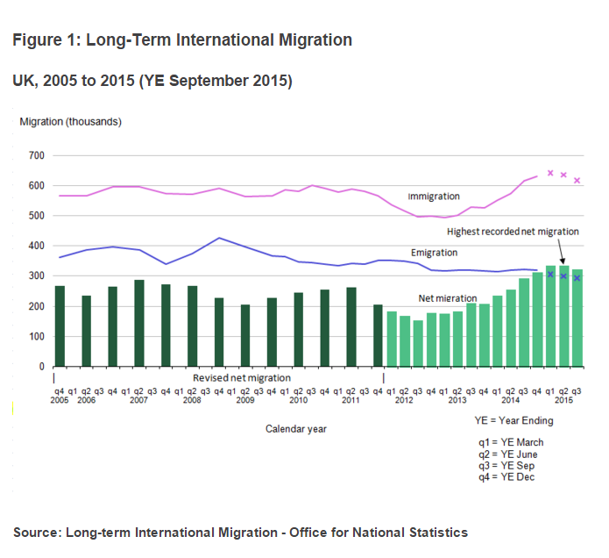
Net migration statistics
Notes:
But first of all, what about the impact on overall net migration?
Reducing net migration to below 100,000 is the Government's flagship policy objective
How close are they to achieving it?
Not close at all!!
Net migration (the green bars on the chart) is in excess of 300,000 per annum – the latest figures released in February 2016 show net migration at 323,000, the second highest level since records began.
Long way to go to reach 100,000 within this term of government (by 2020) and very little room to manoeuvre – although a vote for BREXIT would mean EU migration could be much more controlled than it is now.
What about impact on higher education enrolments

Slide 3
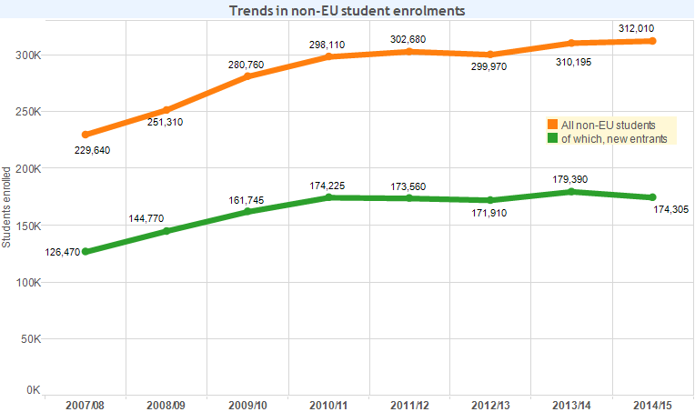
Policy impact
Notes:
And what about international student numbers?
HESA stats over the past 5 years show virtual stagnation
You can see from the chart overall non-EU enrolments (orange line) rose quickly between 2007/08 to 2010/11 but since then have virtually stagnated. New entrant figures (green line) are perhaps more worrying as they show a decline in recent years – by 4% between 2013/14 and 2015/15.
Most recent Home Office releases also indicate a drop in visa applications made by university sponsored students are also falling – down by 2% in the year ending September 2015.
In the year ending September 2014 there was a 2% rise so this reversal in university sponsored visa applications is worrying
And what about our performance compared to other countries?

Slide 4
Country trends
China has sustained UK market
India decline ongoing
US new entrants now exceed Indian new entrants
Other worrying declines
Notes:
Country by country trends are similarly troubling. A recent British Council research paper highlighted the extent to which the UK has been protected from a significant decline in non-EU student numbers by strong growth in Chinese numbers.
In fact, China now accounts for 36 per cent of UK study visas issued globally, - any future decline in the Chinese market will impact the sector heavily.
Also ongoing declines in Indian numbers which have reduced by more than 50% in the past three to four years.
For the first time, the proportion of first year US domiciled students has exceeded that of India: 10,205 from the US as compared to 10,125 from India.
For context, in 2010/11 the number of first year US domiciled students was 9,650 as compared to 23,970 from India
In the 2014-15 academic year HESA reported only 2.2 per cent growth in total Chinese HE students in the UK, compared to 8.3 per cent growth in the USA, 3.6 per cent growth in Australia, and 15.9 per cent growth in Chinese students at all levels in Canada. All the UK’s major competitors are investing heavily in China, both through direct student recruitment and through partnerships such as joint degree programmes. There was an even larger gap in total global student mobility, with the UK seeing just 0.6 per cent growth compared to 8 to 11 per cent growth in these three competitor countries. This was mostly driven by a few markets such as India and Nigeria, which saw major declines in mobility to the UK but rapid growth in competitors
Some other worrying trends – Tier 4 visas for Brazil down 47% 2014-15, Bangladesh down 56.6%, Malaysia down 7.3%

Slide 5
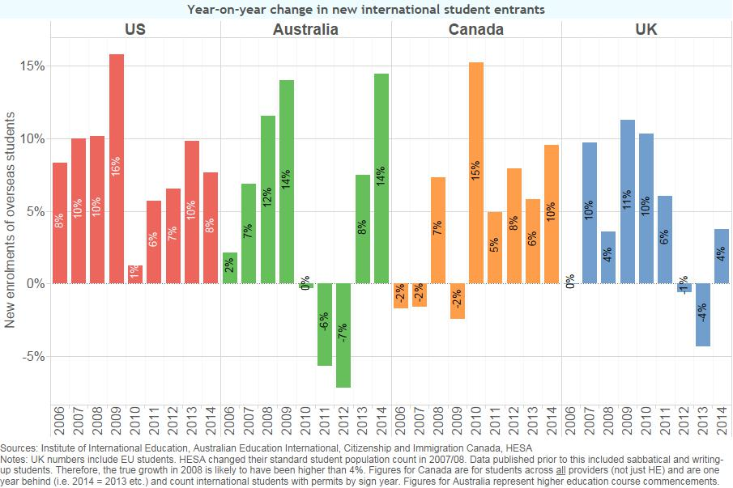
UK growth compared to others
Notes:
And how does the UK’s growth compare internationally? This table doesn’t cover the most recent statistics but nonetheless reveals some telling trends
Meanwhile, the latest available figures show that international student HE enrolments in Australia were up 9.3% between Nov 2014 and Nov 2015.
The latest available figures for the US show an increase in international student HE enrolments of 10% overall from 2013/14 to 2014/15 with increases in new enrolments from India (29.8%), Saudi Arabia (11.2%), China (10/8%) and Brazil (78.2%).
Compared this with 1% increase in the UK in 2014/15 (and 4% decline in new entrants) - worrying

Slide 6
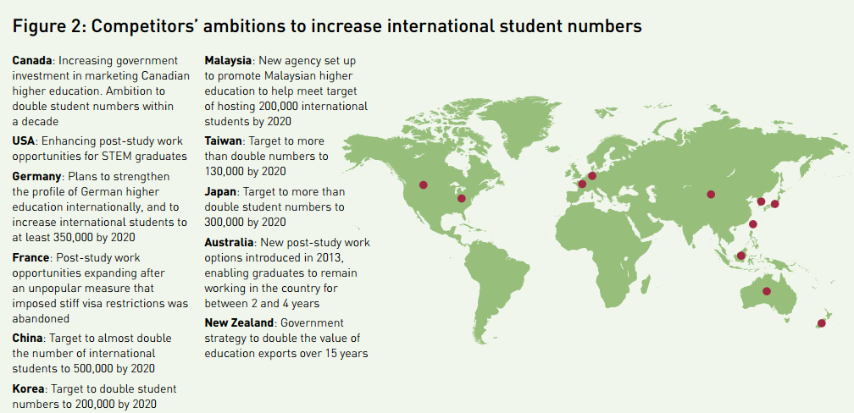
International competition
Notes:
And what of international competition? Although the UK remains the second most popular destination for international students, its position is far from assured. You only need to glance at the graphic on the slide to get a sense of what is happening across the globe by many different countries to enhance their offer to prospective students

Slide 7
Post-study work numbers
2011 – 46,875 found work post-study
2012 – Tier 1 PSW closes
2014 – 7,043 found work post-study
Notes:
And PSW
One of the most contentious policy developments - announced in 2011, took effect in 2012. Particularly contentious given the improvements other countries have made to their PSW offer in recent years
Its closure has led to lots of media coverage overseas and misperceptions that there are no PSW opportunities in the UK, something we have worked hard to correct (but more needs to be done).
So how have the numbers changed?
2011
2014
Please note these figures relate to all the PSW routes - those that were available under Tiers 1, 2 and 5 in 2011 and those available now. Back in 2011 the vast majority were using tier 1 PSW. Since its closure you can see the numbers accessing work on completion of their studies has fallen very significantly
Poses questions to the UK - how can the offer be improved and in the absence of government willingness to do this, how do we more effectively market what is available?
Re-brand. Nothing labelled PSW - could repackage to make it clearer.

Slide 8
UUK’s policy response
Students and net migration
Political engagement
Representing the sector
Press activity
Evidence gathering
Compliance
Notes:
UUK's role
6 Parliamentary committees - students out of net migration

Slide 9
jo.attwooll@universitiesuk.ac.uk
0207 419 5463
LinkedIn: Josephine Attwooll

