Slide 1


Early career social science researchers:
Experiences and support needs
CGHE seminar 88, 19 July 2018

Slide 2
Early career social science researchers:
Experiences and support needs
Dr Richard Freeman
UCL, Bloomsbury and East London ESRC Doctoral Training Partnership
Dr William Locke
Centre for Global Higher Education
UCL Institute of Education, University College London

Slide 3
Outline
Introduction to the research
Research design
Some findings
  The experiences and career trajectories of early career social scientists
  The type and quality of support provided for early career social scientists
  Funding opportunities and their impact
  Survey respondents’ and interviewees’ suggestions for improvement
Some implications
Conclusions and recommendations

Slide 4
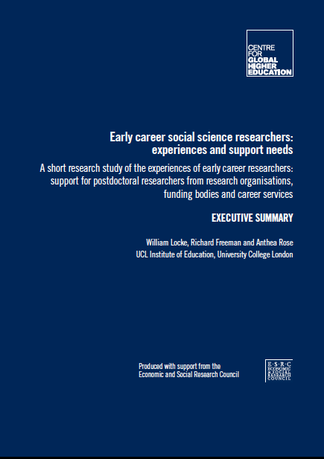
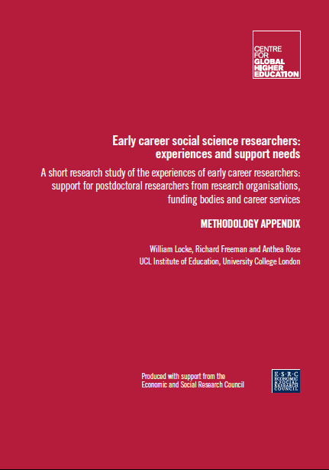
Introduction
Early career social science researchers: Experiences and support needs
Executive Summary & Methodology Appendix
William Locke, Richard Freeman & Anthea Rose
(Economic and Social Research Council, August 2016)
Notes:
Executive summary & methodological appendix published by ESRC in August 2016.
Dr Anthea Rose, Research Associate

Slide 5
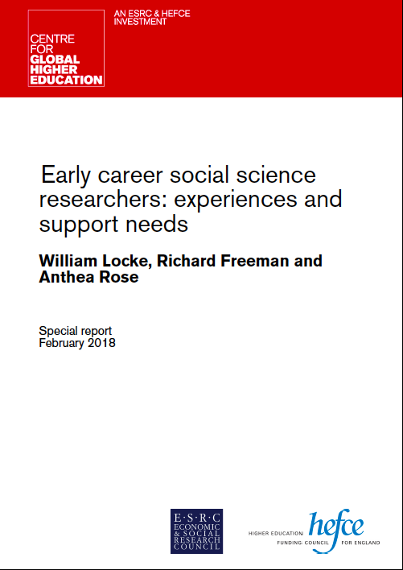
Introduction
http://www.researchcghe.org
for the CGHE Special Report, February 2018
Notes:
Full report published by CGHE in February 2018.

Slide 6
Early career social science researchers:
Experiences and support needs
We are drawing on the findings from a research study for the UK Economic and Social Research Council (ESRC) of the experiences of early career researchers (ECRs) in the social sciences and, in particular, the extent and quality of support for postdoctoral researchers from research organisations, funding bodies and career services (Locke, Freeman and Rose 2016, 2018)
The original aim of the research study was to gain an insight into the diversity of roles, opportunities and support available for (ECRs) in the social sciences whether they worked in the HE sector or not at the time of the study.
Purpose of the research
Notes:
Date set is available, and will provide an important baseline for evaluating changes.

Slide 7
Main objectives of the original research
To assess the range of experiences and circumstances of ECRs in the social sciences after completing their PhD
To identify and assess the type and quality of support provided for ECRs, from a variety of sources, and identify good practice
To identify the common career trajectories for ECRs in the social sciences and develop an understanding of any disparities between their career aims, expectations and reality
To review funding opportunities available to ECRs in the social sciences.

Slide 8
A definition of early career researcher?
A definition of early career researchers was not prescribed and respondents were free to define themselves as such when deciding whether to respond to the survey.
In this seminar, among other things, we will examine the participants’ perceptions of themselves as ‘early career researchers’ and analyse these according to significant variables.
Notes:
No definition imposed: advantages and disadvantages, which we’ll come back to later.
Decided to allow respondents to self-identify
Used ECSS – Early Career Social Scientist – to avoid exclusion
But, required a doctorate

Slide 9

Research Design

Slide 10
Research Design: three phases
An online survey of PhD graduates in the social sciences who described themselves as early career researchers
  1,048 usable responses
  But they may not be representative of the total population
Semi-structured interviews with 35 respondents
  who had studied at a range of types of universities
  with different funding sources
  eight were working outside academia
Semi-structured interviews with nine representatives of relevant research and other organisations, experts and individuals
  all had a stake in the support and progression of ECRs in the social sciences
  the interviews explored the main issues raised by respondents to the survey and the 35 interviewees, the effectiveness of existing sources of support, and ideas for improvement.
Notes:
The first phase of the study consisted of an online survey of PhD graduates in the social sciences who described themselves as early career researchers. 1,048 usable responses were received.
BUT, the study participants cannot be assumed to be representative of the total national population of early career social scientists, and so all findings reported here are necessarily qualified.
The data on the total population of early-career social scientists is incomplete and their profile can only be guessed at.
The second phase built on the findings from the online survey and consisted of interviews with a selection of the survey respondents (46% of respondents had agreed to participate in this follow-up). Semi-structured interviews were conducted with 35 respondents who had studied at a range of types of universities with different funding sources. Eight were working outside academia at the time of the interviews.
Following this, interviews were also held with nine representatives of relevant research and other organisations, experts and individuals with a stake in the support and progression of ECRs in the social sciences. These explored the main issues raised by respondents to the survey and the 35 interviewees, the effectiveness of existing sources of support, and ideas for improvement.

Slide 11
Research Design: analysis
Quantitative – and some qualitative – data from the survey were subjected to a number of bivariate analyses, including by:
type of doctoral institution
receipt of external funding and source
type of support available
career aspirations
years since completing the doctorate
secured first paid post
mode of current employment
nature of current role
gender.
Notes:
Quantitative and some qualitative data from the survey were subjected to a number of bivariate analyses, including by:
type of doctoral institution (Oxbridge, other Russell Group, other UK HEI, and International)
receipt of external funding and source (ESRC, other research council, institution, and other – including self-funded) during and after doctoral study
type of support available (from doctoral institution during doctorate, from doctoral institution after doctorate, from current main employer)
career aspirations (before doctoral study, during doctoral study, after doctoral study, and at the time of the survey)
years since completing the doctorate (0-1, 2-3, 4-5, 6 and above)
secured first paid post (before submitting, less than 3 months, 3-6 months, 6-12 months, 1-2 years, over 2 years, not yet secured a paid post)
mode of current employment (fixed-term, permanent)
nature of current role (primarily research, teaching and research, primarily teaching)
gender.

Slide 12
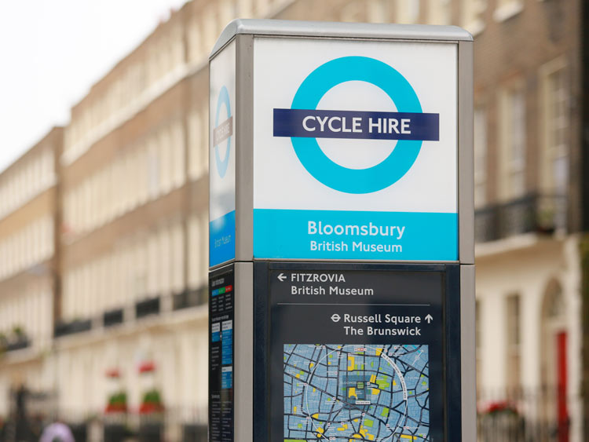
Some findings
Notes:
Some study challenges:
Very short time frame with short notice
Little existing information on specific population (social scientists)
Respondents: 68% female

Slide 13
Findings 1: The experiences and career trajectories of early career social scientists
For most respondents, undertaking doctoral study broadly resulted in their desired outcome: a role within academia
  The majority of respondents (81%) worked in the HE sector immediately following completion of their doctorate, with nearly half in primarily research roles.
However,
  it had taken longer than they had expected
  there was no single common career trajectory for doctoral graduates:
    a “lucky” few had gone directly into a permanent academic post
    many had taken multiple short-term contracts
    some had developed a ‘patchwork’ or portfolio career
    almost all respondents described themselves as ‘unusual’.
Notes:
The evidence from the survey and the follow-up interviews would suggest that, for most respondents, undertaking doctoral study broadly resulted in their desired outcome: a role within academia. The majority of respondents (81%) worked in the HE sector immediately following completion of their doctorate, with nearly half in primarily research roles.
However, follow-up interviews with survey respondents revealed that while several interviewees did report being where they had originally intended to be, or on the way to realising their desired career goal, in most cases getting there had taken longer than they had expected [Nearly a half (48%) of the survey respondents had been awarded their doctorate four or more years previously and nearly a quarter (24%) six or more years previously.]
Also, the journey had been extremely stressful, frustrating and not as straightforward as they had envisaged. Interviews revealed that there is no single common career trajectory for doctoral graduates. Almost all felt that they had taken a unique, unconventional and non-traditional path and interviewees reported a wide range of experiences on completing their studies from going directly into a permanent academic post to multiple short-term contracts. Many had constructed what might be termed a ‘patchwork’ or portfolio career. Aspirations and reality were therefore not always easily aligned.

Slide 14
Time since completion of doctorate
Notes:
From the survey respondents, this shows the range and distribution of the length of time since award of the doctorate.
At the time of the survey, just 2% of respondents had yet to secure a paid position, including only three respondents who had completed their doctoral studies more than five years previously. However, the survey appeared to indicate that the majority were taking at least four years to obtain a permanent or open-ended academic contract and, even after six years, nearly a third had not achieved this.

Slide 15
Number of fixed-term contracts since completion of doctorate
Notes:
Half of all survey respondents had had one or two fixed-term contracts since completing their doctorate. The overwhelming majority (85%) working in higher education held just one contract at the time of responding, with 15% holding two or more contracts concurrently.
Some interviewees said they would like greater acknowledgment by the sector that contract work after doctoral submission is highly likely and that these are frequently short-term in nature.
The majority of survey respondents (83%) were also working full-time, with 78% of them doing so within two years of gaining their doctorate. The percentage on a full-time contract was highest for doctoral graduates from Oxbridge and international institutions at 93% and 92% respectively, with Russell Group and Other UK HE institutions at 79% and 78% respectively. Half (50%) of all respondents had permanent or open-ended contracts with a further 36% employed on a fixed-term contract of 12 months or more. However, 9% had contracts that were fixed-term of less than 12 months duration.

Slide 16
Findings 1: The experiences and career trajectories of early career social scientists
The inability to follow a linear path into academia seemed to be the source of considerable disappointment and frustration among participants
If they had known the difficulties of pursuing an academic career, many respondents said they would have given more consideration to employment opportunities outside academia from the start
However, many referred to an assumption by doctoral supervisors and other academics that a career outside academia following doctoral study is a failure
Notes:
The survey respondents (in their open text responses) and interviewees described a wide diversity of experiences and career trajectories for doctoral graduates, such that it was not possible to discern common career trajectories. Many felt they had taken a unique and ‘non-traditional’ route to where they are now, indicating there is an enduring perception of a traditional, linear path into academia, whether or not this has ever been the experience of the majority of ECRs in the social sciences.
Respondents commented on the need to develop a more realistic understanding and accurate portrayal of the difficulties of forging an academic career. Some felt that, if they had known this, they would have given more consideration to career opportunities outside academia from the start. However, many referred to an assumption by doctoral supervisors and other academics that a career outside academia following doctoral study is a failure.

Slide 17
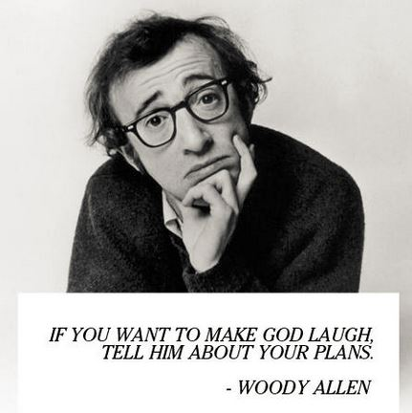

Slide 18
Quote from survey respondent: 1
There are too many people doing PhDs and being encouraged to do PhDs. They are a great money spinner for universities and provide steady employment for people like you reading this, but they are a massive waste of time and effort for a lot of people I have met. I wish I could go back and study plumbing instead 5 years ago, I would be making more money now, have better long term prospects, less debt. But what the hell do you care?
  Male, just completed, awaiting award

Slide 19
Findings 1: The experiences and career trajectories of early career social scientists
ECRs in the social sciences are diverse in every sense and different to those, say, in the physical sciences
They were also more likely to be found in fixed-term, part-time and ‘specialist’ (e.g. teaching-only and research-only) contracts four years or more after their doctorate
There was a strong perception that the period of ‘apprenticeship’ is lengthening, and having an impact on ECRs’ personal lives
Women were more likely to regard themselves as early career researchers for longer, and to be on part-time and/or fixed-term, hourly-paid and zero hours contracts.
Notes:
ECRs are diverse in every sense: not least in age, previous experience, motivation, interests and personal circumstances. Social sciences doctoral graduates are also different to those in the physical sciences, although probably more similar to those in the arts and humanities (Renfrew and Green, 2014). Second, they are also more likely to be found in fixed-term, part-time and specialist (e.g. teaching-only and research-only) contracts for four years or more after their doctorate.
Eight female interviewees (23%) had completed their doctoral studies more than six years previously, compared with just one of the male interviewees.
This is confirmed by the HESA data and other sources of evidence (UCEA, 2015; UCU, unpublished). For example, in 2014/15, women made up 45% of the total number of academics, but 55% of those on part-time contracts; and 39% of female academics were on fixed-term contracts, compared with 34% of male academics (HESA, 2016b). Survey respondents and interviewees in the study reported a lack of transparency in promotion and recruitment processes and a lack of female mentors and role models in academia.
Women’s careers are also more likely to be impacted by career breaks (for example, for maternity leave and for illness). In the hyper-competitive world of academia, any gap in publications, research income and academic interaction can be difficult to recover from. In a long-hours culture, being a parent and not able to work extra hours, restricts female (and some male) academics’ ability to compete, relocate for a new job, attend international conferences and network actively. In some cases, reliance on a spouse’s or partner’s higher income due to low pay also restricts their ability to relocate for a new job. This study appears to confirm that gender inequality continues during the post-doctorate period.

Slide 20
Quote from survey respondent: 2
Sadly I have seen so many highly capable people leave academia after receiving their PhD (predominantly females) because of the short term contracts, periods of instability etc in trying to get a permanent position. At that point, those who I graduated with from first degree [are] secure and progressing in their chosen career and at a point where they can practically take maternity leave (i.e. have worked long enough to be entitled to maternity leave and have longer term contracts) but also at a place in their career where a break wouldn't be detrimental. I am about to hit 30 have no savings, would not be able to get a mortgage, have no maternity rights and face a good few years of precarious employment before any of that is possible. It is not difficult to understand why so many women leave.
Female, 1 year since award of doctorate

Slide 21
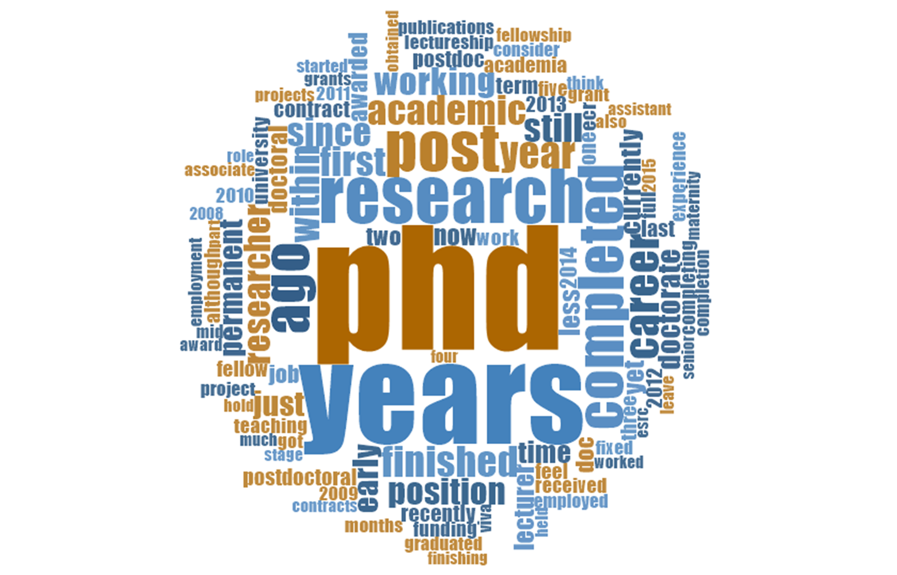
Q1 Would you describe yourself as an Early Career
Researcher? Please outline the reasons for your answer

Slide 22
Findings 1: The experiences and career trajectories of early career social scientists
Self-definitions of an ECR varied depending on:
whether survey respondents and interviewees still met the criteria for an early career researcher set by research funders
the time elapsed since the award of a doctorate
achievement of a permanent or open-ended full-time academic position which requires research, or even a minimum period of time in such a position
winning (external) research grant funding
becoming a principal investigator, especially of an externally-funded project
whether the researcher was male.
Notes:
There were varying views from interviewees on who or what constitutes an early career researcher. The definition was not necessarily time-bound. Interviewees were more likely to link being an early career researcher to their experience and confidence and the appointment to a permanent academic position than they were to the number of years since they had graduated.
All of these characteristics appeared to be helpful in building self-confidence as an autonomous and credible researcher. However, as one expert interviewee suggested, it might be a helpful clarification to identify a set of observable attributes and skills that would mark the transition from early to mid-career researcher in the social sciences. This would offer a more objective, neutral benchmark for everyone concerned and might help to address the gender imbalance. It could include generic characteristics, appropriate for a wide range of working environments outside academia, as well as those that are specific to working in higher education. Ultimately, what early career researchers wanted to know was what they have to do to take their next step, to understand the career options, both inside and outside higher education and to have a realistic view of how to achieve their goals.

Slide 23
Quote from survey respondent: 3
…it is difficult, I think it depends especially when you are going for different funding you are considered an early career researcher within so many years of your PhD, I also think that I probably consider myself early career because I haven’t yet been successful in getting funding, so there are still things that I need to work on. And so I think I am at the cusp, I will probably transit to mid-career with whatever is next, but I think that those are why I consider myself early career.
Female, 8 years since award of doctorate

Slide 24
Male, 4 years since award of doctorate
Quote from survey respondent: 4
I am just about four years since my PhD but I still do not see myself in a kind of stable, secure position. I have a permanent contract, I have had it for the last twelve months but it is only part-time and I am still looking for a full-time contract. In my job I am still on academic probation and I am applying for new positions now because I want to change my workplace because I want to change the nature of my contract. I am still in the process of learning and that is recognised in the nature of my contract…in the provision I receive from my academic mentors from my department and also the allowance in my workload and so on.

Slide 25
Specific issues for women ECRs
There are many (often complex) issues around gender:
The most obvious issue centres on having a family and balancing maternity leave and subsequent childcare
This often delays career progress and results in women considering themselves to be ‘early career’ for longer
Bullying of female early career researchers by male principal investigators
Discrimination when women take career breaks or have to juggle childcare with work
The academic culture generally not being conducive to family life – for either men or women.
Notes:
Academic culture:
This relative precariousness is compounded by the long workings hours and hyper-competitive culture that many participants found in higher education institutions, which was putting pressure on some in their early careers to take on unpaid work and remain mobile and willing to move to an institution in another part of the country.

Slide 26
  Findings 2: The type and quality of support provided for early career social scientists
Survey respondents overwhelmingly agreed that their doctoral studies proved effective training for their current employment (86%) and for their desired employment (83%).
Main sources of support:
  doctoral supervisors and colleagues
  line manager
  basic institutional provision
  access to training (77%)
  office space (77%)
  funding for conferences (72%)
  careers service (39%)
  support for funding applications (29%)
  mentor (26%)
  funding for publication fees (15%)
Notes:
Survey respondents and interviewees were asked about the support available to them during and after their doctoral study.
More female respondents (21%) than males (13%) mentioned a mentor as the most helpful/valuable type of support
Those who had been awarded their doctorate within the last three years were more likely to mention the careers service (42%, compared with 37% of those four or more years after) and a mentor (28%, compared with 23% of those four or more years after) as the most helpful/valuable type of Support
Those who had been in receipt of doctoral funding from the ESRC were more likely to mention the careers service (44%) and less likely to mention a mentor (20%) than respondents with funding from other sources (39%- 27%)
Respondents remarked on the important role played by individuals, such as their supervisor and other academic colleagues, in their preparation for employment after doctoral study. However, there were many who were critical
of the level and type of institutional support on offer. Where it was available, this tended to be for a limited duration, which might not even have included the period for ‘writing up’ a thesis. Or the support may not have been available
remotely, if the doctoral student had to move away (including back to their home). More female respondents (41%) than males (26%) reported encountering difficulties in accessing support, advice and guidance.

Slide 27
Quote from survey respondent: 5
Doctoral institution support:
I don’t really think there was any kind of institutional support. I have received ongoing support from individual people from my PhD supervisor, from some other people from the department. And some things such as looking at job applications, looking at paper drafts, but even such things as getting access to papers from the library, because I have no access to institutions. So but it was all about individuals.
Male, did not give completion date

Slide 28
Quote from survey respondent: 6
Current employer support:
I feel like I am in a professional institution that is ensuring I have the skills that it needs to know I have to do my job. And that those skills are useful to me as well as to the institution so I can put on my CV that I have got a postgraduate certificate of higher education, which is quite good really if I want to be a university lecturer and yet no-one has even mentioned that in the University [I was at before] so it is a different environment and it is a supportive one…
Female, 6 years since award of doctorate

Slide 29
  Findings 2: The type and quality of support provided for early career social scientists
Biggest barrier to achieving chosen career:
accessing funding/jobs (34%)
the requirement for high-quality publications (15%)
lack of time (15%)
short-term contracts (14%)
family responsibilities (e.g. need to re-locate) (10%)
issues relating to their (female) gender (6%) e.g. having children
demands of teaching (6%)
Notes:
Biggest barrier to achieving chosen career
There were 741 responses (71%) to the open-text question on the biggest barrier to survey respondents achieving their chosen career.
Problems highlighted included: accessing funding/jobs (34%) with a third of those making explicit reference to competition; the requirement for high-quality publications (15%); lack of time (15%); demands of teaching (6%). The problem of short-term contracts was mentioned by 14% and 10% referred to problems relating to family responsibilities (e.g. need to re-locate). In addition, 6% highlighted issues relating to their (female) gender, e.g. having children being seen as a barrier, which was mentioned too in interviews.

Slide 30
  Findings 3: Funding opportunities and their impact
25% of the survey respondents reported not having submitted any applications for postdoctoral funding
42% of all respondents reported having at least one application for funding for postdoctoral work funded
Barriers to applying for funding:
the length and complexity of the application process
the low chances of success
the requirement to be on an open-ended contract before being allowed to submit research grant proposals (‘Catch 22’)
Notes:
One-quarter (25%) of the survey respondents reported not having submitted any applications for postdoctoral funding, and 42% of all respondents reported having at least one application for funding for postdoctoral work funded.
However, this could have included small amounts of institutional funding, for example, for conferences and open access publications.
Over half the respondents (in their open text responses) and many interviewees felt there were barriers to applying for funding, either at the national level, in the rules and criteria of funding organisations, or at the
institutional level, in the lack of advice and support and as a result of institutional efforts to limit the number of unsuccessful applications for external funding.

Slide 31
Quote from survey respondent: 7
I asked for feedback in my current post when they hired me because I wanted to know why I hadn’t got the permanent job that they were hiring for and one of the things they said was that I wasn’t in a full-time academic post when I applied. That was why I was applying for the job! So it was a weird Catch-22. It is hard to pursue funding unless you are in a permanent role… if you are in a temporary job the funding application process is slow enough that everything may change by the time you actually got the application through.
Female, 3 years since award of doctorate

Slide 32
Quote from survey respondent: 8
Lack of institutional support:
I am still feeling my way through and rather blindly and you know funding bids and how you put them together and the mysteries of all those things that we are expected to do… how to write a funding bid or the mechanics of it rather than the wording of it. What do you do with it, who does it go to, who has to approve it, who signs it off on it, all those kind of things which I guess varies from one institution to another… I probably should know the answer… but I don’t. I don’t know where to look.
Male, 7 years since award of doctorate

Slide 33
  Findings 4: Survey respondents’ and interviewees’ suggestions for improvement
Making doctoral studies a more effective preparation for employment:
Some experience of teaching (24%): opportunities for teaching, obtaining training and/or a suitable qualification
Publication/publishing (21%)
Training in grant writing, grant application and grant management (17%)
Greater networking opportunities (9%)
Acquiring administrative skills or experience (6%)
Information about non-academic options (3%)

Slide 34
Training during doctoral study that respondents would recommend to someone else
Notes:
Training during doctoral study that respondents would recommend to someone else on a similar doctoral path (percentage responding – respondents could select more than one)

Slide 35
  Findings 4: Survey respondents’ and interviewees’ suggestions for improvement
Support for those working outside HE:
more training in skills and competencies – generic and discipline specific
  much earlier
  integrated, not bolted-on
continue affiliation to their doctoral institution
  an institutional email account
  access to library services
greater clarity and honesty about the reality of career options both inside and outside of academia, along with the relevant support and training to help them decide on, and achieve, their chosen career path.

Slide 36
Quote from survey respondent: 9
I think it is more just to open your eyes to the range of things which a PhD can do for you, you know there are a lot of options and a lot more people have PhDs than are in academia and they are doing a whole range of things. I know of some industries particularly who want people who have got PhDs in certain subjects so knowing that those are available and yes just as credible as a career option as going into academia.
Female, awarded doctorate that year

Slide 37

Implications:
actual and potential

Slide 38
Implications
We should avoid thinking of early career researchers as a homogenous group pursuing a traditional linear career path
There is a need to develop a more realistic understanding and accurate portrayal of the difficulties of forging an academic career
There is a need for broader definitions of ‘early career researcher’ that are partly based on the competence and expertise of the researcher.
Notes:
Given the findings from this study, we should avoid thinking of early career researchers as a homogenous group pursuing a traditional linear path from undergraduate and masters study through postgraduate research, a post-doctoral position and into full-time permanent employment as a lecturer in higher education. Indeed, the inability to follow a linear path into academia seemed to be the source of considerable disappointment and frustration among participants.
Moreover, the findings from this study suggest the need for broader definitions of ‘early career researcher’ that are not solely based on the time elapsed since the award of a doctorate, but also on the competence and expertise of the researcher.

Slide 39
Redefining ‘early career researcher’
Two main criteria:
The achievement of a permanent full-time academic position: necessary but not sufficient
Successful experience as a principal investigator of an externally-funded research project.
These seemed to mark the transition from ‘early’ to ‘mid’-career as a researcher.
Notes:
The achievement of a permanent academic position was mentioned by respondents but, as this could increasingly be in a teaching-focused role, even this is not sufficient as a marker in a research career. It would seem that successful experience as a principal investigator of an externally- (i.e. not university-) funded research project could be the significant factor that marks the transition from ‘early’ to ‘mid’-career as a researcher (although, perhaps not yet ‘senior’). A previous study of early career researchers in the arts and humanities similarly argued for a broader definition of 'early career researcher' (Renfrew & Green, 2014).

Slide 40
ESRC policy changes
ESRC measures to recognise three distinct ECR stages (2016):
Doctoral
Immediately postdoctorate
Transition to independent researcher
Introduction of ESRC New Investigator strand of its Research Grants scheme.
Notes:
Partly as a result of this study, the ESRC has introduced a number of measures to recognise what it determined were three distinct ECR stages:
Doctoral
Immediately postdoctorate
Transition to independent researcher
In particular, the ESRC introduced a New Investigator strand of its Research Grants scheme specifically aimed at supporting those looking to make the transition to an independent researcher through managing their first major research project.

Slide 41
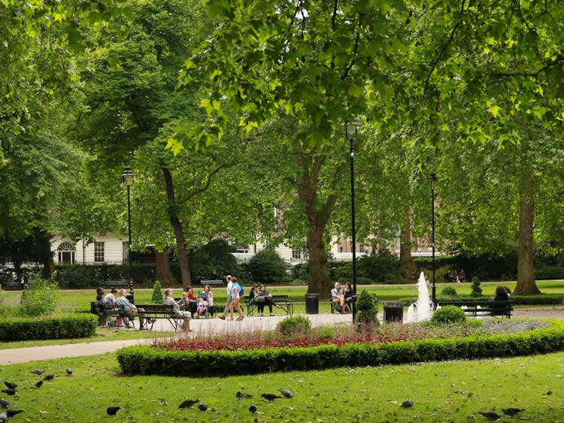
Conclusions and recommendations

Slide 42
Conclusions
Those seeking to enter academia will need to be more pro-active and strategic in pursuit of a permanent full-time position
There appears to be a continuing gender imbalance among early career researchers in the social sciences in academia that favours men
Due to the precariousness of ECRs, an increasing number of doctoral graduates and postdoctoral researchers are falling by the wayside and eventually, reluctantly, abandoning academia, rather than initially and deliberately choosing a career outside HE
The assumption that a career outside academia is a failure should be challenged
Once outside of academia, there are real difficulties in re-entering the profession
It is time to reconsider the traditional research doctorate as sufficient preparation for an academic career, let alone a career outside higher education.
Notes:
There was a strong perception among survey respondents and interviewees that the period of ‘apprenticeship’ is lengthening, and this seemed to be having an impact on early career social scientists’ personal lives, delaying decisions to settle in one place, buy a home, marry and start a family, for example. Some felt trapped in a ‘Catch-22’ situation, in which they could not apply for funding without a permanent post in a university, but were unlikely to be recruited to such a post without a track record of attracting research grants. Others had taken the decision to leave academia and work in other employment sectors – the public or voluntary sector, for example – whether deliberately, or because they could not find secure positions in higher education. Those who wished to re-enter academia at some point in the future were having to find ways of maintaining academic contacts, continue writing and publishing, and search for research funding.

Slide 43
Conclusions
If academic life is to be an attractive future career choice for clever and dedicated people, then it is necessary to be able to show them a realistic description of what becoming an academic means, coupled with a career structure that meets the reality and expectations of an increasingly diversifying workforce.
(Coates and Goedegebuure, 2010: 2)

Slide 44
(Selected) Recommendations
As part of their Researcher Development Framework, Vitae to identify a set of observable attributes and skills that would mark the transition from early to mid-career researcher in the social sciences
For HEIs as employers of doctoral graduates:
For HEIs to monitor the outcomes of internal decision-making about research funding by gender, ethnicity and age and, where skewed, to take action
To provide a structured career development programme, regular appraisals and support for objective setting to be available to all early career academics
To ensure that opportunities for continuing professional development should be made more available to those researchers employed on part-time and fixed-term academic contracts, and to recognise that not all early career researchers are currently in research roles.
Notes:
As part of their Researcher Development Framework, Vitae to identify a set of observable attributes and skills that would mark the transition from early to mid-career researcher in the social sciences (and, potentially, other disciplinary areas).
To monitor the outcomes of internal decision-making about research funding by gender, ethnicity and age (for example, for small grants, internal-demand management, etc) and, where skewed, to take action, e.g. actively encouraging women and BME staff to apply, and enabling leading female and BME academics to provide guidance, etc.
To provide a structured career development programme, regular appraisals and support for objective setting to be available to all early career academics. Where funding for a post is from a Research Council, details of the planned provisional continuing professional development to be included in the application, updated once an individual is appointed and subject to monitoring at completion of the award period.
To ensure that opportunities for continuing professional development should be made more available to those researchers employed on part-time and fixed-term academic contracts, and to recognise that not all early career researchers are currently in research roles.

Slide 45
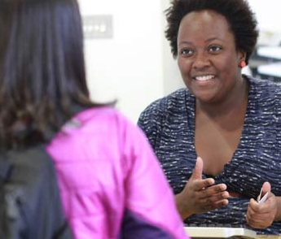
Thanks for listening
Q&As,
discussion

Slide 46
References
Coates, H. and Goedegebuure, L. (2010) The Real Academic Revolution: Why we need to reconceptualise Australia’s future academic workforce, and eight possible strategies for how to go about this, Melbourne: LH Martin Institute: https://melbourne-cshe.unimelb.edu.au/__data/assets/pdf_file/0007/2565070/Why-we-need-to-reconceptualise-Australias-future-academic-workforce.pdf
Locke, W., Freeman, R. and Rose, A. (2018) Early career social science researchers: experiences and support needs, Special Report, London: Centre for Global Higher Education: http://www.researchcghe.org/publications/early-career-social-science-researchers-experiences-and-support-needs/
Locke, W., Freeman, R. and Rose, A. (2016) Early career social science researchers: experiences and support needs, Swindon: Economic and Social Research Council: http://www.esrc.ac.uk/skills-and-careers/postgraduate-careers/early-career-researchers/

