Slide 1
seminar
Centre for Global Higher Education
University College london
May 22, 2018
Is There an International Crisis in the Humanities?
Dennis A. Ahlburg
Distinguished Professor of Economics
Trinity University
San Antonio, TX
And
Visiting Fellow
Oxford Centre for Higher Education Policy Studies
New College, University of Oxford

Slide 2
There is a Crisis.
“The humanities and the arts are being cut away …. in virtually every nation of the world.”
Martha Nussbaum, University of Chicago
“The humanities do perceive themselves to be embattled and are on the defensive throughout and beyond the English- speaking world.”
David Armitage, Harvard University
“There are indicators of clear and present danger to the humanities.”
Rob Paige, Arizona State University
“If nothing is done to put an end to this process of disintegration, the numbers [of humanities students] will continue in a steady downward spiral.”
William Chace, Emory University.

Slide 3
There is not a Crisis.
“The evidence of a crisis [in the humanities] is lacking.”
Michael Meranze, UCLA
“Anyone following the humanities death watch for the last 60 years would be struck both by its recurring character and its disconnect from objective fact.”
Blaine Greteman, University of Iowa
“[There is] no steady downward spiral [in the humanities].”
Michael Berube, Penn State University
“The humanities survived the run down [in government funding] surprisingly well in terms of market share.”
Peter Mandler, Cambridge University

Slide 4
So is there a crisis in the humanities?
Australia - Glenn Withers, ANU
Brazil - Filipe Campello, Federal University of Pernambuco (Reclife, Brazil) and Mariana Brandini Assis,
New York School for Social Research, New York
Egypt - Ragui Assaad, University of Minnesota, and Dina Abdalla, American University in Cairo
France - Michel Wieviorka, École des Hautes Études en Sciences Sociales
Germany - Sibylle Baumbach, University of Innsbruck
Japan - Earl Kinmonth, Taisho University
Mexico - Roberto Brena, El Colegio de México
Palestine and Israel - Russell Berman, Stanford University
South Africa - Keith Breckenridge, University of the Witwatersrand
U.K. - Harry Brighouse and David Arbelaez, University of Wisconsin
U.S. - Dennis A. Ahlburg, Trinity University and Evan Roberts, University of Minnesota

Slide 5
The Questions:
What are the humanities?
Is there a crisis?
If so, what form does it take (enrolment?, funding?, reputation?).
What are the causes?
What are the implications?
Avoid “being cast adrift on an ocean of anecdote masquerading as generalization or of ideology purporting to be fact.” Francis Oakley

Slide 6
Why is it important to define the humanities?
Mandler
- The “humanities have held up well”
- But languages, literature, history, philosophy, and religion have not.
- Creative arts and design, communications, and education have.
So what are the humanities? How are they defined?

Slide 7
Different ways to define the humanities:
Stefan Collini
Humanities is not a “timeless category.”
Brighouse and Arbelaez:
Stipulative - designated by universities
Principled – by subject matter and method of investigation
Historical – what have been called humanities over time

Slide 8
So what are they?
Core Humanities: languages and literatures, history, classical studies, philosophy
Broader Humanities: religion, ethnic/gender/cultural studies, area studies,
archeology, jurisprudence, selected arts, interdisciplinary studies
What about:
* creative arts and design, communications, education (Australia)
* fashion and design, audiovisual and media studies (Brazil)
* social sciences (France)
* empirical aesthetics, digital humanities (Germany)
* behavioral sciences (Mexico, Palestine)
* psychology, public administration, management (South Africa)

Slide 9
What is a crisis?
A departure from the norm and the departure is bad for somebody - students, faculty, society
Brighouse and Arbelaez
“A major and sustained decline in respect and commitment to humanities.”
Withers

Slide 10
Is a crisis measured by falling absolute numbers or a falling share?
A falling market share does not “spell the end of civilization as we know it.”
Stefan Collini
Or does it?

Slide 11
Quantitative Indications of Crisis
 | Crisis | Student Numbers | Market Share | Student/Staff Ratio | Student Quality
Australia | No | ↑ | ↓
Brazil |  | ↑ | ↑ |  | ↓
Egypt |  | ↑ |  | ↑ | ↓
France | Yes | flat | ↓
Germany | No | ↑ | ↓ | ↑
Japan | No | flat |  |  | ↓
Mexico |  | ↑ |  |  | ↓
Palestine | No | ↑ | ↓ | ↑
Israel | No | ↑ | ↓ | ↑
South Africa | Yes | ↓ | ↓
UK | No | ↑ | ↓ | ↑
US | Maybe | ↓ | ↓

Slide 12
Other indicators of crisis
Percentage of faculty full-time ↓ US, UK, Palestine
Prospects for doctoral students ↓ Israel, Germany, US
Legitimacy
Brazil, France, Germany, Mexico, South Africa

Slide 13
A Closer Look at the U.S.
Ahlburg and Roberts
Crisis
Harvard University
  “[Challenges facing he Humanities] provoking alarm in the profession nationally.”
  Humanities majors declined from 30% to 20% over last 60 years but 60% of the decline 2003-2012
  “The real story of humanities enrolments is persistence” over the last 20 years.
  Scott Saul, NYT
  “Since the 1980s enrolments have been fundamentally stable.”
Michael Meranze, UCLA
  “The proportion of men studying the humanities has barely changed since 1950.
David Armitage, Harvard
  “The puzzle is not how men’s behavior has changed but how women’s behavior has changed.”
Ben Schmidt, Northeaster University
No Crisis

Slide 14
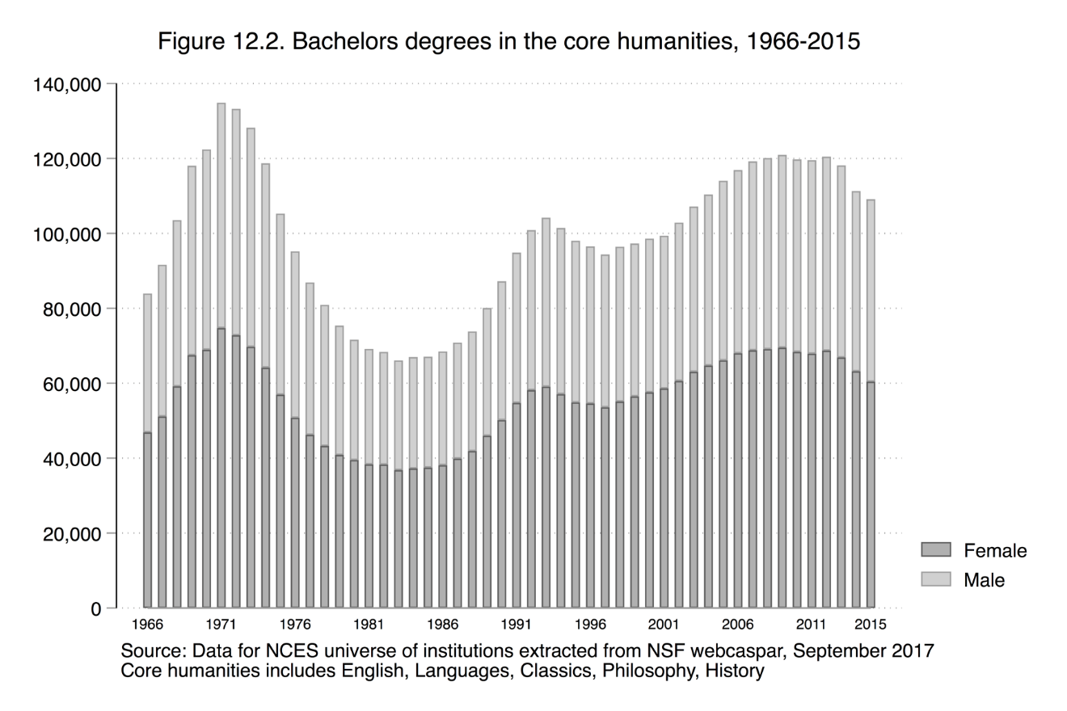

Slide 15
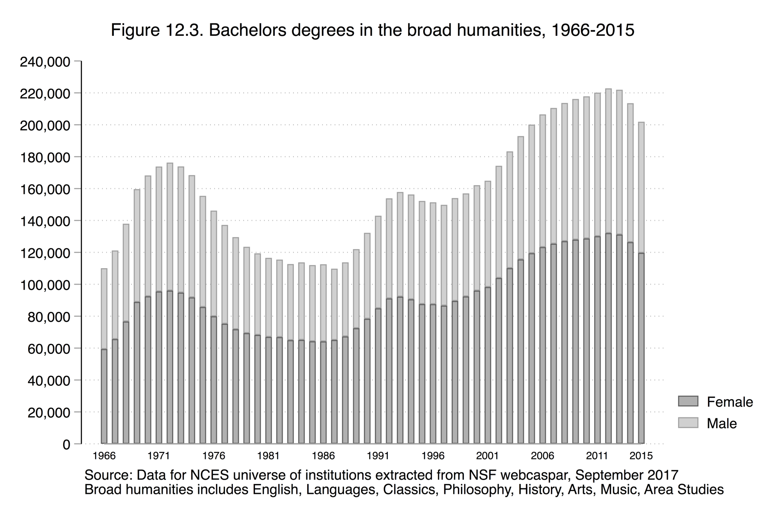

Slide 16
Stability? Growth?
Significant fluctuation in numbers
(rejects Mandler, Saul, Meranze)
Clear ‘crisis’ in 1970s and 1980s
Decline 2009-2015 (core)
2012-2015 (broad)
Similar pattern for men and women
(rejects Schmidt)
Pattern same if add “Arts”
1% point decline = 20,000 majors = 600 faculty

Slide 17
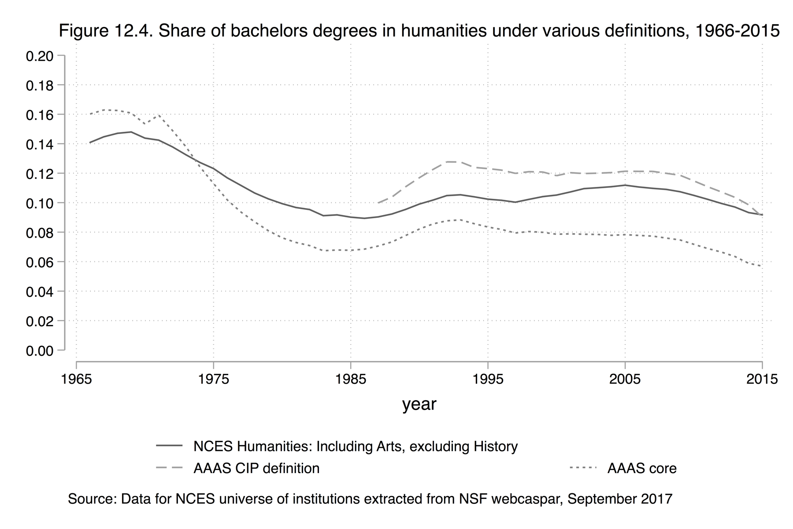
Market Share

Slide 18
Market Share Decline
Core share declined 69% over last 50 years
Broad definition share constant 1980-2005 then declined
Crisis if reference point is 1970 otherwise perhaps not

Slide 19
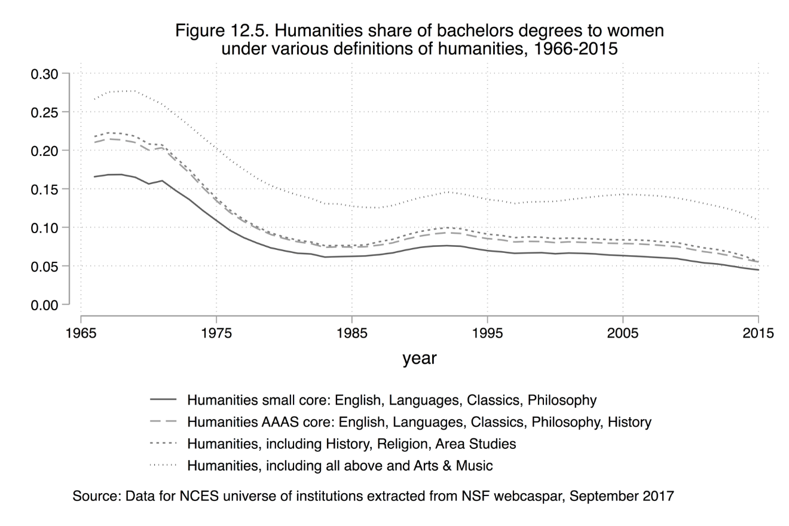
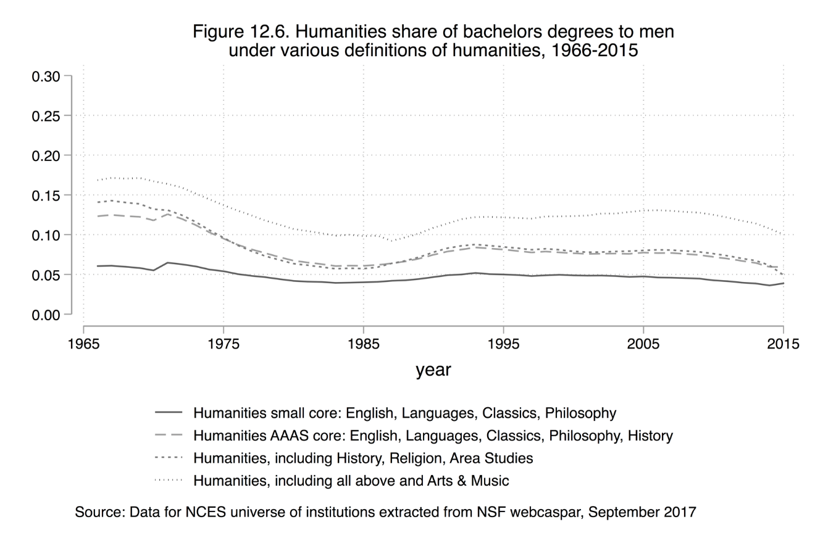
Are Women to ‘blame’ for the decline in the humanities?

Slide 20
Women unjustly accused.
  The pattern for men and women is similar and the male share has
  not stayed constant since 1950 – in fact it declined 1980s to
  2014.

Slide 21
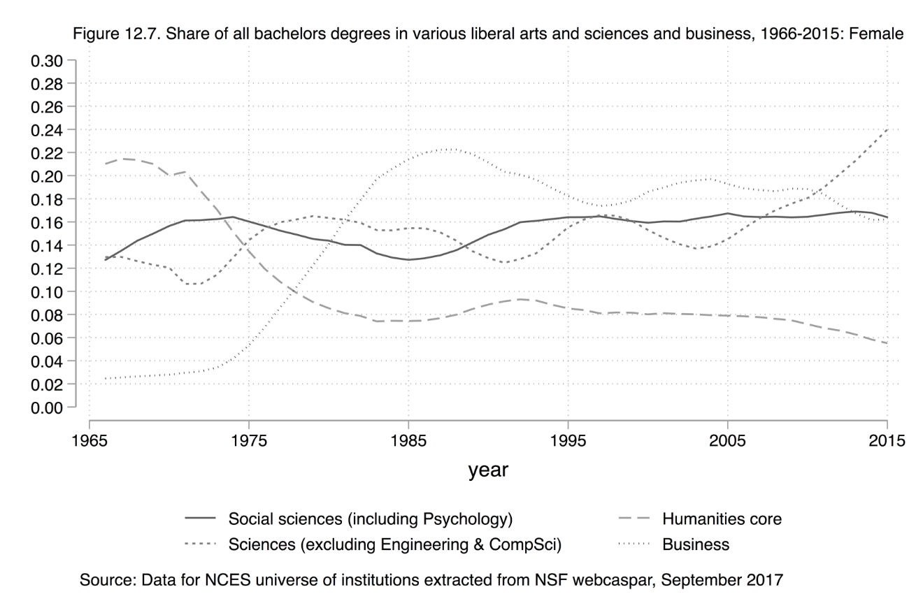
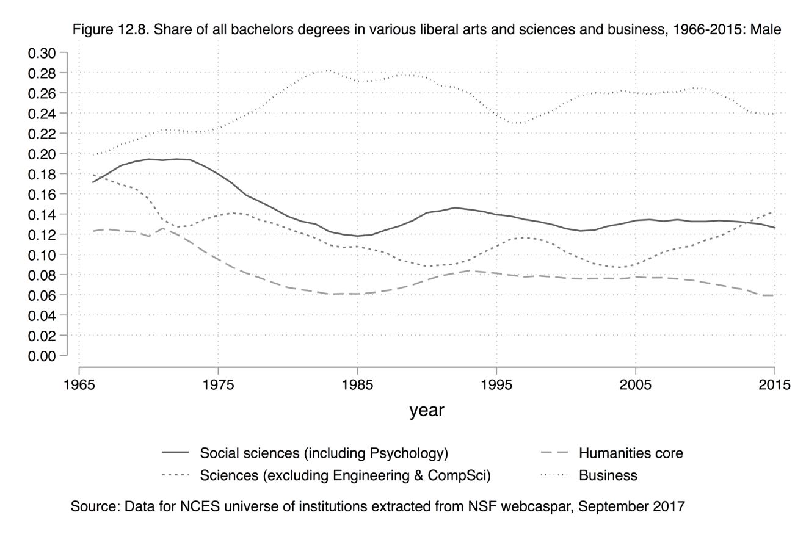
Where did the humanities students go?

Slide 22
There is a simple “two cultures” explanation (the second culture is business) until 1990.
But not post-1990.

Slide 23
What Explains the Fate of the Humanities?
We dismiss
  Demographic change (disadvantaged students) does not
  correspond to ↓ humanities.
  Culture wars - but they happened after the decline of the 1970s and during the increase in 1980s and 1990s.
  The Economy
    Large increases in unemployment associated with very small ↓ humanities
    No impact of stock market crashes
    No impact of Wall Street scandals.

Slide 24
Fluctuations in the humanities are related to:
The pill
Changing preferences of students
Relative earnings

Slide 25
Uptake of pill (and delayed marriage and childbirth) coincides with ↓ humanities (1970-1985 and 2000-2015

Slide 26
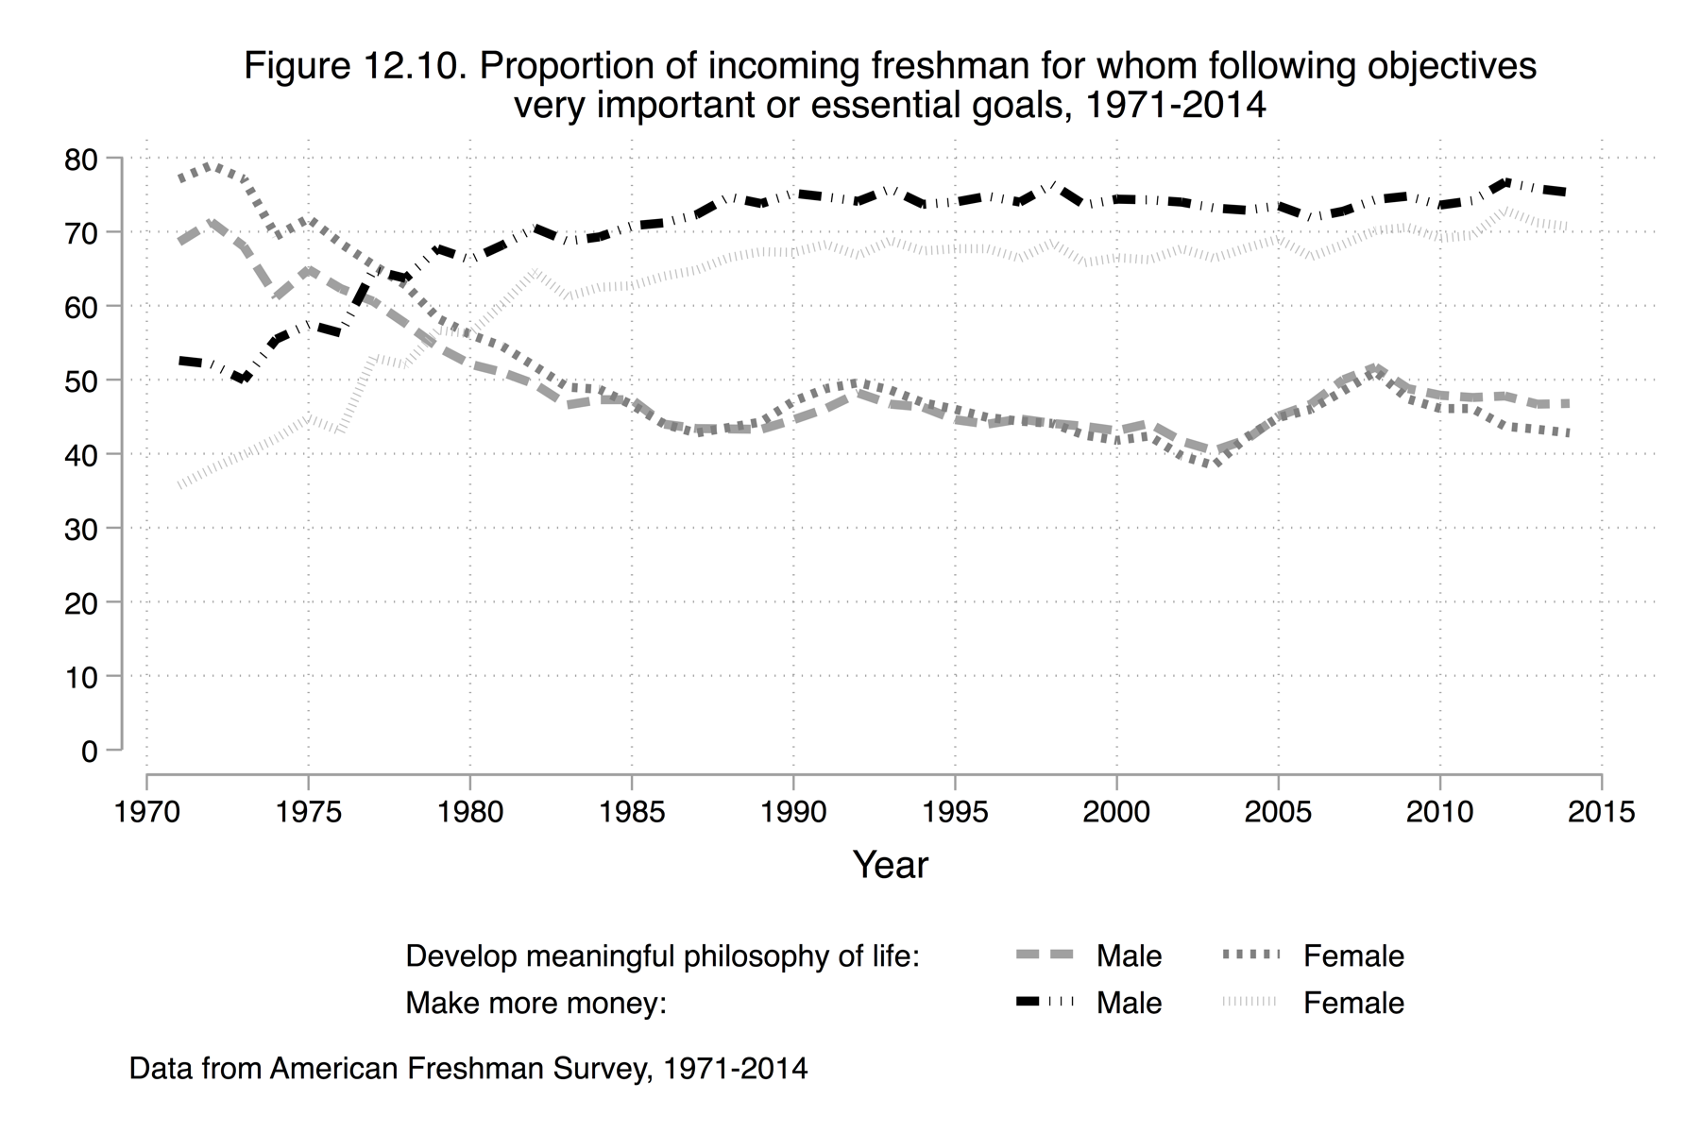
Preferences

Slide 27
Preferences
Rise of importance of making money and decline of developing a meaningful philosophy of life tracks decline of humanities 1970s and 1980s.
Post 1990 the fate of the humanities tracks more closely the importance of a meaningful philosophy of life.

Slide 28
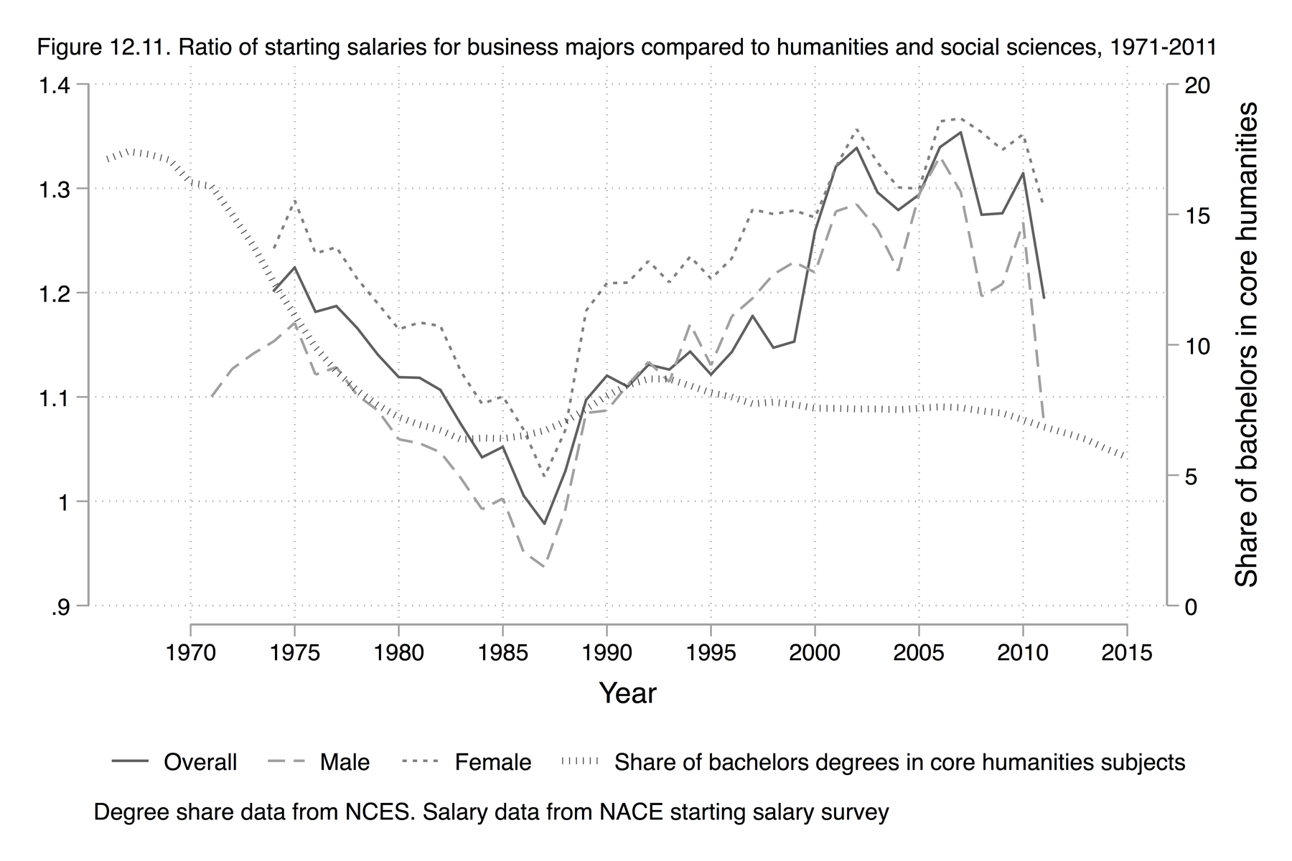
It’s the Money

Slide 29
It is clear students are influenced by starting salaries as relative earnings, and humanities shares move inversely – early 1970s and post 1990.

Slide 30
A Closer Look at the UK
Brighouse and Arbelaez
Crisis
“Currently fixed in the crosshairs are the disciplines of the humanities.”
Alex Preston, the Guardian
“A key feature of the restructuring process has been the increasingly attenuated position of the humanities.”
Collen Lye and James Vernon
No Crisis
“There is no period to which one can point and say ‘there is a crisis of the humanities.’ To the contrary, the absolute number of graduates has grown and grown.”
Pete Mandler

Slide 31
The humanities are: Comparative Literary Studies and English Studies and Historical and Philosophical Studies

Slide 32
Enrolments rose 1994/5 – 2011/12 then slight decline
Increase driven by domestic students
Adding languages does not alter the story

Slide 33
Humanities Share

Slide 34
Share ↓ from 8% to 7% (2,000 students)
Decline greater of languages included

Slide 35
Is there a crisis of funding?
Expenditure

Slide 36
The Pounds:
Real expenditure on the humanities increased by $200 million 2002/3 – 2009/10
Humanities share of university spending fell

Slide 37
Staffing

Slide 38
The People
Full-time staff increased slightly and much less than other areas.
Considerable growth in part-time
Student/staff ratio increased

Slide 39
Conclusion: UK
Claims of crisis seem alarmist
Enrolment has increased
Resources have not declined
However, share of students and staff have declined
There could be a future crisis if:
  the fall-off in enrolment continues
  if quality of instruction declines
  If quality of research declines
  If society’s support for the humanities declines
  If students become more sensitive to earnings differentials

Slide 40
Do the humanities contribute to society?
Yes.
  Emphasize what gives meaning to life
  Teach how to deal with complex, non-routine problems
  Impart skills to interpret and communicate complex ideas
  Impart skills to evaluate information, ask difficult questions, and place in historical and cultural context
  Brighouse and Abelaez
  Economic argument
    Humanities impart “efficiency-enhancing” skills which are increasingly important
    “soft-skills”
  “Society needs new narratives, revive family life, restore community bonds and shared moral culture.” David Brooks
  Humanities has a comparative advantage in these areas.

Slide 41
Is arguing in favour of the humanities a “sell-out?”
Stefan Collini warns against “internalizing the language of contribution to economic growth as the defining purpose [of the humanities].”
The humanities are not “gadget-ready panacea for machinations of society, politics, and culture.”
Soni and Callebert

Slide 42
My position:
Parents, students, administrators, and politicians use the language of economic value.
A refusal to do so is equivalent to admitting the humanities do not contribute to the economy.
One can place a “lower-bound” estimate on the value of the humanities.
“To take advantage of the vocational potential of the humanities is not to sell out to the corporate world, but to bring the critical perspective of the humanities into that world.”
Paul Jay

Slide 43
A few concluding thoughts
Should the definition of the humanities be broadened to include “useless degrees that won’t get you a job?”
Berube
Will this lead to a crisis within the humanities?
Should the humanities be defended using an economic argument?
Are the economic returns to a degree in the humanities underestimated?
  Rise of the “soft-skills” post 2000
  Importance of graduate school

Slide 44
Conclusion
There is no world-wide crisis in the humanities.
However, the humanities do not have a “shining future” in many countries.

