Slide 1
For-profit Higher Education in the US
Stephen Hunt: Centre for Global Higher Education
UCL Institute of Education 01/03/2017
“Higher education: changing global relations”
CGHE 2017 conference

Slide 2
The US higher education system has four principle types of institution:
Public four-year colleges: each state supports at least one such system – these include substantial research universities
Public two-year colleges, commonly called ‘community colleges’
Private non-profit institutions: these include the Ivy League colleges, doctoral universities, and the exclusively undergraduate liberal arts college sector
For-profit private sector (OECD, 2012)

Slide 3
Rationale for Private for-profit higher education
Mitt Romney praised for-profit colleges: “hold down the cost of education.”
The profit motive: rewards those who go after inefficiencies: the same quality for a much cheaper price.
There is also the long term – since the early 1980s - reduction in funding for US public institutions

Slide 4
U.S. For-profit sector: character
Most institutions are small proprietary schools, often privately owned.
Fifteen large-scale - multi-state - institutions account for 60 per cent of all student enrolments in the for-profit sector (Bennett et al., 2010).
Students number in them are in the tens or hundreds of thousands, and publically traded (Bok, 2013).
The large institutions are often subsidiaries of still larger parent companies, and have attracted Wall Street/venture capital investment (Douglass, 2012; Lechuga, 2010).

Slide 5
U.S. For-profit sector: character
For profits will tend to occupy the same academic space
The for-profits concentrate almost exclusively on teaching
Strip out any ‘non-essential’ aspects of provision.
Market sensitivity
business studies
IT
health related courses (Bok, 2013)
Flexibility
(Deming, Goldin, and Katz, 2012).

Slide 6
U.S. For-profit sector: composition
The for-profits opening up new markets to higher education.
The sector has specifically positioned itself to attract a type of student.
Older, employed, studying for specific skills to get better paid employment
Less socially and financially advantaged
More frequently from minority groups
(Surowiecki, 2015).

Slide 7
U.S. For-profit sector: history
The for-profit sector played little or no part in the twentieth century massification of American higher education.
“In the early 1970s for-profits enrolled just 0.2 percent of all degree-seeking students in the United States” (Hanford, 2016).
It has, until relatively recently, been the fastest growing element in the entire higher education sector (Bok, 2013).

Slide 8
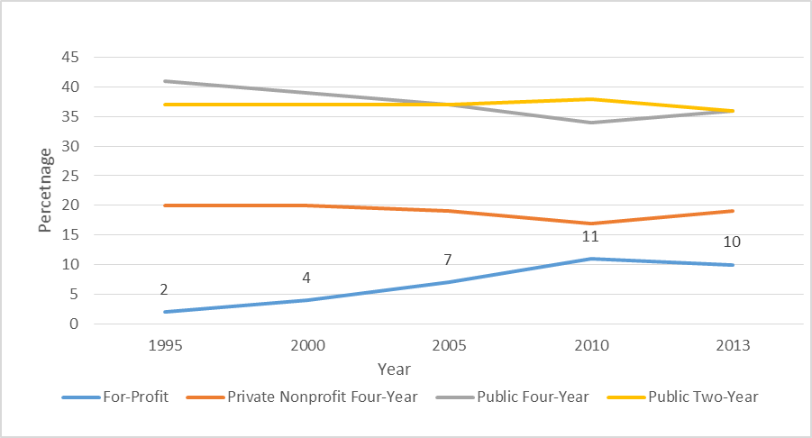
Percentage of US student population by type of provider 1995 - 2013 (source: The College Board, 2015)
There were an estimated 3,436 for-profit higher education institutions in 2014-15.

Slide 9
Distribution of federal student loan funds by sector, 2004-05 to 2013-14, selected years (Source: The College Board, 2015)
2010-11students at for-profit institutions received 25 per cent of federal loans, and 25 per cent of Pell Grants, but only accounted for 11 per cent of enrolments.

Slide 12
The effect of the profit motive…

Slide 13
U.S. For-profit sector: issues
Problems facing for-profits
Significant sections have been accused of:
• Recruitment abuses: The use of exaggerated and misleading claims, in advertising and marketing, designed to increase enrolment
• Low graduation rates: 2002 cohort: 22 per cent graduation rate
Greater student debt: $39,950 in 2012: $14,000 more than public colleges
High student loan default rates: about half of all loan defaults
• Courses identified as fraudulent, i.e. delivering little if any quality teaching. Harking report: 18 per cent of revenues on teaching

Slide 15
Course sales techniques
“Don’t ask people what they THINK about something you’ve said.
Instead, always ask them how they FEEL about it. People buy emotionally and justify it logically.”

Slide 18
Department of Education released data in November 2016
Mean earnings of graduates of public undergraduate career training certificate programs are nearly $9,000 higher than mean earnings of graduates of for-profit undergraduate certificate programs
Nearly a third of for-profit certificate students graduated from programs where the typical graduate earned less than what a full-time minimum wage worker earns in a year, compared with only 14 percent in the public sector.
https://studentaid.ed.gov/sa/about/data-center/school/ge?src=press-release
Many graduates at for profits leave with lower earnings than they had when they started: for-profits substantially underperform other colleges, even accounting for their more disadvantaged student body.

Slide 19
The National Consumer Law Center – an independent consumer justice organisation

Slide 20
Student Debt
Total US student loan debt reached $1.3 trillion in 2015:
This figure has more than doubled over the last 10 years (The Federal Reserve, 2016).
In 2015 40 million individuals now have outstanding student loans;
In 2008 the figure stood at 29 million (Lewin, 2016).

Slide 21
Response
Obama, 2015: Gainful Employment Regulation requires vocational courses to meet minimum thresholds with respect to the debt-to-income rates of their graduates. Programs that fail to meet these minimum requirements could lose access to all federal financial aid for a period, putting them at a higher risk of closing.
2016 change: In order for students to qualify for federal student aid, institutions must prepare them for "gainful employment in a recognized occupation.“
For a course to fail it’s graduates must have annual loan payments in excess of 12 percent of their total earnings or 30 percent of their discretionary income. Programs that are rated failing in two of three consecutive years are ineligible to receive Title IV student-aid funds.

Slide 22
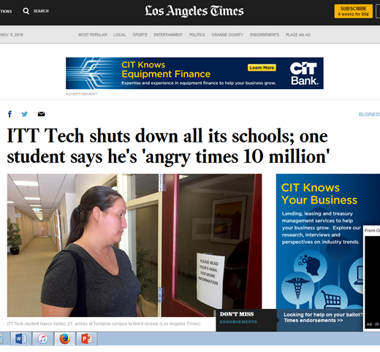
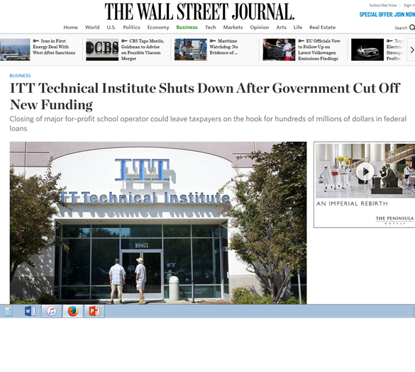
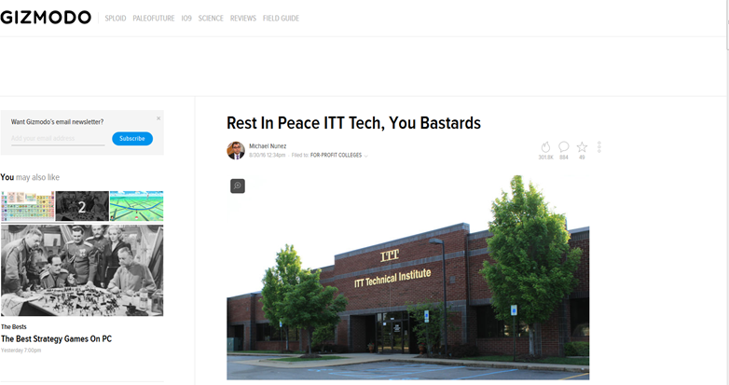
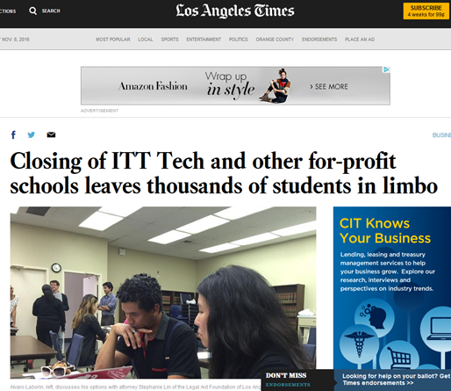
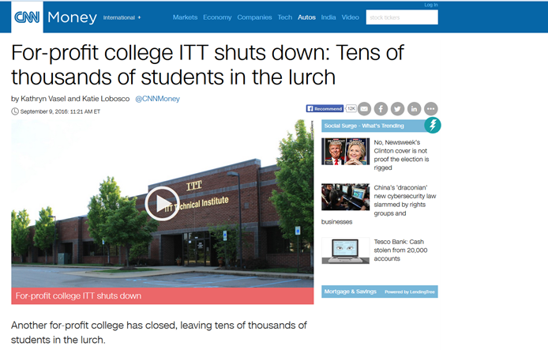
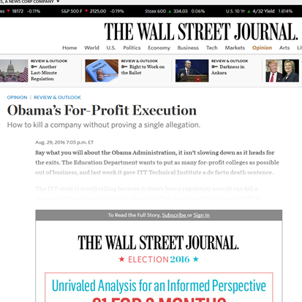

Slide 23
Gainful Employment Regulation Effect:
25th August 2016: ITT Tech: barred from recruiting federal loan students. Required to put up $152 million indemnity
ITT ceased to operate on the 5th September, with up to 40,000 students consigned to limbo, and the tax-payer liable for about $500 million in loans.
ITT’s swift demise indicates a broad feature shared by much of the for-profit sector: its total reliance on federally funded tuition fee loans as an income source.
November 2016: DeVry University, online & locations nationwide, agreed to a $100 million settlement of a federal lawsuit alleging that it falsely advertised the success of its graduates

Slide 24
Gainful Employment Regulation Effect:
January 2017 Report covered 29,000 programs at public non-profit, for-profit institutions.
66 percent of the programs were at for-profit institutions
98 percent of the 800 programs that failed were at for-profit colleges
Those failing programs collectively produced some 116,000 graduates in the years measured, 2010-12;
No course at Community Colleges failed.

Slide 25
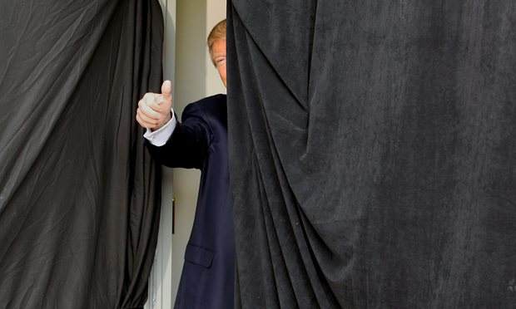

Slide 26
President Trump
The fate of the for-profit sector is like much else now uncertain.
His secretary of State for Education Betsy DeVos has said little about higher education.
The general expectation is Trump will be better disposed towards the for-profit sector than Obama.
He opposes the planned expansion of the public two-year degree Community College sector, which Obama had ambitions to make free for secondary education graduates. Presumably, if demand is to be met now it will be by the private sector.
Student loans should be relocated to the private or non-federal government sector
Trump University likely to return!

