Slide 1
Students, migrants, or student-migrants?
A longitudinal study of international students’ migrant identity throughout migration transitions in the UK and Japan
Thomas Brotherhood - PhD Research Project
CGHE Seminar Series #61
12th October 2017

Slide 2
Order of the presentation
International students’ role in internationalisation and massification
Growing attention and muddled thinking around the migration of international students
Destructive interference between education, economic, and migration policy
A research agenda
Potential for biographical methods in research with student-migrants.

Slide 3
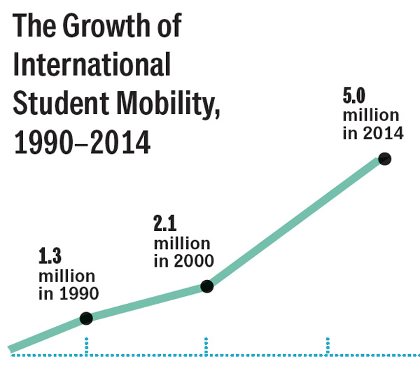
International students – quantitative growth
ICEF, 2015; UIS 2016; UNESCO, 2017

Slide 4
International students – quantitative significance
Country | Bachelor’s (%) | Master’s (%) | Doctorate (%) | Total tertiary education (%)
New Zealand | 16 | 24 | 46 | 21
United Kingdom | 14 | 37 | 43 | 18
Switzerland | 10 | 28 | 54 | 17
Australia | 13 | 43 | 34 | 15
International students as share of tertiary enrolment (OECD, 2017)

Slide 5
International students – qualitative significance
Educational resources
Internationalisation at home
Globalizing home students
International learning environment
De facto ambassadors
Passive affinity for host country transmitted back to home
An effective public diplomacy strategy

Slide 6
Are internationally students “structurally embedded” in the UK and Japan?
The UK and the “silver bullet” narrative (Blair, 1999) | Japan’s waves of internationalisation
Source of financing for higher education (Chankseliani, 2017) | Fundamental to Japan’s public diplomacy efforts in education aid (Kamibeppu, 2016)
Contribute broadly to the UK economy (Universities UK, 2017) | The Nakasone Plan – “Project on welcoming 100,000 students from overseas” (Goodman, 2007)
Supplement the skilled labour pool in key fields. (Findlay, 2001) | Excellence initiatives and “global human resources” (Yonezawa & Yonezawa, 2016)
Lomer, 2017; Geddie, 2015; Kawamura, 2016; Ninomiya, Knight, & Watanabe, 2011

Slide 7
International students in multiple policy fields
International Students
Education Policy
Economic Policy

Slide 8
International students in multiple policy fields (Cont’d)
International Students
Education Policy
Economic Policy
Migration Policy

Slide 9
Migration as a “Trump Card”
International Students
Education Policy
Economic Policy
Migration Policy

Slide 10
Relative power of various concerned ministries lies with those that govern migration
UK | Japan
Home Office / UK Visas and Immigration; the Treasury; Department for Trade and Industrial Strategy; Department for Education etc. | 17 government departments have a role in managing education-migration. Most important being MOJ, MEXT, METI, MOFA.
Treasury and BIS had dominated under New Labour | Ministry of Justice has ultimate authority.
Home Office and UKBA/UKVI have dominated in the Coalition / Conservative era. | A “conservative bastion”

Slide 11
International students in British migration policy
Permanent migrant: “A person who moves to a country other than that of his or her usual residence for a period of at least a year” (UNSD, 2017)
Adopted by the Office for National Statistics “in line with international best practice” (ONS, 2016)
“A discursive barrier to their recruitment in policy” (Lomer, 2017, p. 218)
Criticism
Vast majority of international students do not aspire to permanent migration.
There is no reason that different methods of defining student-migrants cannot be used for external data reporting and internal policy discussion

Slide 12
International students in British migration policy (Cont’d)
Narrative of “public concern”
National security concerns – Prevent
“Bogus” students
Negative social impact
Net-migration targets
“…to reduce net migration to the tens of thousands…”
International students a “soft target” for reducing net-migration
Also a bad target

Slide 13
International students in Japanese migration policy
Pillars of migration policy (Tsuda & Cornelius, 2004)
No unskilled migrants will be admitted
The government will only facilitate highly skilled and professional workers in entering the country
All foreign workers must be admitted on a temporary basis
Proliferation of side-door routes to migration
Shuugakusei
Nikkeijin
Trainee programs

Slide 14
International students in Japanese migration policy
Recent attempts at liberalization aimed at highly skilled foreigners and generous transitional arrangements for international students (Oishi, 2014)
Year | Title | Reference to HS Migration | Agencies
2003 | E-Japan Strategy II | Increase the number of ICT migrant workers to 30,000 | Cabinet Office
2008 | 300,000 International Students Plan | Accept 300,000 international students by 2020 | Cabinet Office
2009 | Fourth Immigration Control Plan | Introduce a points system to promote HS migration | Ministry of Justice
2010 | New Growth Strategy | Double the number of HS migrants; introduce points based system | Cabinet Office
2011 | Policy Guidelines for Regulatory and Institutional Reform | Establish a system where HS migrants can bring parents | Cabinet Office
2012 | Points System for HS Personell | Provide incentives to HS migrants to work in Japan | Ministry of Justice
2013 | Japan Revitalisation Strategy | Revise points system to offer more incentives to HS migrants | Cabinet Office

Slide 15
International students in Japanese migration policy
International education most acceptable form of immigration
Halts demographic decline
Youthful workforce
“Feeds the beast” (Hansen, 2016)
The initial influx of international students “a ‘lifeline’ of Japanese universities for securing enrolment and increasing competitiveness in a global education market” (Kawamura, 2016)
Furthermore, international students already make up the largest group of foreign born residents in Japan
Linguistically and culturally adapted.

Slide 16
International students in Japanese migration policy
Implementation has lagged behind expectations
While 63% of international students wish to remain, only 23% succeed
Failure of recent Highly Skilled Foreign Professional Visa
Reasons
“For a period…”
Protectionism within HEIs
Lack of concerted efforts towards integration - Welfare policies
Unreceptive labour market
“The reoccurrence of these debates suggest that there are some inherently conservative forces in Japanese society, which makes internationalization problematic.” (Goodman, 2016)

Slide 17
Variable manifestations of shared problems
Inappropriate administrative practices
Discursive barriers to meaningful reform
Engrained ideological and cultural practices
Miscommunication between policy and public
Ineffective or clumsy policy interventions

Slide 18
Dominance of neoclassical approaches to understanding and managing migration
Great progress in terms of modeling stay/return decisions and determinants of non-migration.
But this does little to challenge or improve conventional framings of migration systems
Many of the problems that were described above are at least in part attributable this limited analytical frame

Slide 19
Emerging research agenda
Research sensitive to the temporal span of students’ experiences
Biographical research (Baláž & Williams, 2004; King & Raghuram, 2013)
Processual nature of their decision making (Carlson, 2013; Hazen & Alberts, 2006).
“Students’ own perspectives – on their motivations, objectives and experiences” (Brooks & Waters, 2011, p. 2).
Re-engagement with “the human face” of migrant transitions (Favell et al., 2007).
Greater consideration of the life-course (Findlay et al., 2012; Findlay et al., 2015).
Agentive perspective on structure-agency interactions within the education-migration nexus (Baláž & Williams, 2004; Hazen & Alberts, 2006).

Slide 20
Provisional research questions
In what ways may international students come to consider migration transitions?
To what extent and how may individual student-migrants follow their preferred pathways, and what might be effects for these students and their hosts?
How may the social, civic, and political identities of student-migrants change during their migration transition?

Slide 21
Target population and selecting participants
National Case Study
Elite Institution in Global City
Nationally regarded institution in regional city/ town
Mid/Lowly regarded university with local focus
Degree-mobile international students who self-identify as desiring to migrate to the host country.

Slide 22
The biographical-narrative interpretive method
Biographical-Narrative “Entry” Interview |  | Semi-Structured “Exit” Interview
Subsession 1 – Focused life history via Single Question for Inducing Narrative (SQUIN) | Subsession 2 – Detail confirmation and narrative Follow-Up | Subsession 3 – Mutual reflection on pathways, trajectories, and meanings
Intervening time of 9-15 months

Slide 23
Parallel strands of analysis
Subsession 1
Decisions and particular incidents within the “living of the lived life”.
Subsession 2
Decisions within the “telling of the told story”.
Subsession 3
Mutual reflection on both tracks of the analysis.
“A ‘gesalt’ emerges wherein the two types of decisions are mutually informing in understanding the dynamic subjectivity and agency of the study participants, and their conditions” (Wengraf, 2004)

Slide 24
Chordal triad of agency (Emirbayer and Mische, 1998)
The iterational element
Habitual action
“selective reactivation” of patterns of action
The practical-evaluative element
Practical and normative judgments – propensity to exert agency in pursuit of change to structural relations
The projective element
Imaginative action, creation of identity and narrative

Slide 25
Students, migrants, or student-migrants?
A longitudinal study of international students’ migrant identity throughout migration transitions in the UK and Japan
Thomas Brotherhood - PhD Research Project
CGHE Seminar Series #61
12th October 2017

