Slide 1
Transforming Research Universities: National Programs, University Strategies and Routine Practices
Andrey Shcherbenok
Education Development Center,
Moscow School of Management SKOLKOVO
School of Advanced Studies,
University of Tyumen

Slide 2
Lose Coupling ⬄ Governance Limitations

Slide 3
Universities as Loosely Coupled Systems
Universities are “bottom-heavy organisations, driven by rather autonomous professionals, with unclear goals and technologies, loosely coupled activities (unpredictable in terms of outcomes) in a complex multi-level and multi-stakeholder context”
Jeroen Huisman, Higher Education Institutions
as (Changing) Organizations
Core processes are loosely coupled to each other
Complicated technologies, difficult to formalize and reproduce
Technologies loosely coupled to outcomes
Outcomes loosely coupled to goals
Karl Weick, Educational Organizations as Loosely Coupled Systems

Slide 4
Double Structure of an Organization*
RATIONALITY
Bureaucratic core
Official norms, regulations, strategy, organizational structure
Core Processes
Governance as mediation
open, flexible system
production of indeterminacy
loose coupling
closed system
minimalization of indeterminacy
tight coupling
*) J.D. Thompson, Organizations in action

Slide 5
Resilience to history
Ease of localized innovations
Difficulty of systemic transformation

Slide 6
Double Structure of an Organization*
RATIONALITY
Bureaucratic core
Official norms, regulations, strategy, organizational structure
Core Processes
Governance as mediation
Top-Down Reform
Impact Area
open, flexible system
production of indeterminacy
loose coupling
closed system
minimalization of indeterminacy
tight coupling
*) J.D. Thompson, Organizations in action

Slide 7
“Formal rules and structures may impose constraints, increase the bureaucratic burden, slow down the production process, etc. but they have little effect on content and even less on cooperation”
Christine Musselin,
Are Universities Specific Organizations?

Slide 8
Transformation of Core Processes
ORGANIZATIONAL STRUCTURE
Changing rules and formats
CONCEPTS
Changing notions and ideas of faculty and staff
CORE
PROCESSES
NORMS OF OPERATION
Transforming values, subcultures, professional communities, social connections

Slide 9
Transformation of Core Processes
ORGANIZATIONAL STRUCTURE
Changing rules and formats
CONCEPTS
Changing notions and ideas of faculty and staff
CORE
PROCESSES
Example 1: BOLOGNA PROCESS
Example 2: UNIVERSITY RANKINGS
NORMS OF OPERATION
Transforming values, subcultures, professional communities, social connections

Slide 10
Transformation of Core Processes
WHOLESALE IMPORT: STRUCTRUE + PEOPLE
ORGANIZATIONAL STRUCTURE
Changing rules and formats
CONCEPTS
Changing notions and ideas of faculty and staff
CORE
PROCESSES
NORMS OF OPERATION
Transforming values, subcultures, professional communities, social connections

Slide 11
STATE OF AFFAIRS in Russian universities after 1991
systemtic underfunding
decreasing economic complexity
degradation of quality control institutions
massification
direct marketization
EDUCATION
RESEARCH
INNOVATION

Slide 12
After mid-2000s: Top-Down Reform
Ministry of Education and Science
(political will & political limitations, multiple contradictory tasks, limited means of control)
University Administration
CONTROL OF PROCEDURES, CHANGING FORMATS,
SETTING TARGETS
IMITATION
REFORMS “ON PAPER”
Schools, Institutes, Faculties
Departments

Slide 13
Theoretical Models of Universities as Organizations
RATIONALITY
Collegial model
(consensus, university saga, values, etc.)
Garbage can model (organized anarchy, irrational decision making process)
Professional bureaucracy model (decentralized Weberian bureaucracy)
Resource dependency theory (conflicting interests, political basis of decision making, competition for resources)

Slide 14
What is to be done?
Total replacement of faculty and staff
Conservation of the existing core processes
Normalization of university organizations
(autonomy, identity, branding, control of resources, borders, internal hierarchies and control, outcome management: rationalization)
ARENAS
AGENTS
ACTORS

Slide 15
Approach 1: Executive Education

Slide 16
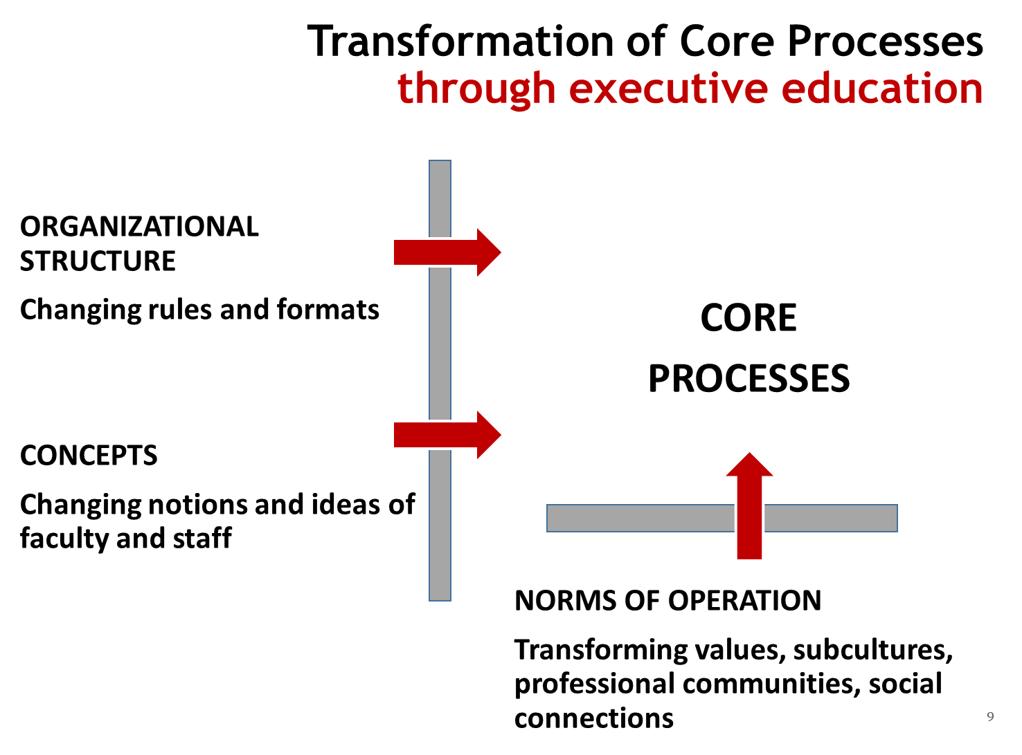
Conditions of ExEd effectiveness for universities:
Active involvement of “participants” in core processes of a particular university
Direct involvement of top management
Sustained critique of received ideas, values and actual practices (“problematization”)
Influx of international expertise and benchmarks
Project work, involving intense and conflicting communication, taking participants outside their habitual frameworks and self-determination

Slide 17
Idealized Design
IDEAL SPACE OF
PROJECT WORK
University Target Model
University
As Is
transformative development
inertial development
University
“Natural” Future
t
*) Russell Ackoff

Slide 18
How is it possible to change an organizational culture? (without replacing its subjects)
Thesis 1: Although there are dominant organizational cultures, universities are populated by groups characterized by distinct and conflicting subcultures

Slide 19
Social Constructivist Approach
A single dominant culture ➔ a number of coexisting subcultures
The culture of a group can now be defined as a pattern of shared basic assumptions learned by a group as it solved its problems of external adaptation and internal integration, which has worked well enough to be considered valid and, therefore, to be taught to new members as the correct way to perceive, think, and feel in relation to those problems.
(Edgar Schein, Organizational Culture and Leadership)

Slide 20
How is it possible to change an organizational culture? (without replacing its subjects)
Thesis 1: Although there are dominant organizational cultures, universities are populated by groups characterized by distinct and conflicting subcultures
Thesis 2: People’s intellectual standpoints and actions are informed by their belonging to a given subculture only to a limited extent
Same people employ different values and norms of conduct in different situations

Slide 21
Social and Professional Cultures
Real
Professional norms
Professional community
Imagined
University community
department
Professor
Social norms

Slide 22
Conflicting cases
professional / disciplinary Norms
Individual grant
Intradepartmental research collaboration
social norms
Research collaboration with “dead souls”
Internal research grant to a
needy person

Slide 23
How is it possible to change an organizational culture? (without replacing its subjects)
Thesis 1: Although there might be a dominant organizational culture, universities are populated by groups characterized by distinct and conflicting subcultures
Thesis 2: People’s intellectual standpoints and actions are informed by their belonging to a given subculture only to a limited extent
Thesis 3: Cultures are inherently unstable and ambiguous, same people employ different values and norms of conduct in different situations

Slide 24
(A postmodern) Individual as a Point of Cultural Intersection
“you need to give up thinking of culture as an entity and trying to understand what it does. Instead, think of culture as a context for meaning making and interpretation”
Mary Jo Hatch, Organization theory: Modern, symbolic, and postmodern perspectives

Slide 25
Implications for core processes transformation
Since
university subcultures are multiple, intersecting, ambiguous, and unstable;
the activities of employees are often loosely coupled not only with each other but also with their underlying cultures
change management should entail rearrangement of tightly and loosely coupled elements in the cultural map

Slide 26
Conditions of ExEd effectiveness for universities:
Active involvement of “participants” in core processes of a particular university
Direct involvement of top management
Sustained critique of received ideas, values and actual practices (“problematization”)
Influx of international expertise and benchmarks
Project work, involving intense and conflicting communication, taking participants outside their habitual frameworks and self-determination

Slide 27
Approach 2: Greenfield within Brownfield School of Advanced Studies University of Tyumen

Slide 30
1. Material Relations
3. Capitalist Transformations: Hidden Resistance and Economic Theory

Slide 31
The SAS as the Driver of University Transformations
Limited Scope (5% of the university)
prerequisites: SKOLKOVO ExEd for ~100 university leaders => shared discourse & concepts
Visible difference & attractiveness
Export of educational formats supported by benchmark
Internal expertise
The center of campus-wide intellectual life
Permeable borders

