Slide 1
University of Chile, 16 May 2017 The public role of higher education: A critical review and a new idea
Simon Marginson Professor of International Higher Education, UCL Institute of Education, University College London, UK
Director, ESRC/HEFCE Centre for Global Higher Education

Slide 2
Three questions about public good
Is the public/private line a distinction between
- non-market or market forms of education (economic distinction),
- state or non-state controlled education (political distinction)?
What are ‘public goods’ in higher education? How are they defined, observe, measured and improved?
Is there a common understanding of public/private in higher education across the world?

Slide 3
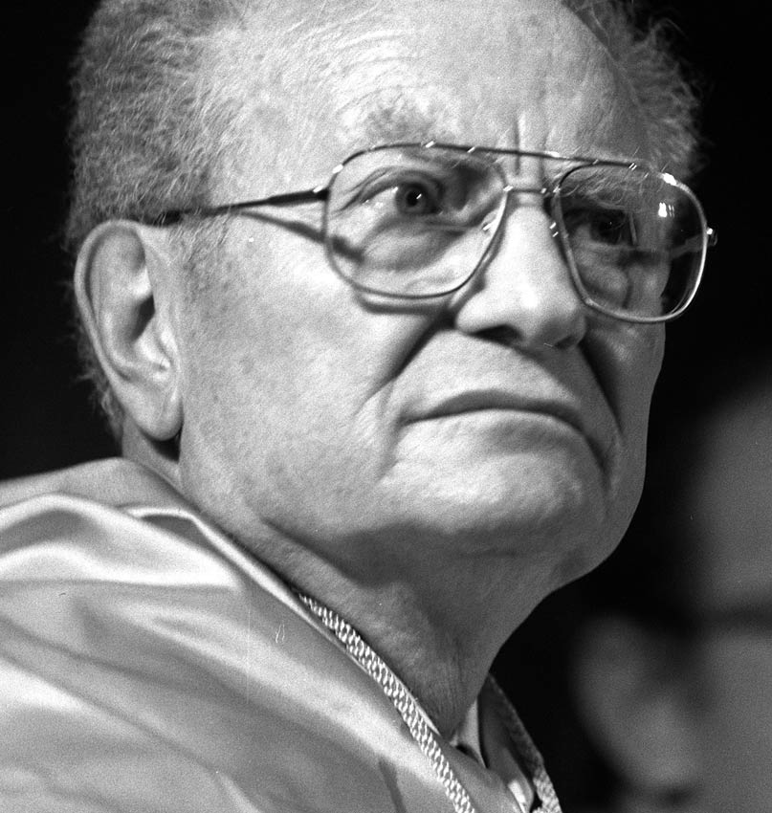
Economic definition of public/private—based on market vs. non-market production Samuelson (1954)
Public goods are non-rivalrous and/or non excludable. They are under-produced or unproduced in economic markets. All other goods are private goods
Notes:
Goods are non-rivalrous when consumed by any number of people without being depleted, for example knowledge of a mathematical theorem, which sustains its use value everywhere, indefinitely, on the basis of free access. Goods are non-excludable when the benefits cannot be confined to individual buyers, such as clean air regulation. Private goods are neither non-rivalrous nor non-excludable. Public goods and part-public goods cannot be produced on a profitable basis, and normally require government funding or philanthropic support.
Here is an enduring fiscal principle for limited liberal states: state funds public goods, family/individual funds private goods
However, Samuelson’s framework is not very helpful in dealing with collective goods,, because it is hard to define collective goods in economic terms
Another key weakness of Samuelson’s definition is that it naturalises the public/private distinction. In reality some ‘public goods’ are shaped by policy. Teaching can be either a public or a private good. Learned knowledge is non-excludable and non-rivalrous. However, whenever student places confer value in comparison with non participation, there is rivalry; and in HEIs with a surplus of applications over places, participation is excludable. Private goods are created and it is possible to have a market in tuition. The extent to which it is a private good is shaped by state policy-- , it depends on the approach to tuition, institutional stratification and so on.

Slide 4
Economic public goods: non-rivalrous and non-excludable
Goods are non-rivalrous when consumed by any number of people without being depleted, e.g. knowledge of a mathematical theorem, sustains use value everywhere, globally, indefinitely, on the basis of free access
Goods are non-excludable when benefits cannot be confined to individuals, e.g. clean air regulation, defence
Private goods are neither non-rivalrous nor non-excludable. They can be produced, sold and bought as individualised commodities in economic markets. This public/private distinction is between non-market production and market production
Research is primarily a public good. Teaching/student places can be either public or private; depends on policy

Slide 5
Political definition of public and private—state vs. non-state
“The line between public and private is to be drawn on the basis of the extent and scope of the consequences of acts which are so important as to need control, whether by inhibition or by promotion… The public consists of all those who are affected by the indirect consequences of transactions”
~ John Dewey, The Public and its Problems, 1927, pp. 15-16
Matters with ‘consequences’ for others include market transactions, organisation of education systems, etc
This public/private distinction is between state-controlled and non-state controlled production

Slide 6
Putting the two definitions together
The economic distinction is non-market vs market
The political distinction is state vs non state
For Paul Samuelson higher education is public, unless it can be produced in a market outside the state. For John Dewey public or private is decided by states and/or democratic communities
The economic and political definitions each have virtues, but also gaps, and each is ambiguous
Putting them together creates four unambiguous categories (four political economies) that can be used to explain higher education and research
Notes:
Samuelson’s economic approach to ‘public’ focuses on the market/non-market distinction. It is stronger with individual-level than collective goods.
Dewey’s political approach focuses on the state/non-state distinction. It is stronger in the handling of collective public goods, or public good
The economic definition identifies the minimum necessary public goods, but posits a zero-sum relation between public and private, and constrains policy choices.
The political definition makes the public/private relation a political choice, not a natural event, enabling zero-summism to be overcome. It also makes explicit the implicit economic assumptions, subjecting them to open choice. It is more comfortable in the normative domain
But the political definition has no limits. This suggests that Dewey’s understanding of ‘public’ should be subjected to the discipline of the economic approach, based on scarcity and costs.

Slide 7
Public and private goods: four political economies of education
Non-market goods
Quadrant 1: CIVIL SOCIETY
Quadrant 2: SOCIAL DEMOCRACY
Teaching: Private learning in Internet, libraries
Research: Self-made scholarship and inquiry
Teaching: Free or low cost, low differentials between HEIs
Research: Publicly funded, integral to researcher
Non-state sector goods
State sector goods
Quadrant 4: COMMERCIAL MARKET
Quadrant 3: STATE QUASI-MARKET
Teaching: Commercial market in tuition/degrees
Research: Commercial research and consultancy
Teaching: Quasi market in student places/degrees, fees
Research: State quasi-market, product formats, competitive
Market-produced goods
NOTE: State, institutions and individuals are active agents in all four quadrants
Notes:
The four quadrants constitute four different political economies of higher education: Civil Society, Social Democracy based on universal public provision (Nordic model), State Quasi-market (now the UK model, isn’t it great!), Commercial Market
The state is active in all four. On the right hand side it shapes production more comprehensively and directly, through public services in Q1 and state quasi-markets in Q2 (both Dewey public activities). On the left hand side it sets regulatory frameworks for conduct (civil and commercial law).
Q1 combines economically public goods with politically private goods. As also in Q2, research and education are non-rivalrous and non-excludable, Samuelson public goods. In Q1 these activities are in Dewey’s private domain, outside politics and regulation. I call this zone civil society and it includes families, communities, social movements. In HE faculty and students pursue unpaid and unregulated activities between more formal agendas.
Q 2 research is research supported from general university funding. Projects are driven by curiosity and merit, not competitive acumen or university status. Much of what we do still sits in Q2. Including this paper. It is not part of a funded research project.
The neo-liberal era has moved action in higher education from Q1 and Q2 to Q3. In Q3 there is a tension between economic (private) and political (public). All is ‘public’ in Dewey’s political sense. Quasi-markets are policy controlled
Educational or research activity in higher education can be positioned on this diagram, according to the extent it is ‘public’ in Samuelson’s economic sense; and the extent it is ‘public’ in Dewey’s political sense, recognised as a matter of common interest and state regulation.
The 4-quadrant diagram makes explicit the political choices associated with economic provision, for example whether or not to produce higher education on a non-market basis—and if non-market, whether to do this in the regulated funded public sector or leave it to civil society.
The 4-quadrants also highlight the question of who should pay, whether the state through taxation or the individual beneficiaries. In matters defined as public in the political sense, it poses the question ‘how public can we afford to be?’ in economic terms.

Slide 8
Global public goods
‘Global public goods are goods that have a significant element of non-rivalry and/or non-excludability and made broadly available across populations on a global scale. They affect more than one group of countries, are broadly available within countries, and are inter-generational; that is, they meet needs in the present generation without jeopardizing future generations.’
~ Inge Kaul, I. Grunberg and Marc Stern (Eds.), Global Public Goods: International cooperation in the 21st century, New York, Oxford University Press, 1999, pp. 2–3
.

Slide 9
Common goods
A particular kind of political public good. Collective and relational goods, goods that provide for social solidarity, equity, democratic self-determination, and social and geographic mobility in populations
The provision of higher education on the basis of equal social opportunity and maximum social mobility is one such common good

Slide 10
Published 19 December 2016, Melbourne University Publishing
https://www.mup.com.au/items/199659

