Slide 1
Disruptive Technology Enhanced Learning Michael Flavin

Slide 2
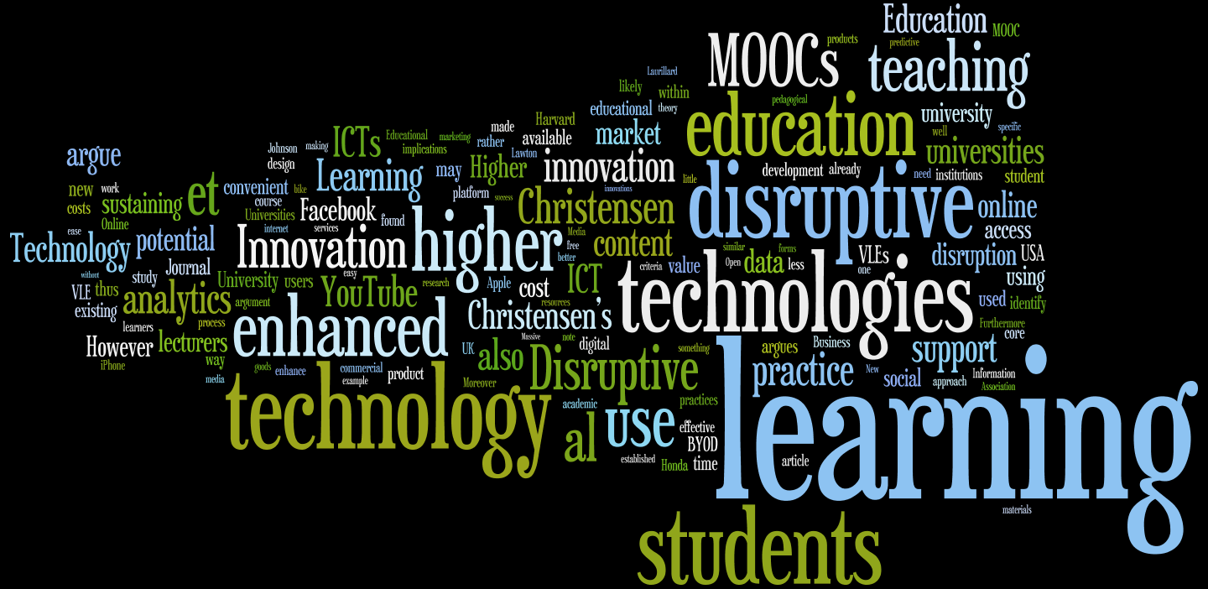

Slide 3
Disruptive Innovation
What all sustaining technologies have in common is that they improve the performance of established products… Disruptive technologies bring to market a very different value proposition than had been available previously… Products based on disruptive technologies are typically cheaper, simpler, smaller, and, frequently, more convenient to use. (Christensen, 1997, p. xv)
Notes:
Disruption = a silicon valley buzzword

Slide 4
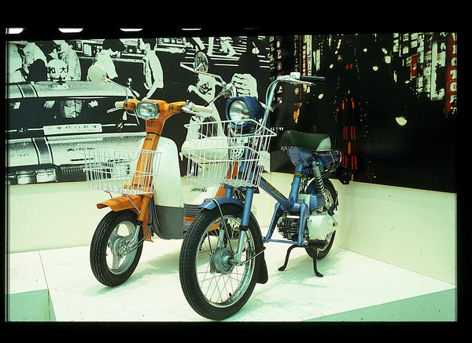
Honda in the USA (Christensen, 1997)
(c) Design Council Slide Collection

Slide 5
The transistor radio (Christensen and Raynor, 2003)
(c) Carnegie Museum of Art, Pittsburgh (c)The Design Council/Manchester Metropolitan University

Slide 6
Lepore, J. (2014)
Disruptive Innovation is a ‘competitive strategy for an age seized by terror’ and ‘a theory of history founded on a profound anxiety about financial collapse, and apocalyptic fear of global devastation, and shaky evidence, gaining ubiquity ‘only after 9/11.’
‘They work a year here, a few months there – zany hours everywhere. They wear jeans and sneakers and ride scooters and share offices and sprawl on couches like Great Danes. Their coffee machines look like dollhouse-size factories.’
Notes:
The retrospective case study

Slide 7
Costs, benefits and practice
Higher Education Funding Council for England (2011), Collaborate to Compete, ‘Quality online learning is not a cheap option’ (p.5).
Bowen (2012) ‘the appalling lack of hard evidence about… potential cost savings’ (p.26).
Smith et al. (2013) specific costs of technology-enhanced learning: ‘Direct costs may include site licence, site administration, technical support, computer hardware, technology infrastructure, course development, faculty development and student training… The time and effort required to overcome resistance to the introduction of new technology and procedures is also a cost factor.’
Sanders (2011) notes, ‘the costs can only be recovered by the providers if there is the economy of scale found in a mass market, or when they are extensively subsidised through grants or advertising’ (p.66).
Marshall (2014) ‘care needs to be taken to ensure that academics and institutions avoid being associated with commercial uses that exploit their reputations and act against the interests of students’ (p.256).
Notes:
Costs expressed quantitiavely
Benefits expressed qualitatively

Slide 8
Bring Your Own Device (BYOD)
Johnson et al. (2016), ‘the question is no longer whether to allow them in the classroom, but how to most effectively integrate and support them’ (p.36).
JISC (2011), ‘The low cost of ownership means that some students can afford newer-specification devices than colleges and universities can supply’ (p.7).
Lawton et al. (2013), ‘there is, however, a movement away from public funding towards privately supported higher education… The gradual withdrawal of the state from HE funding in developed countries is set to stay’ (p.43).
Notes:
Why is this a DI?

Slide 9
Learning analytics
Siemens and Baker (2012), ‘In sectors such as government, health care, and industry, data mining and analytics have become increasingly prominent for gaining insight into organizational activities. Drawing value from data in order to guide planning, interventions, and decision-making is an important and fundamental shift in how education systems function.’
Baer and Campbell (2012) ‘adaptive systems that adapt to the learner’s needs based on behaviours of the individual as well as of past students’ patterns’ (p.62).
Sharples et al. (2015), ‘adaptive teaching,’ ‘stealth assessment,’ ‘Concerns have been raised about collection of vast amounts of data and the ethics of using computers to monitor a person’s every action’ (p.5).
Notes:
learning analytics, a process which gathers details of students’ actions in online environments.
Identify at-risk students
Marketing potential
Personalised learning
Ethical issues around accessing data.

Slide 10
The joys of the Virtual Learning Environment © Bridgeman images

Slide 11
VLEs and social networking technologies
‘security blanket,’ ‘crutch,’ ‘electronic filing cabinet’ (Fry and Love, 2011, p.54).
The VLE is ‘little other than a flexible and accessible library’ (Gordon, 2014, p.10).
Facebook to support a course is ‘a little too intimate’ (Salmon et al., 2015, p.10).

Slide 12
MOOCs
free
convenient
scalable
widen access
motivational content for pre-university students (Gordon, 2014, p.17).
They can also enhance a university’s brand recognition (Burd et al., 2015, p.47).

Slide 13
MOOCs
High dropout rates (Diver and Martinez, 2015; Ng’ambi, 2015).
Expensive for institutions (Gallagher & Garrett, 2013; Hollands and Tirthali, 2014).
MOOC platforms have made little impression so far on TEL activity and are, ‘a long way from being a mainstream concern’ (UCISA, 2014, p.35).
Continuing professional development (Gordon, 2014; Laurillard, 2016).
Compromising openness to find a sustainable niche?
Notes:
MOOCs = Second Life c.2007

Slide 14
Disruptive Innovation is a useful lens for examining technology enhanced learning.
What all sustaining technologies have in common is that they improve the performance of established products… Disruptive technologies bring to market a very different value proposition than had been available previously… Products based on disruptive technologies are typically cheaper, simpler, smaller, and, frequently, more convenient to use. (Christensen, 1997, p. xv)
Notes:
Why are BYOD and analytics disruptive?
Why aren’t MOOCs disruptive?

Slide 15
References
Baer, L. & Campbell, J. (2012) ‘From Metrics to Analytics, Reporting to Action: Analytics’ Role in Changing the Learning Environment’, in, Oblinger, D.G., Ed., Game Changers: Education and Information Technologies, Louisville, CO, Educause
Bowen, W.G. (2012) ‘The “Cost Disease” in Higher Education: Is Technology the Answer?’ The Tanner Lectures, October 2012 (Stanford, CT: Stanford University).
Burd, E.L., Smith, S.P. & Reisman, S. (2015) ‘Exploring Business Models for MOOCs in Higher Education’, Innovative Higher Education, 40, 37-49.
Christensen, C. M. (1997) The innovator's dilemma: When new technologies cause great firms to fail (Boston, Mass: Harvard Business School Press).
Christensen, C. M., & Raynor, M. E. (2003) The innovator's solution: Creating and sustaining successful growth (Boston, Mass: Harvard Business School Press).
Diver, P. & Martinez, I. (2015) ‘MOOCs as a massive research laboratory: opportunities and challenges’, Distance Education, 36 (1), 5-25.
Fry, N. & Love, N. (2011) ‘Business lecturers’ perceptions and interactions with the virtual learning environment’, International Journal of Management Education, 9 (4), 51-56.
Gallagher, S. & Garrett, D. (2013) ‘Disruptive Education: Technology-Enabled Universities’, The United States Study Centre, University of Sydney.

Slide 16
Gordon, N. (2014) Flexible Pedagogies: technology-enhanced learning (York, Higher Education Academy).
Higher Education Funding Council for England (2011) Collaborate to Compete: Seizing the Opportunity of Online Learning for UK Higher Education (Bristol, HEFCE).
Hollands, F.M. & Tirthali, D. (2014) ‘Resource Requirements and Costs of Developing and Delivering MOOCs’, The International Review of Research in Open and Distance Learning, 15 (5), 113-133.
JISC (2011) Emerging Practice in a Digital Age: A guide to technology-enhanced institutional innovation (Bristol, JISC).
Johnson, L., Adams-Becker, S., Cummins, M., Estrada, V., Freeman, A. & Hall, C. (2016) NMC Horizon Report: 2016 Higher Education Edition, Austin, Texas, The new Media Consortium.
Laurillard, D. (2016) ‘The educational problem that MOOCs could solve: professional development for teachers of disadvantaged students’, Research in Learning Technology, 24, http://www.researchinlearningtechnology.net/index.php/rlt/article/view/29369 (accessed 16/06/16).
Lawton, W., Ahmed, M., Angulo, T., Axel-Berg, A., Burrows, A., & Katsomitros, A. (2013) ‘Horizon Scanning: What will higher education look like in 2020?’, The Observatory on Borderless Higher Education, http://www.obhe.ac.uk/documents/view_details?id=934 (accessed 16/06/16).

Slide 17
Lepore, J. (2014) ‘The Disruption Machine: What the Gospel of Innovation Gets Wrong’, The New Yorker, 23rd June, 2014.
Marshall, S. (2014) ‘Exploring the ethical implications of MOOCs’, Distance Education, 35 (2), 250-262.
Ng’ambi, D. (2015) ‘Editorial: Massive open online courses (MOOCs): Disrupting teaching and learning practices in higher education’, British Journal of Educational Technology, 46 (3), 451-454.
Salmon, G., Ross, B., Pechenkina, E. & Chase, A.M. (2015) ‘The space for social media in structured online learning’, Research in Learning Technology, 23, 1-14.
Sanders, J. (2011) ‘The challenge of cost-effective technology-enhanced learning for medical education’, Education for Primary Care, 22, 66-69.
Sharples, M., Adams, A., Alozie, N., Ferguson, R., Fitzgerald, E., Gaved, M., McAndrew, P., Means, B., Remold, J., Rienties, B., Roschelle, J., Vogt, K., Whitelock, D. & Yarnall, L. (2015). Innovating Pedagogy 2015. Milton Keynes, Open University.
Siemens, G. & Baker, R.S.J. (2012) ‘Learning analytics and educational data mining: towards communication and collaboration’, LAK ’12: Proceedings of the 2nd International Conference on Learning Analytics and Knowledge, Vancouver, Canada, 29 April-2 May 2012, 252-254.
Smith, P., Rao, L. & Thompson, S. (2013) ‘Towards Developing a Cost-Benefit Model for Learning Management Systems’, CONF-IRM 2013: International Conference on Information Resources Management. Retrieved from http://aisel.aisnet.org/cgi/viewcontent.cgi?article=1045&context=confirm2013 (accessed 16/06/16).
Universities and Colleges Information Systems Association (UCISA) (2014) ‘2014 Survey of technology enhanced learning for higher education in the UK’, University of Oxford, Oxford.

Slide 18
Dr Michael Flavin
King’s College London
Michael.flavin@kcl.ac.uk
0207 848 2923

Slide 19
Thank you © Bridgeman images

