Slide 1
University of Chile, 17 May 2017 Synergy or tension in the research university? National public goods and global public goods
Simon Marginson Professor of International Higher Education, UCL Institute of Education, University College London, UK
Director, ESRC/HEFCE Centre for Global Higher Education

Slide 2
An interdependent world in which global tendencies are often decisive
This includes the massive worldwide growth of higher education and the spread of local scientific capacity to more than 50 countries

Slide 3
51 countries with 1000 science papers p.a. US National Science Foundation data for 2011
ANGLO-SPHERE | EUROPE EU NATIONS |  | EUROPE NON-EU | ASIA | LATIN AMERICA
Australia | Austria | Italy | Croatia* | China | Argentina
Canada | Belgium | Netherlands | Norway | India | Brazil
N. Zealand | Czech Rep. | Poland | Russia | Japan | Chile*
UK | Denmark | Portugal* | Serbia* | Malaysia* | Mexico
USA | Finland | Romania* | Switzerland | Pakistan* | M.EAST /AF
 | France | Slovakia | Turkey | Singapore | Iran
 | Germany | Slovenia* | Ukraine | South Korea | Israel
 | Greece | Sweden |  | Taiwan | Saudi Arab.*
 | Hungary | Spain |  | Thailand* | Sth. Africa
 | Ireland | Sweden |  |  | Egypt
 |  |  |  |  | Tunisia*
* Reached 1000 papers since 1997 (11 out of 51 nations)

Slide 4
World GDP, population and tertiary enrolment, 1970-2013 (1970 = 1.0) 1970 = 1.0. Constant price GDP. Data from World Bank, UNESCO Institute of Statistics

Slide 5
Gross Tertiary Enrolment Ratio (GTER, %): World, North America/Western Europe, Latin America and the Carribean, 1971-2014

Slide 6
Regional Gross Tertiary Enrolment Ratios (%), 1970, 1990, 2010 and 2014
 | 1970 | 1990 | 2010 | 2014
World | 10.0 | 13.6 | 29.3 | 34.5
North America/ W. Europe | 30.6 | 48.6 | 76.9 | 76.4
Central and Eastern Europe | 30.2 | 33.9 | 67.9 | 74.4
Latin America and Caribbean | 6.9 | 16.9 | 40.9 | 44.7
East Asia and Pacific | 2.9 | 7.3 | 27.3 | 39.1
Arab States | 6.0 | 11.4 | 25.5 | 28.9
Central Asia | n.a. | 25.3 | 26.7 | 25.7
South and West Asia | 4.2 | 5.7 | 17.4 | 22.8
Sub-Saharan Africa | 0.9 | 3.0 | 7.7 | 8.2
Notes:
.

Slide 7
Tertiary participation rate in Indonesia, China, India 1974, 1994, 2014 (%)
In India the UNESCO data are for 1973, 1995, 2014

Slide 8
GTER and urbanisation in Indonesia 1990-2013 (1)

Slide 9
GTER and urbanisation in Indonesia 1990-2013 (2)

Slide 10
Comparative tertiary-level participation, OECD countries using Pat Clancy’s Participation Index and OECD data for 2014

Slide 11
The spread of higher education through the workforce
‘What mass higher education does is to break the old rigid connection between education and the occupational structure’ that prevented graduates from taking non-graduate jobs.
~ Martin Trow, Problems in the Transition from Elite to Mass Higher Education, Carnegie Commission on Higher Education, Berkeley, 1973.

Slide 12
Research finds people with tertiary education, on average …
Have a larger range of employment options
Are more likely to be in good health, as are their families
Have more advanced levels of skill in the use of information and communications technology
Are more geographically mobile, independent of income level (suggesting greater personal confidence and agency freedom)
Report higher levels of inter-personal trust (again suggesting greater personal agency)
Are more likely to state that they have a say in government (likewise suggesting greater personal agency)
Are more positive about migration and cultural diversity
Walter McMahon, Higher Learning, Greater Good (2009)
OECD, Education at a Glance (2015)
OECD, Perspectives on Global Development 2017: International migration in a shifting world (2016)

Slide 13
Educational level and ICT and problem solving skills, OECD survey, selected countries
Country | GTER 2013 (%) | Proportion of 25-34 year olds with ‘good ICT and problem solving skills’, by highest completed educational qualification, nine countries, 2012
 |  | below upper secondary education (%) | upper secondary or post-school non-tertiary (%) | tertiary education (%)
Finland | 91 | 9 | 29 | 57
United States | 89 | 3 | 21 | 51
Australia | 87 | 15 | 33 | 56
Russia | 78 | 13 | 16 | 27
Norway | 76 | 15 | 32 | 59
Poland | 71 | 2 | 7 | 37
Japan | 62 | 8 | 24 | 49
England (UK) | 57 | 10 | 30 | 53
Canada | n.a. | 5 | 26 | 47

Slide 14
Level of education and interpersonal trust (%)

Slide 15
McMAHON’S ESTIMATE Of PRIVATE NON MARKET BENEFITS OF COLLEGE EDUCATION (direct benefits, average college graduate, 4.5 years of education, 2007 US dollars)
Own health benefits | 16,800
Own longevity | 2179
Spouse’s health | 1917
Child’s health | 4340
Child’s education and cognitive development | 7892
Management of fertility and lower family size | 1551
Better consumption and saving patterns | 3401
Total value of quantified private non-market benefits p.a. | 38,080
Other positive non-market private effects (unquantified) related to job conditions and location amenities, better tastes, less obsolescence of skills due to better general education, greater well-being via enhanced income, etc. See McMahon 2009.

Slide 16
McMAHON’S ESTIMATE Of DIRECT SOCIAL EXTERNALITIES OF COLLEGE EDUCATION (average college graduate, 4.5 years of education, 2007 US dollars)
Democratization and political institutions | 1830
Human rights and civic institutions | 2865
Political stability | 5813
Community life expectancy | 2308
Reduced inequality (greater opportunity, less poverty, etc.) | 3110
Less crime | 5647
Reduced health costs and prison costs | 544
Environment (cleaner air and water, less deforestation) | 5609
Total social benefits | 27,726
Other positive social benefits (unquantified here) related to higher tax receipts, social capital, the dissemination of the outcomes of R&D. See McMahon 2009.

Slide 17
McMAHON’S ESTIMATE Of TOTAL BENEFITS OF COLLEGE EDUCATION (average college graduate, 4.5 years of education, 2007 US dollars)
Net private earnings benefits p.a. | 31,174
Non-market private benefits p.a. | 38,080
Direct social benefits (direct externalities) p.a. | 27,726
Total p.a. | 96,980
Direct social externalities constitute 29 per cent of the total benefits of higher education. However, total externalities include the indirect social benefits. These are the contributions of externalities to the value generated in private earnings and private non-market benefits. Once this indirect element is included, McMahon estimates that externalities total 52 per cent of the average value of higher education.

Slide 18
Income inequality (2012), and two indicators of social mobility (2000s and 2012) OECD countries with available data
 | Gini coefficient after tax/ transfers (2012) | Ratio between 90/10 incomes after tax/ transfers (2012) | Social mobility1: IIE, Corak study (2000s) | Social mobility 2: Odds ratios, OECD (2012)
Denmark | 0.249 | 2.8 | 0.15 | 3.0
Slovak Republic | 0.250 | 3.2 | --- | ---
Norway | 0.253 | 3.0 | 0.17 | 2.0
Czech Republic | 0.256 | 3.0 | --- | ---
Finland | 0.260 | 3.1 | 0.18 | 1.4
Sweden | 0.274 | 3.3 | 0.27 | 2.3
Austria | 0.276 | 3.5 | --- | 5.1
Netherlands | 0.281 | 3.3 | --- | 2.8
Switzerland | 0.285 | 3.5 | --- | ---
Germany | 0.289 | 3.5 | 0.32 | 5.1
Poland | 0.298 | 3.9 | --- | 9.5
Ireland | 0.304 | 3.8 | --- | 3.3
France | 0.306 | 3.6 | 0.41 | 6.0
South Korea | 0.307 | --- | --- | 1.1
Canada | 0.315 | 4.2 | 0.19 | 2.6
Australia | 0.326 | 4.4 | 0.26 | 4.3
Italy | 0.327 | 4.4 | 0.50 | 9.5
Spain | 0.335 | 4.9 | 0.40 | 3.9
Estonia | 0.338 | 4.7 | --- | 4.7
United Kingdom | 0.350 | 4.2 | 0.50 | 6.4 *
United States | 0.390 | 6.2 | 0.47 | 6.8
Japan | --- | --- | 0.34 | 5.1
Chile | --- | --- | 0.52 | ---
IIE or ‘Intergenerational income elasticity’ is ‘the percentage difference in earnings in the child’s generation associated with the percentage difference in the parental generation’ (Miles Corak 2012, p. 2).

Slide 19
Stratification within high participation higher education systems reduces upward mobility UK: Rate of entry to university tiers, by school background combined entry data for 1996, 1998, 2000, 2002, 2004 and 2006 Source: Vikki Boliver 2011
Entrants to higher education | Russell Group universities % | Other pre-1992 universities % | Post-1991 universities %
All entrants | 22 | 20 | 58
Private school entrants | 53 | 24 | 23
State school entrants | 20 | 20 | 60

Slide 20
And many are left out: Social inequality in achieved college degrees, USA, 1970/2013 Bachelor degree by age 24, family income quartile Source: The PELL Institute and Penn Ahead, 2015

Slide 21
The new polarisation of higher educated societies

Slide 22
November 2016 US Presidential election: the college education factor in voting
The 50 counties in the US with the highest level of college education: diverse by state, income, ethnic composition and other respects. In 48 of these counties Clinton improved on Obama’s 2012 vote by an average of 9 percentage points. These districts included many counties with high proportions of white voters
The 50 least educated counties in the US: Clinton’s vote collapsed here, compared to Obama in 2013; she lost ground in 47 of the 50 counties, with an average slide of 11 percentage points. Again this set of counties were fairly varied among themselves except for the education factor
Trump received 72% of the white non-college male vote and 62% of the white non-college female vote. Among white women voters there was a majority for Clinton only among the college educated.
Clinton’s problem was that two thirds of Americans are white, while only 35 per cent of Americans have achieved a college degree

Slide 24
Brexit and educational level, June 2016
 | LEAVE | REMAIN
Total (same for men and women) | 52 | 48
EXIT POLLS
18-24 years | 27 | 73
Higher degree | 36 | 64
First degree | 43 | 57
Secondary education | 64 | 36
Primary education | 72 | 28
KINGS COLLEGE LONDON STUDY
Degree holders | 26 | 74
No qualifications | 78 | 22

Slide 25
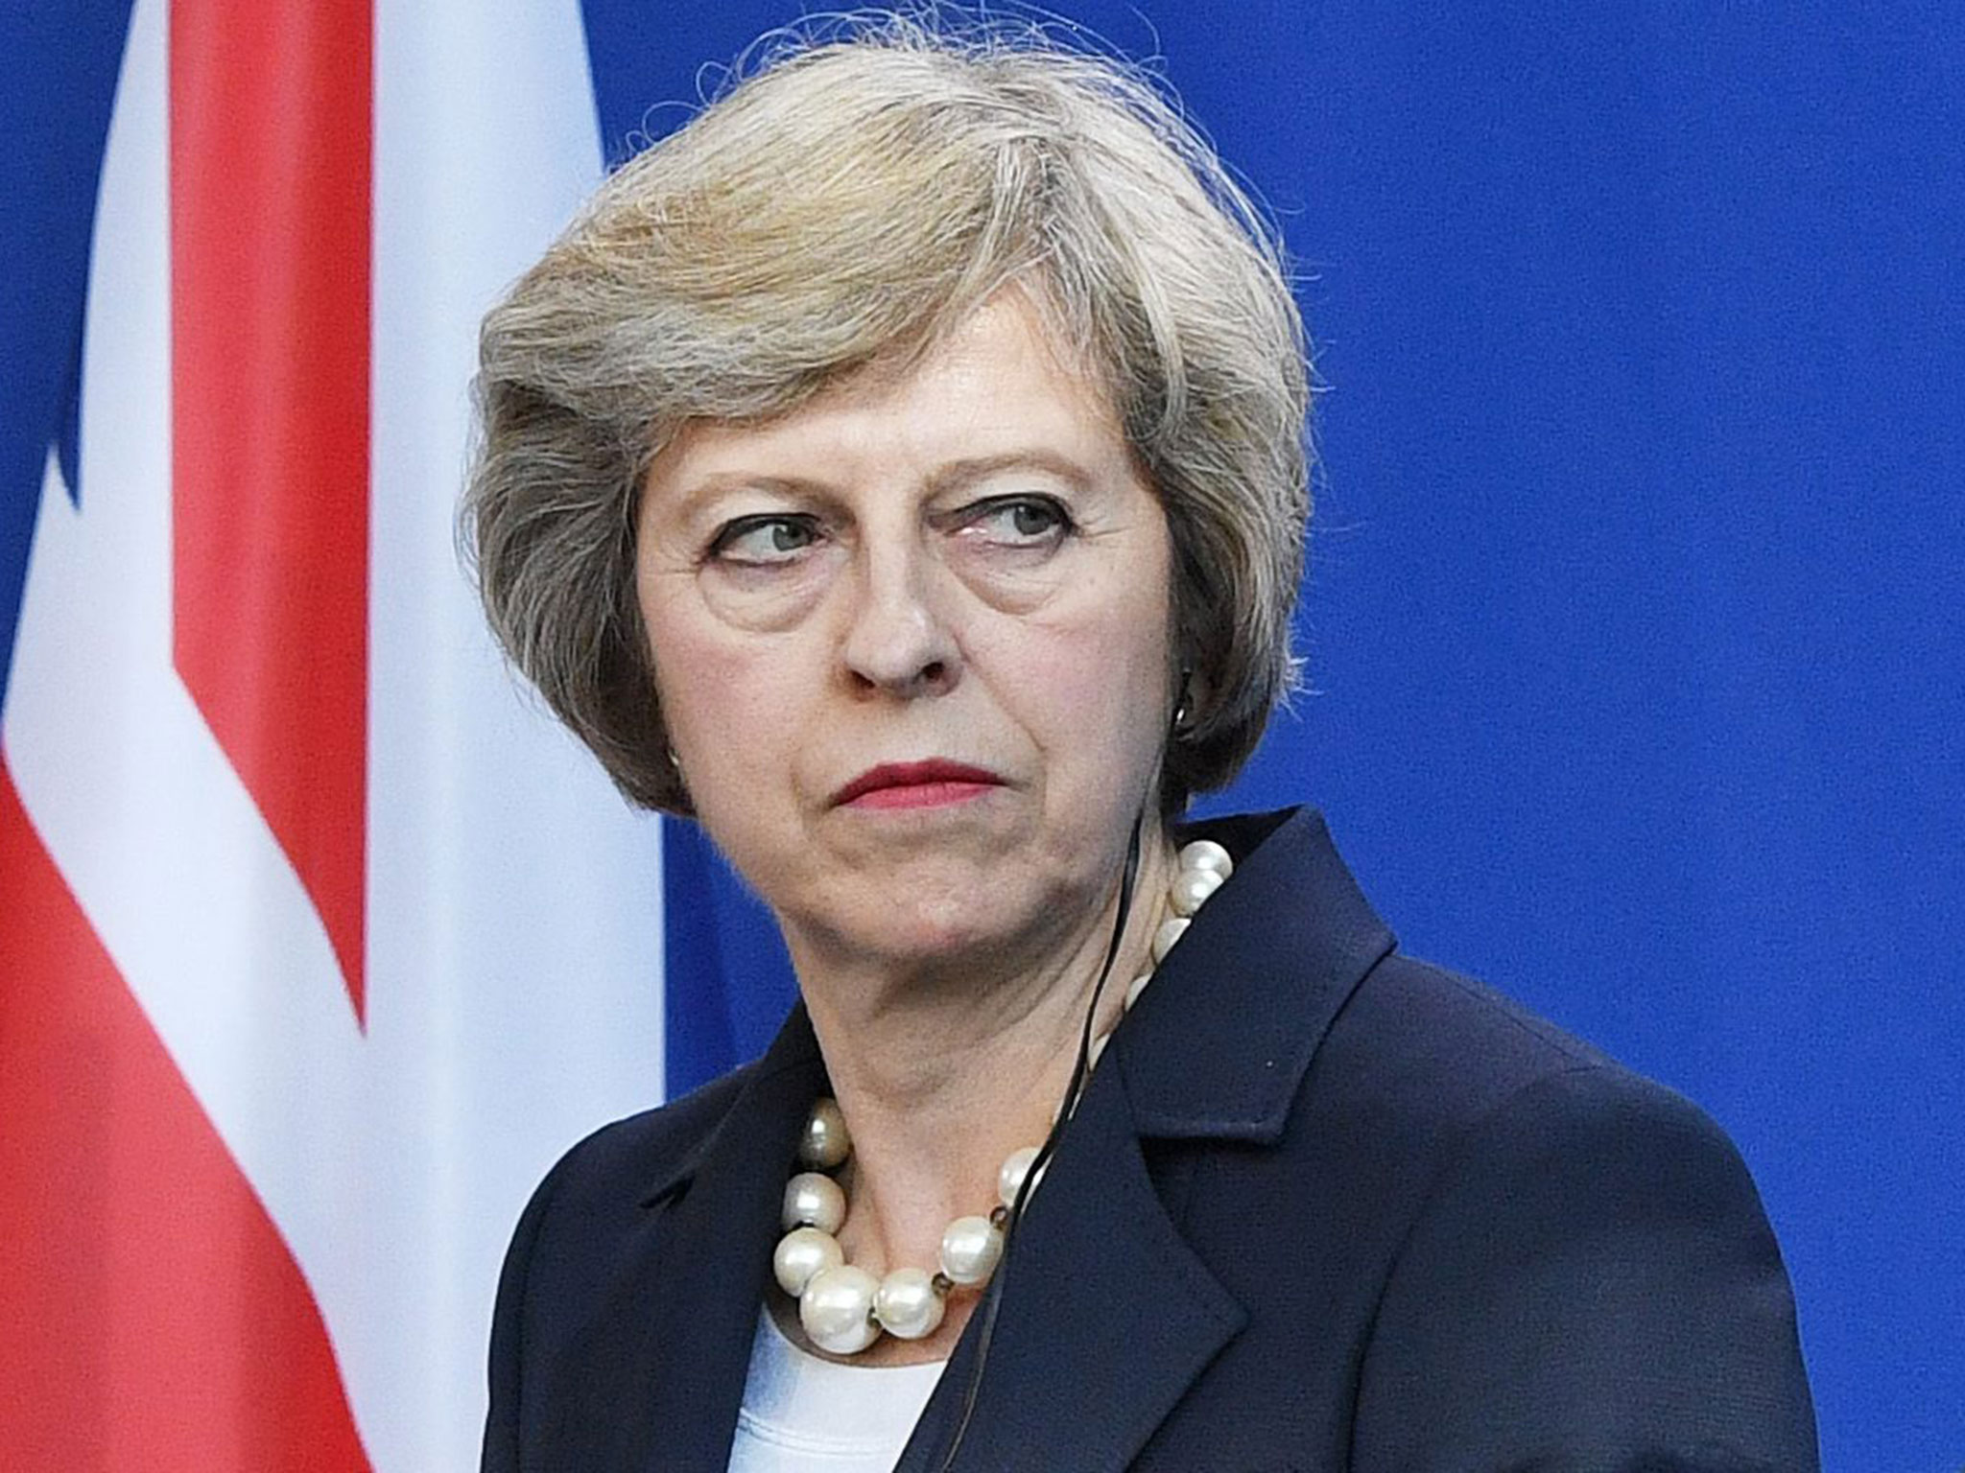
Global flows collide with national identity: The UK and Brexit
Theresa May at election time 2017: ’Strong and stable leadership’ over a shriveling nation?
Brexit: Looks like a very very big blunder

Slide 26
“If you believe you are a citizen of the world, you are a citizen of nowhere” ~ UK Prime minister Theresa May, Conservative Party conference, 5 October 2016

Slide 28
National public goods and/or global public goods? Higher education (1) faces tension between its national/local and its global public goods, (2) faces tension with local populations without direct benefits
National public goods | Global public goods
Higher education builds cities, regions and communities | Globally networked higher education brings world closer, addresses global problems
Higher education provides opportunities for upward mobility to local populations | Opportunities for local and international students (but amid growing inequality)
Secure and stable living standards at home | Cross-border mobility creates opportunities for those moving into countries
Maintenance of border security and a bounded and stable national identity | Flows of international students and faculty, new ideas, new languages, many cultures

